Slide 1
D Reporting FY22 for FY21 Grads

Slide 2

D Reporting
ODE sends 2 files to the Data collector under level 2 Reports in the March D manifest
The top file is an Excel file that you can look at to see your concentrators
The second file is the file that MVECA loads into the FFE.
You cannot delete or add any students to that file

Slide 3
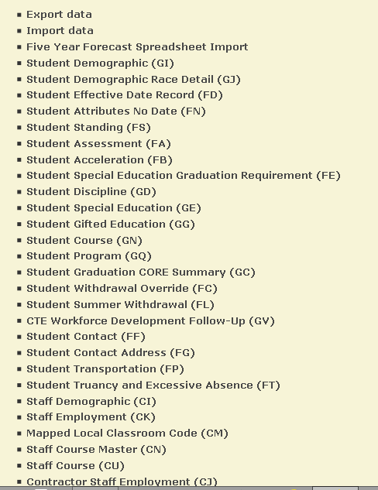
Entering Data for D Reporting
Log into the FFE –Access the FFE from MVECA’s home page under the EMIS tab.
Chose CTE Workforce Development Follow-Up (GV)

Slide 4
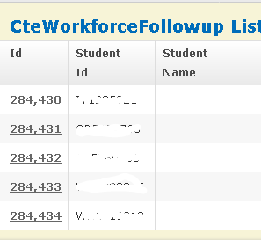
Entering Data for D Reporting
Click on the ID number to open the record

Slide 5
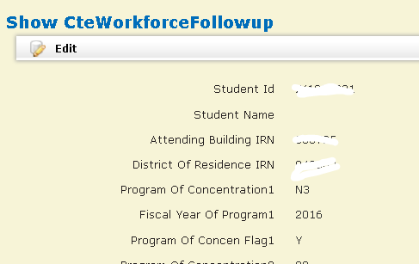

Entering Data for D Reporting
Click Edit and enter your data.
Once you have completed entering data on each record you will click update
When all students have been updated you will export your data out so you can add it to the Data Collector.

Slide 6
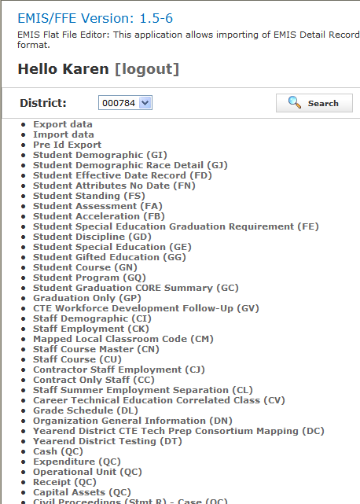
Exporting Data from the FFE
Click on Export data from the Home Page

Slide 7
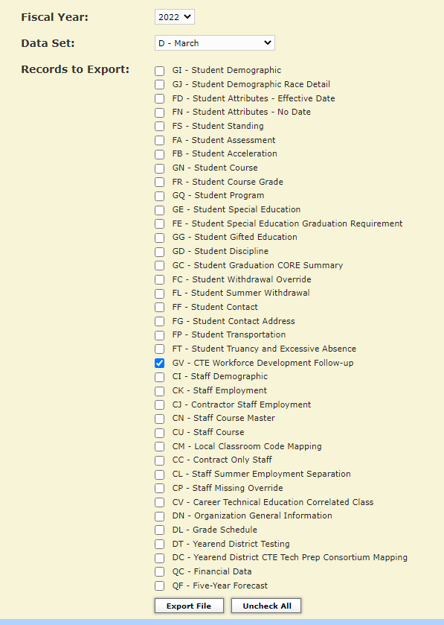
Exporting Data from the FFE
Make sure Fiscal Year is 2022
Click the arrow and choose
D- March
It will default to GV being checked

Slide 8
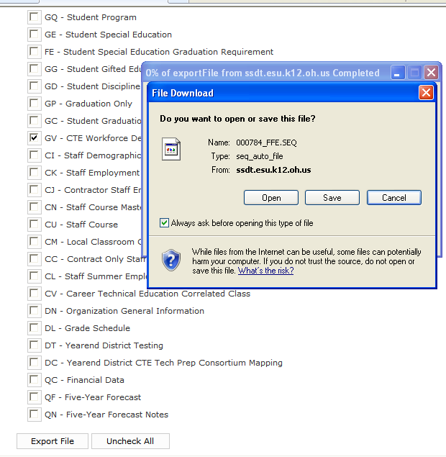
Exporting Data from the FFE
Click Save
Click Export File

Slide 9
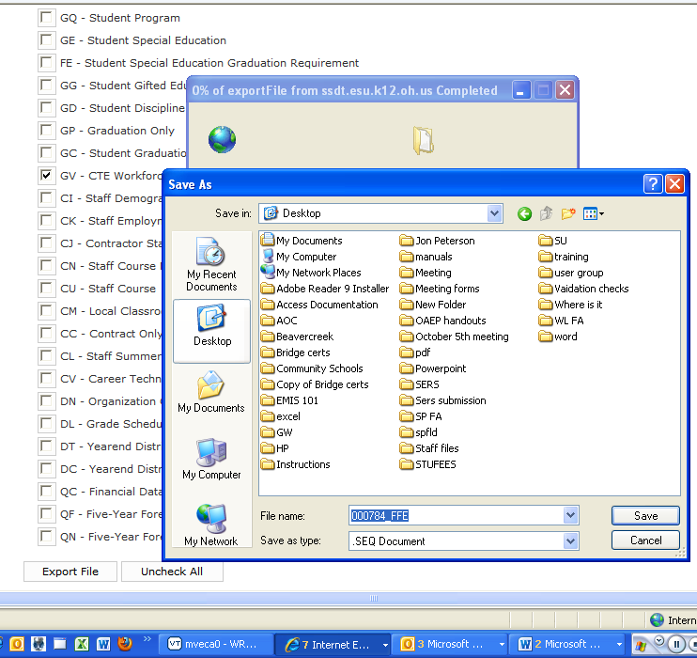
Exporting Data from the FFE
Choose where you want the file saved
Can be desktop or a folder on
your computer
Name the file (your choice)
Leave it as a .seq file
Save

Slide 10


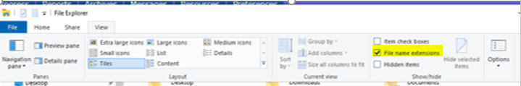
Exporting Data from the FFE
If you cannot save the file as it comes out, it will be in your downloads so you can pick it up from there. If you want to save it to a folder on your desktop or on your computer you can do the following
Open explorer
Click View
You will see checkbox next to File Name extensions. Check that box

Slide 11
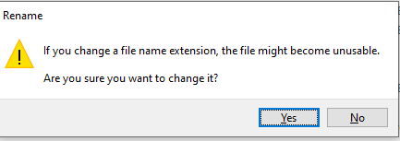
Then if you file saves as a .txt or a .csv file you will be able to rename the file to a .seq file. You can name the file whatever you would like.
Find the file
Right Click on the file name choose rename
It will highlight the name. Change the .csv to .seq
It will give you this warning, click yes
This file will load into the Data Collector

Slide 12
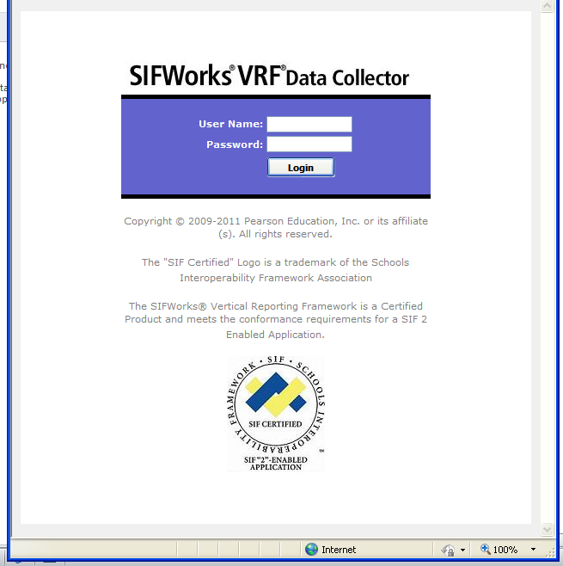
Loading the file into the Data Collector
Log into the Data Collector

Slide 13
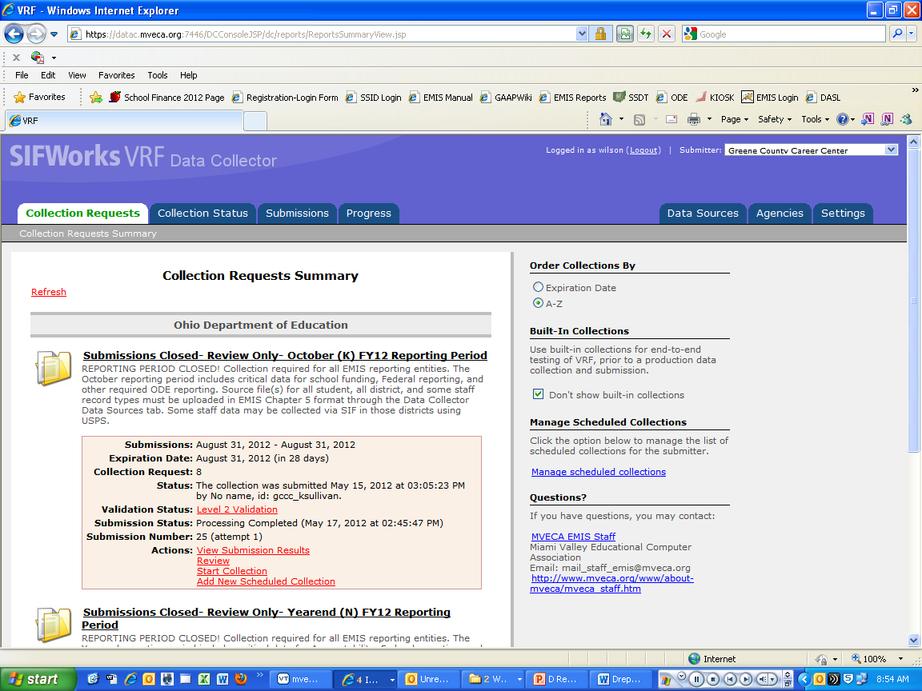
Loading the file into the Data Collector
Click on Data Sources

Slide 14
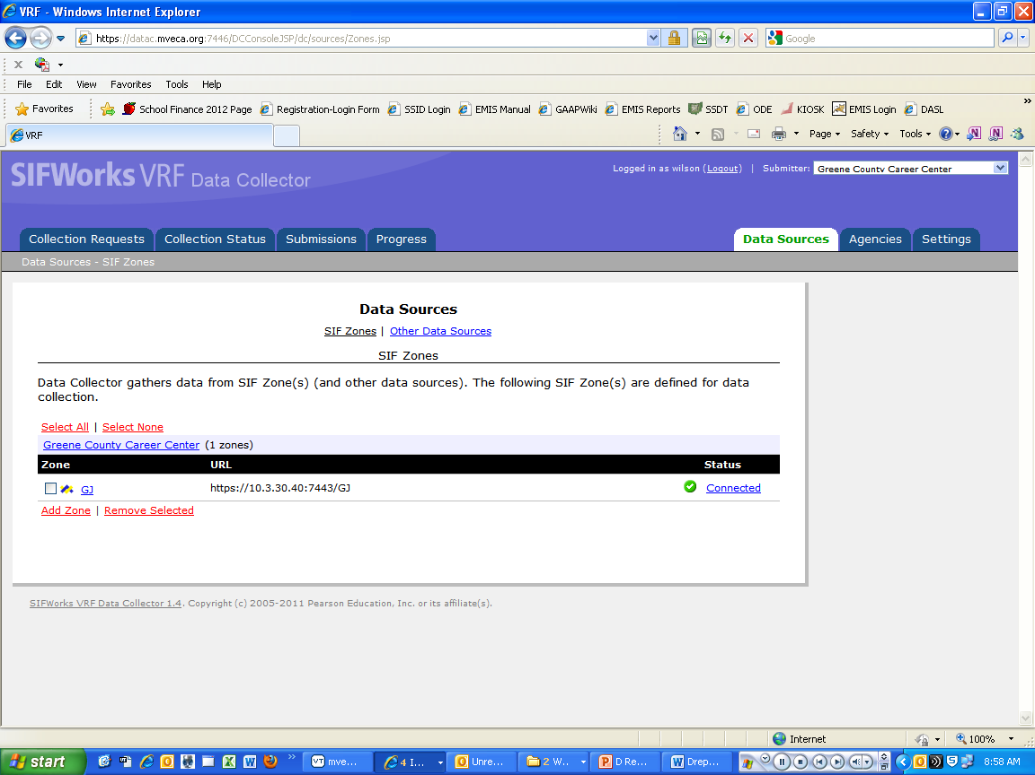
Loading the file into the Data Collector
Click on Other Data Sources

Slide 15
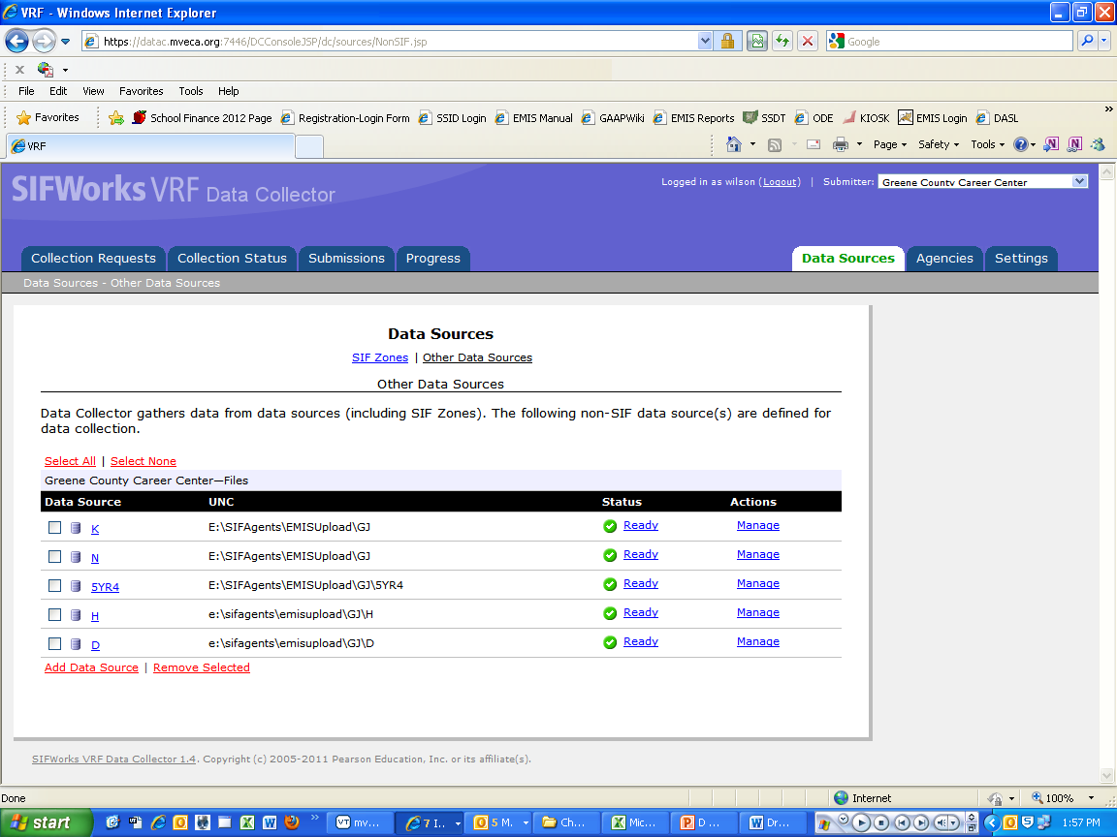
Loading the file into the Data Collector
Click on Manage for D

Slide 16
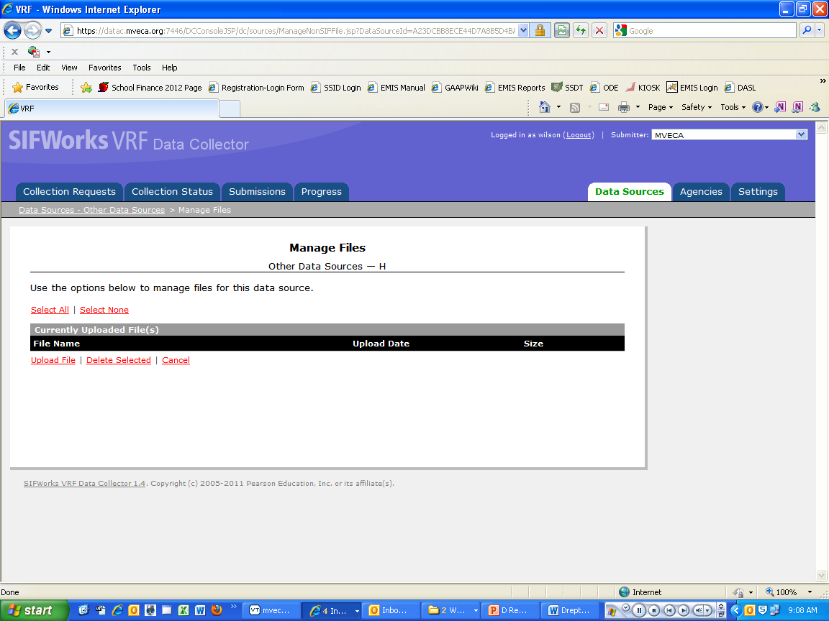
Loading the file into the Data Collector
Click on Upload file

Slide 17
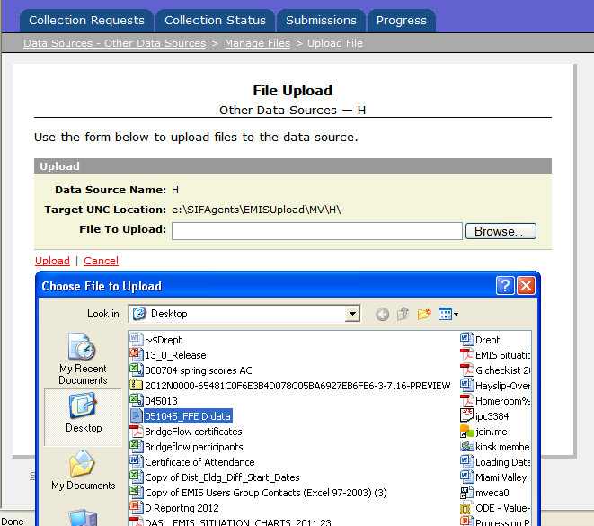
Loading the file into the Data Collector
Click on Browse
Find the file you saved from the FFE double click the file or click open at the bottom of the box
Click upload

Slide 18
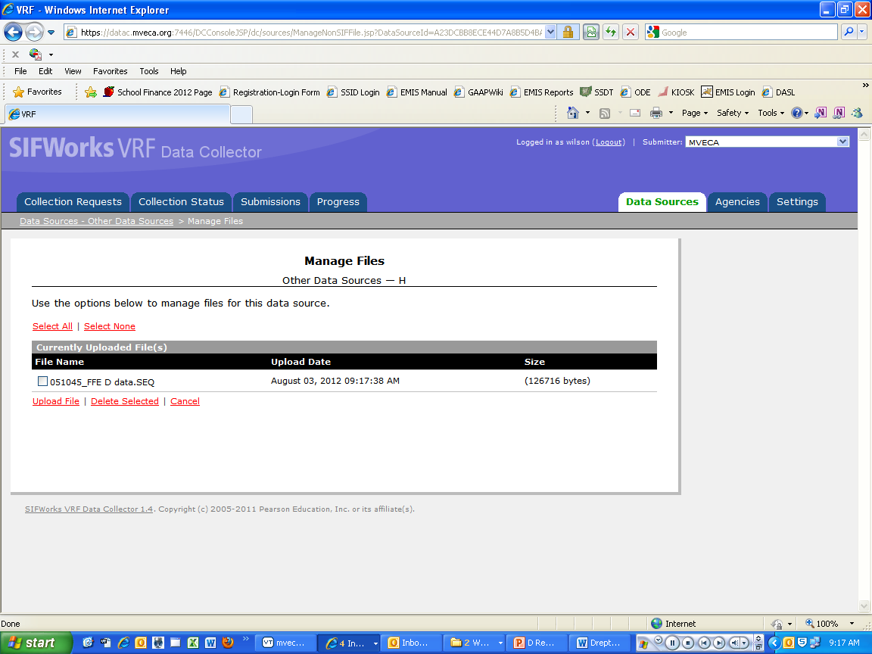
Running the Collection
Click on Collection Requests

Slide 19
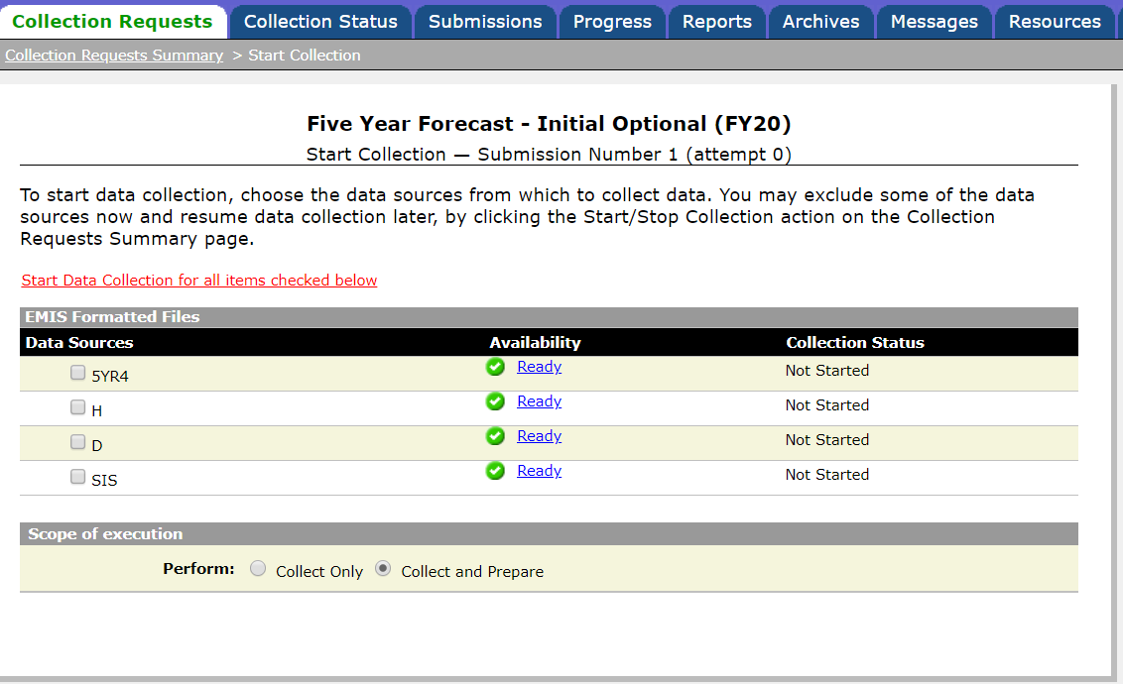
Running the collection
Click on D for the March Data
Then click on start Data Collection

Slide 20
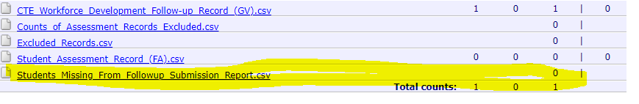
Running the collection
After you run the collection and click on preview prepared data you will see this. Make sure that the highlighted report says 0. It can be confusing sometimes when you look at it. If you just look at the top line it will list all the students in the file but does not take into consideration if they are all there with follow-up data.
Please let me know if you have any questions.

