Slide 1
Troubleshooting Career Technical Education (CTE) FTE Reports

Slide 2
The Ohio Department of Education funds development of EMIS training materials as part of the EMIS Alliance grant. There is an expectation that ITCs will utilize these materials in training provided to your districts. That said, there are restrictions on use of the EMIS Alliance materials as follows: Materials developed as part of the EMIS Alliance program must be provided at no cost to your training participants. If you utilize the EMIS Alliance training materials – in whole or in part – you must not charge participants a fee to attend the class where the materials are used. Likewise, you may not use the materials or any portion thereof in any event where a fee is charged to attend. Exceptions must be approved in writing by the Department of Education in advance of scheduling/promoting any event which may violate these restrictions.
Questions regarding appropriate use of EMIS Alliance materials, or requests for exception to the restrictions noted above, should be directed to Melissa Hennon [Melissa.Hennon@education.ohio.gov].

Slide 3
Overview
CTE FTE reports are generated for Local Education Agencies (LEAs) who have students reported with CTE EMIS data. CTE program funding is generated through CTE FTEs which are part of the CTE FTE reports. This presentation will provide data verification and error resolution guidance.
Notes:
This presentation will cover CTE Level 2 reports. It is recommended that attendees have access to their own reports as well as the CTE FTE Report Explanation, the FY22 CTE Program and Assessment Matrix, along with information about their own CTE programs including copies or electronic access to CTE-26 information.

Slide 4
Outline
CTE Level 2 Reports
Accessing and Formatting Level 2 CTE Reports
Understanding the CTE FTE Detail Report
Connecting the CTE FTE Detail Report and the CTE Error Detail Reports
Troubleshooting the CTE FTE Error Detail Reports
Understanding the CTE FTE Summary Reports
CTE Overrides
CTE FTE Daily Summary Reports
Notes:
We will cover the process of preparing and reviewing report content. We will then look at how the reports are linked together and where to see errors. We will also look at summary and CTE override reports.

Slide 5
CTE FTE Level 2 Reports

Slide 6
CTE Level 2 Reports
(CTEA-000) CTE FTE Detail
Full detail report by student and course
Report of students with errors on any of the error detail reports
(CTEA-001) CTE Student Error Detail
Report of students with Error Result Codes
(CTEA-002) CTE Course Error Detail
Report of courses with Error Result Codes
(CTEA-003) CTE Staff Error Detail
Report of staff with Error Result Codes
Notes:
The CTE FTE Detail Report has the most detail of students and courses while the three error reports contain student, course or staff error result codes. LEAs may have one to three of the error reports or none at all.

Slide 7
CTE Summary and Override Reports
(CTEA-004) CTE FTE Summary by Course
Summary report by course with Course Potential and Actual FTEs
(CTEA-005) CTE FTE Summary by Category
Summary report by FTE Fund Pattern Code and CTE Fund Category with Course Potential and Actual FTEs
(CTEA-006) CTE Approved Overrides
Report of overrides approved by the Office of Career Tech and applied to the CTE funding process
Notes:
The summary reports do not contain student specific data. There is a summary by course and a summary by Fund Pattern Code. Both reports contain FTE data and include potential and actual FTEs. The CTE Approved Overrides report will allow districts to verify that overrides have been approved and that CTE funding is flowing based on the approved override.

Slide 8
CTE FTE Daily Summary Reports
(CTEA-007) CTE FTE Daily Summary Report – Students District is Educating
Contains CTE FTEs summed by CTE Fund Category Number
(CTEA-008) CTE FTE Daily Summary Report – Students Initially Funded at District
Contains CTE FTEs summed by Result Code and CTE Fund Category Number
(CTEA-009) CTE FTE Daily Summary Report – Transfers
Contains CTE FTEs summed by Result Code and CTE Fund Category Number
Notes:
CTE FTE Daily Summary Reports are currently being update by ODE and are not yet available. We will demonstrate how to use the daily summary reports to monitor data and understand how the funding flows on these reports.

Slide 9
CTE Report Data
CTE reports use EMIS data from
Initial and Final Staff and Course (L) Collections
Calendar (C) Collections
Student (S) Collections
CTE reports are updated nightly using EMIS data submitted as of 5pm
CTE reports can contain EMIS data from other LEAs
Notes:
Since CTE reports use data from multiple collections, collections should be clean and up to date for the most accurate CTE reports to be generated.

Slide 10
Accessing and Formatting Level 2 CTE Reports

Slide 11
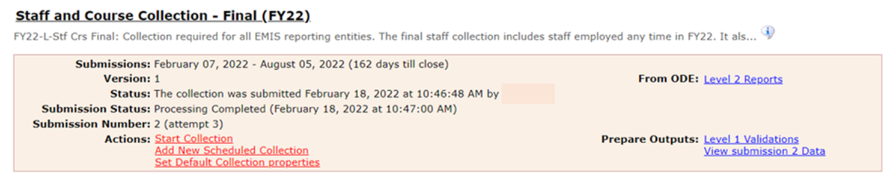
Accessing CTE Reports
CTE reports are available in Staff and Course (L) Collections
Select Level 2 Reports
Notes:
Districts can log into the Data Collector and pull up their live data as we work through the presentation.

Slide 12
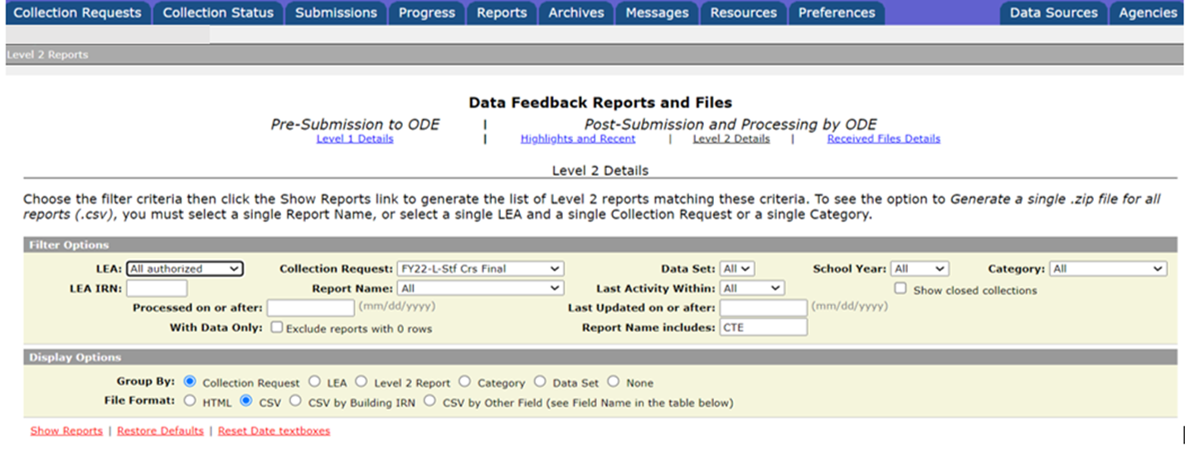
Accessing CTE Reports, cont’d
The Level 2 Reports link from the
Collection Requests tab will
take you to the Reports tab and
to Level 2 Reports
Use filter to limit results
Select “Show Reports”

Slide 13
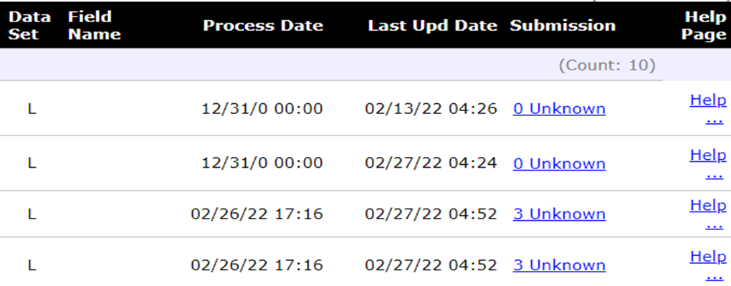
Level 2 Report Dates
Process date – when ODE successfully processed the data used in the report for the entire state
Last Updated date – when report was updated with data that added, changed or removed rows. If no rows changed then the date remains unchanged
Submission – when LEA submitted data
Date appears as “12/31/0” when the
report can’t be tied to a particular
collection such as the CTAC reports
(ODE is working on the missing 0)
Note - there is a bug with the display of Process and Last Updated Dates and ODE is working on a fix
Notes:
ITC Staff note- If nightly processing at ODE does not complete, the Level 2 reports will not update. Go to Settings, Level 2 Report Tables, then scroll down and select “Show Last Updated Dates”. The “Updated Date” column should contain the day following nightly processing.

Slide 14
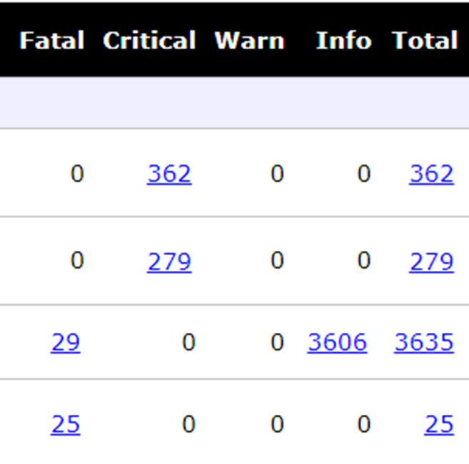
CTE Report Error Categories
Fatal severity codes occur when the CTE FTE Adjusted FTE is zero
Critical severity codes occur when the
CTE FTE Adjusted FTE is less than the
Original FTE but is not reduced to zero
Informational severity codes will appear
when the Adjusted FTE and Original FTE
are the equal
It is recommended to review the entire
report and not just focus on errors
Notes:
ITC Note- If an error count link does not generate the correct number of rows, create a Cherwell ticket to ODE EMIS.

Slide 15
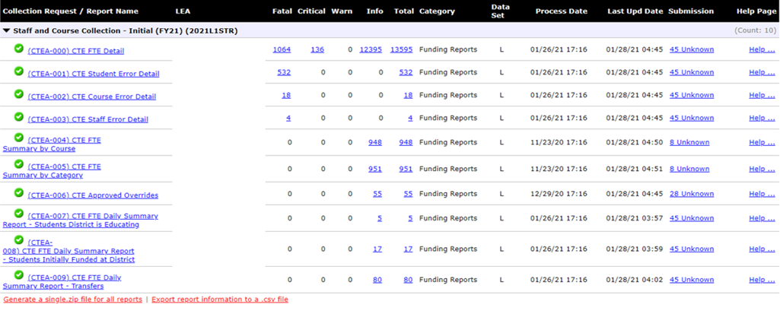

Availability and Opening of CTE Reports
Error Detail and Approved Override reports will be available as applicable to each LEA
CTE FTE Daily Summary
Reports are currently being
updated by ODE
Notes:
This example from FY21 shows an LEA that has received all possible CTE FTE reports including the CTE FTE Daily Summary Reports which are not available as of the date of this presentation (March 2022)

Slide 16
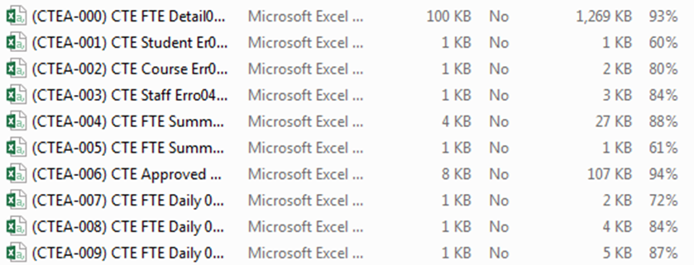
Open (CTEA-000) CTE FTE Detail Report
From the Level 2 Reports screen or the ZIP file, open the CTE FTE Detail Report
Note -these reports are not yet available
Notes:
Presenter – Use the 1 - CTEA-000 CTE FTE Detail DEMO.xlsx file

Slide 17
Formatting the (CTEA-000) CTE FTE Detail Report
Select Header Row and Wrap Text
Freeze Top Row
Justify column width
Apply Filters
Better yet, use a macro!
Notes:
Use the MACRO from the FY19 EMIS Alliance Excel session if you have it set up on your computer.
Demonstrate these steps of preparing the report and the attendees can prepare their own report as you demonstrate the Basic Excel steps.
Presenter demonstrate report preparation.
Select top row and select Wrap Text from the Home Tab.
While the top row is selected, from the View tab, select Freeze Panes and Freeze Top Row.
Select entire spreadsheet (click cell between Row 1 and Column A) then place cursor on a line between any two column headers and double click.
While spreadsheet is highlighted, from the Data tab, choose Filter (or from the Home Tab select Filter).

Slide 18
Quick Check
Are you able to access your most recent CTE reports?
Have your reports been updated since your last review?
Can you format the CTE reports to prepare them for review?
CTE reports contain a large amount of data and should be reviewed often. Knowing how to prepare the reports using Excel can make the data review process much easier. Saving your work between reviews can be helpful in troubleshooting issues over time.
Notes:
As a best practice, encourage districts to keep notes from previous troubleshooting of these reports to save time as the reports continue to be updated. Suggest that participants create a workbook of reports for easy comparison as they progress through the reporting process.

Slide 19
Understanding the CTE FTE Detail Report

Slide 20
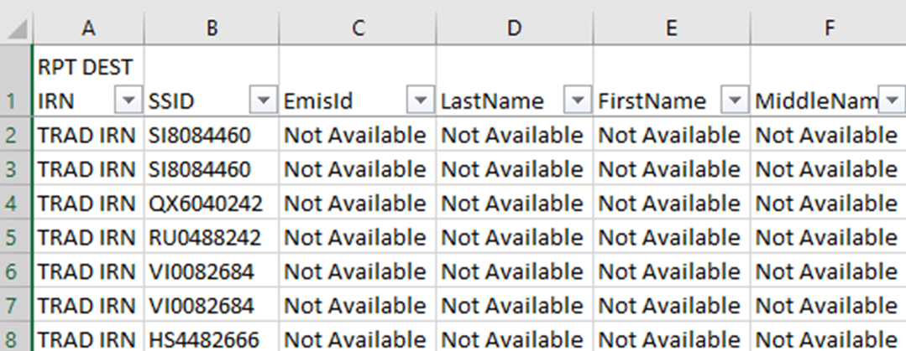
(CTEA-000) CTE FTE Detail Report Data
Contains rows of CTE data by student and CTE course in which they are enrolled
Students with changes to their Student Standing (FS), Student Attributes Date Effective (FD), or Student Course (GN) Records can have multiple rows of data on the CTE FTE Detail Report
The first column contains
the IRN of the LEA
receiving the report
Notes:
Refer to the Level 2 Report Explanation: CTE FTE Reports for additional information regarding the data contained within this report. For the next few slides, the filters have been removed so that the titles in the headers are fully visible. Attendees and presenter can leave their filters on.

Slide 21
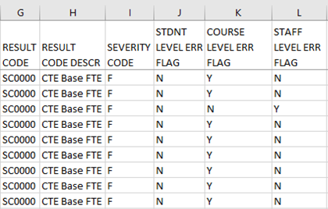
(CTEA-000) CTE FTE Detail Report Data, cont’d
Result Code “SC0000” and
Result Code Description
“CTE Base FTE” are not
error codes
The Severity Code is set based on a comparison
between the original FTE and the adjusted FTE
CTE FTEs with an “F” Fatal Severity Code are reduced to zero
CTE FTEs with a “C” Critical Severity Code are reduced but not to zero
CTE FTEs with an “I” Information Severity Code are not reduced
In an upcoming slide we will talk about
the relationship between the CTE FTE Detail
Report and the Error Detail Reports
Notes:
The SC0000 is often mistaken as an error when it is simply a placeholder on the CTE FTE Detail Report. Result Codes and Result Code Descriptions are errors on the Student, Course, and Staff Error Detail Reports. Note that the Severity Code can differ between the CTE FTE Detail Report and an associated error report. The Severity Code on the CTE FTE Detail Report will reflect the error’s effect on the CTE FTE.

Slide 22
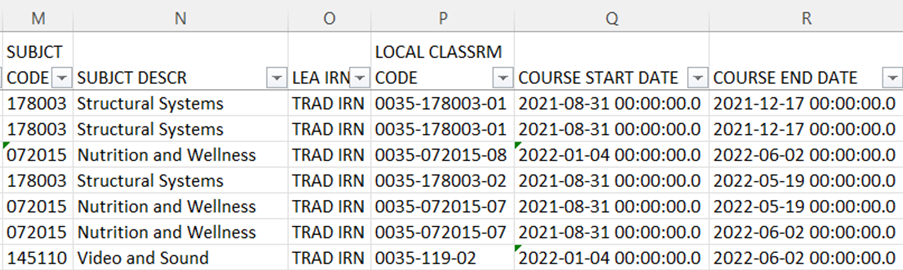
(CTEA-000) CTE FTE Detail Report Course Data
This section of the report contains some of the course data that is used to generate the student CTE FTE
The LEA IRN is that of the
educating LEA. Your IRN here
is your data. Another LEA’s IRN
here is their data.
The Course Start and End Dates come from the
Course Master (CN) Record and do not reflect
when the student was enrolled in the course
Notes:
Course data in the report is separated into two different sections, columns M through R and on the next slide, columns AC through AI. Attendees might want to consider rearranging columns as they are reviewing the report to bring all course data together especially when sharing this report with other staff.

Slide 23
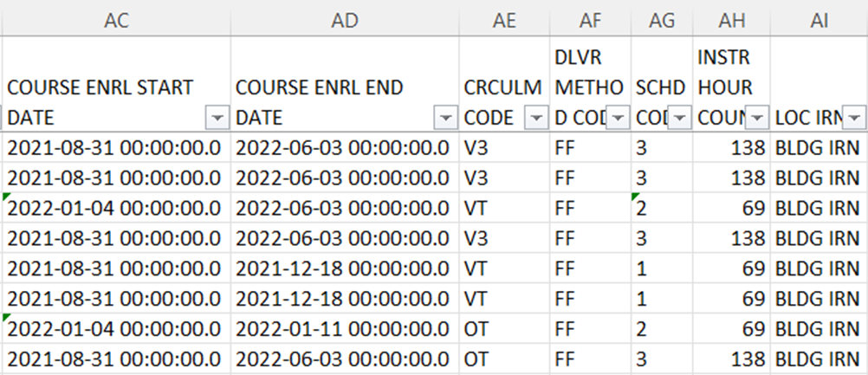
(CTEA-000) CTE FTE Detail Report Course Data, cont’d
Additional columns containing course data are further to the right side of the report
The Course Enrollment Start and End dates
reflect a student’s actual enrollment dates
in the course and come from the Student
Course (GN) Record
Notes:
Review the Curriculum Code, Delivery Method, Schedule Code (aka Semester Code), Scheduled Instructional Hours Count (aka Length of Scheduled Instruction) and Location IRN columns on the report and suggest that attendees consult EMIS Manual Section 4.2 Course Master (CN) Record for additional information.

Slide 24
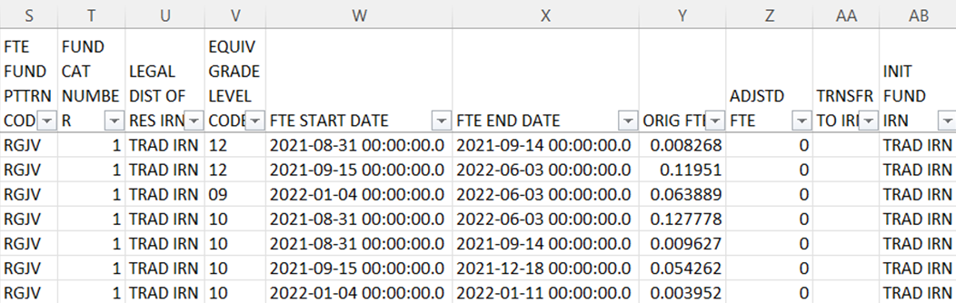

(CTEA-000) CTE FTE Detail Report Funding Data
Columns S through AB and AJ contain data used to determine the flow of funding as well as the CTE FTE values
The next series of slides will review selected columns
Notes:
We will review only some of the columns, so refer to the CTE FTE Report Explanation for additional detailed descriptions of all columns.

Slide 25
CTE FTEs
Career Tech is funded though student CTE FTEs
Students associated with multiple LEAs can appear on more than one (CTEA-000) CTE FTE Detail Report
For example, students who attend another LEA for Contract Career Tech or through a Special Education Cooperative will appear on the educating and resident district’s (CTEA-000) CTE FTE Detail Report since the funding passes through the resident district
CTE FTEs are calculated for each row on the report
Students can have multiple CTE FTEs calculated for the same course due to changes to their Student Standing (FS), Student Attribute Effective Date (FD), or Student Course (GN) Records
Notes:
Districts may be able to see resident students on their CTE FTE Detail Reports based on what the educating district is reporting when the CTE funding flows through the resident district. This is informational for the resident district. Also note that a student attending elsewhere can appear on the CTE FTE Detail report but will not appear on the error reports.

Slide 26
FTE Fund Patterns
FTE Fund Pattern Codes (Column S)
Indicate how the funds will flow for that specific CTE FTE row
Examples - RGJV, CTVC, SPCO, etc.
Initially Funded IRN (Column AB)
CTE FTE funding initially goes to this IRN
Transferred to IRN (Column AA)
CTE FTE funding will be transferred to this IRN
When blank, the funding goes to the Initially Funded IRN
Notes:
The flow of CTE FTEs uses a number of data elements on the report to demonstrate how the funds are flowing for each row of data. In the next series of slides, we will look at some combinations of the codes and IRNs to understand how they work together. For a full list of FTE Fund Pattern Codes, refer to the FTE Report Explanation on the EMIS Validation and Report Explanations page of the ODE website.

Slide 27
Inclusion Codes
Inclusion Codes (Column AJ) indicate where the CTE FTE will be counted
FULL – included in the ADM of the LEA receiving the report
NONE – not included in the ADM of the LEA receiving the report
Since most funding now flows directly to the educating entity, inclusion codes will most often appear as FULL
Situations where transfers will still occur are
Contract Career Tech students
Special Education Cooperative students
Notes:
When troubleshooting the CTE FTE Detail report, using the FTE Fund Source and funding IRNs will give a clear picture of how the funds are flowing.

Slide 28
CTE Categories, Subject Codes, and Programs
Category 1: WFD in Agriculture and Environmental Systems, Construction Technologies, Engineering and Science Technologies, Finance, Health Science, Information Technology and Manufacturing Technologies
Category 2: WFD in Business Administration, Hospitality and Tourism, Human Services, Law and Public Safety, Transportation Systems and Arts and Communications
Category 3: Career Based Intervention Programs
Category 4: WFD in Education and Training, marketing, WFD in Academics, Public Administration and Career Development
Category 5: Family and Consumer Science Programs
Notes:
Category 1 is the highest paying category while 5 is the lowest. Note that when CTE FTE Category Number appears as 0, this happens when a course with an academic subject code is reported with a curriculum element of PS – College Credit Plus and a Delivery Method Element of CP - Career Tech College Credit Plus Course, as these courses do not generate career tech funding.

Slide 29
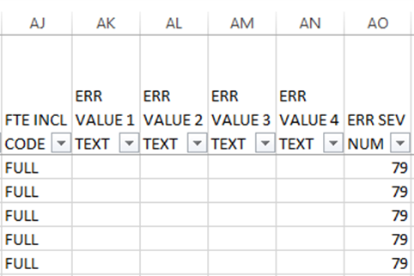
Remaining Columns
The Error Severity Number aligns with
the Severity Code, however, when
working on this report, refer directly
to the Severity Code
Error Value Text Columns are populated on
the CTE FTE Error Detail reports and not on
the (CTEA-000) CTE FTE Detail Report

Slide 30
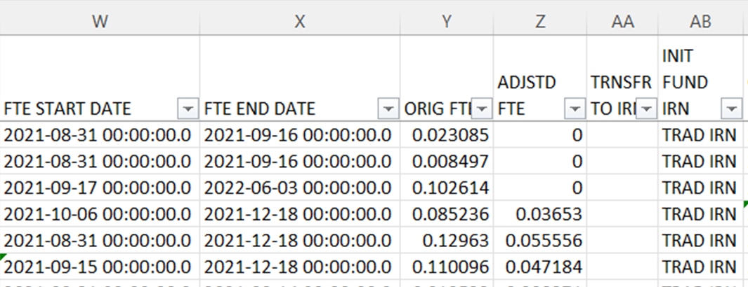
Calculating CTE FTEs
Original FTE
Calculated using student, course, and calendar EMIS data
Adjusted FTE
Original FTE minus any adjustments applied from errors
Notes:
LEAs will often focus on adjusted CTE FTEs but not dig into the CTE FTE original calculations to verify them for accuracy. In the next series of slides, we will look at the data used in the generation of CTE FTEs.

Slide 31
Original CTE FTE Calculation
Calculating the Original CTE FTE (aka Base or Potential CTE FTE)
Numerator
(Student Course Days/Course Days) x Length of Scheduled Instruction
Student Course Days – days enrolled in course using the student’s assigned calendar
Course Days – calendar days between course start and end from the Course Master (CN) Record
Length of Scheduled Instruction
Denominator
Community Schools 920 hours
Other LEAs (including STEM districts) 1080 hours
Notes:
The calculation of the CTE FTE is different from the regular FTE as a standard denominator is used based on LEA type. On the next slides we will give some examples of the calculations.

Slide 32
Course Days
Use the Calendar Display Report to calculate
Course Days
Student Course Days
Access the Calendar_Display.csv file from the submission files (aka preview or review files) in the Calendar Collection
Sum the Student Session Days for the length
of the course and for time the student was
enrolled in the course
Notes:
Presenter can demonstrate accessing a Calendar Display Report from the Data Collector.

Slide 33
Non-Community School CTE Student Example
Student enrolled in course for 180 days
Course days equal 180
Length of Scheduled Instruction is 360 hours
(Student Course Days/Course Days) x Length of Scheduled Instruction
1080 hours
(180/180) x 360
1080
= 0.333333
Notes:
If the student would be enrolled less than the possible course days, the CTE FTE will be reduced.

Slide 34
Community School CTE Student Example
Student enrolled in course for 172 days
Course days equal 172
Length of Scheduled Instruction is 360 hours
(Student Course Days/Course Days) x Length of Scheduled Instruction
920 hours
(172/172) x 360
920
= 0.391304
Notes:
This example shows the smaller denominator of 920 that is used for community school students.

Slide 35
Quick Check
Are all approved CTE program students appearing on the report?
Are the CTE FTEs being calculated correctly?
Can you confirm that the CTE FTE funding IRNs and FTE Fund Source codes are correct?
The (CTEA-000) CTE FTE Detail Report contains data that should be verified. Errors should be corrected when possible. Review all of the data for accuracy and completeness.

Slide 36
Connecting the CTE FTE Detail Report and the CTE Error Detail Reports

Slide 37
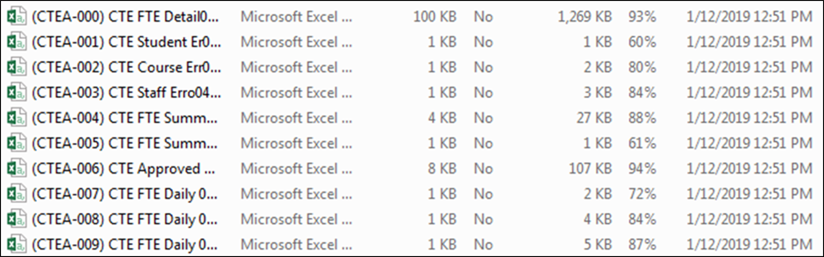
Open and Prepare the Error Reports
From the Staff and Course Collection
Level 2 Reports, open the error reports
Remember that error reports will appear as
applicable to each LEA. LEAs could receive any
number of the three error reports or none at all
Notes:
Presenter, open and prepare the 2-CTEA-001 CTE Student Error Detail DEMO.xlsx, 3-CTEA-002 CTE Course Error Detail DEMO.xlsx, and 4-CTEA-003 CTE Staff Error Detail DEMO.xlsx files.

Slide 38
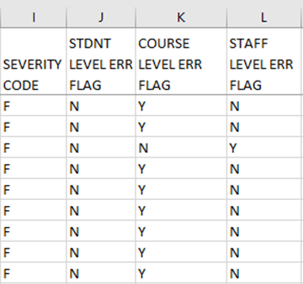
Tying the CTE Reports Together
This example is a segment of a CTE FTE Detail Report
Student, Course, and Staff Level Error Flags indicate on which error report to find the error
Student Level Error Flag “Y”
(CTEA-001) CTE Student Error Detail
Course Level Error Flag “Y”
(CTEA-002) CTE Course Error Detail
Staff Level Error Flag “Y”
(CTEA-000) CTE Staff Error Detail

Slide 39
CTE Errors
A staff level error can reduce the CTE FTE for all students in courses that are affected by the staff error
A course level error can reduce the CTE FTE for all of the students in the course
A student level error can reduce a single student’s CTE FTE
Severity codes appear on the CTE FTE Detail, and the CTE FTE Student Error Detail Report
Notes:
.

Slide 40
(CTEA-003) CTE Staff Error Detail Report
Staff Level Error Flags of “Y” from
the (CTEA-000) CTE FTE Detail
Report will be listed on the (CTEA-003)
CTE Staff Error Detail Report with a
Result Code that begins with “SF”
Notes:
Staff errors will appear by course and reflect the teacher data from the Initial L Staff and Course Collection.

Slide 41
(CTEA-002) CTE Course Error Detail Report
Course Level Error Flags of “Y” from
the (CTEA-000) CTE FTE Detail Report
will be listed on the (CTEA-002) CTE
Course Error Detail Report with a Result
Code that begins with “CS”
Notes:
On this slide you can see that the course error codes are very similar to the student error codes and can be easily confused.

Slide 42
(CTEA-001) CTE Student Error Detail Report
Student Level Error Flags of “Y” from the (CTEA-000) CTE FTE Detail Report will be listed on the CTE (CTEA-001) Student Error Detail Report with a Result Code that begins with “SC”
Notes:
The error codes for student errors begin with SC and course errors begin with CS which can be confusing.

Slide 43
Quick Check
Can you find the Error Flag columns on the (CTEA-000) CTE FTE Detail Report and find the error on the associated student, course, or staff error report?
Do your errors apply to single students or to groups of students?
Have you applied filters to your error reports so that we can review each error in the next set of slides?
The (CTEA-000) CTE FTE Detail Report uses Error Flags to indicate which Error Detail Report contains an error for that row of data. Sometimes an error is for a single student and sometimes an error relates to a classroom or classrooms of students.

Slide 44
Troubleshooting the CTE Error Detail Reports
Notes:
It is recommended that attendees have access to the FY22 CTE Program and Assessment Matrix which can be found at http://education.ohio.gov/Topics/Career-Tech
Attendees should also have access to the CTE-26 for each CTE program they are reporting.

Slide 45
Staff Errors
(CTEA-003) CTE Staff Error Detail
Report of staff with Error Result Codes
In the next series of slides, we
will filter on a Result Code
and discuss troubleshooting
Notes:
Presenter can use 4-CTEA-003 CTE Staff Error Detail DEMO.xlsx

Slide 46
Staff Errors, cont’d
When multiple teachers are associated with a course, the teacher who appeared on the Teacher Licensure Course Status Report (TLC) will be listed on this report
Errors on the (CTEA-003) CTE Staff Error Detail Report can affect an entire classroom of students, so a single line on this report could cause multiple students to be affected on the (CTEA-000) CTE FTE Detail Report
Notes:
The Teacher Licensure Course Status Report was generated during the Initial Staff and Course (L) collection. Presenter can demonstrate how to access the TLCS report in the closed Staff and Course Initial Collection.

Slide 47
Staff Error Result Code SF0002
Teacher does not have appropriate certificate/license to teach course
CTE FTE is reduced to zero (Fatal)
Verify the teacher’s licensure using the Educator Search Tool
https://core.ode.state.oh.us/Core4/ODE.CORE.Lic.Profile.Public.UI/
Initial Staff and Course (L) data is used for this check
If the teacher is certified to teach the course and you are seeing this error, verify the course is coded correctly
Contact the Office of Career Tech to request an override if applicable
Notes:
Have attendees look at their Teacher Licensure Status report to reference teachers who were or were not certified in the Initial Staff and Course (L) collection. An example of an override situation would be for a Project Lead the Way teacher who is certified, however appears on the TLC Report and the CTE Staff Error Report as not certified.

Slide 48
Staff Error Result Code SF0003
Teacher does not meet appointment or status requirements
CTE FTE is reduced to zero (Fatal)
If the Curriculum Code begins with a “V” at least one teacher must be reported with
Type of Appointment Element
1-Certificated/licensed, or
2-Classified, or
3-Internship
Position Type R-Regular
If incorrectly reported in Initial L, correct the data in Final L and if the change does not correct the problem create a helpdesk ticket to ODE and they will determine if it can be corrected
Notes:
This may not qualify for an override.

Slide 49
Staff Error Result Code SF0004
The total CTE length of scheduled instruction for this teacher is greater than 1080 hours
CTE FTE is reduced (Critical)
Do Mapped Local Classroom Code (CM) Records need to be reported?
Refer to EMIS Manual Section 4.6 Mapped Local Classroom Code (CM) Record for guidance
Is this teacher teaching at multiple LEAs?
When a teacher teaches at multiple LEAs all hours are used in this check
When there are multiple teachers associated with the course who are all over 1080 hours, the one with the lowest hours is used. In the case of a tie, the lowest Staff ID is used
Notes:
This error is generated when there is not one teacher with a total CTE length of scheduled instruction is <=1080. For example, when a course has multiple teachers, then the error is only generated if all teachers have greater than 1080 hours. Presenter can show where mapping can be entered into the SIS. If needed, open the EMIS Manual section 4.6 Mapped Local Classroom Code Record to discuss what courses can be mapped. This is a proportional check, so the CTE FTE is reduced for all students taught by this staff member is based on 1080 allowed hours divided by the total hours of instruction. See the CTE FTE Report Explanation for additional information on this check.

Slide 50
Staff Error Result Code SF0005
Teacher of Teaching Profession course does not meet degree level requirement
CTE FTE is reduced to zero (Fatal)
If subject code is reported as Teaching Profession course
350011 - Teaching Professions or
350020 - Curriculum and Instruction for Teaching Professions
Staff must have Master’s Degree or higher
Staff Demographic (CI) Record Education Level Element must be
3-Masters or
5-Doctorate
If incorrectly reported in Initial L, correct the data in Final L and if the change does not correct the problem create a helpdesk ticket to ODE and they will determine if it can be corrected
Notes:
NOT ON DEMO FILE. This check looks at the Initial Staff and Course (L) Collection for the Education Level. If the course was not reported in the Initial Staff and Course (L) collection, contact the Office of CTE for guidance.

Slide 51
Staff Error Result Code SF0006
Course does not have a teacher assigned
CTE FTE is reduced to zero (Fatal)
Adjustment generated when course does not have a teacher assigned
Check that a valid staff member is assigned to this course during Initial Staff and Course (L)
If staff member was not reported, then no CTE FTE funding is generated
Look for a fatal error or an excluded staff issue in the Staff and Course (L) Collection
If incorrectly reported in Initial L, correct the data in Final L and if the change does not correct the problem create a helpdesk ticket to ODE and they will determine if it can be corrected
Notes:
No resolution to this error since EMIS data was not reported correctly. Contact the Office of Career Tech if you feel this is not correct.

Slide 52
Staff Error Result Code SF0007
The total length of scheduled CCP CTE instruction for this teacher is greater than 1080 hours
CTE FTE for students taught by this teacher is reduced by a factor equal to 1080/ Total Length of Scheduled Instruction
Only applicable to CCP CTE courses
Do any of these classes need to be mapped together?
Check teacher’s courses and if under 1080 hours, ask your ITC to put a helpdesk ticket to ODE EMIS to see if this teacher is being reported by another LEA
Notes:
Not on DEMO file

Slide 53
Course Errors
(CTEA-002) CTE Course Error Detail
Report of courses with Error Result Codes
In the next series of slides, we will filter on the Result Code and discuss troubleshooting
Notes:
Presenter can use 3 - CTEA-002 CTE Course Error Detail DEMO.xlsx.

Slide 54
Course Error Result Code CS0001
Curriculum code reported is not valid for the reported subject code
CTE FTE is reduced to zero (Fatal)
Curriculum code and subject code combination reported for the course does not exist in the FY22 CTE Matrix
Curriculum code ‘PS’ College Credit Plus (CCP) reported with a delivery method code other than ‘CP’ Career Tech College Credit Plus Course
Valid curriculum codes for each subject code can be found in the FY22 CTE Program and Assessment Matrix
Notes:
Refer to the CTE-26 for this program and to the FY22 CTE Program and Assessment Matrix FY22 CTE Program Matrix tab. Note that the Location IRN reported on the CCP CTE course should be the IRN from the CTE-26 and not the college.

Slide 55
Course Error Result Code CS0003
V3 course not correlated to an anchor course
CTE FTE is reduced to zero (Fatal)
Course is reported as V3 CTE Related/Correlated and not correlated to
VN CTE Non-Cooperative Based Anchor or
VT CTE Tech Prep Non-Cooperative Based Anchor or
VP CTE Tech Prep Cooperative Program Anchor
Check the CTE-26 and add the appropriate CTE Correlated Class (CV) Record
Notes:
Demonstrate where CTE Correlated data is located within the Student Information System.

Slide 56
Course Error Result Code CS0004
Instructional hours reported are less than the minimum hours required
CTE FTE is reduced to zero (Fatal)
CTE FTE will be reduced to zero if the hours reported are less than the minimum hours allowed per the CTE Program and Assessment Matrix
Verify CTE Hours of Scheduled Instruction on the CTE-26
Check the FY22 CTE Program and Assessment Matrix
Do Mapped Local Classroom Code (CM) Records need to be reported?
Refer to EMIS Manual Section 4.6 Mapped Local Classroom Code (CM) Record for guidance
Notes:
Demonstrate this result code on the DEMO file. If a district indicates that they reported mapping and they are still getting this result code, did the mapping turn out as expected? Since the mapping is currently done at ODE they should verify that the end result of the mapping looks correct.

Slide 57
Course Error Result Code CS0007
Instructional hours reported are greater than the maximum hours allowed
CTE FTE is reduced (Critical)
CTE FTE will be reduced to the max hours allowed per the CTE Matrix
Verify CTE Hours of Scheduled Instruction on the CTE-26
Are the hours too large?
Check the FY22 CTE Program Matrix for maximum hour values
Notes:
Presenter can demonstrate this result code using the DEMO file and show where the value for Length of Scheduled Instruction is located within the Student Information System. Also demonstrate how to add mapping records in the SIS. If needed, open the EMIS Manual section 4.6 Mapped Local Classroom Code Record to discuss what courses can be mapped. Same as the previous slide- If a district indicates that they reported mapping and they are still getting this result code, did the mapping get reported correctly?

Slide 58
Course Error Result Code CS0008
Course reported with non-academic subject code and curriculum code VA or VB, not valid for funding
CTE FTE is reduced to zero (Fatal)
VA-CTE Applied Academic or VB-CTE Applied Academic Advanced Placement
Subject code must begin with
05 – English Language Arts
11 - Mathematics
13 - Science
15 – Social Studies
Check the subject code being reported against what appears on the CTE-26
Notes:
**Note that the result code title should say “Non-Academic” in the report explanation as well. Refer to the CTE-26 for this program and to the FY22 CTE Program and Assessment Matrix FY22 CTE Program Matrix tab.

Slide 59
Course Error Result Code CS0020
Workforce Development Course not approved by the Office of CTE
CTE FTE is reduced to zero (Fatal)
Program of Concentration of a Workforce Development course not approved by the Office of CTE – No approved CTE-26
Verify the location IRN matches the CTE-26
Verify the district IRN matches the CTE-26
Verify the subject code is aligned with the Program of Concentration
If all reported data is correct, Contact the Office of Career Tech to verify that this is an approved program
Notes:
Check the CTE-26 and the CTE Program and Assessment Matrix to verify the building IRN, Program of Concentration, and the subject code. If the district is administering a course that does not align to a Program of Concentration that they have an approved CTE-26 for, then the course cannot be funded, and this result code will be generated.

Slide 60
Course Error Result Code CS0021
Anchor course VP and course V3 are not correlated
CTE FTE is reduced to zero (Fatal)
Report a CTE Correlated Class (CV) Record for
VP CTE Tech Prep Cooperative Program Anchor
V3 CTE Related/Correlated
Check the CTE-26
Report a CTE Correlated Class (CV) Record
Notes:
Demonstrate where the Correlated Class (CV) Records are located in the SIS.

Slide 61
Course Error Result Code CS0023
CBI or FCS/GRADS programs not approved by the Office of CTE
CTE FTE is reduced to zero (Fatal)
CBI - Career Based Intervention
FCS/GRADS - Family and Consumer Sciences/Graduation, Reality and Dual Role Skills
Program reported with a location IRN and district IRN that is not approved by the Office of CTE
Verify the accuracy of the location IRN being reported for this course
Subject codes will be added to the report at a future time
Notes:
Presenter demonstrate where in the SIS that the Location IRN is located. Location IRNs can be researched using OEDS.

Slide 62
Course Error Result Code CS0024
Senior Only Credential not approved by the Office of CTE
CTE FTE is reduced to zero (Fatal)
Senior Only Credentialed course (38XXXX)
These subject codes start with “38” and end with the four-character Assessment Area Code of the Industry Credential Code that is associated with the course
Subject code, location IRN, and district IRN combination is not approved by Office of CTE
Check the CTE-26 for the correct subject code and location IRN
Subject codes will be added to the report at a future time
Notes:
Refer to the 2.8 Student Assessment (FA) Record section of the EMIS manual. Presenter can demonstrate where to make changes to subject codes and/or location IRNS in the SIS as needed.

Slide 63
Course Error Result Code CS0025
CTE academic course not approved by the Office of CTE
CTE FTE is reduced to zero (Fatal)
Program is Workforce Development, or CBI, or FCS/GRADS
CTE Academic course in this program is reported with a location IRN and district IRN that is not approved
Check the CTE-26 for the correct location IRN
Make correction to the location IRN as appropriate
Subject codes will be added to the report at a future time
Notes:
Presenter can demonstrate where the location IRN is located in the SIS as needed.

Slide 64
Student Errors
(CTEA-001) CTE Student Error Detail
Report of students with Error Result Codes
In the next series of slides
we will filter on each Result
Code and discuss troubleshooting
Notes:
Presenter can use 2 - CTEA-001 CTE Student Error Detail DEMO.xlsx. This is a screenshot of the first few columns of the CTE Student Detail Error Report.

Slide 65
Student Error Result Code SC0001
CBI student not coded as disadvantaged or having a disability
CTE FTE is reduced to zero (Fatal)
For the duration of the student’s enrollment in a Career Based Intervention Program (subject code 252525), disadvantagement must be reported as
academically disadvantaged, or
both academically disadvantaged and economically disadvantaged, or
both economically disadvantaged and with a disability condition
note that students with a disability should not be reported as academically disadvantaged
Refer to the FD section of the EMIS Manual for detailed reporting instructions for the disadvantaged and disability elements
Notes:
Demonstrate where to find these elements in the Student Information System and verify that the dates and values of the disadvantgement and disability elements are being reported correctly.

Slide 66
Student Error Result Code SC0003
Grade level not valid for curriculum code
CTE FTE is reduced to zero (Fatal)
If Curriculum Code is NOT VM - CTE Middle Grade Course, students must be in grade levels 7 and higher
Verify student state equivalent grade level reported on the Student Attributes Effective Date (FD) Record
Grade level appears on the Student Error Detail report for quick reference
If the data is correct, the error remains
Notes:
Demonstrate how to see the grade levels of students on the CTE Student Error Detail Report. Check allowable grade levels on FY22 CTE Program and Assessment Matrix. Also verify that the curriculum code is correct (see the CTE-26)

Slide 67
Student Error Result Code SC0006
VP course does not have a valid subject code
CTE FTE is reduced to zero (Fatal)
Curriculum Code VP – CTE Tech Prep Cooperative Program Anchor, reported for cooperative tech prep programs only where all students are required to be involved in paid work-site based instruction
Verify that the subject code is valid for this VP course
Refer to the CTE-26 for this program and to the FY22 CTE Program and Assessment Matrix FY22 CT Program Matrix tab
Notes:
Presenter can demonstrate where to find the 4.7 Subject Code section of the EMIS Manual.

Slide 68
Student Error Result Code SC0009
V3 pre-apprenticeship or entrepreneurship course not correlated
CTE FTE is reduced to zero (Fatal)
Course with curriculum code V3-CTE Related/Correlated and subject code of
990361 Entrepreneurship Skills or
990363 Essential Skills for Business or
990365 Pre-Apprenticeship
Must be correlated to an anchor course with a curriculum code of
VT-CTE Tech Prep Non-Cooperative Based Anchor or
VP-CTE Tech Prep Cooperative Program Anchor
see list of subject code options in the CTE FTE Report Explanation
Notes:
NOT ON DEMO FILE. Refer to the CTE-26 for this program and to the FY22 CTE Program and Assessment Matrix FY22 CTE Program Matrix tab. Presenter demonstrate how to add a CTE Correlated Class (CV) Record in the Student Information System as needed. Note that the CTE FTE Report Explanation includes specific subject codes for the VT or VP courses - 01xxxx, 04xxxx, 07xxxx, 14xxxx, 17xxxx, 33xxxx, 34xxxx, 35xxxx, 360230, or 990371.

Slide 69
Student Error Result Code SC0013
Grade level not valid for curriculum code VM
CTE FTE is reduced to zero (Fatal)
Verify that the students in this VM - CTE Middle Grade Course are in grades 07, 08, 09, or 10
Exception – students enrolled in a course with a subject code of 990364 with curriculum code of VM must be in grades 07, 08, or 09
Verify student state equivalent grade level reported on the Student Attributes Effective Date (FD) Record
Grade level appears on the Student Error Detail report for quick reference
Verify that the curriculum code of VM is correct, see the CTE-26
Notes:
Demonstrate how to see the grade levels of students on the Student Error Detail Report. Check allowable grade levels on FY22 CTE Program and Assessment Matrix.

Slide 70
Student Error Result Code SC0014
Student’s single course level CTE FTE is greater than student’s regular FTE
CTE FTE is reduced (Critical)
Occurs when the CTE FTE is greater than the regular base FTE
CTE FTE is reduced to be no more than the base FTE
Course-level FTE greater than student regular FTE due to
Incorrect student enrollment
Duplicate course reporting
Incorrect Length of Scheduled Instruction (CN100) for career tech course
Student enrolled in a CTE Course that generates a CTE FTE that is greater than the student’s base FTE and if correctly reported, should be ignored
Notes:
The student’s FTE can be found in the current Student Collection, Level 2 Reports, (FTED-001) FTE Detail Report. If the data is being reported correctly this result code should be ignored.

Slide 71
Student Error Result Code SC0015
Student’s total CTE FTE is greater than student’s regular FTE
CTE FTE is reduced (Critical)
If student’s total adjusted CTE FTE is greater than their total regular base FTE multiplied by 1.1 then the student’s total CTE FTE is reduced to be no more than the total regular base FTE multiplied by 1.1
This occurs when the total length of instruction for the CTE courses taken by a student exceeds 1080 for traditional districts and JVSDs or 920 hours for community schools
Can occur when courses are split (duplicated) due to changes on Student Standing (FS) or Student Attributes (FD)
Notes:
The student’s FTE can be found in the current Student Collection, Level 2 Reports, (FTED-001) FTE Detail Report. If the data is being reported correctly the result code should be ignored.

Slide 72
Student Error Result Code SC0016
Subject code not valid for curriculum code VA or VB
CTE FTE is reduced to zero (Fatal)
VA CTE Applied Academic and VB CTE Applied Academic Advanced Placement
Cannot be reported with subject codes
050014 Intervention English
050119 Intervention Reading
111950 Intervention Mathematics
110190 Transition to High School Mathematics
150400 Intervention Social Studies
132900 Intervention Science
Verify the curriculum code and subject codes are reported correctly for this course as they appear on the CTE-26
Notes:
NOT ON DEMO FILE Refer to the CTE-26 for this program and to the FY22 CTE Program and Assessment Matrix FY22 CTE Program Matrix tab.

Slide 73
Student Error Result Code SC0017
Student has a non-fundable fund pattern code
CTE FTE is reduced to zero (Fatal)
NFRG Non-fundable situation
NFER Not fundable, based on errors in coding
The student will appear with a non-fundable FTE Fund Pattern Code on the current Student Collection, Level 2 Reports, (FTED-001) FTE Detail Report
Verify this student’s EMIS coding on the Student Standing (FS) and Student Attributes Effective Date (FD) Records
Verify EMIS student data in ODDEX History for shared students
Notes:
Using ODDEX History can be helpful to determine how students are being coded between districts. For shared students, the Sent To and How Received elements reported must be correct. An example would be a student who is a direct enrollment to a JVSD, the resident district is not in the same jointure as the JVSD, and the student is reported with a How received code of “X”.

Slide 74
Student Error Result Code SC0019
Negative CTE FTE
CTE FTE is reduced to zero (Fatal)
When a course taken by a student generates multiple CTE FTE adjustments that result in the total adjusted CTE FTE for the course being a negative number, then a positive adjustment is generated to bring the total adjusted CTE FTE for the course up to zero

Slide 75
Quick Check
Are you using the CTE FTE Report Explanation to understand the errors?
Does the EMIS data align with the CTE-26 and the CTE Program and Assessment Matrix?
Are you submitting updated EMIS data as changes are made?
Resolving CTE FTE errors can require data correction and can sometimes require contacting the Office of Career Tech or the ODE EMIS Office
Notes:
Information on how to contact the Office of Career Tech will be available at the end of this presentation.

Slide 76
Understanding CTE Summary Reports

Slide 77
CTE Summary Reports
(CTEA-004) CTE FTE Summary by Course
Summary report by course with Course Potential FTE and Course Actual FTE
(CTEA-005) CTE FTE Summary by Category
Summary report by FTE Fund Pattern Code and CTE Fund Category with Course Potential FTE and Course Actual FTE
Notes:
There are no DEMO files for this section, screenshots are included.

Slide 78
Open CTE Summary Reports
From the Staff and Course Collection
Level 2 Reports, open the CTE FTE
Summary reports
Notes:
Attendees can open their summary reports and follow along using their own data.

Slide 79
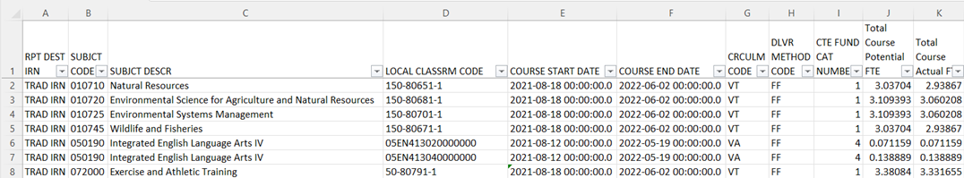
(CTEA-004) CTE FTE Summary by Course
Summary report by course with Course Potential FTE and Course Actual FTE
Verify that all courses are listed, and that all data is correct
If actual and potential FTEs are different, refer to the error reports
Notes:
This report will show by course how much potential and actual FTE is being generated. Sharing this report with district staff is recommended.

Slide 80
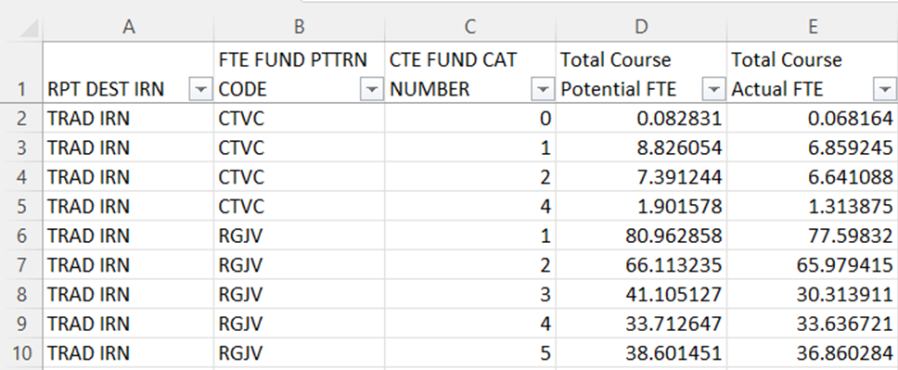
(CTEA-005) CTE FTE Summary by Category
Summary report by FTE Fund Pattern Code and CTE Fund Category with Course Potential and Actual FTEs
Overview of CTE data that could be useful when comparing data from week to week
Not a funding flow report as does not contain FTE Inclusion Codes or Funding IRNs
Notes:
This is a very high-level report that could be beneficial when monitoring the CTE reports for changes.

Slide 81
Requesting CTE Overrides

Slide 82
CTE Overrides
When CTE EMIS data is correct and CTE errors are generated, sometimes it is appropriate to request an override
Note that for FY22 some CTE overrides are now automated
See January 25, 2021 EMIS Newsflash for more information regarding automated overrides and to access the CTE Teacher Licensure Override Request Template

Slide 83
CTE Overrides, cont’d
Once an override is approved, a CTE Approved Override Report will be generated in the Staff and Course (L) Collection Level 2 Reports
The approved override will restore the CTE FTE for students affected by the error and the error will no longer appear in a CTE error report
Notes:
There is no notice given when a CTE Approved Override Report is generated in the Staff and Course (L) Collection Level 2 Reports, so districts will need to periodically check their reports to see if the override was approved. Note that an approved CTE Override will not correct issues on the Teacher Licensure Course Status Report.

Slide 84
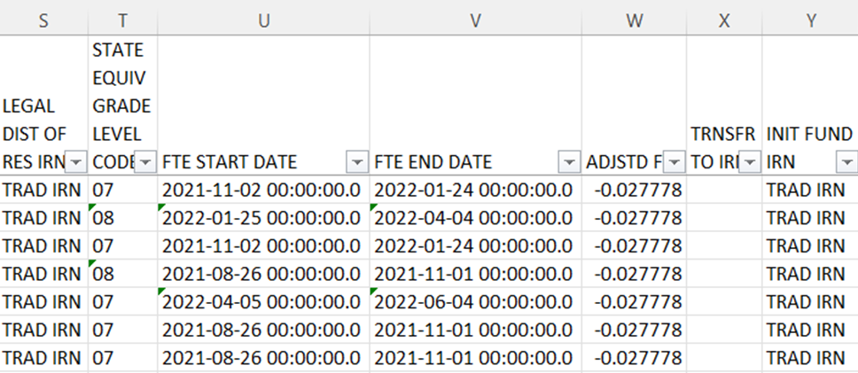
CTE Approved Overrides
(CTEA-006) CTE Approved Overrides Report
contains students who had adjusted CTE FTEs due to any type of error (student, course, or staff errors) for which an override was approved
The Adjusted FTE column will contain the CTE FTE
amount that is being restored due to the approved override – check against detail to see that this is happening
Notes:
Presenter, open and prepare the 75- CTEA-006 CTE Approved Overrides.xlsx. The adjusted FTE shows as a negative amount on the CTE Approved Overrides Report. Check the CTE FTE Detail Report to verify that the adjustment for the override has been applied to the students and that the previously reduced CTE FTE is now funded.

Slide 85
Quick Check
Have you identified an issue that may require a CTE override?
Have you contacted the Office of Career Tech to request an override?
Did you check to see that an (CTEA-006) CTE Approved Overrides Report was received?
CTE overrides are sometimes necessary to allow CTE programs to be funded correctly. An override request can sometimes take a considerable amount of time to process. Submitting override requests as early as possible is recommended.

Slide 86
CTE FTE Daily Summary Reports Being Updated
Notes:
As of the time of this training, the CTE FTE Daily Summary Reports were in the process of being updated. For this training, use the screenshots on the slides and note the result codes that will no longer be generated once these reports are updated.

Slide 87
CTE FTE Daily Summary Reports
Contain student CTE FTEs calculated from EMIS data that was processed on ten specific dates
Should be reviewed often to identify fluctuations in the amount of CTE FTEs being generated from specific submissions
Contain result codes that are not an indication of an error but rather identify student education/funding situations
Are separated by educating/funding situations which can be tied back to the CTE FTE Detail Report
Steps to match to CTE FTE Detail can be found in prior year versions of this training at https://community.mcoecn.org/display/EM/EMIS+Alliance+Public+Space
Notes:
It would be helpful to attendees to bring a copy of the report explanation to the workshop as it contains a lot of helpful information. The report explanation, “Level 2 Report Explanation: CTE FTE Daily Summary Reports”, can be found at ODE Home > Topics > Data > EMIS > Documentation > EMIS Validation and Report Explanations.

Slide 88
CTE FTE Daily Summary Reports, cont’d
(CTEA-007) CTE FTE Daily Summary Report – Students District is Educating
Contains CTE FTEs summed by CTE Fund Category Number
(CTEA-008) CTE FTE Daily Summary Report – Students Initially Funded at District
Contains CTE FTEs summed by Result Code and CTE Fund Category Number
(CTEA-009) CTE FTE Daily Summary Report – Transfers
Contains CTE FTEs summed by Result Code and CTE Fund Category Number
Notes:
These are the three CTE FTE Summary reports that are available in the data collector. Once the reports are available, have districts pull up their files to follow along through the next series of slides. Presenter, there are no DEMO files for the Daily Summary Reports.

Slide 89
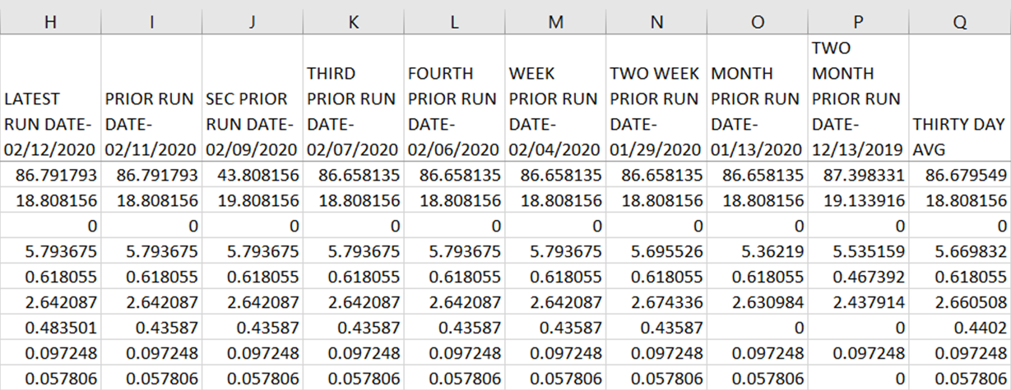
CTE FTE Run Dates
All three daily summary reports contain the same 10 Run Date Columns
Most recent CTE FTEs are to the left and prior CTE FTEs are to the right
Notes:
These columns appear on all three of the daily summary reports. If columns are not fully expanded or if filters are turned on, the dates will not be viewable. It is important to note that the thirty-day average values could possibly reset when new manifests are released. Also note that when CTE FTE reports are generated during the beginning of the Initial L Staff and Course Collection, the last column could contain Prior Year data instead of a Thirty Day Average.

Slide 90
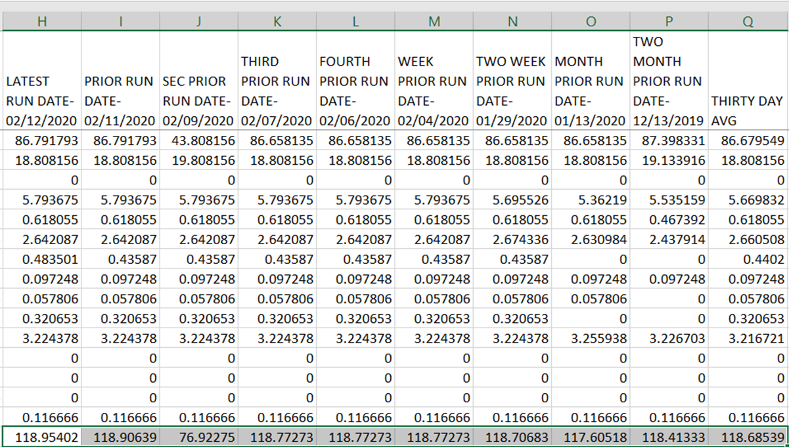
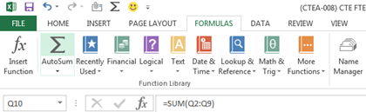
CTE FTE Fluctuations
1. Select the blank cells below the
CTE FTE values and select AutoSum
from the Formulas tab to
more easily find fluctuations
2. Notice the dip in CTE FTEs after this run.
Issue was resolved and subsequent run is higher
Notes:
This is not a demo file, use this slide to demonstrate a fluctuation. Use any DEMO file to show how to select the blank cells below the CTE FTE values and how to auto sum.

Slide 91
Error Severity Codes
Error Severity looks at the Thirty Day Average value and compares it to the value from the Latest Run to draw attention to differences that may be of concern. You can miss this if you don’t look often.
The Fatal (F) in the first line indicates a drop from the Thirty Day Average value to zero
Critical (C) indicates a decrease of 10% or
more (but not to zero) in the Latest Run
Warning (W) indicates a decrease of 5% to 10%
but not to zero or an increase of 20% or more
Notes:
Presenter can point out the differences between the CTE FTE values and the Error Severity Code that is being generated based on that difference. Informational Error Severity Code is used for all rows that are not Fatal, Critical, or Warnings. The Columns between the Latest Run and the Thirty Day Average were hidden for this example. Please refer to the report explanation for additional information regarding Error Severity Code Determination.

Slide 92
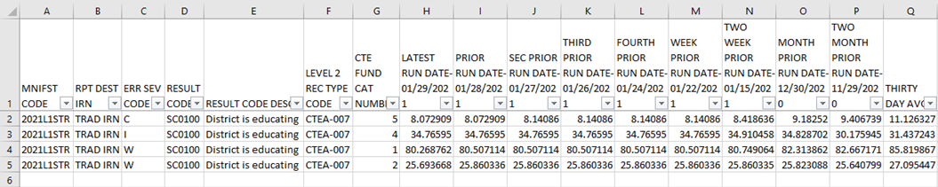
CTEA-007 Students District is Educating
Includes CTE FTEs for students the LEA is educating regardless if the district is initially funded or if the funding will transfer to another LEA
Result Code is SC0100 – Students LEA is educating
This is the only result code on the CTEA-007 report
This result code could appear for any entity that receives CTE reports
Notes:
Result codes on CTE FTE Daily Summary reports are not errors but are an indication of specific student situations as they relate to the reports. As we work through each of the three reports, we will discuss the result codes on each report.

Slide 93
CTEA-008 Students Initially Funded at District
Includes CTE FTEs of students for which the LEA is initially funded
Displays CTE FTEs as initially funded, positive amounts
Contains Result Codes indicating the LEA is initially funded and break down transfer information by student situation
Result Code SC0110 – no transfer of funds
Result Code SC0120 – funds transferred to a JVSD
For Result Code SC0130 – funds transferred to a Community School/STEM
For Result Code SC0140 – funds transferred to another district

Slide 94
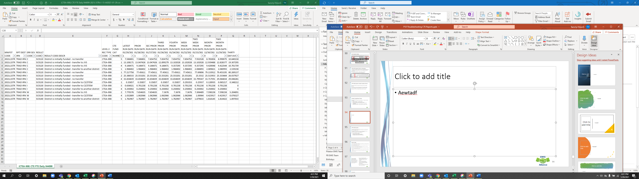
CTAE-008 Report Example
Report is sent to traditional districts
This example contains four results codes, SC0130 will no longer be generated
Number of result codes will vary by district

Slide 95
CTEA-009 Transfers
Includes CTE FTEs that will either transfer in or out from the LEA receiving the report
Displays CTE FTEs that transfer in as positive amounts and CTE FTEs that transfer out as negative amounts
Includes CTE FTEs for students who are
in open enrollment situations
in specific non-open enrollment situations (contract vocational and special education cooperative)
attending community schools or STEM schools

Slide 96
Result Codes
SC0150 – Open-enrolled in, initially funded elsewhere and funding transferred to educating LEA (positive amount)
SC0160 – Open-enrolled out, initially funded then funding is transferred to the educating LEA (negative amount)
SC0170 – Non-open enrolled in, initially funded elsewhere then funding is transferred to educating LEA (positive amount)
SC0180 – Non-open enrolled out, initially funded then funding is transferred to the educating LEA (negative amount)
SC0190 – Community School/STEM educating, funding transferred in (positive amount)
SC0200 – Resident student at Community School/STEM, funding transferred (negative amount)
Notes:
The CTEA-009 CTE FTE Daily Summary Report –When one entity sees a positive amount, another entity will see a negative amount.

Slide 97
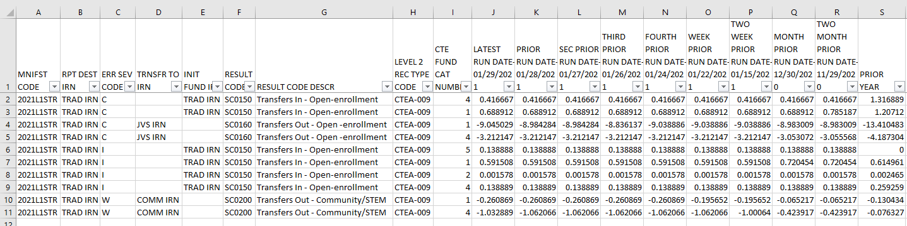
CTEA-009 Report Example
Only non-open enrollment result codes will appear for FY22
Any LEA type with fund transfers can receive this report
Note the positive and negative amounts as well as the transfer IRNs

Slide 98
Quick Check
Are you checking the Daily Summary reports often to avoid any negative impacts on CTE funding?
Can you identify individual students in the Daily Summary reports by filtering the CTE FTE Detail Report?
Are you sharing these reports with others in your district?
CTE FTE Daily Summary Reports are helpful to identify fluctuations in CTE FTEs that could affect funding. They can also be used to follow the flow of CTE funding based on student situations.
Notes:
Information on how to contact the Office of Career Tech will be available at the end of this presentation.

Slide 99
Summary
CTE reports contain data to verify and issues to correct
The troubleshooting process requires interaction between the CTE FTE Detail Report and the error reports
Use the CTE FTE Summary Reports to verify data and to compare data from previous versions of the reports
Confirm that corrections have been made in the source system and that new EMIS data has been submitted for CTE reports to be updated

Slide 100
Office of Career Tech
Office of Career Tech Contact Information
877-644-6338
cteohio@education.ohio.gov
CTETeacherOverride@education.ohio.gov
Some instances where districts should contact the Office of Career Tech
Career Technical Override questions
CTE-26 approval process
Other CTE questions should go the EMIS Helpdesk via your ITC
Questions pertaining to CTE Accountability/CTE Report Card should be sent to accountability@education.ohio.gov
Notes:
Explain to attendees that some issues can be addressed through the ITC and ODE EMIS office while other times districts contact the CTE office directly. Also, there are more reasons when districts can contact the CTE office and these are just some examples.

Slide 101
Resources
http://education.ohio.gov
Current EMIS Manual
ODE Home > Topics > Data > EMIS > Documentation > EMIS Manual
Level 2 Report Explanations
ODE Home > Topics > Data > EMIS > Documentation > EMIS Validation and Report Explanations
CTE FTE Reports
CTE FTE Daily Summary Reports
ODE Career Tech main page
ODE Home > Topics > Career Tech > Resources > FY22 Program and Assessment Matrix
Your ITC

Slide 102
Questions?
If you would like a certificate of attendance for this
training, you must complete the below feedback form
within 5 business days of this training
https://tinyurl.com/EA-District-Feedback

