Slide 1
Working Assessment
Missing Lists
Notes:
Add content/slides with examples from your student software & ODDEX
Add your own notes
Add PowerPoint Animations to stay on topic
Add links to specific pages in a URL by adding
#page=[page number]
https://education.ohio.gov/getattachment/Topics/Data/EMIS/EMIS-Documentation/Current-EMIS-Manual/2-8-1-Assessment-Area-Codes-v5-1.pdf.aspx?lang=en-US#page=5
Have additional information you would like to see added to these presentations. Please leave feedback ☺

Slide 2
The Ohio Department of Education funds development of EMIS training materials as part of the EMIS Alliance grant. There is an expectation that ITCs will utilize these materials in training provided to your districts. That said, there are restrictions on use of the EMIS Alliance materials as follows: Materials developed as part of the EMIS Alliance program must be provided at no cost to your training participants. If you utilize the EMIS Alliance training materials – in whole or in part – you must not charge participants a fee to attend the class where the materials are used. Likewise, you may not use the materials or any portion thereof in any event where a fee is charged to attend. Exceptions must be approved in writing by the Department of Education in advance of scheduling/promoting any event which may violate these restrictions.
Questions regarding appropriate use of EMIS Alliance materials, or requests for exception to the restrictions noted above, should be directed to Melissa Hennon [Melissa.Hennon@education.ohio.gov].

Slide 3
Overview
Assessment missing reports can be used by districts to verify which students need assessment results and which students need a Score Not Reported reason
These reports can be used prior to receiving assessment results to troubleshoot students believed to be appearing on the Assessment Missing Report in error and to report Score Not Reported reasons for students you know have not tested and for whom you will not have results

Slide 4
Assessment Missing Reports
Are generated by assessment type code for some, not all assessments
Are level 1 reports which are generated when the collection is prepared
  Must at least re-prepare to see daily updates
Use similar criteria to determine missing assessments
Are available when noted in collection request release notes
  Are not always produced in initial version of the collection request
  Statewide vendor results comparison to EMIS data is typically added later so missing reports can change
Notes:
This presentation is not a comprehensive assessment training. The intention is to explain how assessment missing reports are generated and how to troubleshoot them.
Student Assessment (FA).csv combined with Where Kids Count Level 2 report - Verify Total Records Reported with the District Assessment data team

Slide 5
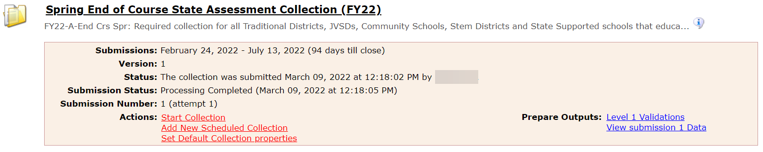
Level 1 Reports
Assessment Collection Example
To get to Level 1 reports, select the “View submission…” link

Slide 6
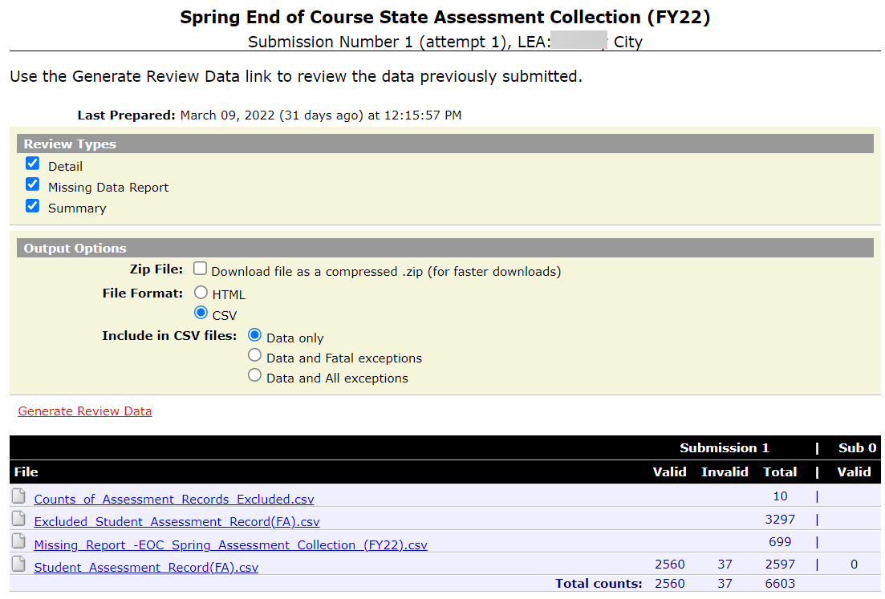
Level 1 Reports, cont’d
Select “Generate Review Data”
Find the Missing Report

Slide 7
Formatting the Assessment Missing Report
Open the Assessment Missing Report
  Wrap text header row
  Freeze top row
  Expand all columns
  Apply filters
  Better yet, run your macro!
Notes:
Presenter can use Working Assessment Missing List DEMO.xlsx. It is recommended to save the CSV file as an Excel file so that all Excel functionality is available. Demonstrate these steps of preparing the report and the attendees can prepare their own report as you demonstrate the Basic Excel steps. Select top row and select Wrap Text from the Home Tab. While the top row is selected, from the View tab, select Freeze Panes and Freeze Top Row. Select entire spreadsheet (click cell between Row 1 and Column A) then place cursor on the line between any two column headers and double click. While spreadsheet is highlighted, from the Data tab, choose Filter (or from the Home Tab select Filter)
Note: I use our districts missing reports and open them as they have questions.

Slide 8
Quick Check
Are you able to locate the missing report for each applicable assessment collection?
Are you able to open and format the CSV report to begin the review process?
Who in your district can assist with these reports?
The Assessment Missing reports contain students who are expected to have testing records reported. It is important to work with these reports proactively as the reports can change as additional data is added.
Notes:
.

Slide 9
Understanding Assessment Missing Reports

Slide 10
Expected Assessments
Assessments are expected when a student
  Is enrolled during the test administration window, and is reported with a district relationship of 1, or
  Students reported with a Sent to Reason of
    CT - Contract Career-Technical Education Participant
    JV - Joint Vocational School District Program Participant
    MR - BDD Program Participant
    NP - Non-public placement at District Expense (District Relationship = 1)
    OS - State School (OSB or OSD) Program Participant
    PI - Proprietary Institution Program Participant
  Has assessment results appearing in the statewide vendor file associated to that LEA
Notes:
Some assessments will have additional qualifiers for expected assessments.
https://education.ohio.gov/getattachment/Topics/Data/EMIS/EMIS-Documentation/Current-EMIS-Manual/2-8-Student-Assessment-FA-Record-v12-0.pdf.aspx?lang=en-US#page=7
Who Has to Take Each Assessment? P4
https://education.ohio.gov/getattachment/Topics/Data/EMIS/EMIS-Documentation/Current-EMIS-Manual/2-8-Student-Assessment-FA-Record-v12-0.pdf.aspx?lang=en-US#page=8
Who Reports Each Assessment? p5
Helpdesk 100316
Q1. My question is whether or not the sent reasons of CE or CI should also be included on this list when the educating entity (sent to IRN) is reported with either all 999999's (non-reporting) or is reported as an ESC IRN as they do not report school age students.
WKC rules indicate the following on Institutional Placements and FAY so I just want to make sure we are giving all the information necessary in this situation:
A student who is enrolled as of the Friday of the first full week of October, then leaves the district through one of the following codes, and then returns to the district prior to the end of the school year will be considered as continuously enrolled for a FAY
CE - Court ordered institutional placement in a facility as defined by ORC §2151.65 or §2152.41
CI - All court ordered institutional placements other than foster care and facilities defined by ORC §2151.65 or §2152.41
NI - Non-court ordered or foster care institutional placement
Verify correct MOA IRN assignment for these students
A1. I checked with the ODE Office for Accountability and also the Office of Assessment, and here is there response: "that if a district no longer is ‘responsible’ for a student’s education, then that district also has no requirement to test. The reverse also is true – if a district is deemed ‘responsible’ they also hold the responsibility to either test the student or make sure someone else tests him/her.
We tell districts if they no longer are responsible (usually deemed this by the court), they are to withdraw the student – so anyone who still has a student on their roles IS responsible (either they are responsible for actually delivering the education OR they are financially responsible for paying someone else to do it).“
Helpdesk #2957
Q2 Canton Local has a juvenile detention center within their boundaries, called Multi-County. The EMIS Coordinator of Canton Local just contacted me to ask if student's from Multi-County refuse to take an assessment (i.e. 11th grader refuses to take ACT) does this count against Canton Local? (Assuming the student was at the JDC, educated by Canton Local during the testing period). I read on the '2018-2019 Technical Documentation - Where Kids Count – April 1, 2019' documentation that these students would count in the Participation Rate - what does this mean for Canton Local?
A2. In cases where a student is in a juvenile detention facility, the district is still required to provide for the student’s education. For that reason, the students are included in Report Card measures like other students, as specified in the “Where Kids Count” and various other technical documentation. Student refusal to take an assessment would need to be reported with the appropriate Score Not Reported reason code.

Slide 11
Testing Windows
State testing windows
  Search “testing dates” education.ohio.gov
  See EMIS Manual test date valid options in the 2.8 Student Assessment (FA) Record
LEA chooses a shorter testing window
  See EMIS Manual 5.3 Organization General Information (DN) Record
    Report an Assessment Group attribute when your LEA has selected a shorter assessment window than the state testing window
    The start date of the shorter testing window is only reported for collections that have an enrollment-based assessment missing report
      ASMTFG3ELA – Fall 3rd Grade ELA Assessment
      ASMTSPRELA – Spring English Language Arts (all grades including EOC)
      ASMTSPRMSS – Spring Math, Science, Social Studies (all grades including EOC)
For FY22, local test windows will be used, if reported
  If not reported, default to state testing windows when generating Assessment Missing reports
Notes:
https://education.ohio.gov/getattachment/Topics/Data/EMIS/EMIS-Documentation/Current-EMIS-Manual/5-3-Organization-General-Information-DN-v11-2.pdf.aspx?lang=en-US#page=8
Page 6

Slide 12
Missing Assessments
Missing reports do not
  Look at Acceleration records (FB) or Grad Exemption (FE) records
  Look at other assessment collections
    Exception Alt. Assess. GX, GA
    Review Other Participating Assessments column
  AU students do not require assessments to be reported
    Students in grades 3-8 are not required to take statewide tests
    Scholarship students who attend chartered nonpublic schools are required to take any tests required by that school for graduation
Notes:
Appendix I: Guidance for Special Testing Scenarios
Scholarship Program Assessment Requirements:
https://oh-ost.portal.cambiumast.com/-/media/project/client-portals/ohio-ost/pdf/sp22-tam/appendix-i---ost-sp22-tam.pdf#page=4
Page 4

Slide 13
Missing Assessments
The number of missing records that must be ignored has been significantly reduced
  Score Not Reported reasons should not be reported if the record should be ignored as it could have a negative impact on accountability calculations
  Missing reports can be impacted by another LEA’s reporting
  Verify ODDEX SCR issues closely
    SCR issues have the potential to impact the LRC & missing assessments
  When in doubt, ask ODE via the EMIS Helpdesk
Notes:
When another LEA is reporting a preschool student with an incorrect district of residence, a student could appear on the missing report for that incorrectly reported DOR. Look in ODDEX for misreported DOR data as well as SCR conflicts.
Review (ENRL-001) Resident Students Educated Elsewhere
Helpdesk search “missing assessment ignore”

Slide 14
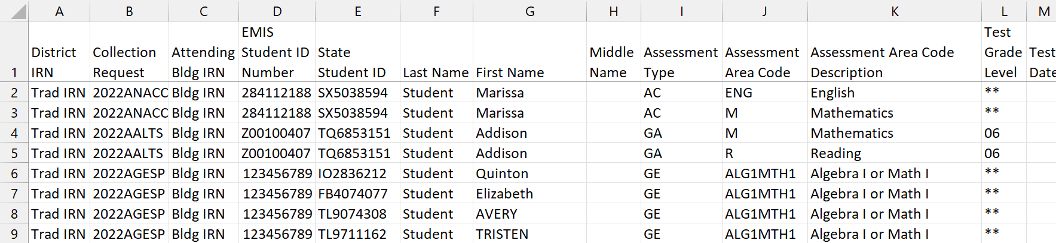
Missing Assessment Data
The column headers on the Assessment Missing reports are consistent across assessment collections
Data specific to the missing assessment is included
Missing lists contain only one Collection Request,
this screenshot is for demonstration purposes only
Some Assessment Missing Reports can
contain more than one Assessment Type
Notes:
Refer to the EMIS Collection Calendar for Collection Request Names.

Slide 15
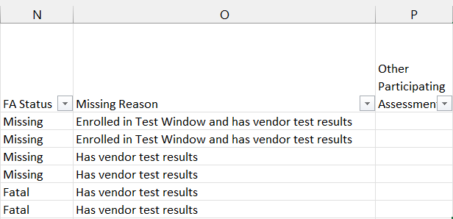
FA Status – Fatal
Fatal
  Record is not passing validation checks
  Submitted record is the test needed to remove the student from the missing report
  Once corrected the record will not show on the missing report

Slide 16
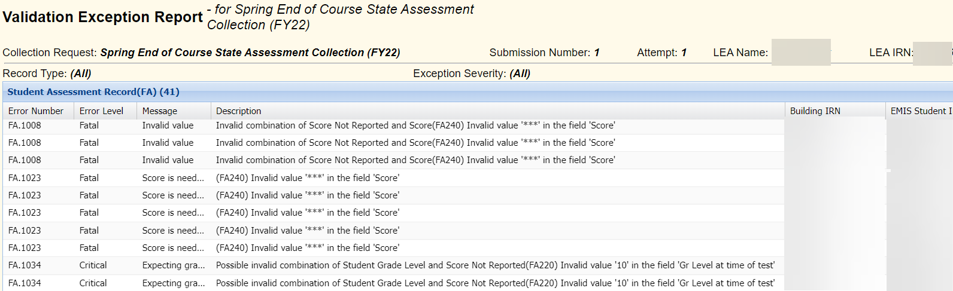
Level 1 Validations
Fatal Level 1 errors can cause missing assessments
  See EMIS Manual Section 2.8 Student Assessment (FA) Records
Correct Level 1 Errors

Slide 17
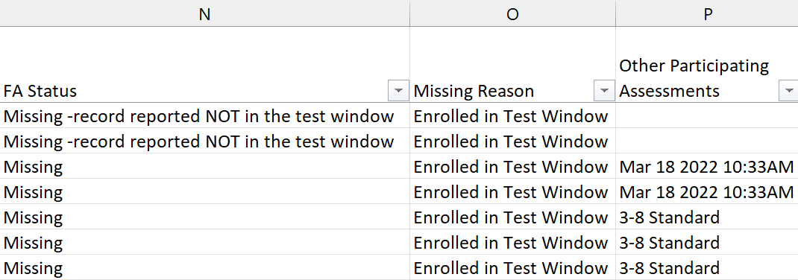
FA Status – Missing
Missing
  The test record needed to remove the student from the missing report has not been reported
Missing – Record reported NOT in the test window
  The test record reported matches the same subject area expected but does not have a date within the test window

Slide 18
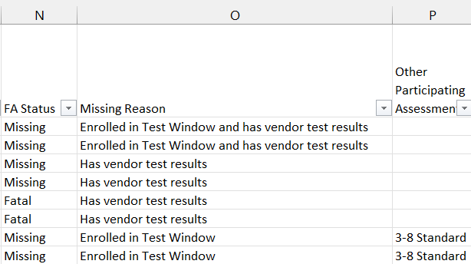
Missing Reasons
Rows on the Assessment Missing Report will have a missing reason
  Enrolled in test window, or
  Has vendor test result, or
  Enrolled in test window and has test result

Slide 19
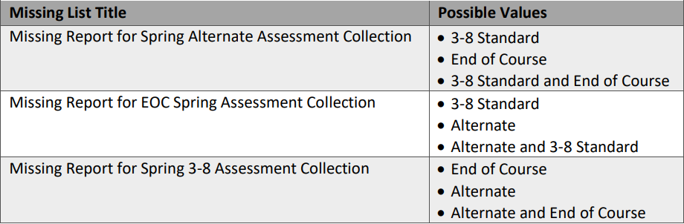
Other Participating Assessments
Spring Missing Lists ONLY
  Likely Spring Alternate Assessment (opens first) will contain references to other missing lists that open later, EOC Spring and Spring 3-8
  In those cases, the column will not change until changes are made in those later collections
  Based on the district’s most recent prepare
  Value will change or be removed once valid assessment scores or Score Not Reported reasons for the relevant tests have been included in the district’s assessment collections

Slide 20
SSIDs and Missing Assessments
SSID Change: Vendor vs FS Record
  Should SSID change issue be ignored?
  Most if not all Assessments, DO consider SSID changes
  Vendor
    SSID updates due to change in vendor file of SSID from PRE-ID to the results file are only updated in vendor file when the results are initially received
    SSID changes that occur after the initial results received from the vendor to ODE are only updated once
    Manual process performed by ODE prior to initial vendor load
  Enrollment changes in FS record will update SSID changes as submitted
    During overnight processing ODE uses the latest student data to update SSID’s reported on the FS records
      In which case districts may find it necessary to wait a day
      Do a re-prepare before seeing the update in the missing report
Notes:
Duplicate SSID
Student enrolls and is given a new SSID instead of the one reported by the previous LEA
Keep the SSID active that has been in existence the longest
Delete the newer SSID and link it to the prior SSID using the “Delete an Invalid SSID” function in the Maintenance Menu
Report the inactive SSID on the first Student Standing (FS) Record and report the active SSID on the next Student Standing (FS) Record
Helpdesk 4002973 Remind LEAs not to report the old SSID as withdrawn with an 81 (or any other withdrawal code), simply add a new FS record and report the correct SSID. Using the Student Locator Framework will significantly reduce the number of duplicate SSIDs.

Slide 21
SSIDs and Missing Assessments
Missing Report due to vendor results
Scenario 1
  SSID appears on an Assessment Missing Report due to having vendor results
  Missing SSID is not being reported to EMIS, Examples-
    Student was enrolled at time of pre-id submission but not reported to EMIS and deleted from the SIS
    Student was enrolled with incorrect SSID at time of pre-id submission but not reported to EMIS with the incorrect SSID
    These examples should no longer generate a missing assessment if there are no actual vendor results however if it does NOT, create a helpdesk ticket
Notes:
Incorrect SSID
Student enrolls and is given an SSID that belongs to another student
Find the correct SSID for the student
If this incorrect SSID has been reported to EMIS, it must be reported for the remainder of the fiscal year
Do not delete/deactivate the incorrect SSID on the SSID website
Report the incorrect SSID on the first Student Standing (FS) record and report the correct SSID on the next Student Standing (FS) record
If two entities are reporting the same SSID, you should expect to see an adjustment (typically FT0002 for overlapping dates) on the FTE Reports for both entities. Once the SSIDs are reported correctly the adjustment will go away. The EPCT error in the SCR can be ignored/hidden once the issue is corrected.

Slide 22
SSIDs and Missing Assessments
Missing Report due to vendor results…cont’d
Scenario 2
  SSID appears on an Assessment Missing Report due to having vendor results
  SSID is currently being reported to EMIS, Example,
    SSID submitted to Pre ID but later withdrawn with a code of 81 – “Student reported in error”
  Report a test record with a Score Not Reported Reason of “H”
    H - SSID for this student appears on the assessment vendor file due to an error in the data provided to the assessment vendor; student with this SSID was not required to be assessed
Notes:
Student vendor results were incorrectly reported as belonging to the district
New Level 2 Report recent released:
(ENRL-002) Student 81 Withdrawal Error Report
This is being added to the reporting guidance for withdrawal code 81:
If the student was not enrolled in the district in the prior year and—despite having completed enrollment paperwork—has not attended at all in the current year (so there is no Admission Date to report), then Withdrawal Reason 81 is reported in the current year to indicate that there was no enrollment for the student. Note that an 81 withdrawal record for this student is only required if the student has been reported to EMIS via an FS Record showing an enrollment. If an 81 withdrawal is reported and the student later enrolls and attends the district in the same school year, the 81 record should no longer be reported.
This will be added to the new guidance already posted under change 23-77:
Option 81, Student Reported in Error. Withdrawal Reason 81 is to be reported when a student has been reported in error in the current year. If a student was reported as enrolled in the district on the last day of school in the previous school year and was not reported as withdrawn, then Withdrawal Reason 81 cannot be reported in the current year. If the student withdrew prior to the last day of the previous school year but was not reported as withdrawn, then a Student Withdrawal Override (FC) Record should be reported for the student in the current year.If the student withdrew on or after the last day of the previous school year, then the student’s summer withdrawal can be reported with either a Student Summer Withdrawal (FL) Record or a Student Attributes–Effective Date (FD) Record, a Student Standing (FS) Record, and a Student Demographic (GI) Record. If the student was previously enrolled in the district in the current year and reported with any Withdrawal Reason other than 81, then the student cannot be reported with Withdrawal Reason 81 on any subsequent Student Standing (FS) Record in the current year.

Slide 23
SSIDs and Missing Assessments
Missing Report due to vendor results…cont’d
Scenario 3
  SSID appears on the Missing Report due to having vendor results
  Student is being reported with two SSIDs
    Two Student Standing FS records
    First Student Standing with prior, incorrect SSID
    Second Student Standing FS with correct SSID
  Verify SSID change was reported correctly
  Confirm scores are reported using the correct SSID
    Report the test using the latest SSID and ignore the missing on the old SSID
  Create an EMIS Helpdesk ticket
Notes:
Other less common SSID scenarios can be submitted to the EMIS Helpdesk for resolution.

Slide 24
Quick Check
Have you cleaned up your assessment level 1 validations?
Can you find the state windows on the ODE website?
Did you keep a list of students with SSID changes?
The Assessment Missing reports are helpful tools that can be used to identify students who did not test. The reports are similar across tests and collections.
Notes:
.

Slide 25
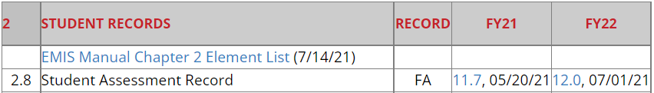
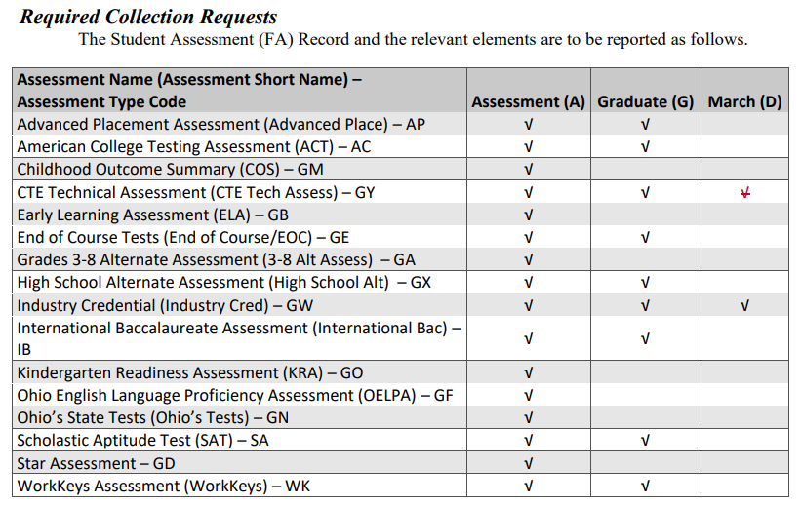
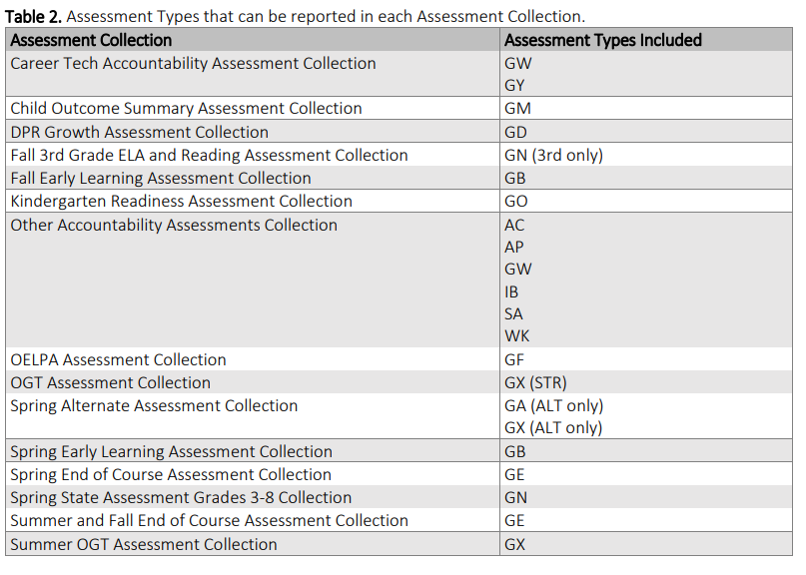
Assessment Missing Reports by Collection – EMIS Manual
Keep up with the latest changes in the EMIS Guide
https://education.ohio.gov/Topics/Data/EMIS/EMIS-Documentation/Current-EMIS-Manual
Education.ohio.gov
  Keyword Search “EMIS Manual”
  2.8 Student Assessment Record
  FY22 Column
  Required Assessment Type by Reporting Period
    Page 3
  Assessment Type(s) by Collection
    Page 10

Slide 26
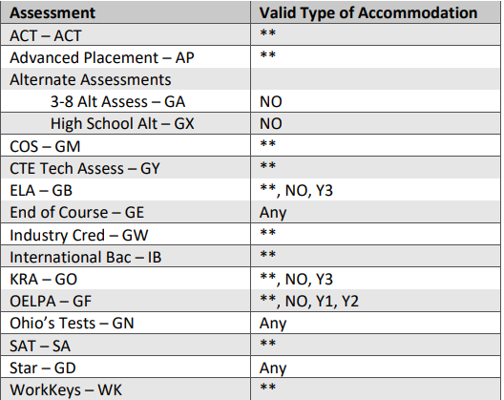
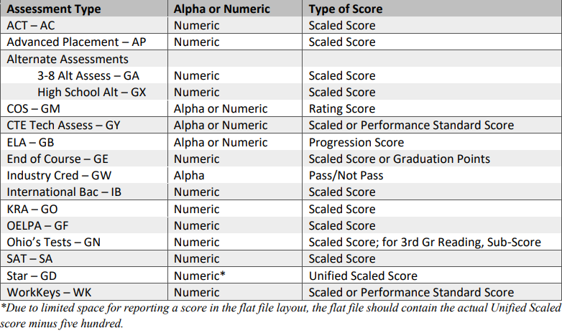
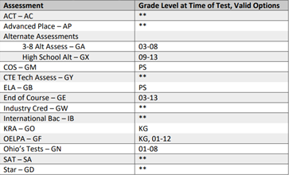
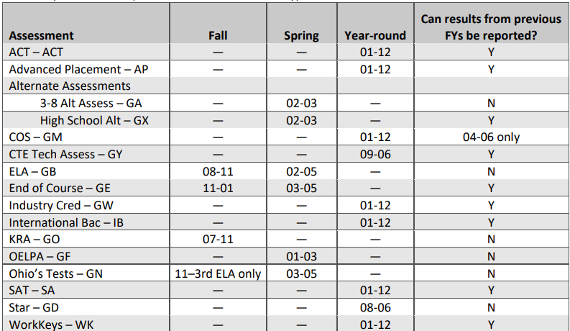
Assessment Missing Reports by Collection – EMIS Manual
Verify ALL Fields for each Assessment Type
Accommodations
Assessment Area Code
  EMIS Manual
  Section 2.8.1
Required Test Type
Score
Test Grade Level
Test Dates
Notes:
https://education.ohio.gov/getattachment/Topics/Data/EMIS/EMIS-Documentation/Current-EMIS-Manual/2-8-Student-Assessment-FA-Record-v12-0.pdf.aspx?lang=en-USAccommodation#page=24
p21
Required Test Type - STR, ALT, IPD, INP p13
Score p13
https://education.ohio.gov/getattachment/Topics/Data/EMIS/EMIS-Documentation/Current-EMIS-Manual/2-8-Student-Assessment-FA-Record-v12-0.pdf.aspx?lang=en-USAccommodation#page=16
Test Grade p20
https://education.ohio.gov/getattachment/Topics/Data/EMIS/EMIS-Documentation/Current-EMIS-Manual/2-8-Student-Assessment-FA-Record-v12-0.pdf.aspx?lang=en-USAccommodation#page=23
https://education.ohio.gov/getattachment/Topics/Data/EMIS/EMIS-Documentation/Current-EMIS-Manual/2-8-1-Assessment-Area-Codes-v5-1.pdf.aspx?lang=en-US
Assessment Area Code

Slide 27
Score Not Reported Reasons

Slide 28
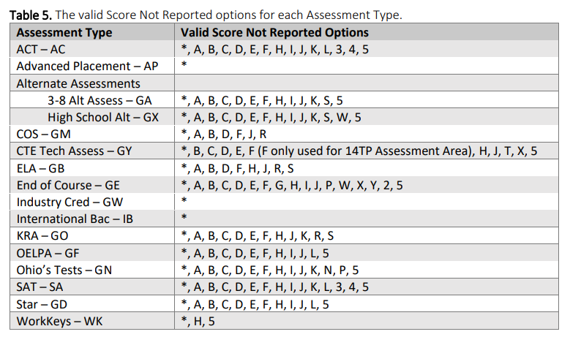
Score Not Reported – EMIS Manual
Keep up with the latest changes in the EMIS Guide
https://education.ohio.gov/Topics/Data/EMIS/EMIS-Documentation/Current-EMIS-Manual
Education.ohio.gov
  Keyword Search “EMIS Manual”
  2.8 Student Assessment Record
  FY22 Column
  Page 15
Notes:
https://education.ohio.gov/Topics/Data/EMIS/EMIS-Documentation/Current-EMIS-Manual
Education.ohio.gov
Keyword Search “EMIS Manual”
2.8 Student Assessment Record
FY22 Column
Page 15
https://education.ohio.gov/getattachment/Topics/Data/EMIS/EMIS-Documentation/Current-EMIS-Manual/2-8-Student-Assessment-FA-Record-v12-0.pdf.aspx?lang=en-USAccommodation#page=18

Slide 29
Working Missing Assessment Lists
When troubleshooting missing assessments prior to your LEA’s test results reported to EMIS, you could see most assessments appear as missing
Students who were required to test but did not test should be reported with a Score Not Reported (SNR) reason on a manually created test record
It is a best practice to manually create test records with SNR reasons in the SIS once the non-testing reason is known

Slide 30
Score Not Reported Reason A
A – Medical Reason
  Can be reported for students that aren't assessed due to COVID and any students quarantined due COVID exposure
    Assessment windows were extended so students present during any part of an assessment window are expected to be assessed
    Parents who refuse to have their students tested due to non-medical concerns should be reported as B-Parental Refusal
  Districts are not required to submit a waiver request to ODE, however, if a waiver isn't submitted and approved the student will show as untested on the Report Card
  Questions regarding the medical and parental refusal SNRs should be put into an EMIS Helpdesk ticket
  https://education.ohio.gov/Topics/Data/Report-Card-Resources/Emergency-Medical-Waivers
Notes:
https://education.ohio.gov/Topics/Data/Report-Card-Resources/Emergency-Medical-Waivers

Slide 31
Score Not Reported Reasons B - F
Specific SNR reasons are valid for each test
  B – Parent Refusal
  C – Student Refusal
  D – Suspension/Expulsion
  E – Absent during test administration window
  F – Other (reason not listed)
Only report if the student was required to test and did not
SNR Reasons of B-F count against accountability measures
Notes:
These SNR reasons are valid for many different assessments. Refer to the EMIS Manual section 2.8 Student Assessment Record (FA) for additional information on SNR reasons. Districts with questions about medical waivers can reach out to the ODE Office of Accountability

Slide 32
Score Not Reported Reasons G and H
G – EOC Assessment (GE) not given for the course in which the student is enrolled within this district, includes courses that span multiple years (GE Assessments only)
  Local curriculum does not align with the test
  Typically applies to all students in the class
  Should be reported in the first year of a two-year course
H – SSID for this student appears on the statewide assessment vendor file due to an error in the data provided to the vendor
  SSID is not required to be assessed

Slide 33
Score Not Reported Reasons I, J, and K
I – Student was tested but the test was invalidated by ODE or by the LEA
J – Student moved in or out before test administered
  Enrolled at start of testing window but move prior to a test subject being administered
  Students who enroll at the end of a testing window should be tested
K – Not required in this district because student is part-time or home schooled or at a nonpublic school and is not enrolled in a course for this assessment/subject area
Notes:
SNR reasons of J, K, and L are valid for many assessments.

Slide 34
Score Not Reported Reasons L, N, and P
L – Student has a disability condition for which no vendor accommodation exists
N – Student taking subject above grade level, no subject test at higher grade (GN Assessments only)
P – Not tested due to timing of Alternate Assessment determination (GE and GN Assessments only)
  This SNR is only valid when IEP team determines on or after the last day of the AASCD testing window and prior to the standard testing window, that a student should take the Alternate Assessment for Student with Cognitive Disabilities
Notes:
GE assessments are End of Course, GN assessments are Ohio’s State Tests 3-8, GB assessment is PS ELA, GM assessment is PS COS, and GO assessment is the KRA.
English
language arts Mathematics Science
Grade 3 ✓ ✓
Grade 4 ✓ ✓
Grade 5 ✓ ✓ ✓
Grade 6 ✓ ✓
Grade 7 ✓ ✓
Grade 8 ✓ ✓ ✓

Slide 35
Score Not Reported Reasons R, S, and T
R – Parent requests results not be reported to the state
  PS and KG assessments only, GB, GM, GO
  Report when parent makes a request under ORC §3301.0714(B)(1)(n). Also applies to the preschool assessments managed by the Office of Early Learning and School Readiness
S – Non-scorable assessment
  GA, GB, GO, and GX Assessments only
T – CTE student is earning an industry recognized credential (GW) in place of a CTE technical assessment (GY)
Notes:
GA is 3-8 Alternate Assessment, GB is PS ELA Assessment, GO is KRA Assessment, GM is Childhood Outcome Summary (COS) and GX is HS Alternate Assessment.
GW is Industry Credential and GY is CTE Technical Assessment (Webxam)

Slide 36
Score Not Reported Reason W
W – Student receiving graduation credit for assessment area (Valid for GE and GX assessments)
  Due to course completion prior to EOC being available, or
  Due to an assessment administration being cancelled due to a COVID-19 ordered school building closure in school year 2019-2020, or
  Due to the COVID-19 related flexibility for juniors and seniors in school year 2020-2021
  Can report this SNR if using course grade and actual result, ODE will use the higher score
    Number in score field represents graduation points earned
    Refer to the EMIS Manual section 2.8 Student Assessment Record (FA) for additional information on this SNR reason
  Test taken date must be from a prior to FY22
Notes:
GE is End of Course exams, GX is HS Alternate Assessment. For course completion prior to EOC being available, test dates should be prior to the Spring of FY16.

Slide 37
Score Not Reported Reason X
X – Student received graduation credit for assessment area due to completion of a dual credit course (GE Assessments)
  For EOC (GE) number in score field represents number of graduation points earned from the CCP course
X – Student received graduation credit for assessment area due to completion of a CTE dual credit course (GY Assessments)
  For CTE Technical Assessment (GY) score field represents the student’s proficiency
Notes:
CCP courses
COLLEGE CREDIT PLUS COURSE GRADE to OHIO GRADUATION POINTS
FY22 Grad Requirements - https://education.ohio.gov/Topics/Ohio-s-Graduation-Requirements/18-Points-on-State-Tests

Slide 38
Score Not Reported Reason X, cont’d
X – Student received graduation credit for assessment area due to completion of a CTE course that requires a WebXam (GY Assessments)
  For 2019-2020 – applicable to all grade levels
  For students who took the regular GY assessment before the ordered school-building closure, the actual assessment result should still be reported in EMIS
  Report an additional GY assessment record with the performance level for the assessment based on the student’s earned grade in the CTE course, even if the 2019-2020 course was over before the ordered school-building closure
  ODE will use the highest score from all reported assessments when calculating the performance level/summative score for the relevant program of concentration

Slide 39
Score Not Reported Reason X, cont’d
X – Student received graduation credit for assessment area due to completion of a CTE course that requires a WebXam (GY Assessment)
  For 2020-2021 – only 11th and 12th grade students
  For students who took the regular GY assessment, the actual assessment result should still be reported in EMIS
  Report an additional GY assessment record with the performance level for the assessment based on the student’s earned grade in the CTE course
  ODE will use the highest score from all reported assessments when calculating the performance level/summative score for the relevant program of concentration

Slide 40
FY20 Webxam Course Grade Conversions
All prior year CTE Assessment results are reported in the Career Tech Accountability Assessment Collection FY22
Districts submitted the CTE course grades (non-CCP) to the Center on Education and Training for Employment (CETE)
  CETE converted course grades and return them to the district
  If a district missed the deadline all records were hand entered
  For additional information on which students can use this flexibility and how the grade-based proficiency level to be reported is determined for GY assessments, see http://education.ohio.gov/Topics/Student-Supports/Coronavirus/Career-Technical-Education
The converted course grades will be reported as GY test records with a SNR value of X
Notes:
CETE is pronounced like “seat”
WEBXAM COURSE GRADE TUTORIAL 2021
https://www.youtube.com/watch?v=UHJiYrKbtUo
WEBXAM COURSE GRADE UPLOAD FILE TEMPLATE AND OTHER RESOURCES
https://www.webxam.org/Public/CourseGrades

Slide 41
Score Not Reported Reasons Y and 2
Y – Student transferred with course completed out of state or while being homeschooled (EOC Assessment only)
  Number of graduation points required is reduced
  Score value = ***
2 – Student received graduation credit for alternative non-public school EOC assessment prior to public district enrollment (EOC Assessment only)
  Number in score field represents number of graduation points earned
Notes:
Helpdesk 104029

Slide 42
Score Not Reported Reasons 3, 4, and 5
3 – An 11th grade student who achieved remediation free score on all parts of the ACT (AC) or SAT (SA) prior to the spring of grade 11 and are exempted during the official state paid administration of the assessment
4 – English Learner, less than 2 years in US schools and no accommodations available (AC and SA Assessments only)
5 – Student assessed, but results not available from assessment vendor by close of collection or appeal window
Notes:
ACT remediation free scores: https://education.ohio.gov/Topics/Ohio-s-Graduation-Requirements/College-and-Career-Readiness-Test

Slide 43
Quick Check
Do you have a copy of the Student Assessment Record (FA) section of the EMIS Manual available?
Are you working with staff members in your district to determine when a Score Not Reported reason is appropriate?
Score Not Reported reasons are used in manually created test records. Creating manual test records should only be done when it is appropriate as misreporting could have a negative impact on accountability.
Notes:
.

Slide 44
Other Assessment Reports
Notes:
https://education.ohio.gov/Topics/Data/EMIS/EMIS-Documentation/Current-EMIS-Manual
Education.ohio.gov
Keyword Search “EMIS Manual”
2.8 Student Assessment Record
FY22 Column
Page 3
Page 10

Slide 45
Excluded Report
Do not appear on missing or level 1 reports
  Excluded record was not processed
NOT valid for record type
  District IRN
    May be valid if test was administered by another EMIS reporting entity
  Assessment Type Code
  Assessment Area Code
  Test Grade Level
    Not valid for Assessment Type Code and/or Assessment Area Code
  Test Date
    Prior Year results to be expected in the excluded report
    Current Year
      Verify date is within testing window
  Required Test Type
    Not valid for Assessment Type Code and/or Assessment Area Code

Slide 46
Supplementary CSV
Supplementary CSV may not always be available
  If ODE does not have results from the vendor, Supplementary CSV file cannot be produced
These are additional records that do not appear on the missing report
Student was not on the vendor file AND Record is reported to ODE by the district
Districts may report newly enrolled students with test results from a prior district

Slide 47
Gen Issues – Assessments
IS0031 - Alternant Assessment but no Disability
IS0365 - Assessment Pass Rate = 0%
IS0366 - Assessment Pass Rate = 100%
IS0367 - Assessment Pass Rate = ‘–’
IS0368 - Large Change Assessment Pass Rate
IS0385 - Invalid STAR Score
IS0390 - Invalid Grade for STAR
IS0391 - Invalid Score Not Reported for STAR
IS0392 - NextGen Outside Range
Notes:
https://education.ohio.gov/getattachment/Topics/Data/EMIS/EMIS-Documentation/FY16-EMIS-Validation-and-Report-Explanation-Docume/General_Issues_Report_Explanation.pdf.aspx?lang=en-US

Slide 48
Gen Issues – Assessments
IS0393 - EOC Outside Range
IS0394 - OELPA Outside Range
IS0410 - STAR: Invalid Date
IS0421 - OELPA Score Not Reported Check 'L' on All Domains
IS0449 - KRA Data Reported does not match vendor file
IS0459 - ELA Data Reported Does Not Match Vendor File
IS0491 - Preschool Reported as your resident student *NEW
Notes:
https://education.ohio.gov/getattachment/Topics/Data/EMIS/EMIS-Documentation/FY16-EMIS-Validation-and-Report-Explanation-Docume/General_Issues_Report_Explanation.pdf.aspx?lang=en-US

Slide 49
Assessment Missing Reports by Collection
Notes:
https://education.ohio.gov/Topics/Data/EMIS/EMIS-Documentation/Current-EMIS-Manual
Education.ohio.gov
Keyword Search “EMIS Manual”
2.8 Student Assessment Record
FY22 Column
Page 3
Page 10

Slide 50
Missing Report – COS Assessment Collection
Child Outcome Summary Assessment Collection (20##AGMFY)
  Preschool COS/Assessment Type Code – GM
Report will display the resident district's preschool students who are reported with a disability and ODE has yet to receive a COS assessment for the student
Once vendor file is received, ODE will apply the results to the missing report
Valid SNR reasons for manually created GM test records
  A, B, D, F, J, and R
If a student’s COS is missing and no SNR reason is applicable create an EMIS helpdesk ticket
Notes:
When another LEA is reporting a preschool student with an incorrect district of residence, a student could appear on the missing report for that incorrectly reported DOR. Look in ODDEX for misreported DOR data as well as SCR conflicts and (ENRL-001) Resident Students Educated Elsewhere.
(GNIS-476) Gen Issues - Preschool - Number of Students with COS Scores Reported (informational)
https://education.ohio.gov/getattachment/Topics/Data/EMIS/EMIS-Documentation/FY16-EMIS-Validation-and-Report-Explanation-Docume/General_Issues_Report_Explanation.pdf.aspx?lang=en-US
Page 28
https://education.ohio.gov/Topics/Data/EMIS/Reporting-Responsibilities/Data-Appeals Aug. 29-Sep 9
FY21 report change: Remove scholarship students from COS missing report. Updates the COS missing report to exclude preschoolers on scholarships.
Indicator 7 - https://education.ohio.gov/Topics/Early-Learning/Preschool-Special-Education
https://education.ohio.gov/getattachment/Topics/Data/EMIS/Resources-for-EMIS-Professionals/EMIS-Training/2021_November-2.pdf.aspx?lang=en-US
Slide 51
https://education.ohio.gov/getattachment/Topics/Data/EMIS/Resources-for-EMIS-Professionals/EMIS-Training/2022_March-1.pdf.aspx?lang=en-US
Slide 11
Assessment Area Codes
https://education.ohio.gov/getattachment/Topics/Data/EMIS/EMIS-Documentation/Current-EMIS-Manual/2-8-1-Assessment-Area-Codes-v5-1.pdf.aspx?lang=en-US#page=21

Slide 51
Missing Report – ELA Assessment Collections
Two Preschool ELA Collections
  Fall Early Learning Assessment Collection (20##AGBFL)
  Spring Early Learning Assessment Collection (20##AGBSP)
Preschool ELA/Assessment Type Code – GB
Valid SNR reasons for manually created GB test records
  A, B, D, F, H, J, R, and S
If a student’s ELA is missing and no SNR reason is applicable create an EMIS helpdesk ticket
Notes:
When another LEA is reporting a preschool student with an incorrect district of residence, a student could appear on the missing report for that incorrectly reported DOR. Look in ODDEX for misreported DOR data as well as SCR conflicts.
(GNIS-459) Gen Issues - Preschool - ELA Data Reported Does Not Match Vendor File
https://education.ohio.gov/getattachment/Topics/Data/EMIS/EMIS-Documentation/FY16-EMIS-Validation-and-Report-Explanation-Docume/General_Issues_Report_Explanation.pdf.aspx?lang=en-US Page 26
https://education.ohio.gov/getattachment/Topics/Data/EMIS/Resources-for-EMIS-Professionals/EMIS-Training/2021_November-2.pdf.aspx?lang=en-US Slide 50
https://education.ohio.gov/Topics/Early-Learning/Kindergarten/Early-Learning-Assessment
https://education.ohio.gov/getattachment/Topics/Early-Learning/Kindergarten/Early-Learning-Assessment/Early-Learning-Assessment-for-Administrators/ELA-FAQ-s.pdf.aspx
https://education.ohio.gov/Topics/Data/EMIS/Reporting-Responsibilities/Data-Appeals Aug. 29-Sep 9
Early Learning Assessment Data Manager Update
Spring Early Learning Assessment Data Collection and Reporting
The ELA spring data collection closes on 05/14/2022 at 11:59 PM. Teachers will not be able to enter assessment data after this time. Data Managers will be able to approve transfers and clean up the student demographic data through 05/20/2022 at 11:59 PM. Please use the Learning Progression Score Report generated from the Ready for Kindergarten Online (KReady) system which will be available for download starting 05/27/2022 for the spring data collection for reporting scores in EMIS or EAS.
The fall 2023 Early Learning Assessment data collection will open on August 15.
If you have questions about the Early Learning Assessment, please email ELAHelp@education.ohio.gov
For technical questions, please contact the Help Desk:
(844)-512-6446
http://www.ohio-k12.help/

Slide 52
Missing Report – ELA Assessment Collections, cont’d
Report will display preschool students enrolled during the testing window
  who are enrolled in an ECE program (how Received = E) who do not have an ELA test reported (with or without a disability)
    The LEA who owns the ECE Grant is required to report the ELA assessments to EMIS
  who have a disability and who do not have an ELA test reported
    District of residence reports assessments
    Educating LEA if not DOR can report ELA assessments
Once vendor file is received, ODE will apply the results to the missing report
Notes:
Gen Issues will be produced by ODE for this assessment reporting issue.
Helpdesk # 103560
Q. DistrictA has a student on the missing report for Fall Early Learning Assessment. No name is listed on the report, however his student. This student is missing testing results. He is not enrolled in Garfield and not sure how he is connected to this district. Can you assist with information for this student as to where they may be attending? We have tried to look them up in ODDEX, but have not found any information on this student. We suspect that another district is pointing to DistrictA.
A. District B, was reporting the student till 11/1/2021, pointing to DistrictA as the Legal District of Residence. If you are not the LDR, you could contact them to correct their reporting. If they do, the timing of the correction may be too late to update the missing report. So if you're not the resident district, then ignore the missing.

Slide 53
Missing Report – KRA Fall Assessment Collection
Kindergarten Readiness Assessment Collection (20##AGOFL)
KRA/Assessment Type Code – GO
Report will display any student reported with
  Grade level of KG
  Enrolled between the first day of school and November 1st
  Report checks for the student in any district’s prior year S data
    If found the student will not be considered as missing the KRA
    Verify SSID reported by prior district in prior year
      Be sure SSID change is reported correctly
      Send a Helpdesk ticket to ODE
  English Learners are expected to take the KRA assessment
Notes:
(GNIS-449) Gen Issues - Preschool - KRA Data Reported Does Not Match Vendor File
Page 25
https://education.ohio.gov/getattachment/Topics/Data/EMIS/EMIS-Documentation/FY16-EMIS-Validation-and-Report-Explanation-Docume/General_Issues_Report_Explanation.pdf.aspx?lang=en-US
https://education.ohio.gov/Topics/Early-Learning/Kindergarten/Ohios-Kindergarten-Readiness-Assessment
Fall KRA Supplementary Assessments Being Reported: This report lists students the district is reporting even though the students are not missing. It is recommended that districts confirm the students in the reports because they will be included in submissions to the Department.
** Completed Appeal
https://education.ohio.gov/Topics/Data/EMIS/Reporting-Responsibilities/Data-Appeals Feb. 22- Mar 11

Slide 54
Missing Report – KRA Fall Assessment Collection, cont’d
When a kindergarten student withdraws to another district during the testing window, the district with the most recent enrollment should report the KRA results
  To facilitate this reporting, if a kindergarten student has a partial KRA assessment record in one district, and then moves to a different district, the first district is expected to share the results with the second district
  Student should not appear on the first district’s assessment missing report
  Second district should report KRA test to EMIS

Slide 55
Missing Report – KRA Fall Assessment Collection, cont’d
Once vendor file is received, ODE will apply the results to the missing report
Score not reported reasons valid for manually created KRA records
  A, B, C, D, E, F, H, J, K, R, S
If a student’s KRA is missing and no SNR reason is applicable create an EMIS helpdesk ticket
  See slide SSIDs and Missing Assessments, Scenario 3
Notes:
Scenario 3
SSID appears on the Missing Report due to having vendor results
Student is being reported with two SSIDs
Two Student Standing FS records
First Student Standing with prior, incorrect SSID
Second Student Standing FS with correct SSID
Verify SSID change was reported correctly
Confirm scores are reported using the correct SSID
Report the test using the latest SSID and ignore the missing on the old SSID
Create an EMIS Helpdesk ticket

Slide 56
Missing Report – Fall Third Grade ELA Assessment Collection
Fall 3rd Gr ELA and Reading Collection (20##AGNFL)
  Ohio’s State Test Grade 3 ELA and Reading/Assessment Type Code – GN
Based on student data (student attributes such as grade level, effective start date, end date, and withdrawal reason), special education event reporting, and vendor files
Report will display grade 3 students who were enrolled during the fall test window
Once vendor file is received, ODE will apply the results to the missing report
Valid SNR reasons for manually created GN test records
  A, B, C, D, E, F, H, I, J, K, N, P, and 5
If a student’s Fall Third Grade ELA is missing and no SNR reason is applicable create an EMIS helpdesk ticket
Notes:
GNIS-0392 - The score reported for the 3-8 Next Gen Assessment is outside the valid range.
https://education.ohio.gov/getattachment/Topics/Data/EMIS/EMIS-Documentation/FY16-EMIS-Validation-and-Report-Explanation-Docume/General_Issues_Report_Explanation.pdf.aspx?lang=en-US
Page 22
https://education.ohio.gov/getattachment/Topics/Data/EMIS/Resources-for-EMIS-Professionals/EMIS-Training/2022_March-1.pdf.aspx?lang=en-US
Slide 9
Scale Score Range – Performance Standards
https://oh-ost.portal.cambiumast.com/-/media/project/client-portals/ohio-ost/pdf/online-system-resources/understanding-score-reports/2021-2022-understanding_state_tests_reports.pdf
Page 5

Slide 57
Missing Report – Spring 3-8 Assessment Collection
Spring State Assessment Grades 3-8 Collection (20##AGNSP)
Ohio’s State Tests 3-8
Assessment Type Code – GN
Once vendor file is received, ODE will apply the results to the missing report
Report will reflect SSID changes

Slide 58
Missing Report – Spring 3-8 Assessment Collection, cont’d
Report will display grade 3 – 8 students who were enrolled during the test window
  If a student is accelerated in a subject that exists at the student’s grade level on the Ohio’s State Tests, as reported on the Student Attributes – Effective Date (FD) Record, but there is no such OST subject test available at the accelerated grade level, report the test grade level of the non-existent test with a SNR value of N
    N – Student taking subject above grade level, no subject test at higher grade
  If a student is subject accelerated in ELA or Math to a higher grade, then the student is removed from the ELA/Math overall grade level and added to the denominator of the accelerated grade level
Notes:
If the student passes the 3rd grade ELA in the fall, they should not appear as missing in the spring. Looks at the fall assessment score, not the promotion score.
Higher grade level must be reported for student to be removed from the missing results. When higher grade level is no longer reported student will appear on the missing report for the current grade level. Acceleration record is not used for the missing report.

Slide 59
Missing Report – Spring 3-8 Assessment Collection, cont’d
If a student is in grades 3-8 but is also being included in the denominator of the EOC Missing list the student is removed from the 3-8 Missing list for that subject area
Students reported with ALT test type on IEP should not appear as missing
  Student won't be removed from the Missing OST (3-8 & EOC) until districts report the ALT test type
Valid SNR reasons for manually created GN test records
  A, B, C, D, E, F, H, I, J, K, N, P, and 5
If a student’s 3-8 Spring Ohio’s State test is missing and no SNR reason is applicable create an EMIS helpdesk ticket

Slide 60
TIDE Resource
Available to help identify students who failed to take required 3-8 OST and EOCs
  A tool is available in the TIDE testing portal to help districts identify which students were pre-identified to take a test but did not complete it. Staff who have access to the TIDE portal can run reports from the “Monitor Test Progress” (MTP) task menu that will provide a list of the students who did not test.
See the EMIS Newsflash – May 24, 2021, for additional information
Notes:
https://education.ohio.gov/Topics/Data/EMIS/News/EMIS-Newsflash-%E2%80%93-May-24-2021
Education.ohio.gov
Topics
EMIS
View All News

Slide 61
Missing Report – EOC Summer and Fall/Spring
Assessment Collection
Two End of Course Collections
  Summer and Fall End of Course Assessment Collection (20##AGEFL)
  Spring End of Course State Assessment Collection (20##AGESP)
End of Course (EOC)/Assessment Type Code – GE
Spring End of Course State Assessment Collection
  Missing report based on course reporting and vendor files
Summer and Fall EOC Collection
  Missing report was not available in FY22 due to no vendor file received
Once statewide test vendor file is received, ODE will apply the results to the missing report
Will reflect SSID changes
Notes:
Missing report does not exist for Graduate G collection. Verify excluded student assessment record (fa).csv AND student assessment record (fa).csv AND Level 2 Grad reports AND Received Files GRAD Cohort reports.
GNIS-0393 EOC Outside Range
https://education.ohio.gov/getattachment/Topics/Data/EMIS/EMIS-Documentation/FY16-EMIS-Validation-and-Report-Explanation-Docume/General_Issues_Report_Explanation.pdf.aspx?lang=en-US
Page 22
More info. regarding Ohio Grad requirements:
https://education.ohio.gov/Topics/Ohio-s-Graduation-Requirements
https://education.ohio.gov/getattachment/Topics/Data/EMIS/Resources-for-EMIS-Professionals/EMIS-Training/2022_March-1.pdf.aspx?lang=en-US
Slide 8
Scale Score Range – Performance Standards
https://oh-ost.portal.cambiumast.com/-/media/project/client-portals/ohio-ost/pdf/online-system-resources/understanding-score-reports/2021-2022-understanding_state_tests_reports.pdf
Page 5

Slide 62
Missing Report – End of Course Collections
Enrolled in Test Window
  Student is enrolled in a course that requires an EOC exam AND
  Student course enrollment falls within the test administration window
Enrolled in Test Window and has Vendor Results
  Student is enrolled in a course that requires an EOC exam AND
  An EOC test subject with a score is in the statewide test vendor file
Has Vendor Results
  Student is NOT enrolled in a course that requires an EOC exam AND
  An EOC test subject with a score is in the statewide test vendor file
  Note- Students may not have all parts of the test
    Additional parts reported will be reflected on the Supplementary Report
Notes:
Q. Student who took part 1 of EOC assessment and then was hospitalized and did not get to take part 2. There is a score being reported but it is low due since he didn't complete the entire test.
A. Any score below the min for that grade level would fatal. So yes, they would need a Score Not Reported Reason. Text below is from Test User’s Administration guide:
If a high school student retakes a test to earn higher graduation points, the student must retake both parts; there is no option to retake only one part. For further information see the Department’s Retake Policy

Slide 63
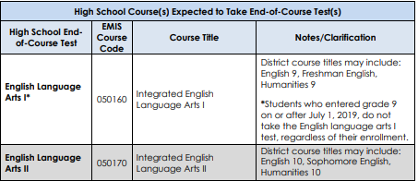
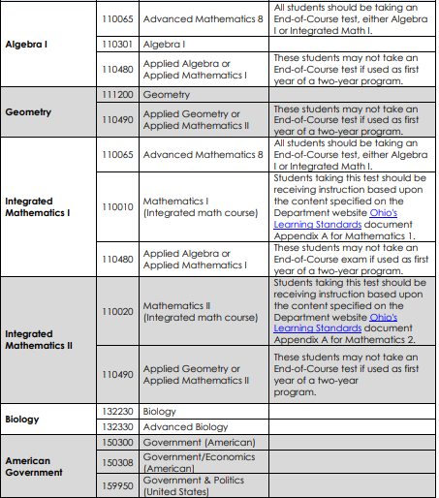
EOCs and Subject Codes
Test Administration Guide
  https://oh-ost.portal.cambiumast.com/-/media/project/client-portals/ohio-ost/pdf/sp22-tam/ost-sp22-tam-final-122021.pdf
  Page 20
Notes:
American History is not required to be reported, and will no longer appear on the missing reports however, if the student takes the assessment, it is recommended that the district reports the results. English Language Arts I is only acceptable for kids who started 9th grade before 7/1/2019. Data Collector will accept ELA I regardless of fiscal year began 9th grade, however students who don’t meet the criteria should not be tested. This chart is not applicable to alternate assessments.

Slide 64
Missing Report – End of Course Collections
Checks to see if the student has previously taken the appropriate subject test or was reported with a substitute test record for that subject
Checks to see if the student was reported with an IEP with an ALT test type that is effective during the alternate assessment testing window
Students that took the test at a JVSD/Contract Vocational District are assigned to the resident/sending district based on the JVSD reporting

Slide 65
Missing Report – End of Course Collections, cont’d
Valid SNR reasons for manually created GE test records
  A, B, C, D, E, F, G, H, I, J, P, W, X, Y, 2, and 5
If a student’s EOC test is missing and no SNR reason is applicable create an EMIS helpdesk ticket

Slide 66
Missing Report - Spring Alternate Assessments
Spring Alternate Assessment Collection (20##AALTS)
  Based on student data and vendor file
    student attributes such as grade level, effective start date, end date, and withdrawal reason special education event reporting
  Grades 3-8 Assessment Type Code – GA
  High School Assessment Type Code – GX
  Looks for IEP Test Type ALT on the Special Ed GE
  Once vendor file is received, ODE will apply the results to the missing report
  Valid SNR reasons for manually created test records
    A, B, C, D, E, F, H, I, J, K, S, 5 also W for GX Assessment only
Notes:
https://education.ohio.gov/getattachment/Topics/Data/EMIS/Resources-for-EMIS-Professionals/EMIS-Training/2022_March-1.pdf.aspx?lang=en-US
Slide 5
GNIS-0031 – Alternant Assessment but no Disability
https://education.ohio.gov/getattachment/Topics/Data/EMIS/EMIS-Documentation/FY16-EMIS-Validation-and-Report-Explanation-Docume/General_Issues_Report_Explanation.pdf.aspx?lang=en-US
Page 9
Scaled Score Range – Performance Standards
https://oh-alt.portal.cambiumast.com/-/media/project/client-portals/ohio-alt/pdf/2021q1/aascd_performance_standards.pdf

Slide 67
Missing Report - Spring Alt Assessments, cont’d
Looks for students with ALT test type on their xIEP event (Special Ed GE) during the administration window
  Grades 3-8 and 11th or 12th grade students (to be included on the Missing Report)
  Checks if they have passed the Alternate Assessment in each subject
  By 11th grade most alternately assessed students have taken all necessary courses
If a student’s Alternate Assessment test is missing and no SNR reason is applicable create an EMIS helpdesk ticket
Notes:
Alt Assessments are taken in 10th grade, all subjects at one time. The new Alternate Assessment is structured similar to the EOC. Alt Assessments are taken when they take the course. Students can take Alt Assessment starting in 9th grade and at any time through HS career. Students take Alt Assessments based on their IEP. This missing report does not look at Student Special Education Graduation Requirement Records (FE). Alternate assessment students are not automatically exempted and must continue to take the ALT Assessment if not exempted.
Student is on missing alternate assessment. Student was assessed in a prior year. Student was not assessed in the current year. Do NOT report a SNR record for the current year. This will NOT remove the student from the missing alt. assess. report. Prior year scores require overnight processing before it impacts the missing assessment report. After overnight processing the district needs to do a re-prepare to ensure that they're looking at the latest report.
Helpdesk # 103782
Q. StudentA is missing the Social Studies and Science tests. The Spec Ed department in the district has indicated that the student met the requirements for these 2 tests last year. However, I see a Score Not Reported reason of "F" for these 2 tests last year. Should the student have tested this year? The student is also exempt from the consequences of the EOC- and they are reporting that as well.
Also, student StudentB is also showing as missing on this report. He was incorrectly reported as needing to take the ALT test, but that reporting was corrected on later reporting. When will this student come off of the missing report?
A. We have prior tests in Math and Reading for StudentA, so this student is missing Social Studies and Science.
StudentB, should not be on the missing for the ALT Assessment. He is on the missing for the Standard Assessment. Ignore the missing for the ALT and report the standard assessment tests. Normally the student will drop off the ALT Assessment if there's been a recent change in the district's special ed reporting for this student, such that his IEP test type was updated to STR. It usually takes a couple of days before the update is pushed through to the Data Collector. You can try and do a prepare of the ALT collection and see if the student still appears on the missing. If it does, let me know but ignore the ALT missing.
Clarification: IF a test is reported with a passing score from a prior year the student will NOT appear on the missing test. This situation requires documentation regarding why the student was misreported with change in IEP test type.

Slide 68
Missing Report - OELPA Spring Assessment Collection
OELPA Assessment Collection (20##AGFSP)
Ohio English Language Proficiency Assessment – OELPA/Assessment Type Code – GF
Report will display students enrolled during the test window who are reported with an English Learner/Limited English Proficiency (LEP) Status Element not equal to N
Once vendor file is received, ODE will apply the results to the missing report
Valid SNR reasons for manually created test records
  A, B, C, D, E, F, H, I, J, L, and 5
If a student’s OELPA test is missing and no SNR reason is applicable create an EMIS helpdesk ticket
Notes:
GNIS-394 - The score reported for the Ohio English Language Proficiency Assessment (OELPA) is outside the valid range.
Page 22
GNIS-0421 - OELPA Score Not Reported Check 'L' on All Domains
Page 22
https://education.ohio.gov/getattachment/Topics/Data/EMIS/EMIS-Documentation/FY16-EMIS-Validation-and-Report-Explanation-Docume/General_Issues_Report_Explanation.pdf.aspx?lang=en-US

Slide 69
Missing Report – DPR Growth Assessment Collection
DPR Assessment Collection (20##AGDFY)
STAR Assessment (fka - MAP)/Assessment Type Code – GD
Students enrolled in spring test window will show on the missing during the fall test window until spring has been submitted
  Prepare monthly to verify the updated students assessed on the vendor file during each test window
Report will display students in 9th grade or higher who are enrolled at a Dropout Prevention and Recovery community school
  Not required for students with disabilities who are reported with an IEP Test Type of ALT
Once vendor file is received, ODE will apply the results to the missing report
Valid SNR reasons for manually created GD test records
  A, B, C, D, E, F, H, I, J, L, and 5
If a student’s STAR test is missing and no SNR reason is applicable create an EMIS helpdesk ticket
Notes:
GNIS-0391 – Invalid Score Not Reported for STAR
Page 21
GNIS-0410 - STAR student assessment records reported with test dates outside of the assessment administration dates
Page 22
https://education.ohio.gov/getattachment/Topics/Data/EMIS/EMIS-Documentation/FY16-EMIS-Validation-and-Report-Explanation-Docume/General_Issues_Report_Explanation.pdf.aspx?lang=en-US
STAR Missing List Update – Data Collector Message Center notification
As of Friday January 28th, the STAR Missing List has been changed from only listing students who are enrolled in the 2nd test administration window - January 2nd to May 27th - to students who are enrolled anytime from the start of the first test window - August 2, 2021- to the end of the second test window- May 27, 2021. A student will appear on the missing list if they are enrolled, and we have yet to receive a STAR Math and STAR Reading test record. The change allows assessment records from both test administrations to be reported throughout the year. The ODE Office for Community Schools plans to provide a Received File this week showing the tests reported to date.

Slide 70
Missing Report - Career Tech Spring Assessment Collection
Career Tech Accountability Assessment Collection (20##ACTSP)
Industry Credential (GW) – No Assessment Missing report
CTE Technical Assessment (aka OCTCA and WebXam)/ Assessment Type Code – GY
Valid SNR reasons for manually created GY test records
  B, C, D, E, (F - only for 14TP Assessment Area), H, J, T, X, and 5
If a student’s CTE Technical Assessment test is missing and no SNR reason is applicable create an EMIS helpdesk ticket
Notes:
https://education.ohio.gov/getattachment/Topics/Data/EMIS/Resources-for-EMIS-Professionals/EMIS-Training/2022_March-1.pdf.aspx?lang=en-US
Slide 7

Slide 71
Missing Report – Other Accountability Assessments
Other Accountability Assessments Collection (20##ANACC)
  Advanced Placement (AP) - No Assessment Missing Report
  International Baccalaureate (IB) – No Assessment Missing Report
  WorkKeys (WK) – No Assessment Missing Report
    Valid SNR reasons for manually created WK test records, H, X, and 5
  American College Testing (ACT) AC
  Scholastic Aptitude Test (SAT) SA
    Assessment Missing report will display
      Students in grade 11
      The test that the LEA indicated they would use (ACT or SAT)
    Once vendor file is received, ODE will apply the results to the missing report
Notes:
For WorkKeys Score Not Reported information, refer to the EMIS Manual, COVID-19 Related EMIS Reporting Guidance.
https://education.ohio.gov/getattachment/Topics/Data/EMIS/Resources-for-EMIS-Professionals/EMIS-Training/2022_March-1.pdf.aspx?lang=en-US
Slide 6

Slide 72
Missing Report - ACT and SAT
Alternately assessed students are not required to take the ACT or SAT (SNR Reason = L)
  L – Student has a disability condition for which no vendor accommodation exists
Retained 11th grade student is not required to test if they took it in a prior year
  If the retained 11th grade student appears on the missing report, ignore the missing
Students that took the test at a JVSD/Contract Vocational district are assigned to the resident/sending district based on the JVSD reporting
Notes:
https://education.ohio.gov/getattachment/Topics/Data/EMIS/Resources-for-EMIS-Professionals/EMIS-Training/2022_March-1.pdf.aspx?lang=en-US
Slide 6
Assessment Area Codes:
ENG English
M Mathematics
R Reading
S Science
W Writing

Slide 73
Missing Report - ACT and SAT, cont’d
Valid SNR reasons for manually created AC and SA test records
  A, B, C, D, E, F, H, I, J, K, L, 3, 4, and 5
If a student’s ACT or SAT test is missing and no SNR reason is applicable create an EMIS helpdesk ticket
If a district indicated they were giving one test and instead gave the other test, create a helpdesk ticket to clean up the assessment missing
Notes:
EMIS receives a file from the Assessment Data Manager that includes all districts signed up to give the ACT and another file with districts signed up to take the SAT. EMIS uses the SAT file and assigns students in those districts to the SAT Missing List; all other students are assigned to the ACT Missing List (the ACT file is not used). A link is sent to superintendent’s/school administrators in August to submit the ACT or SAT selection.
Non-College Reportable Results:
Helpdesk ticket 3035 & 103703
Report the assessment record with the score received.
Report no accommodations (**) were provided. The district may wish to administer another district-paid ACT for the student with appropriate accommodations, so he or she may perform to the best of his or her potential.
Helpdesk #103810
Q. Took the ACT on their own in February and skipped our ACT testing window in March. The scores are being reported and making it to the DC as
valid records, but the scores are still showing on the missing list as "outside of the testing window".
As long as you are reporting the results from a prior administration, you could report a current record with an FY22 Spring administration date and a SNR of 3 Student achieved remediation free score on all parts of the ACT or SAT prior to spring of grade 11. That would take the student off the missing report.

Slide 74
Quick Check
Have all tested and non-tested students been accounted for?
Are Assessment Missing Reports reviewed on a regular basis?
Are others in your district involved in the review of assessment data?
Assessment Missing reports are intended to be used as a tool to identify students who may be required to test and for which a reported assessment is not found.

Slide 75
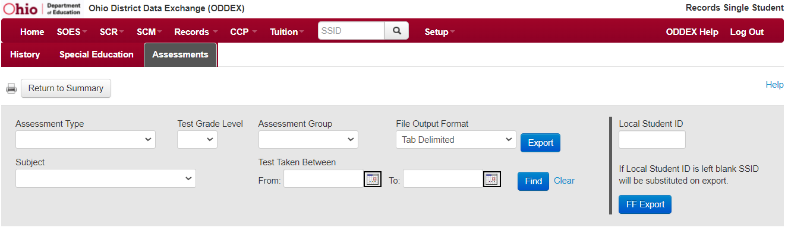
ODDEX
OH|ID > ODDEX App
  https://ohid.ohio.gov/wps/portal/gov/ohid/login
Records > Single Student > Assessments
  https://wiki.ssdt-ohio.org/display/oddex/Assessments

Slide 76
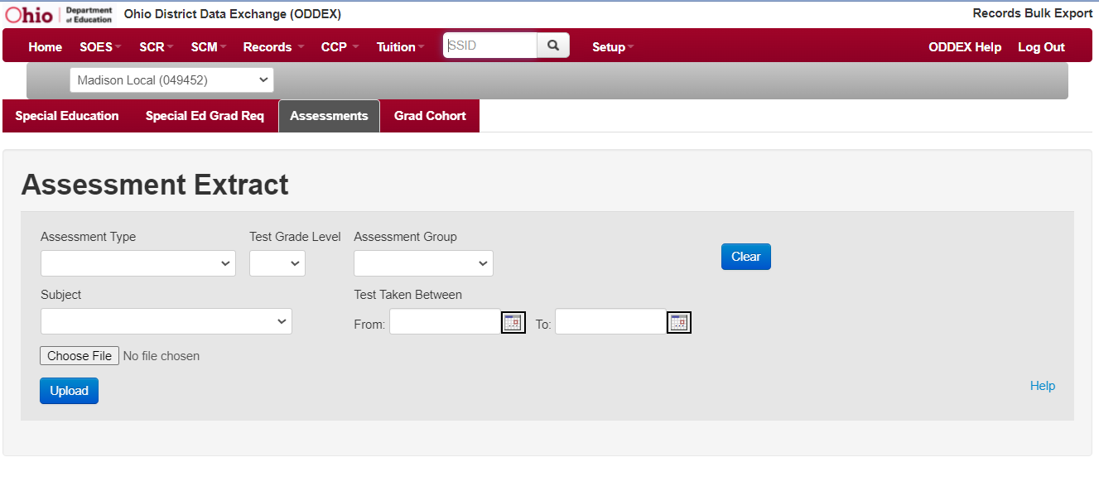
ODDEX
Records > Bulk Export > Assessments
  https://wiki.ssdt-ohio.org/display/oddex/Bulk+Export
CSV Upload File
  Column 1 = SSID
  Column 2 = (optional)
    Blank
    Local Student ID

Slide 77
ODDEX
Filter
  Assessment Type
  Subject
  Test Grade Level
  Assessment Group
Local Student ID Tips
  If the student data source system uses local student ids with leading zeroes or spaces, it will be necessary to include the leading zeroes/spaces in the CSV file. If, for example, only five characters/digits are supplied for the local id in the CSV file, the result in the export file will be the five characters/digits with four trailing spaces.
    'ABCDE '
    '12345 '
  If the local student id '12345' has leading zeroes, it needs to be supplied in the CSV file as
    AA1234567,000012345

Slide 78
Summary
Assessment Missing Reports can be useful before and after test results are received
Caution must be taken to create SNR test records only when they are appropriate
Assessment data should be reviewed early and often
Assessment data is used for accountability purposes and can be audited

Slide 79
Resources
Testing
  ODE Home > Testing
Monthly Testing Newsletters
  ODE Home > Testing > Test Coordinator News
  Deadlines/Important Dates
  Pre-ID Dates
  Test Dates
  Result Dates
  Rescores
Ohio Test Portal
  ODE Home > Testing > Ohio’s State Test Portal
Notes:
https://education.ohio.gov/Topics/Testing
https://education.ohio.gov/Topics/Testing/K-8-District-Test-Coordinator-Bulletin-1
https://oh.portal.cambiumast.com/

Slide 80
Resources
EMIS Manual
  ODE Home > Data > EMIS > Documentation > EMIS Manual
EMIS Release Notes
  ODE Home > Data > EMIS > EMIS Technical Documentation > EMIS Release Notes
Assessment Missing Reports – Report Explanation
  ODE Home > Data > EMIS > Documentation > EMIS Validation and Report Explanations
ODDEX
Data Collection Calendar & Appeals
Your district staff
Your ITC

Slide 81
Questions?
If you would like a certificate of attendance for this
training, you must complete the below feedback form
within 5 business days of this training
https://tinyurl.com/EA-District-Feedback
Notes:
Presenter- Insert your contact information on this slide.
ITC Feedback for Certificate of Attendance
https://tinyurl.com/EA-Train-the-Trainer-Feedback

