Slide 1
Troubleshooting the Where Kids Count Report

Slide 2
The Ohio Department of Education funds development of EMIS training materials as part of the EMIS Alliance grant. There is an expectation that ITCs will utilize these materials in training provided to your districts. That said, there are restrictions on use of the EMIS Alliance materials as follows: Materials developed as part of the EMIS Alliance program must be provided at no cost to your training participants. If you utilize the EMIS Alliance training materials – in whole or in part – you must not charge participants a fee to attend the class where the materials are used. Likewise, you may not use the materials or any portion thereof in any event where a fee is charged to attend. Exceptions must be approved in writing by the Department of Education in advance of scheduling/promoting any event which may violate these restrictions.
Questions regarding appropriate use of EMIS Alliance materials, or requests for exception to the restrictions noted above, should be directed to Melissa Hennon [Melissa.Hennon@education.ohio.gov].

Slide 3
Overview
WKC Report
  Generated using EMIS data from traditional districts, ESCs, community schools, and STEM schools
  Contains result codes that indicate where the student will count if the student is included in accountability measures
This presentation will focus on troubleshooting the WKC reports
  Resolve data reporting issues
  Verify data for accuracy and completeness
Notes:
This session is designed to be conducted as a workshop where districts are looking at their own data. Attendees should have access to their WKC reports and it is recommended that they have a copy of the most recent Where Kids Count Report Explanation (printed or electronic) as well as a copy of the document “Technical Documentation Ohio’s Where Kids Count Business Rules” last revised date 1/1/2020. The technical document contains additional information about accountability calculations. The WKC Report is generated but can be ignored for JVSDs.

Slide 4
Outline
Where Kids Count (WKC) Process
Assigning Majority of Attendance and Accountability IRNs
Accessing and Preparing the WKC Report
Student Attending Situations and Where Kids Count
WKC Summary Report
Notes:
In this workshop we will discuss the WKC process and the assignment of MOA IRNs as well as how EMIS coding affects the WKC process. We will locate and open the WKC Report from the Data Collector and then discuss data within the report. We will review the WKC Reports and troubleshoot the data in the report for accuracy and completeness.

Slide 5
WKC Process
LEAs assign MOA IRNs to students based on Full Academic Year (FAY) criteria that are specific to assessment requirements
  Incorrect assignment of MOA IRNs can negatively impact accountability measures
LEAs report student EMIS data that is used in WKC calculations (How Received, Sent To, EL, etc.)
WKC Reports contain WKC IRNs and WKC Result Codes assigned based on district data
Notes:
It is important for districts to understand that they report MOA IRNs and student attending data. The WKC rules are then applied and are contained within the WKC Report. Student data for WKC is verified separately from assessment data.

Slide 6
Assigning Majority of Attendance and Accountability IRNs

Slide 7
Assigning MOA IRNs
IRN of the building or district where a student is continuously enrolled from the Friday of the first full week of October through the MOA End Date, March 31
  This timeframe is referred to as a Full Academic Year (FAY)
Located on the Student Attributes – No Date (FN) Record
JVSDs are not required to report MOA or Accountability IRNs (can report default values of ******)
ESCs must report MOA IRNs for preschool students
Notes:
For FY22, the Friday of the first full week of October is October 8, 2021. JVS’s do not need to do anything with the WKC Report, even though they are still receiving it. Regarding ESC’s – from the reporting instructions for MOA IRN in EMIS Manual Section 2.6 Student Attributes – No Date (FN) Record, ESC’s are required to report this element for preschool students with the IRN of the ESC.

Slide 8
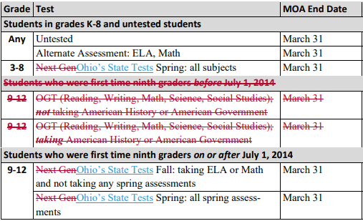
MOA End Dates Removed
MOA End Date of March 31 is based on assessment requirements, not whether student actually took the test
This (partial) chart is
from the EMIS Manual,
section 2.6 Student
Attributes-No Date (FN)
Record
Notes:
Presenter- discuss the chart and note that the “9th…BEFORE 7/1/2014” is no longer VALID is showing as strikethrough would have been students who began 9th grade in 13-14 or earlier (most of them graduated during 16-17). Students who were first time ninth graders AFTER July 1, 2014 are most of the graduating class of 2018 and beyond. Next Gen tests wording has been updated to Ohio’s State Tests.

Slide 9
MOA IRN Levels
Building Level - Student continuously enrolled in one building in the district for a FAY
  Report the building IRN
District Level - Student continuously enrolled in the district for a FAY but enrolled in multiple buildings
  Report the district IRN
State Level - Student not continuously enrolled for a FAY
  Report ******
Notes:
Grade 7 and 8 students that take End of Course Exams will have those End of Course Exams count at the overall building of the student

Slide 10
MOA IRNs
Must be a building or district IRN that belongs to the reporting entity
Resident/Sending district reports the building IRN the student would attend in the district for the following students
  School aged student educated at an ESC
  College Credit Plus participant (Sent to PS)
  Student educated at County Board of Developmental Disabilities (Sent to MR)
  Joint Vocational School Student (Sent to JV)
  Contract Career Technical Student (Sent to CT)
  Non-public placement at district expense (Sent to NP)
Notes:
Note that the MOA IRN must be the building the student would attend if the student attended the district and cannot be an IRN that is not their own.

Slide 11
FAY Exception
A student who is enrolled as of the Friday of the first full week of October, then leaves the district through one of the following codes, and then returns to the district prior to the end of the school year will be considered as continuously enrolled for a FAY
  CE - Court ordered institutional placement in a facility as defined by ORC §2151.65 or §2152.41
  CI - All court ordered institutional placements other than foster care and facilities defined by ORC §2151.65 or §2152.41
  NI - Non-court ordered or foster care institutional placement
Verify correct MOA IRN assignment for these students
Notes:
This is most common for students who are in Juvenile Detention Centers.
Friday, October 8, 2021 (FFWO)
Some software systems do not calculate this correctly and the student will appear counting at the state level. Look at Sent to reason, see if student was enrolled on FFWO (10/8/2021) and returned before last day of school You can get all of this information from the FS record and apply filters or sort options. Use your excel skills.

Slide 12
Gen Issues MOA Error
IS0027 Majority of Attendance – Roll-up to the State
  Occurs when 20% or more of students have a MOA of ****** which counts the students at the state level
  Review students reported with MOA IRN of ******
    Current Student Collection, Data Collector Submission data, FN file
    WKC Report, students with Result Code WK0004
  If the MOA IRNs are correctly reported, then the Gen Issues error can be ignored.
  Questions about this error can be directed to Adam Schiming from the Office of Accountability and Continuous Improvement
    Adam.Schiming@education.ohio.gov
Notes:
When JVSDs receive this Gen Issues error, they can ignore as it will not affect their LRC or funding.

Slide 13
Accountability IRN
Students simultaneously enrolled in two buildings or attending a special program in another building may be reported with the IRN of the responsible building
  Report an Accountability IRN to count the student at the responsible building on the Student Attributes – No Date (FN) Record
  Must be enrolled for a FAY to report anything other than ******
  To report an Accountability IRN, the MOA IRN must be a building
  If not applicable, report an Accountability IRN of ******
Notes:
Demonstrate where the Accountability IRN value is located in the student information system. The Accountability IRN should never be the same IRN value as the MOA IRN. We will discuss this element further on an upcoming slide.

Slide 14
Software Demonstration
Since attendee software varies, ITCs should demonstrate or explain the process in the applicable student information software system to assign MOA IRNs
  Use the Student Information System (SIS) to demonstrate how MOA IRNs can be viewed or exported for data verification
Notes:
Some attendees may use a different software however, a demo should be done for the software(s) that the ITC supports. Some SISs assign MOA IRNs automatically, so if your system does this, the process can be explained instead of demonstrated. Suggest that attendees review their Student Attributes No Date (FN) preview file from the Data Collector to review Majority of Attendance IRNs and Accountability IRNs for accuracy.

Slide 15
Quick Check
Are MOA IRNs assigned for all students at the correct level?
Have students who were not enrolled for a FAY been reported with an MOA IRN of ******?
Have accountability IRNs been assigned appropriately?
MOA IRNs and Accountability IRNs should be assigned and carefully reviewed for accuracy as these are critical elements in the WKC process.

Slide 16
Accessing and Preparing the WKC Report

Slide 17
WKC Reports
WKC Reports for traditional districts and ESCs
  Midyear Student Collection
  End of Year Student Collection
WKC Reports for community schools and STEM districts
  SOES End of Year Student Collection
Collections must be processed for reports to be generated
Two WKC Level 2 Reports
  (WKCD-001) Where Kids Count
  (WKCD-002) Where Kids Count Summary
Notes:
Presenter- Use (WKCD-001) Where Kids Count DEMO.xlsx to demonstrate report preparation and filter for example as each WKC Result Code is discussed.

Slide 18
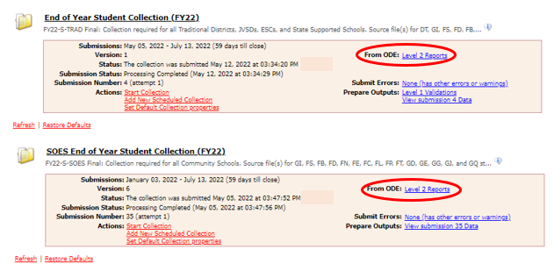
Level 2 Reports
WKC Reports are available in the Level 2 Reports link
Notes:
Clarify that the Level 2 Reports link is available after the collection is submitted and is processed by ODE overnight.

Slide 19
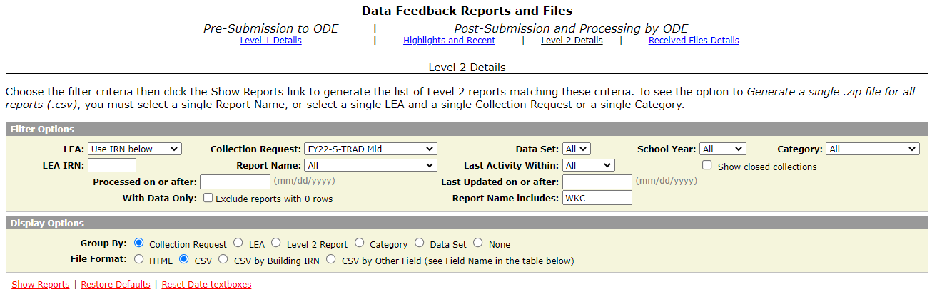
Generate and Open Level 2 Reports
Collection request FY22 S
TRAD Final or FY22 S SOES Final
depending on your LEA type
Tip: Narrow results by using
WKC in the filter “Report
Name Includes”
Select “Show Reports”
Notes:
A live demonstration of this process could be helpful to attendees. Verify that all attendees can accomplish this task during this session.

Slide 20
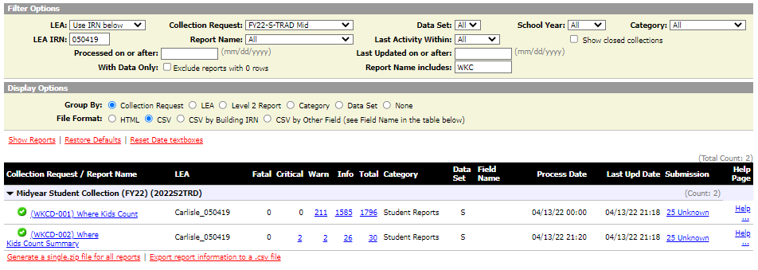
Generate and Open Level 2 Reports
Click on the link to download the ZIP file or download just the WKC reports
Notes:
A live demonstration of this process could be helpful to attendees. Verify that all attendees can accomplish this task during this session.

Slide 21
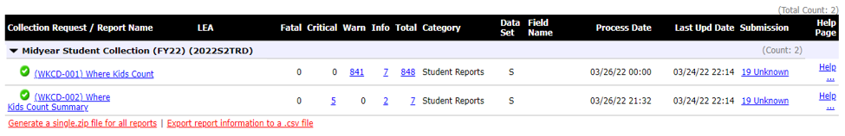
WKC Report Error Categories
WKCD-001 WKC Report can contain fatal, warning, and informational severity levels
WKCD-002 WKC Summary Report can contain critical, warning, and informational severity levels
Best practice is to open the entire report
and not focus on specific severity levels
Notes:
Error counts will appear on this page. Note that there are no critical errors on the WKC Report, and no fatal errors on the WKC Summary Report. Severity levels will appear in the report and are defined in this presentation with each result code. Note that the update date indicates the last time changes were made for that district’s report. The district could have submitted data multiple times and data could have been processed multiple times without there being any updates to the report.

Slide 22
Prepare the WKC Report
Prepare both WKC reports for analysis
  Select header row and wrap text
  Freeze top row
  Justify column width
  Apply filter
  Better yet, run your macro!
Notes:
Presenter use the (WKCD-001) Where Kids Count DEMO.xlsx and (WKCD-002) Where Kids Count Summary DEMO.xlsx file to demonstrate these steps. Attendees can prepare their own report as you demonstrate the Basic Excel steps.
Select top row and select Wrap Text from the Home Tab
While the top row is selected, from the View tab, select Freeze Panes and Freeze Top Row
Select entire spreadsheet (click cell between Row 1 and Column A) then place cursor on line between any two column headers and double click
While spreadsheet is highlighted, from the Data tab, choose Filter (or from the Home Tab select Filter)

Slide 23
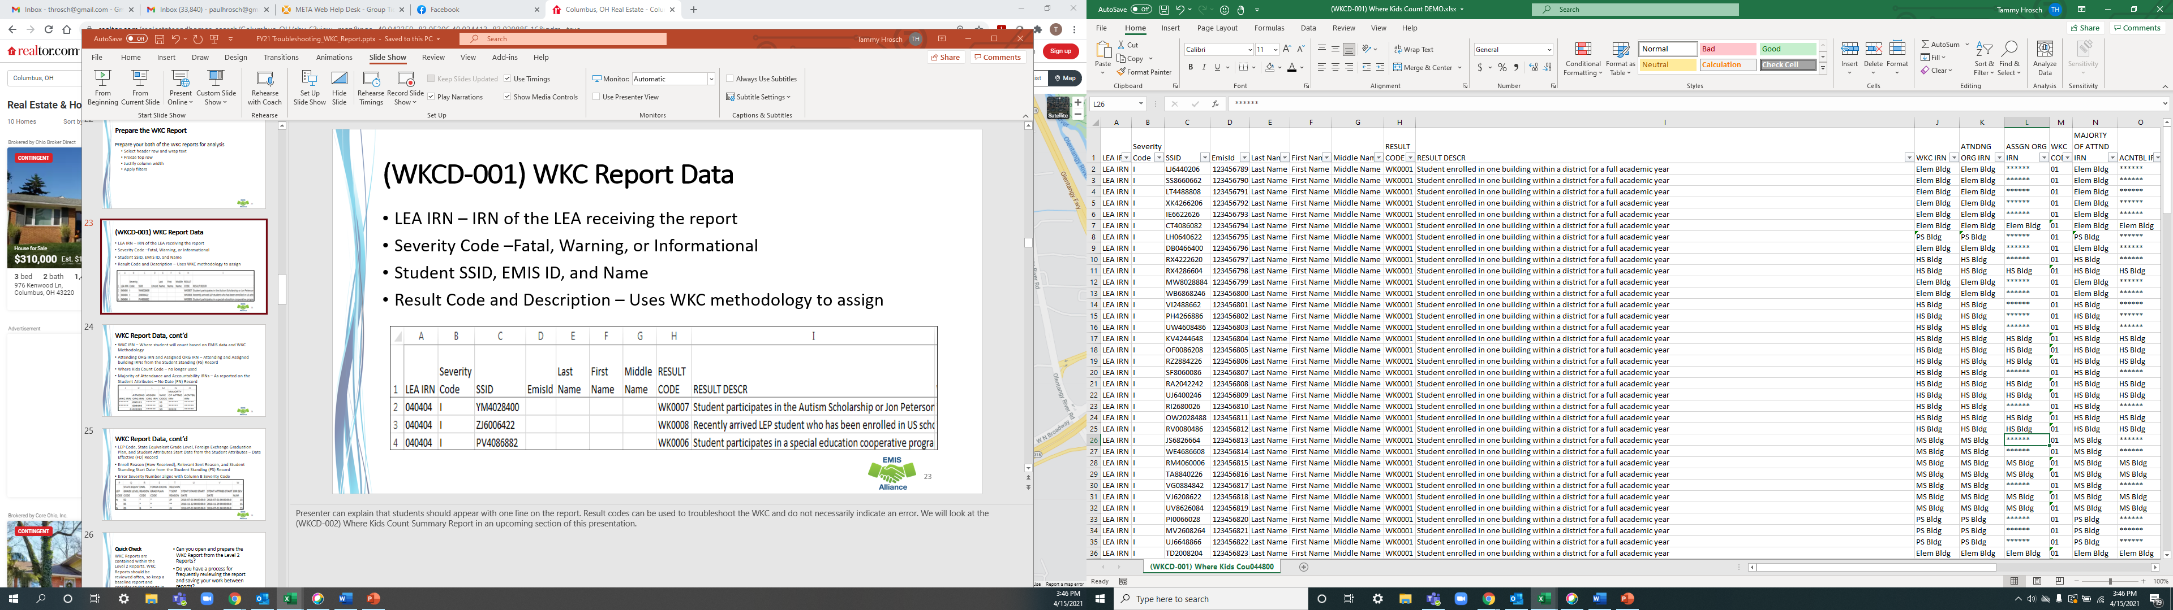
(WKCD-001) WKC Report Data
LEA IRN – IRN of the LEA receiving the report
Severity Code – Fatal, Warning, or Informational
Student SSID, EMIS ID, and Name
Result Code and Description – Uses WKC methodology to assign
Notes:
Presenter can explain that students should appear with one line on the report. Result codes can be used to troubleshoot the WKC and do not necessarily indicate an error. We will look at the (WKCD-002) Where Kids Count Summary Report in an upcoming section of this presentation.

Slide 24
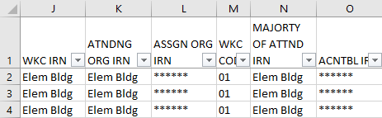
WKC Report Data, cont’d
WKC IRN – Where student will count based on EMIS data and WKC Methodology
Attending ORG IRN and Assigned ORG IRN – Attending and Assigned building IRNs from the Student Standing (FS) Record
Where Kids Count Code – no longer used
Majority of Attendance and Accountability IRNs – As reported on the Student Attributes – No Date (FN) Record
Notes:
The WKC IRN is calculated by ODE. The Attending ORG (building) IRN, Assigned ORG (building) IRN, and MOA IRN are as they are reported to EMIS.

Slide 25
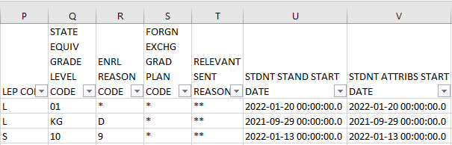
WKC Report Data, cont’d
English Learner (EL) Code, State Equivalent Grade Level, Foreign Exchange Graduation Plan, and Student Attributes Start Date from the Student Attributes – Date Effective (FD) Record
Enroll Reason (How Received), Relevant Sent Reason, and Student Standing Start Date from the Student Standing (FS) Record
Error Severity Number aligns with Column B Severity Code
Notes:
As we go through the upcoming slides, it will be explained how these elements are used in the WKC process. Note that the Error Severity Number column can be ignored if using the Severity Code column. (Error Severity no longer on the report).

Slide 26
Quick Check
Can you open and prepare the WKC Report from the Level 2 Reports?
Do you have a process for frequently reviewing the report and saving your work between reports?
Are you sharing this report with other district staff for verification purposes?
WKC Reports are contained within the Level 2 Reports. WKC Reports should be reviewed often, so keep a baseline report and consider saving reports in an Excel workbook for easy comparison as subsequent WKC Reports are reviewed.

Slide 27
Student Attending Situations and Where Kids Count

Slide 28
EMIS and Where Kids Count
Students can count at
  Educating Building
  Sending Building
  Resident District
  Educating District
  State Level
Students who count at a building will also count at the district and state levels
Students who count at the district level will also count at the state level
Students could count only at the state level
Notes:
This section will focus on EMIS Coding that is used in WKC calculations. Remember that we report first MOA and Accountability IRNs and then ODE applies the WKC rules based on the EMIS data reported

Slide 29
EMIS and Where Kids Count, cont’d
EMIS coding determines where students count
  WKC calculations are based on the student’s Student Standing (FS) and Student Attributes – Effective Date (FD) Records as of March 31
A student may have an MOA IRN of a building or district but still get rolled up to only the state level because of their attending situation or Student Attributes – Date Effective (FD) Record elements
Notes:
If a student has multiple FS or FD records, the records that are active on March 31 will be used.

Slide 30
Records and Elements
Elements critical in determining where kids count-
  Student Standing (FS) Record
    District Relationship
    Effective Start Date
    How Received
    Sent Reason
  Student Attributes – Date Effective (FD) Record
    Foreign Exchange Student Graduation Plan
    English Learner
    State Equivalent Grade Level
  Student Attributes – No Date (FN) Record
    Accountability IRN
    Majority of Attendance IRN
Notes:
It is important that EMIS data as referenced in this slide is correct as it will have an impact on where kids count in your LEA.

Slide 31
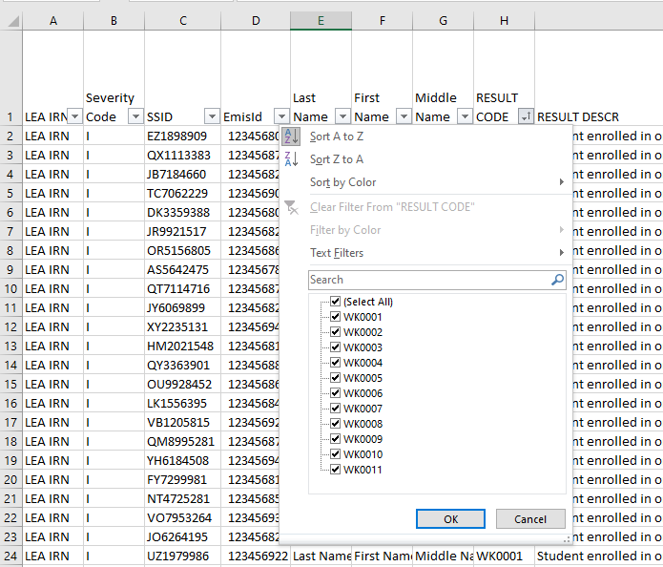
Troubleshooting WKC IRNs and Result Codes
Filter on the WKC Result Code column
The DEMO files contains 11
Possible Result Codes
Notes:
Presenter – the following slides will discuss each result code. Attendees can filter on the result codes to work through their own report.

Slide 32
Not Enrolled for a FAY
Result Code WK0004
  MOA IRN = ******
  WKC IRN = ******
  Severity Code = Warning
    Student is not enrolled in either a building or a district for a FAY
    Includes students with How Received codes
      6 - In-state Student Attending Nonpublic School
      I - Student receiving non-instructional, supplementary or related services
    Student counts at the state level
    A significant number of students with a MOA IRN of ****** will generate the General Issues error IS0027 Majority of Attendance – Roll-up to the State
Notes:
Remind districts to verify this data carefully. Since some SISs require a process to be run to update MOA IRNs while other SISs create them automatically. Be sure that students with result code WK0004 truly were not enrolled for a FAY. If an LEA discovers that their MOA IRNs are not populated correctly, data should be updated, resubmitted, and processed by ODE overnight for the WKC Report to be updated and ready for troubleshooting.

Slide 33
Not Enrolled for a FAY - Exception
Result Code WK0004
  MOA IRN = ******
  WKC IRN = ******
  Severity Code = Warning
    Student is enrolled in either a building or a district and could meet FAY
    DOR has reporting responsibilities, but the student will not graduate from that district, the student remains in this situation for the entire school year (open enrolled out, foster court placed out, etc..)
      Includes Sent Reason codes FC, OE, FP, 64, etc.
    Student does not qualify for other Result Codes during the WKC process
    Student will appear to count at the state level, however the student will appear differently for the educating district based on their reporting
Notes:
This is “NOT NEW” the WKC has always functioned this way. The above information is not in the WKC explanation updated information was published back in July 2015 in an EMIS Newsflash. The WKC report is a verification report and must show all students the district is reporting to ODE, regardless if the student will be included in the accountability situations. There is not a specific Result Code for this situation so WK0004 is used.

Slide 34
No WKC IRN
Result Code WK0010
  MOA IRN = No valid value reported
  WKC IRN = ??????
  Severity Code = Fatal
    Fatal error because no MOA IRN was reported and no WKC IRN value can be assigned
    Student will not be included in any accountability calculations
    Can occur in the case of a summer withdrawal who is assigned to the state calendar (See FTE Detail report)
      Correct EMIS reporting so that the student is assigned to a district calendar on the FTE Detail report
Notes:
Some SISs will not allow the FN record to be saved without an MOA IRN value being reported which will make this result code uncommon.

Slide 35
Count at Educating Building
FAY and percent of time greater than zero (District Relationship = 1) and How Received
  * - Not Applicable
  3 - In-state, non-resident, non-tuition, non-contract student (unauthorized student)
  7 - Non-resident residing with grandparent (ORC §3313.64)
  8 - Non-resident senior year
  9 - Non-resident open enrollment student
  A - Non-resident student, parent is a district employee (ORC §3313.64)
Notes:
Regular resident students, superintendent’s agreements in, open enrollment in, all count where they are being educated.

Slide 36
Count at Educating Building cont’d
FAY and percent of time greater than zero (District Relationship = 1) and How Received
  C - Foster placed
  D - Court Placed non-Foster
  G - Foster Placed student who open enrolls into a third LEA
  J - Non-foster student placed under program of the county children and family services department, without court involvement
  R - Jon Peterson Scholarship Program participant
  S - Superintendent’s Agreement
  W - Non-resident attending under Title 1 Public School Assistance
  Y - Placed in DYS (reported by DYS)
Notes:
Court, foster, and county placed students count where they are being educated. For How Received of R, this situation would occur when an EMIS reporting entity is a Jon Peterson Scholarship provider. These students count at the educating building.

Slide 37
Count at Educating Entity
FAY and How Received
  M - Student attending a community school
Conversion Community School
  Students also count in the sponsoring traditional district’s accountability calculations unless the school is designated as a dropout recovery and prevention school
Start-up Community School
  Students will not be included in the traditional district’s accountability calculations unless the community school and traditional school district where the school is located have filed a “District Roll Up of Affiliated New Startup Community School’s Performance Data, Fiscal Year 2022” form available through the Office of Community Schools
Notes:
Contact information for the Office of Community schools is, community.schools@education.ohio.gov or call 614-466-7058.

Slide 38
STEM Students
STEM “district” is similar to a community school
  Count at educating STEM district and resident district
  If enrolled for FAY and How Received
    K - Student attending a STEM district
STEM “school” is a building within a traditional district
  Count at STEM school (building and district)
  Do not count back at the resident district
  If enrolled for FAY and Reported as a Non-resident
Notes:
STEM building students do not appear on the DORs WKC Report.

Slide 39
Count at Sending Building or District
FAY and Sent to
  CT - Contract Career Technical Education
  CR - Resident District Career Technical Education Participant Reported by community schools only and counts at the community school
  ES - Educational Service Center Preschool Program Participant
  JV - Joint Vocational School District Participant
  MR - BDD/MRDD Program Participant
  NP - Non-public school placement at district expense
  OS - State School (OSB/OSD) Program Participant
  PI - Proprietary Institution Program Placement
  PS - College Credit Plus Program Participant
Notes:
If the sending LEA has only a district IRN, then the district IRN will appear.

Slide 40
One Building for FAY
Result Code WK0001
  MOA IRN = Building IRN
  WKC IRN = Building IRN
  Severity Code = Informational
    Student is enrolled in one building within a district for a FAY
    Student counts at the building where the FAY criterion is met
    Student also counts at the district and state levels
    Verify that the student is being reported correctly
Notes:
This should be a common result code for the attendees from traditional districts.

Slide 41
FAY and Accountability IRN
Result Code WK0002
  MOA IRN = Attending Building IRN
  Accountability IRN = Accountable Building IRN
  WKC IRN = Accountable Building IRN
  Severity Code = Informational
    Student enrolled in one building within a district for a FAY, but district has determined that the student should be included in another building within the reporting district for accountability purposes
    Accountable building IRN should match the Assigned Building IRN on the Student Standing (FS) Record
    Student counts at the building indicated in the Accountability IRN by the educating entity and counts at the district and state levels
Notes:
An example would be a district with two elementary buildings and all students with disabilities attend elementary A regardless of their assigned building. Students who are assigned to elementary B but attend elementary A because they are special education can be reported with an Accountability IRN of building B.

Slide 42
FAY and Multiple Buildings or District Only IRN
Result Code WK0003
  MOA IRN = District IRN
  WKC IRN = District IRN
  Severity Code = Informational
    Student is enrolled in the district for a FAY and changes from one building to another within the district
    Student counts at the district level and state level
    ESCs, Community schools, and STEM districts will see this code since they have a district IRN and not a building IRN
Notes:
An example of this would be a student who moved to a different location within the district and based on their address, their assigned building changed. The student did not withdraw from the district, they just changed buildings within the district.

Slide 43
Institutional Placement
FAY and How Received
  P - Court Placed students, excluding foster care and facilities defined by ORC §2151.65 or §2152.41
  Q - Court Placed students, facility defined by ORC §2151.65 or §2152.41, reporting district is educating
  T - Student placed in non-court ordered institutions
  Also includes situations where students are reported with How received of P, Q, or T along with a Sent to value of CT, JV, MR, OS, or PS

Slide 44
Institutional Placement - Count at State Level
Result Code WK0005
  MOA IRN = Building IRN, District IRN, or ******
  WKC IRN = ******
  Severity Code = Informational
    Student is placed into an institution either via court placement or parental placement as of March 31
    Student counts at the state level

Slide 45
Special Education Cooperative
FAY and How Received
  B - Non-resident student attends a district Special Education Program
  Includes students reported with a How Received code of B along with a Sent to code of CT, JV, MR, OS, or PS
This situation is specific to special education students who attend a special education program in another school district and is not applicable to ESC special education units
Notes:
CT – Contract Career Technical Education Participant
JV – Joint Vocational School District Program Participant
MR – BDD Program Participant
OS – State School (OSB or OSD) Program Participant
PS – College Credit Plus Program Participant

Slide 46
Special Education Cooperative - Count at Resident/Sending District
Result Code WK0006
  Educating District MOA IRN = Building IRN
  Resident/Sending District WKC IRN = District IRN
  Severity Code = Informational
    Student participates in a special education cooperative program in another district and is in the educating district for a FAY
    Student counts in the resident/sending district
    Will appear on both entity’s reports based on the educating district’s data
    Counts at educating district for the AMO participation rate calculation
    Counts at resident/sending district for all other accountability calculations

Slide 47
Scholarship Students Count at State Level
Sent to
  AU - Autism Scholarship Program Participant
  JP - Jon Peterson Scholarship Program Participant
    In this situation the Jon Peterson Provider is not an EMIS reporting LEA
Result Code WK0007
  MOA IRN = ******
  WKC IRN = ******
  Severity Code = Informational
    Student participates in Autism, Jon Peterson Scholarship, counts at state level
    Autism Scholarship and Jon Peterson Scholarship students educated by a non-EMIS reporting entity also count at the state level

Slide 48
English Learner
FAY and English Learner (EL) Status L or S
  L - EL Enrolled in U.S. Schools for first time (1 to 180 school days)
  S - EL Enrolled in U.S. Schools for 2nd Year (181 to 360 school days)
  A recently arrived EL student who has been enrolled in U.S. schools no more than 2 school years will be removed from all proficiency calculations
  EL students must be tested in all subjects and must take the Ohio English Language Proficiency Assessment (OELPA)
  Students who exit EL will be included in the EL subgroup for up to 4 years after they exit
Notes:
Timelines of the reporting of EL codes is a district responsibility and should be closely monitored as they can affect funding and accountability.

Slide 49
Some English Learners- Count at State Level
Result Code WK0008
  MOA IRN = Building IRN, District IRN, or ******
  WKC IRN = ******
  Severity Code = Informational
    Recently arrived EL student who has been enrolled in US schools less than 2 years when English Learner(EL) = L or S
    Student counts at the state level

Slide 50
Foreign Exchange
Foreign exchange students
  Grade 10 in U.S. less than 180 days (FD190 not *)
  Grade 11 and 12 in U.S. less than 180 days, does not plan to graduate in Ohio (FD190 is N)
Foreign Exchange Student Graduation Plan (FD190) valid options
  * - Not applicable (student is not a foreign exchange student)
  L - Foreign exchange student plans to graduate in Ohio but leave the United States after graduation
  N - Foreign exchange student does not plan to graduate in Ohio
  S - Foreign exchange student plans to graduate in Ohio and stay in the United States after graduation
Notes:
Note that FD190 is the Foreign Exchange Graduation Plan. Explain the FD190 values as they relate to the student situations in the first two bullets. For example, Grade 10 foreign exchange students in the US less than 180 days must have a Foreign Exchange Graduation Plan of L, N, or S to count at the state level. Grade 11 and 12 students who are in the U.S. less than 180 days and are reported with a Foreign Exchange Student Graduation Plan of N – Foreign exchange student does not plan to graduate in Ohio.

Slide 51
Some Foreign Exchange - Count at State Level
Result Code WK0009
  MOA IRN = Building IRN, District IRN or ******
  WKC IRN = ******
  Severity Code = Informational
    A recently arrived foreign exchange student who has been enrolled in U.S. schools less than 180 school days and does not plan to graduate in Ohio
    Student counts at state level
    If SSID is found in a prior year’s database, the foreign exchange student will count at the building

Slide 52
Student Court Placed Out of State - District Responsible for Cost
Result Code WK0011
  MOA IRN = ******
  WKC IRN = ******
  Severity Code = Informational
    The student will count at the state level
    The district should be funded for the student, but the student will not be part of the district’s accountability
    The student must be reported as Sent to CO – Court placed out of state, LEA is responsible for paying cost of education, for a time period that spans over March 31

Slide 53
Quick Check
Have Student Standing (FS) and Student Attributes – Date Effective (FD) Record elements been verified for accuracy?
Have WKC IRNs been reviewed for accuracy?
Are you saving your work for a baseline comparison to your previous report?
WKC Result Codes and WKC IRNs are assigned based on EMIS data. If the EMIS data reported is incorrect, the WKC Result Codes and WKC IRNs could be incorrect.

Slide 54
WKC Summary Report

Slide 55
(WKCD-002) WKC Summary Report
Contains a count of students by State Equivalent Grade Level and by Majority of Attendance IRN as reported
Compares the current year percentage to the prior End of Year Student Collection percentage
Includes by severity code, the amount of percentage change across both years
Example - Look for groups of students in a single grade level or demographic that are rolling up to the state, which could be an indication of incorrect data reporting
Notes:
Presenter can use (WKCD-002) Where Kids Count Summary DEMO.xlsx. It is important for LEAs to understand the importance of accurate reporting of Majority of Attendance IRNs based on FAY criteria. If MOA IRNs are misreported, there can be an impact of that inaccurate reporting on accountability calculations. Seeing the data in a year-to-year comparison could reveal inaccuracies in reporting.

Slide 56
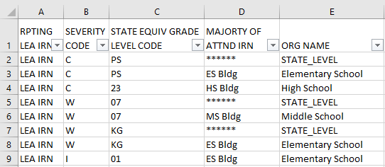
(WKCD-002) WKC Summary Report Data
Reporting LEA IRN – IRN of the LEA receiving the report
Severity Code – Critical, Warning, or Informational
State Equivalent Grade Level as reported by the LEA
Majority of Attendance IRN as reported by the LEA and Org Name
Notes:
Presenter can discuss the column headers and contents of each column. We will discuss the Severity Code determination in an upcoming slide.

Slide 57
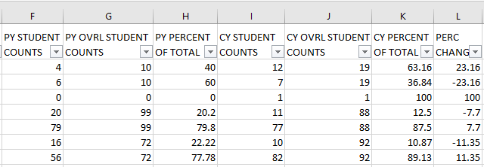
Student Counts
PY (Prior Year) and CY (Current Year) Student Counts are a total by each unique combination of grade level and MOA IRN in each row
PY and CY Overall Student Counts are all students in that grade level

Slide 58
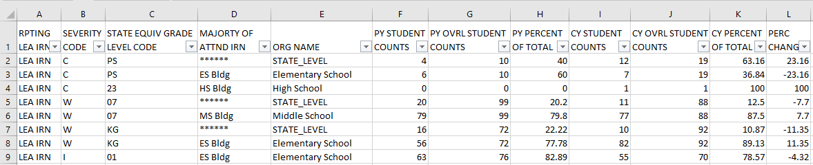
Percent of Total
PY and CY Percent of Total values are calculated by dividing the Student Count by the Overall Student Count
In the first row, 4 divided by 10 equals 40% for the prior year and 12 divided by 19 equals 63.16% in the current year

Slide 59
Percent Change
Percent Change is calculated by subtracting the PY Percent of Total from the CY Percent of Total
In the first row, CY Percent of Total of 63.16% minus PY Percent of Total, 40% equals a Percent Change of 23.16%

Slide 60
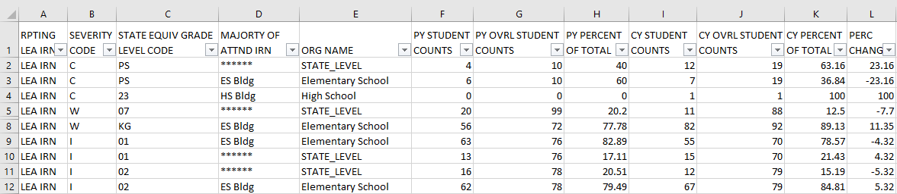
Percent Change and Severity Code
Severity Codes are determined by the Percent of Change
  Critical – Positive or negative change greater than 19.99%
  Warning – Positive or negative change between 7.51 and 19.99%
  Informational – Change between -7.5% and 7.5%

Slide 61
Analyzing the WKC Summary Report
Compare prior year to current year to identify potential reporting issues
  What could be the reason for the critical severity codes for grades PS and 23?
  What could be causing the warning severity codes for grades 07 and KG?
  A large percentage change could be an indication of a data reporting issue.
Notes:
The critical severity codes for grades PS could be caused by incorrect MOA IRNs being reported in the current year counting towards the state level or a change in enrollment numbers. Grade 23 critical severity code is probably due to no grade 23 students enrolled in the Previous Year and the district now has a grade 23 student in Current Year. The warning severity codes for 07 grade could be caused by an decrease in enrollment in the Current Year counting towards the state level. The warning severity code of KG appears to be an increase of enrollment at the elementary school level. What else should we look at? Does the data make sense? Did a building open or close? Did a building’s population increase or decrease significantly? Was data misreported last year?

Slide 62
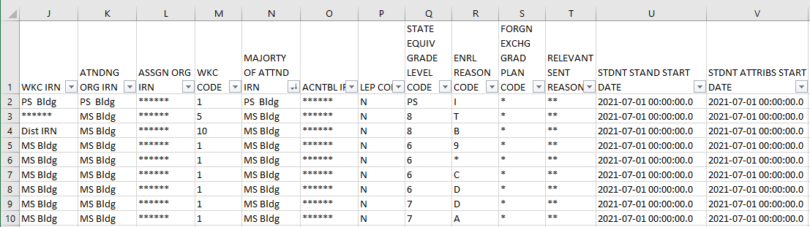
Current Year Data
Filter on the (WKCD-001) Where Kids Count Report to drill down to students in each row of the (WKCD-002) Where Kids Count Summary Report
Filter by Majority of Attendance IRN and State Equivalent Grade Level to see student level WKC data
(WKCD-001) Where
Kids Count Report
Notes:
Presenter can suggest that districts filter their current year (WKCD-001) Where Kids Count Report if they are questioning the quantities of students who are appearing on the (WKCD-002) Where Kids Count Summary CY columns.

Slide 63
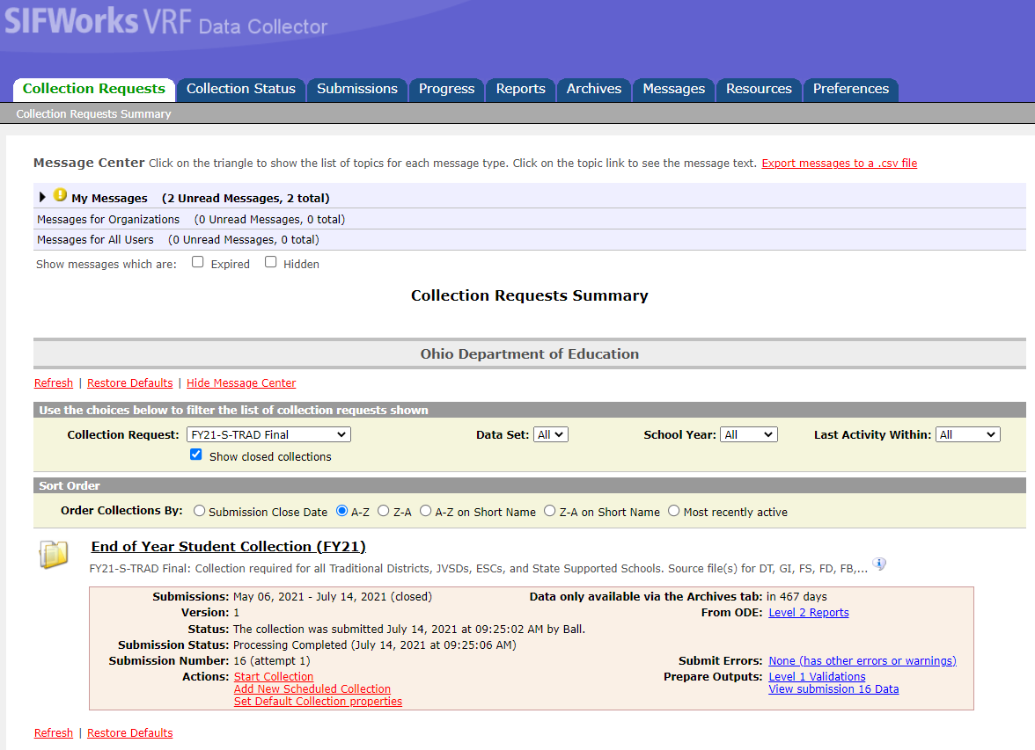
Prior Year Data
Prior year WKC Report can be found on the Collection Request Tab
Select “Show closed collections”, then select the Final S-Trad or Final S-SOES for the prior fiscal year
Once the collection is no longer
Available on the Collection Request
tab, the WKC report will be available in
the Archive tab
WKC Report is available
In the Level 2 Reports Link
Notes:
Filtering on the prior year WKC Report will reveal the students who are included in the PY columns on the CY Summary report.

Slide 64
Summary
Where Kids Count rules are at the root of accountability calculations
Districts must accurately report EMIS data and verify that Where Kids Count data is correct and complete
Districts should verify accountability data in the Secure Data Center (SDC) once assessment data is loaded and available for review

Slide 65
Resources
Current EMIS Manual
  ODE Home > Topics > Data > EMIS > Documentation > EMIS Manual
Level 2 Report Explanations: Where Kids Count
  ODE Home > Topics > Data > EMIS > Documentation > EMIS Validation and Report Explanations
Technical Documentation Ohio’s Where Kids Count Business Rules
  ODE Home > Topics > Data > Report Card Resources
Your ITC

Slide 66
Questions?
If you would like a certificate of attendance for this
training, you must complete the below feedback form
within 5 business days of this training
https://tinyurl.com/EA-District-Feedback
Notes:
ITC Staff insert your contact information on this slide.

