Slide 1
Troubleshooting
FY22 Graduation Reports

Slide 2
The Ohio Department of Education funds development of EMIS training materials as part of the EMIS Alliance grant. There is an expectation that ITCs will utilize these materials in training provided to your districts. That said, there are restrictions on use of the EMIS Alliance materials as follows: Materials developed as part of the EMIS Alliance program must be provided at no cost to your training participants. If you utilize the EMIS Alliance training materials – in whole or in part – you must not charge participants a fee to attend the class where the materials are used. Likewise, you may not use the materials or any portion thereof in any event where a fee is charged to attend. Exceptions must be approved in writing by the Department of Education in advance of scheduling/promoting any event which may violate these restrictions.
Questions regarding appropriate use of EMIS Alliance materials, or requests for exception to the restrictions noted above, should be directed to Melissa Hennon [Melissa.Hennon@education.ohio.gov].

Slide 3
Outline
Overview of Reports and Requirements
  Level 2 Reports
    Newly Assigned to Grad Cohort Report
    Grad Cohort Year Status Reports
    CTE Grad Cohort Reports
    Grad Issues – Please Review Report
    Graduation Gen Issues Reports
  Received Files
    Graduation Cohort Pathway Reports
    RPTCRD CCWMRdy Report
Notes:
In this workshop we will discuss graduation reports and how to use them to verify student data and some graduation requirements. This is not a comprehensive graduate reporting training but rather a training on troubleshooting reports which focus on very specific EMIS data.

Slide 4
Overview
Graduation Reports
  Generated using EMIS data reported by traditional districts, JVSDs, community schools, and STEM schools
  Used to verify students have met certain graduation requirements as expected
  Available to LEAs who report graduates through the Graduate Collection
    JVSDs will receive the Level 2 CTE Grad Cohort reports (CTGR-XXX)
This presentation will focus on troubleshooting the reports to verify graduation data
Notes:
Attendees should have access to their reports and bring with them a list of their graduates. A student who is not appearing as expected could be missed if there is nothing to compare the reports to.

Slide 5
Graduation Reports
Can be used to verify –
  Student graduation cohort placement
  Withdrawal and diploma dates
  Graduation pathway data (not all pathways)
  Graduation accountability data
Graduation reports do not contain all data reported for graduates
Graduation data not contained within the reports should be verified for accuracy and completeness
Notes:
Pathway reports can be used to verify if students have met the EOC pathway, the ACT/SAT remediation free pathway, or the WK Industry Credential pathway.

Slide 6
Class of 2022 Graduation Requirements
Graduation requirements and options
  Are extensive and go beyond the scope of this training
    We will discuss specific parts of graduation requirements and options that are included as part of the current graduation reports
  Can be found by searching the ODE website for “Class of 2022 Graduation Requirements” or at this link
    http://education.ohio.gov/Topics/Ohio-s-Graduation-Requirements/Earning-an-Ohio-High-School-Diploma-for-the-Cl-2
Notes:
FY22 cohort students had the option of meeting FY22 grad requirements or meeting the FY23 and beyond grad requirements. Graduation Pathway reports are currently only checking for FY22 pathway requirements (EOC, ACT/SAT, WK/IC)

Slide 7
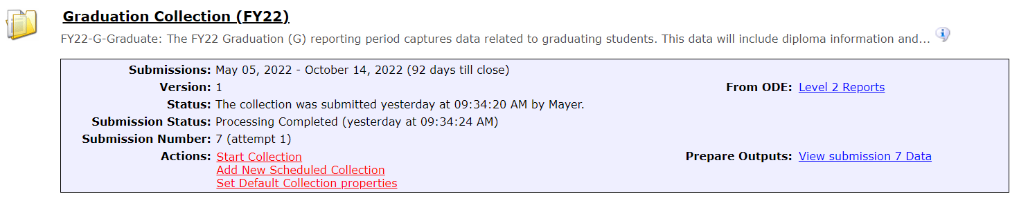
Accessing Graduation Reports
From the Data Collector Graduate Collection (FY22) select the Level 2 Reports link
Notes:
Encourage districts to look at their own graduate data during this workshop. We are going to show two locations to find graduate reports, Level 2 Reports and Received Files.

Slide 8
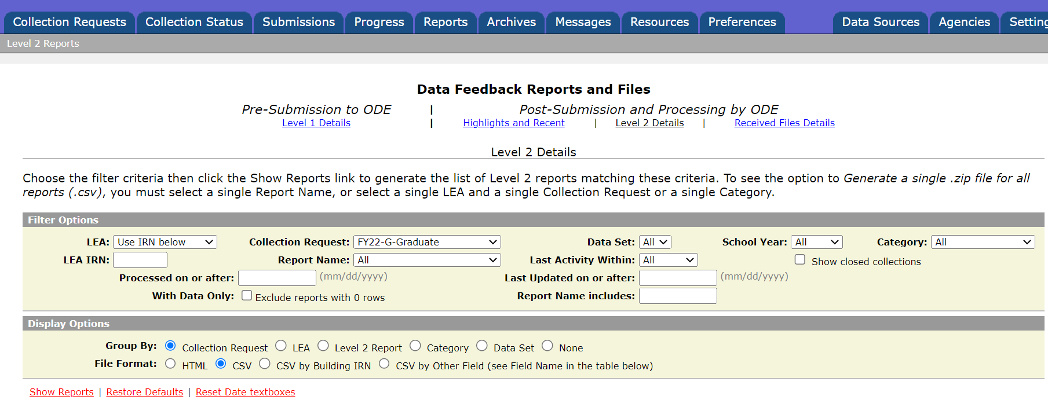
Level 2 Reports
You will land on the Level 2 Details page
and the Collection Request filter will be
set to “FY22 – G – Graduate”
Select “Show Reports”

Slide 9
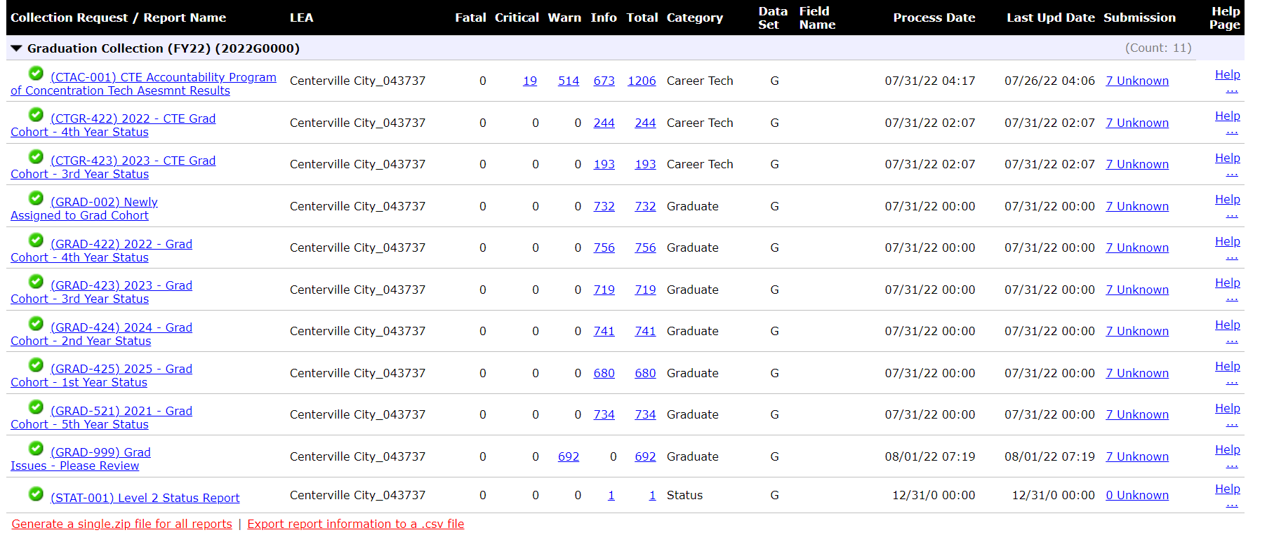
Level 2 Reports, cont’d
Your list of graduate reports
will vary from this example
The first report we are going to look at is the
(GRAD-002) Newly Assigned to Grad Cohort
Notes:
Attendees can generate a zip file of the reports if they like since this presentation will review many of the reports.

Slide 10
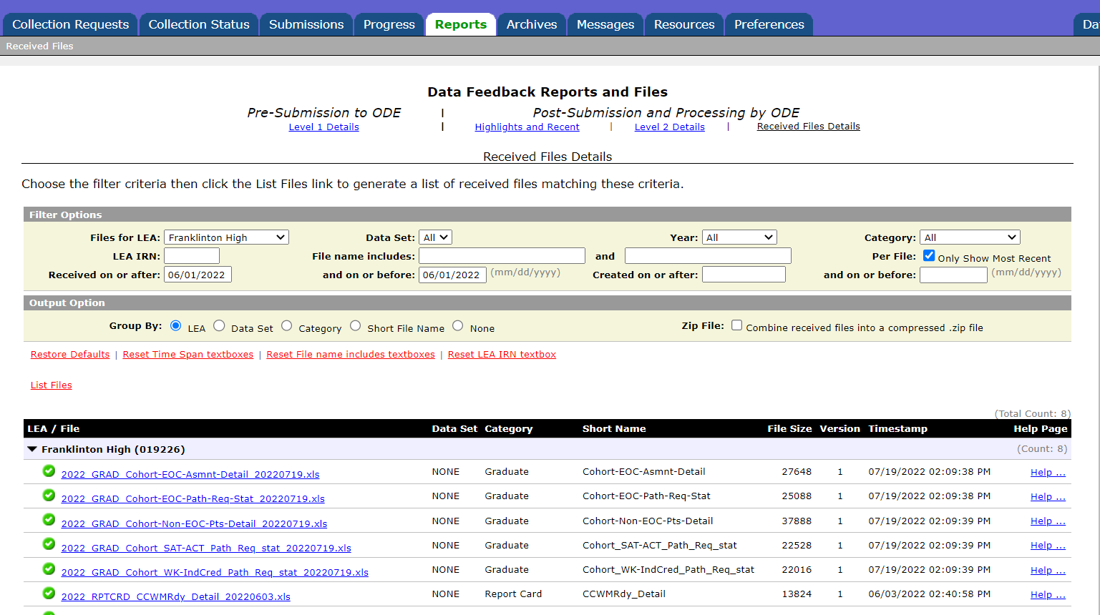
Received Files
On the Reports tab of the Data
Collector, select Received Files
Use filters to narrow the search for files
Select “List Files”
We will open received files
in an upcoming section of
this presentation
Notes:
A live demonstration of how to use filters and to show how the reports will be listed as chronological by year and then alphabetical by report name would be helpful.

Slide 11
Prepare the Report
Prepare your report for analysis
  Select header row and wrap text
  Freeze top row
  Justify column width
  Apply filters
  Better yet, use your macro!
  Use VLOOKUP to add names to Received Files
  See prior year versions of this presentation for step-by-step
  instructions
    https://community.mcoecn.org/display/EM/EMIS+Alliance+Public+Space
Notes:
Presenter use the (GRAD-002) Newly Assigned to Grad Cohort- DEMO
file to demonstrate these steps. Attendees can prepare their own report as you demonstrate the Basic Excel steps.
Select top row and select Wrap Text from the Home Tab
While the top row is selected, from the View Tab, select Freeze Panes and Freeze Top Row
Select entire spreadsheet (click cell between Row 1 and Column A) then place cursor on the line between any two column headers and double click
While spreadsheet is highlighted, from the Data tab, choose Filter (or from the Home Tab select Filter)

Slide 12
Quick Check
What are your district’s graduation requirements?
Who is monitoring student pathway progress?
Who in your district do you work with to validate this data?
Students in the class of 2022 have multiple ways to meet graduation requirements. EMIS data will be used to determine which pathway(s) the student meets. The graduation reports will aid in determining if EMIS data has been reported correctly.
Notes:
Think about your district’s own graduation requirements. Are these above the state minimum? Do you know who to talk to when validating graduation data?

Slide 13
Newly Assigned to Grad Cohort Report

Slide 14
Newly Assigned to Grad Cohort Report
Contains students that are being assigned to a graduation cohort during the first year they are assigned to any cohort
For FY22, students on the report would not have been in any graduation cohort for any district prior to FY22
Was previously available in the End of Year Student Collection and is now included in the Graduate Collection
Important to review while data collections are open if corrections need to be made
In some cases, a student’s placement into an incorrect cohort can be appealed depending on timing of data reporting and appeals
Notes:
All traditional districts, community schools, and STEM districts that graduate students receive the Newly Assigned to Grad Cohort Report. It is available as part of Mid-Year and End of Year Student (S) collections, and the Graduate (G) collection.
Data for this report is pulled from the Grad Cohort Status reports (but not the Grad Issues report). The report includes any student that has data in the ADD COHORT BY GRAD EVENT CODE column of the reports.
.

Slide 15
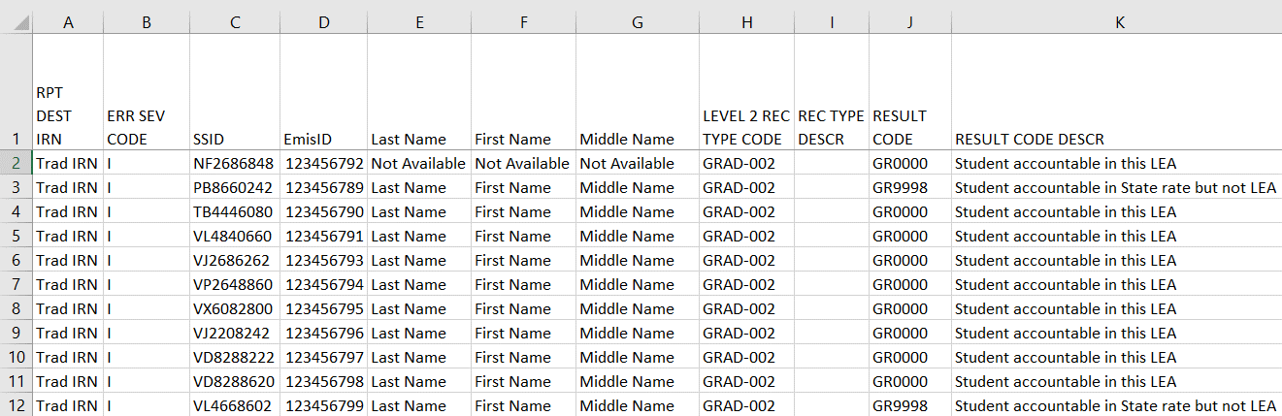
Newly Assigned to Grad Cohort, cont’d
A student with EMIS ID and Name
“Not Available” could be a STEM District
student for which your LEA is accountable
We will filter on Result
Codes in upcoming slides
Notes:
Presenter can use (GRAD-002) Newly Assigned to Grad Cohort DEMO and toggle between the PowerPoint and the DEMO file.
Columns are set up the same on the Newly Assigned to Grad Cohort Report and the Grad Cohort reports. We will discuss column headings in more detail in the upcoming Grad Cohort section.
If a student appears with EMIS ID and Name as “Not Available”, scroll to the right for the IRN of the entity reporting the student in the column titled “SRC LEA IRN”. We will cover this on the next slide.

Slide 16
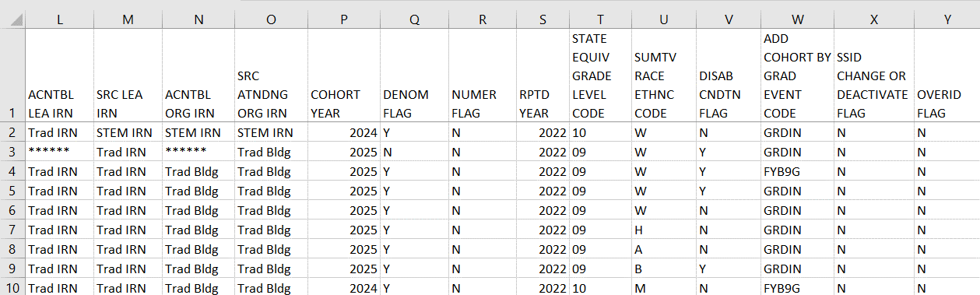
Newly Assigned to Grad Cohort, cont’d
Student added to the cohort based on grade
level = GRDIN, Student added using the Fiscal
Year Began 9th Grade Element = FYB9G
IRNs can be used to determine which
LEA is reporting the student
Denominator is set to Y when your
LEA is accountable. Numerator will
be N until the student is reported
with an on-time diploma
Note the appearance of a
STEM IRN. The STEM District and
Resident district are both accountable
Notes:
Since this data is scrambled, you see STEM District IRN. However, in an unscrambled file, you would see the actual STEM District IRN. Use OEDs to look up the IRNs, as necessary. Note that this example is a STEM District and not a STEM Building within a traditional district. Only STEM DISTRICT students count back to the resident district; STEM BUILDING students count at both the building and district at the educating district.
Column W-“Add Cohort By GRAD Event Code” will list how a student was added to a Grad Cohort (either GRDIN or FYB9G)
Grad Cohort determination- (confirmed with Roger Holbrook)
Fiscal Year Began 9th grade- used for students who were not reported by the district in a prior year. ODE looks backward one year for the SSID number.
GRDIN- State Equivalent Grade Level as of October 1 for students reported in a prior year by the district
Note that this report can include multiple cohort years.

Slide 17
Filter on Result Codes
Verify that all newly assigned students are appearing on the report as expected
Filter on Result Code GR0000 – Students who appear in the denominator for the district in their graduation cohort
  Verify the newly assigned students to be in the correct cohort
  Update EMIS data if appropriate and when collection is still open

Slide 18
Filter on Result Codes, cont’d
GR9997 – Student accountability moved to another LEA
  Example would be a student who transferred to another Ohio school district
GR9998 - Students who count at the state level
  Examples are Autism and Jon Peterson Scholarship students, and students who are placed into institutions (How Received P or T)
GR9999 – Students who have exited the cohort
  Example would be a student who moved out of state or withdrew to a non-public school
Notes:
Only Result Codes GR0000 and GR9998 appear on the DEMO file.

Slide 19
Quick Check
Can you verify that the cohort placements are correct for the students listed on the report?
Are all students appearing on the report as expected?
Are there any incorrect cohort assignments and can the data be changed, or appealed?
The Newly Assigned to Grad Cohort report can be very helpful in identifying students who have been assigned to a cohort during the current fiscal year. This can provide opportunities to make data corrections, or to file an appeal depending on timing.

Slide 20
Grad Cohort Year Status Reports

Slide 21
Graduation Cohort Year Status Reports
Reflect the status of students who have been assigned to a specific graduation cohort for graduation rate purposes
Contain student graduate data that should be verified for accuracy and completeness
Contain numerator and denominator data of the graduation rate for that cohort
Contain flags to indicate passage of graduation pathways
  Pathway data comes from the Cohort Pathway Reports in Received Files which are not updated nightly
Notes:
All traditional districts, community schools, and STEM districts that graduate students receive Grad Cohort Reports. They are available as part of Mid-Year and End of Year Student (S) collections, and the Graduate (G) collection.
Graduates reported in 22G could contain students from many different cohorts.
Cohort assignment is based on State Equivalent Grade Level as of October 1 if the student WAS reported in a prior year and Fiscal Year Began Ninth Grade if student WAS NOT reported in a prior year. Also see Cherwell ticket 2000306 for an additional example.
Grad Cohort determination- (confirmed with Roger Holbrook)
Fiscal Year Began 9th grade- used for students who were not reported by the district in a prior year. ODE looks backward one year for the SSID number.
GRDIN- State Equivalent Grade Level as of October 1 for students reported in a prior year by the district

Slide 22
Graduation Rates and the LRC
2022 four year and 2021 five-year graduation rates will appear on the 22-23 Local Report Card (LRC)
  2022 four-year graduation rate uses a denominator of students for which the district is accountable and a numerator of on time graduates
  2021 five-year graduation rate uses a denominator of students for which the district is accountable and a numerator of four year on time graduates plus students who graduated within five years

Slide 23
Graduate Collection Level 2 Reports
For LEAs Reporting Graduates
  (GRAD-422) 2022 - Grad Cohort - 4th Year Status
  (GRAD-423) 2023 - Grad Cohort - 3rd Year Status
  (GRAD-424) 2024 - Grad Cohort - 2nd Year Status
  (GRAD-425) 2025 - Grad Cohort - 1st Year Status
  (GRAD-521) 2021 - Grad Cohort - 5th Year Status
For Dropout Prevention and Recovery (DPR) Schools Only
  (GRAD-620) 2020 - Grad Cohort - 6th Year Status
  (GRAD-719) 2019 - Grad Cohort - 7th Year Status
  (GRAD-818) 2018 - Grad Cohort - 8th Year Status
Notes:
Note that the report names contain a number that represents the graduate measure length (4-year, 5 year, etc.) with the cohort graduation year (22, 23, etc.) Grad-422 represents the 4-year graduate rate for the cohort year of 2022. This section of the presentation is going to focus on the 4-year graduation rate for the class of 2022 however, all reports should be reviewed.
DPR- Dropout Prevention and Recovery School

Slide 24
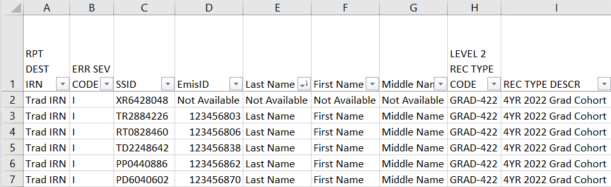
Grad Cohort Report Columns
Columns A through G contain the IRN of the LEA receiving the report, Error Severity Codes, Student Names and Student IDs
  “Not Available” in the name columns indicate a student that the district is accountable for, not currently reporting to EMIS such as a STEM District student
All Error Severity Codes are Informational
Columns H and I contain
the name of the report
Notes:
Presenter can use (GRAD-422) 2022 – Grad Cohort- 4th Year Status DEMO
To identify the students with names listed as “Not Available”, also look at the SRC LEA IRN in column M (not viewable on this slide) to identify who is educating the student. Look the IRN up in OEDS to identify the educating entity.
Only STEM District students count back to the resident district; STEM building students count at both the building and district at the educating district. Level 2 Record Type Code, and Record Type Description columns contain the same value for all students on the report.

Slide 25
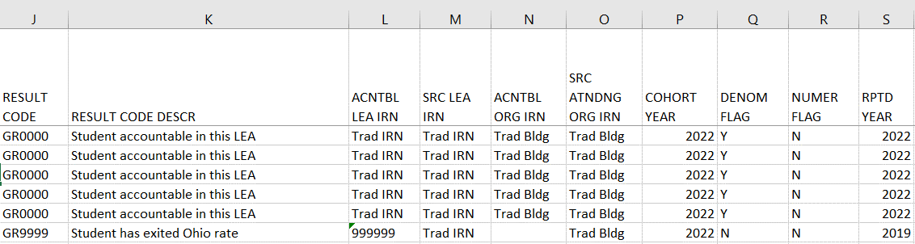
Grad Cohort Report Columns, cont’d
Columns J through S contain Result Codes, IRNs, cohort year, graduation rate denominator and numerator values, as well as the year the student was reported
Verify cohort year is correct
LEA accountable for this student
LEA whose data is being used
Numerator Y’s divided by Denominator
Y’s will produce the graduation rate
Notes:
We will review each result code in upcoming slides. We will also show how to sort to get to the graduation rate.
Note that the ACNTBL LEA IRN and SRC LEA IRNs (columns L and M) are district level IRNs while the ACNTBL ORG IRN and SRC ATNDING ORG IRN (columns N and O) are building level IRNs. Note that the SRC ATTNDG ORG IRN could be a district level IRN IF the district is reporting a district level IRN on the FS 160 (Attending Building IRN element). The report displays what is reported, no manipulation or conversion is done. –Per Chad Richardson at ODE
EMIS Manual- section 2.1
Districts should only report a district IRN in the FS 160 (Attending Building IRN element) field if one of the following How Received situations applies-
6- In State Student Attending Non-Public School
F- Student Receiving Career Assessment Services Only
I- Student Receiving non-instructional, supplementary or related services
P- Court Placed students, excluding Foster Care
T- Students placed in Institutions, Non- court ordered

Slide 26
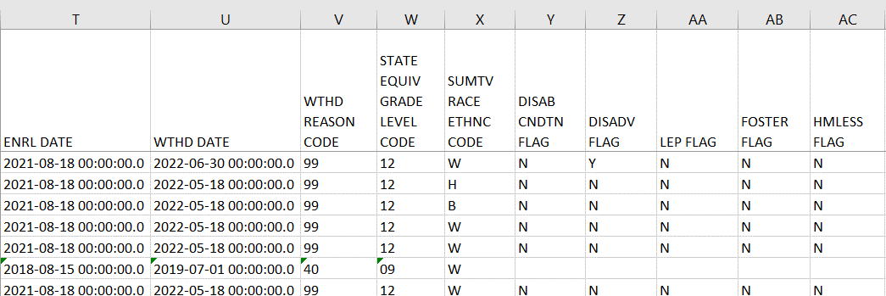
Grad Cohort Report Columns, cont’d
Columns T through AC contain enrollment and withdrawal dates, withdrawal codes, along with demographic and Student Attribute - Date Effective Record (FD) values
Accountability calculations for the graduation rate use the most recently reported disadvantagement
data. Students reported with a Disability, LEP, Foster, or Homeless code at any time once they begin 9th
grade or are newly added to a cohort, will be included for accountability calculations.
Notes:
We will discuss withdrawal codes in depth in upcoming slides. Note that if a graduate is not reported with a withdrawal code of 99, the withdrawal date and withdrawal code could appear as blank, or a prior withdrawal code could appear.
Columns X - AC have been added due to additional accountability calculations that will be used as part of the graduation rate on the Local Report Card.

Slide 27
Class of 2022 Graduation Pathways
Grad Cohort Year Reports look at these three specific pathways from the Grad Cohort Pathway Reports
  Ohio’s State Test Pathway
  College and Career Readiness Tests Pathway
  WorkKeys and Industry Credential Pathway
Grad Cohort Year Reports do not look at the FY23 pathways from these reported program codes
  520100 - Alternative Competency College Credit Plus Requirement Met- Math and English CCP
  520101- Alternative Competency College Credit Plus Requirement Met- English CCP Only
  520102- Alternative Competency College Credit Plus Requirement Met- Math CCP Only
  520105 - Alternative Competency Career Experience and Technical Skill Requirement Met
  520110 – Military- Intent to Enlist
Notes:
Note that graduation data including graduation seals are reported to EMIS but are not included in the graduation reports in FY22.
Pathway reports do not reflect graduation requirements for the Class of 2023 and beyond. Information related to those graduation requirements will be included in ODDEX in the coming months.

Slide 28
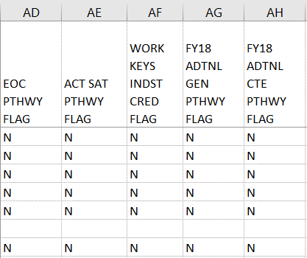
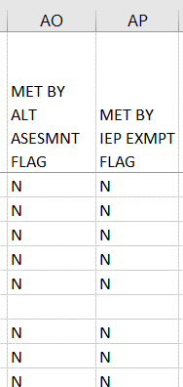
Grad Cohort Report Columns, cont’d
Columns AD through AH and columns AO and AP contain Pathway data and Met By data
Grad Cohort reports are generated
nightly however, pathway flags and “met by” columns are kept in sync with the pathway reports found in Received Files. These values will be updated when the pathway reports are updated.
Students reported with additional graduation Pathway program codes will NOT appear as Y
Note that students with a “Y” in this column will not appear on the Pathway reports
Notes:
Columns AD-AF are updated whenever Pathway Files are updated. Pathway files are received files which are not updated nightly. This section of the report can be out of sync with reported grad data used for grad cohort reports and may not indicate the latest reported grad data.
Columns AG and AH indicate “FY18”, however these additional pathways apply to prior year graduates. These columns refer to Alternative Pathway codes 520001 Student expected to graduate in the Class of 2018 or 2019 has completed additional graduation option 1 (non-CTE focus), 520002 Student expected to graduate in the Class of 2018 or 2019 has completed additional graduation option 2 (CTE focus).’ 520021 Student expected to graduate in the Class of 2020 has completed additional graduation option 1 (non-CTE focus)., 520022 Student expected to graduate in the Class of 2020 has completed additional graduation option 2 (CTE focus).
Cherwell ticket 104928
“You are correct, those flags are only getting updated for students who are prior year graduates. We need to make changes to the report, either removing those flags entirely or updating the logic to include the new program codes....but that decision has not yet been made.
Thank you,
Chad”
We will review graduation pathway reports in upcoming sections.
For columns AO and AP, if there is a 'Y' in either one of the columns and all other Pathway Flags are 'N' the student will not count as a graduate in the Federal Grad Rate for that cohort (even if the Numerator column = 'Y’). For the federal graduation rate, we look to see if alt assessed students or students who meet by exemptions have met any of the pathways just like “typical” students. If they have, they count as a graduate in the federal rate. If they have not, then they are not counted as a graduate in the federal rate. Essentially, all graduates in the federal rate must meet requirements made available to all students and cannot be counted as a graduate if they are graduating solely based on exemptions or other alternative options available only to students with disabilities.

Slide 29
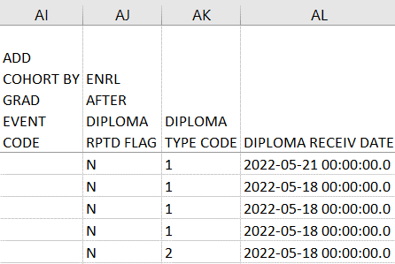
Grad Cohort Report Columns, cont’d
Columns AI through AL contain cohort placement, enrollment after diploma reported and diploma data
Add Cohort by Grad Event Code
“GRDIN” –based on grade level
“FYB9G” –based on fiscal year
began ninth grade “Blank”
indicates the student was not
assigned to a cohort during this
fiscal year
Verify Diploma
Date – See Slides 65-66
If Y for “Enrolled after Diploma
Reported”, verify data for accuracy
Review diploma type for accuracy
as it is used in the generation of
the new CCWMRdy report
Notes:
When questioning placement into a cohort, use the Cohort placement value in ODDEX to investigate. Typically, cohort changes are not possible unless the collection is still open to report corrected data. An appeal (when open) could be filed to request a cohort placement change, however, there is no guarantee that the situation would qualify for an appeal. Also review column AK, Diploma Type Code for accuracy since honors diplomas are included in the CCWMRdy report.
Column AI- “Add Cohort By GRAD Event Code” information will appear on the cohort report if the student was added to that cohort report during the year the report was generated otherwise the value will be blank.
Cohort assignment is based on State Equivalent Grade Level as of October 1 if the student WAS reported in a prior year and Fiscal Year Began Ninth Grade if student WAS NOT reported in a prior year. Also see Cherwell ticket 2000306 for an additional example.
Grad Cohort determination- (confirmed with Roger Holbrook)
Fiscal Year Began 9th grade- used for students who were not reported by the district in a prior year. ODE looks backward one year for the SSID number.
GRDIN- State Equivalent Grade Level as of October 1 for students reported in a prior year by the district

Slide 30
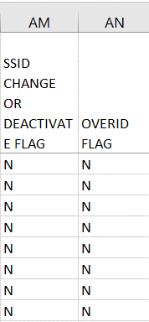
Grad Cohort Report Columns, cont’d
Columns AM and AN contain SSID changes and override flags
When a student has an SSID change or
deactivated SSID, the flag will be set to Y
  In ODDEX Grad Cohort the student’s event code will be-
    SIDCH – SSID Change – New SSID
    SIDPV – SSID Change – Previous SSID
    SIDDC – SSID Deactivation – New Current SSID
    SIDDP – SSID Deactivation – Previous SSID
When a student has an approved appeal involving graduation
data, the Override Flag will be set to Y
  In ODDEX the Override Related Flag will be set to Y

Slide 31
Where Students Count for Graduation
In the next series of slides, we will filter on each result code and discuss each situation
  Currently there are four result codes which indicate where the student will count for accountability measures
    Count in a district
    Not count in any district or at the state level
    Count at the state level
    Count in a different district
  We will show how the student looks in ODDEX as we look at each result code
Notes:
All current result codes are informational, however they should be verified for accuracy

Slide 32
Result Codes and the Graduation Rate
Count in this LEA’s graduation rate
  GR0000 Student accountable in this LEA
  Students the LEA is educating and or responsible for educating
  Students who are sent to a Special Education Coop
    Sent to SE
  STEM District students count back to the resident district
    STEM Building students count at both the building and district at the educating district
  Denominator Flag is set to Y for these students
Notes:
Are these students appearing as expected? Are there any students expected to be counting for the district that are not?
STEM District/ STEM Building- The law changed in 19-20 as to where students count who are educated at STEM buildings that are part of a traditional district

Slide 33
Result Codes and the Graduation Rate, cont’d
Do not count in this LEA’s Graduation Rate
  GR9997 Student accountability moved to another LEA
    41 Transferred to Another Ohio School District
    Could be other withdrawal code or blank
  GR9998 Student accountable in State rate but not LEA
    Jon Peterson or Autism Scholarship student
    How Received P, Q, or T
  GR9999 Student has exited Ohio rate
    40 Transferred to Another School District Outside of Ohio
    42 Transferred to a Private School
    43 Transferred to Home Schooling
    46 Transferred out of the United States
    52 Death
  Denominator Flag is set to N for these students
Notes:
How Received-
P Court-Placed Students, Excluding Foster Care and facilities defined by ORC §2151.65 or §2152.41
Q Court-Placed Students, facility defined by ORC §2151.65 or §2152.41, reporting district is educating
T Students Placed in Institutions, Non-Court Ordered

Slide 34
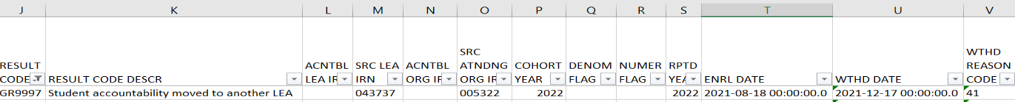
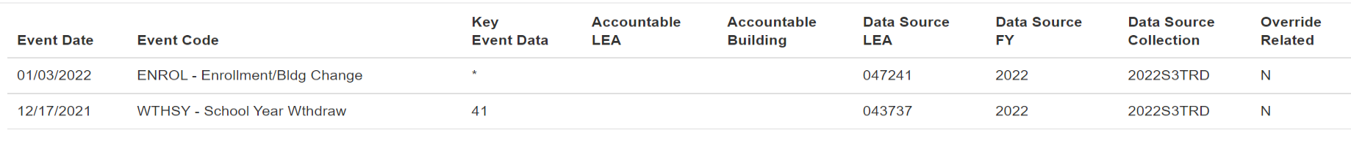

Student Accountability Moved to Another LEA
Filter on Result Code GR9997
  41 Transferred to Another Ohio School District
  Could be other withdrawal code or blank
Section of Grad Cohort Report
Section of ODDEX Grad Cohort tab
The withdrawing district will see the
enrollment into the new LEA but will
not see the cohort placement in ODDEX
New LEA IRN will appear here
Notes:
Student must be enrolled at the next LEA with the same SSID and within the timeframe of the cohort. SRC LEA IRN from the Grad Cohort Report comes from the student’s new school and will appear as the Data Source LEA IRN in ODDEX.

Slide 35
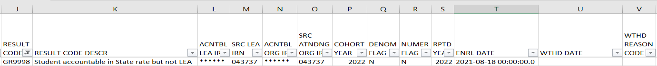
Student Accountable in State Rate but not LEA
Filter on Result Code GR9998
  Example of a Jon Peterson Scholarship student
Section of Grad Cohort Report
Section of ODDEX Grad Cohort
Student accountable LEA IRN is
****** and is not included in
the graduation rate (N/N)
Notes:
The top section is from the graduation cohort report and the bottom section is from ODDEX. Per ODE (ticket 3570), when a diploma is reported for a student that counts at the state level, the numerator could be set to Y, however the student still counts at the state level, ******.

Slide 36
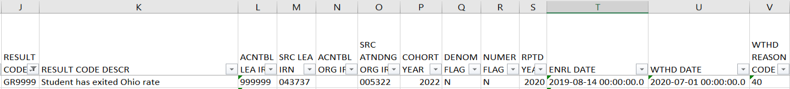
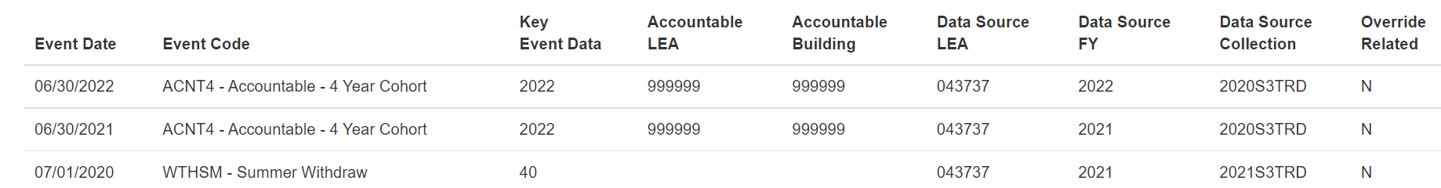
Student has Exited Ohio Rate
Filter on Result Code GR9999
  Example of a student withdrawn out of state – withdrawal code 40
Section of Grad Cohort Report
Section of ODDEX Grad Cohort
Student’s Accountable IRN is 999999 and is
not included in the graduation rate (N/N)
Notes:
This is one example of a student who has exited the Ohio Rate by withdrawing with a 40, out of state. Cherwell ticket 6424 contained an example of a student who withdrew out of state and returned but was reported as a Grad Only student. Since the student didn’t reenroll into the district, they were not placed back into the district’s graduation rate.

Slide 37
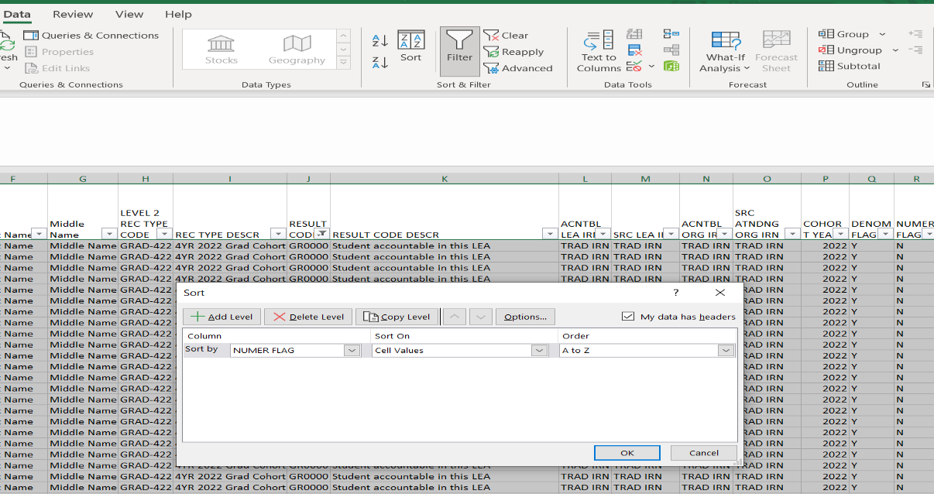
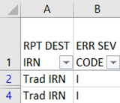
Student Accountable in This LEA
3. From the Data tab, select Sort
1. Select all data
2. Filter on Result Code GR0000
4. Sort by “Numerator Flag” and leave
the “Order” as A to Z then click “OK”
Notes:
This will bring the students that count against the district to the top Numerator = N, Denominator = Y. In the upcoming slides we are going to look at students with this combination to verify their accuracy.

Slide 38
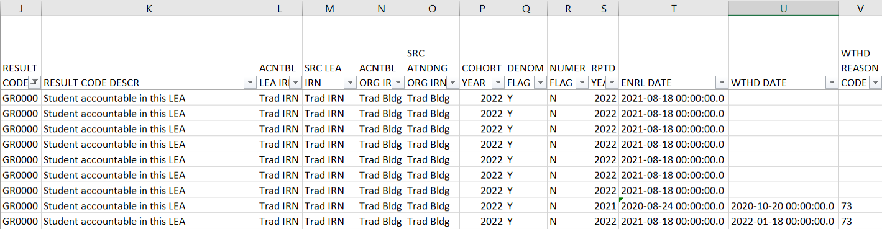
Student Accountable in This LEA, cont’d
Denominator = Y and Numerator = N
  Not Withdrawn/Non-Graduate
  These students not reported as graduates, verify data accuracy
Filter on blank
withdrawal dates
Notes:
These students count against the graduation rate since the students did not graduate on time.

Slide 39
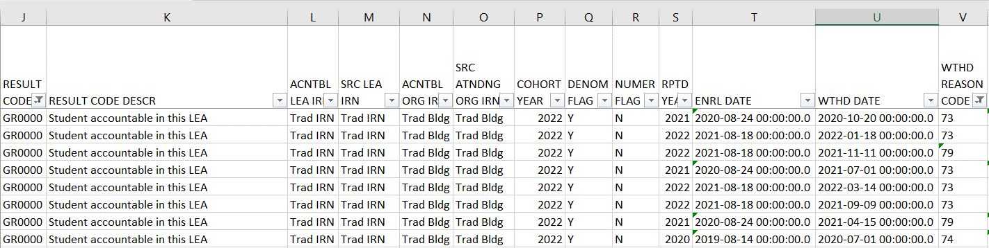
Student Accountable in this LEA, cont’d
Denominator = Y and Numerator = N
  Withdrawn with a 48 or 7# code/Non-Graduate
  These students were reported as dropouts, verify data accuracy
Filter on withdrawal
codes of 48 and 7#
Notes:
These students were reported as dropouts and did not enroll at any Ohio public school after dropping out, so the student remains in the last educating district’s graduation rate.

Slide 40
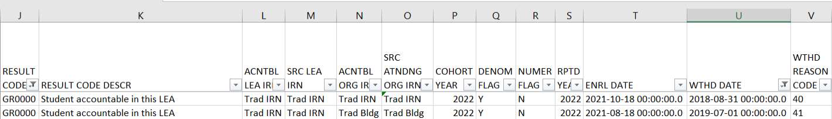
Student Accountable in This LEA, cont’d
Denominator = Y and Numerator = N
  Re-enroll after withdrawal (Could be any withdrawal code)
  Enrollment date is after withdrawal date
  No withdrawal of 99 or diploma reported
  Re-enrolled student did not graduate on time, verify data for accuracy
Notice that the enroll date is after the withdrawal
date and the student has not graduated on time

Slide 41
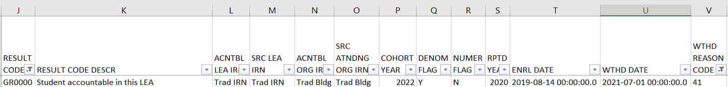
Student Accountable in This LEA, cont’d
Denominator = Y and Numerator = N (withdrawal date after enroll date)
  Withdrawn with a 41 but did not enroll elsewhere with the same SSID
  Did the student withdraw with a code that would have removed them from the cohort? (40, 42, 43, or 46?) If yes and documented, report a Withdraw Override Record (FC) in 22G
  Did the student enroll at another district with a different SSID? See upcoming slide to deactivate and link your SSID
  Did the student fail to enroll anywhere after withdrawing? If YES, leave as is.
Notes:
Use ODDEX to see if the student enrolled elsewhere with the same SSID. If the student enrolled elsewhere and does not appear in ODDEX, contact the withdrawn to district. The next two slides will provide explanations of the FC record and changes to SSIDs.

Slide 42
Withdrawal Override (FC) Record
Student reported as withdrawn to another district but remains in the withdrawing district’s cohort
  SSIDs whose withdrawal was reported with an incorrect date or reason in a prior school year, and SSIDs for whom the EMIS reporting entity has received new information since the withdrawal was reported which indicates that the withdrawal reason should be updated in order for the student to properly count within the longitudinal graduation rate
  Report a Student Withdrawal Override (FC) Record in 22G to report a correct withdrawal code
  Retain documentation to support this change
Notes:
Student Withdrawal Override (FC) Record should be documented to include the information that was discovered to support this change.

Slide 43
SSIDs and the Graduation Rate
When a student moves from one LEA to another, the subsequent LEA must report the student with the same SSID as the prior district
When a different SSID is reported by the subsequent LEA, the student will appear in both LEA graduation rates as he or she appears to be two different students
If the prior district discovers that the withdrawn student remains in their graduation rate after their ability to report the student to EMIS has closed, they should delete (aka deactivate) their SSID on the SSID website and link it to the SSID being reported by the subsequent educating district
Notes:
Using the new LEAs SSID seems to contradict prior guidance to use the SSID that was already in existence however, this gives the prior LEA the ability to correct the situation since they are no longer reporting the student to EMIS. The new LEA could report an SSID change back to the prior LEA’s SSID and that would also remediate the situation.

Slide 44
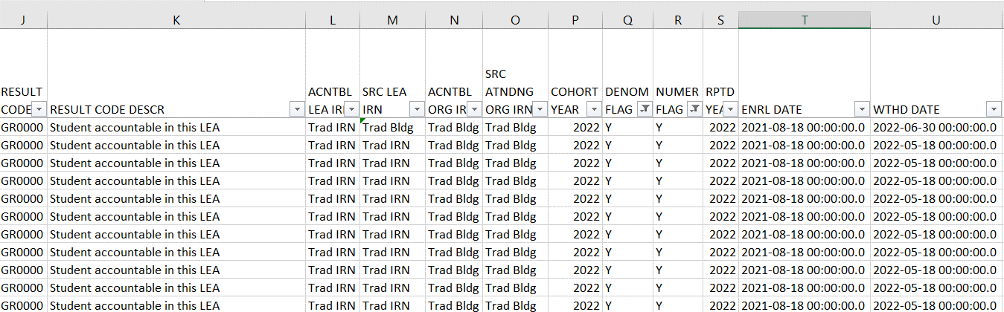
Student Accountable in This LEA, cont’d
Denominator = Y and Numerator = Y (Filter on Numerator = Y)
  Withdrawn 99 and Diploma Reported
  Are all graduates listed? Did these students actually graduate?
IMPORTANT! Before proceeding to the next slide, clear the Numerator Flag filter
Notes:
Note that if a student is reported as receiving a diploma and withdrawal code of 99 is not reported, a blank withdrawal code, or prior withdrawal code could appear for these students. The numerator flag set to Y indicates that the student was reported with a diploma date and diploma type and graduated on time. The numerator of Y does not check to see if the student met a pathway.

Slide 45
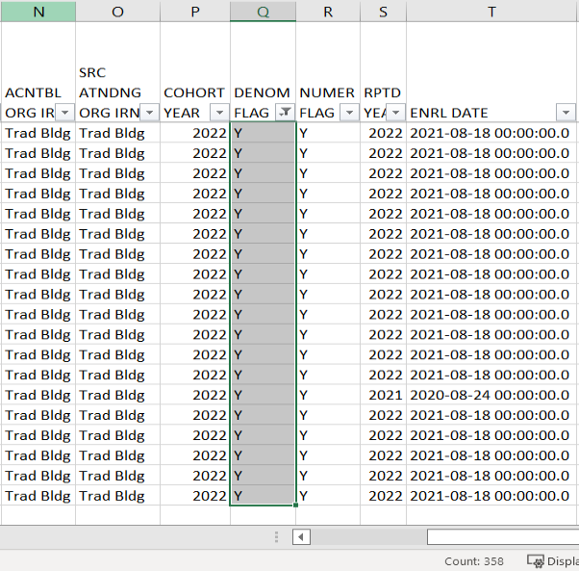
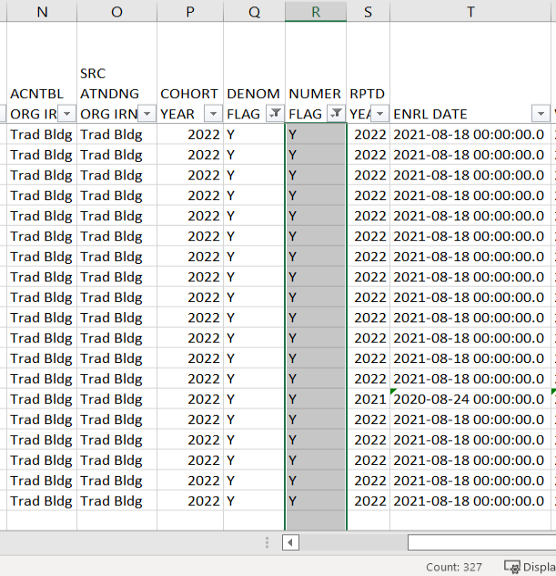
Calculate the Graduation Rate
Select all Y’s in
Denominator
Flag Column
Select all Y’s in
Numerator
Flag Column
Divide the numerator by the denominator 327/358 = 0.9134078
91.0%
Denominator is 358
Numerator is 327

Slide 46
Quick Check
Are the students counting in your graduation rate correctly?
Are you able to calculate your graduation rate?
Have you reported Withdrawal Override (FC) Records as needed?
Graduation Cohort Reports allow districts to verify cohort members and to calculate their graduation rate for current cohort and future cohorts. These reports should be reviewed carefully to verify that all students are counting correctly.
Notes:
Think about your district’s own graduation requirements. Are these above the state minimum? Do you know who to talk to when validating graduation data?

Slide 47
CTE Grad Cohort Reports

Slide 48
CTE Grad Cohort Reports
Generated for traditional districts, community schools, STEM districts, and JVSDs
Are very similar to the Grad Cohort Year Status reports and contain additional CTE related data
  JVSDs receive these reports
Contain students who met the definition of a CTE Concentrator by graduation cohort
  Students appear as accountable or in some cases, not accountable to the LEA
  Students appear as accountable at only one LEA
  The CTPD has no bearing on who shows up on the reports
Data will be used as part of the CTE Local Report Card
Notes:
These reports contain the same data as the Grad Cohort reports with additional columns. The reports include the CTE Program of Concentration, Gender Code, Non-Traditional Flag, Single Parent Flag, Migrant Flag and Reported Year. We will discuss these additional elements in upcoming slides. While districts should still report CTE programs of concentration, students no longer have to be reported as concentrators to appear in accountability measures. The Department now derives concentrator status when a student is found to have met the definition of a concentrator and a program of concentration has not been reported by the LEA providing their CTE courses.

Slide 49
CTE Grad Cohort Reports, cont’d
Level 2 Reports in the Graduation Collection
  (CTGR-422) 2022 – CTE Grad Cohort – 4th Year Status
  (CTGR-423) 2023 – CTE Grad Cohort – 3rd Year Status
  (CTGR-424) 2024 – CTE Grad Cohort – 2nd Year Status
  (CTGR-425) 2025 – CTE Grad Cohort – 1st Year Status
  (CTGR-521) 2021 – CTE Grad Cohort – 5th Year Status
Your LEA may receive none, or any number of these reports

Slide 50
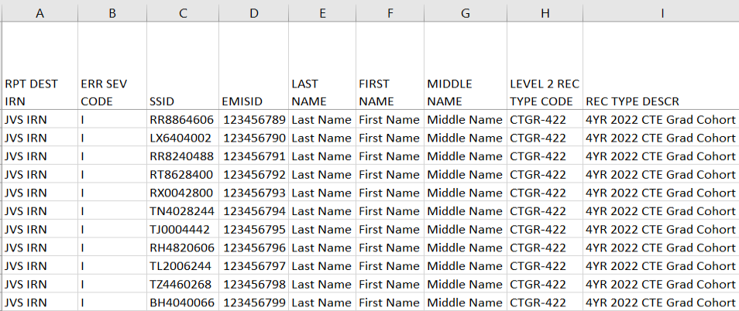
CTE Grad Cohort Report Columns
IRN of LEA receiving the report
Students will appear on only one row
All Error Severity Codes
are Informational
Name of the report
Notes:
Presenter can use (CTGR-422) 2022- CTE Grad Cohort- 4th Year Status DEMO.xlsx

Slide 51
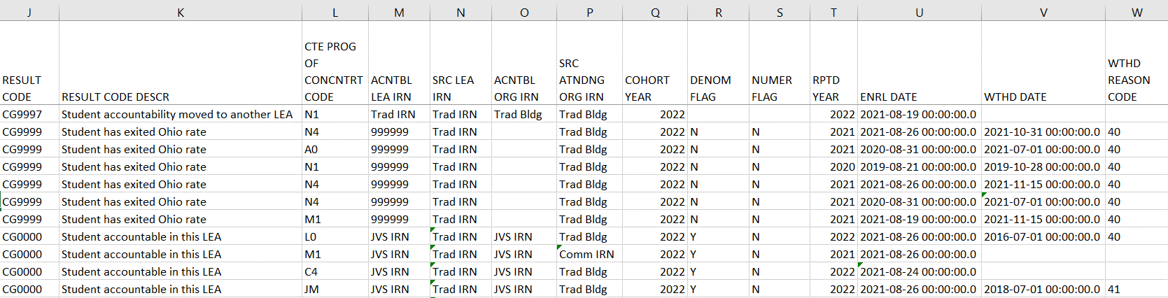
CTE Grad Cohort Report Columns, cont’d
Four potential Result
Codes and Descriptions
Accountable and
Source IRNs
Student’s Cohort Year and Graduation
Rate from the Grad Cohort Report
Enrollment data
Last CTE Program of Concentration
of the student in the district
The last year the student was
a concentrator at your LEA

Slide 52
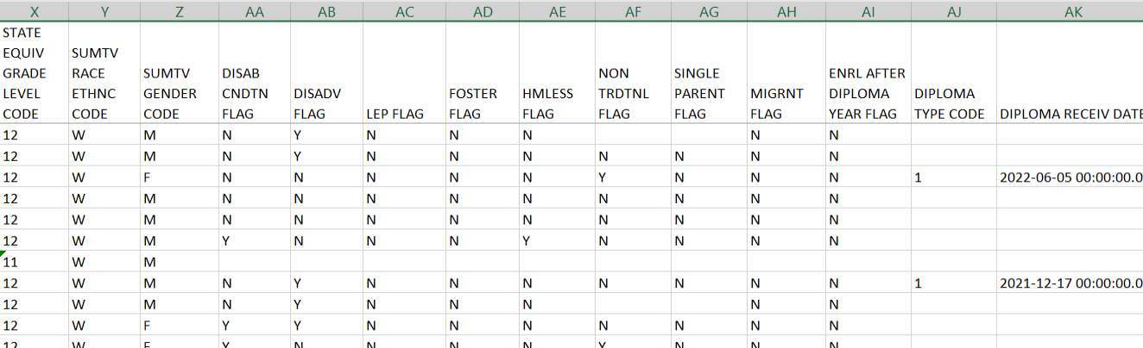
CTE Grad Cohort Report Columns, cont’d
Non-traditional Flag will be Y if the student’s reported gender is the non-traditional gender for the program of concentration
Single Parent Flag will be Y if the
student is reported with the
305010 program code
Accountability calculations for the graduation rate use the most recently reported disadvantagement
data. Students reported with a Disability, LEP, Foster, Homeless, or Migrant code at any time once they begin 9th grade or are newly added to a cohort, will be included for accountability calculations.
Notes:
The Summative Gender Code (column Z) column header should be Gender Code and may be updated. 305010 program code is for the CTE Single Parent Subgroup. See the EMIS Manual section 2.9 Student Program (GQ) Record. The diploma date and type appear on the report based on the graduating LEA’s data.

Slide 53
CTE Grad Report Result Code CG0000
Filter on Result Code CG0000 (Informational)
  Student accountable in this LEA
    Any LEA type receiving this report could be accountable including JVSDs
  Student is in the denominator for the LEA in their CTE Graduation Cohort
  In most cases this should be the most common result code received
  Verify that all students are appearing as expected
    Check additional EMIS elements are correct

Slide 54
CTE Grad Report Result Code CG9997
Filter on Result Code CG9997 (Informational)
  Student accountability moved to another LEA
  Student is a CTE Concentrator in the district, but the district is not the accountable LEA
  When a CTE Concentrator completes courses at more than one district during the school year, a tie breaker is used to determine which district is accountable for the CTE Grad measure.
      First tie breaker-The district that has the greatest amount of actual CTE FTE generated for the student is the accountable district.
      If the generated CTE FTE is the same for both districts than the second tie-breaker is completed.
      Second tie breaker- The district that has the greatest amount of credit reported for the student is the accountable district.
  The district that is not accountable receives the CG9997 result code.
Notes:
Cherwell 104933
The tie-breaker works as such, to determine:
#1.the district that has the greatest amount of actual CTE FTE generated for the student.
-If the generated CTE FTE is the same for both districts than the second tie-breaker is completed.
#2.the district that has the greatest amount of reported credit reported for the student.
Once both the #1 and #2 tie-breakers have been calculated one district has been identified as the accountable district for the CTE Grad measure. The district that is not found to be the accountable district is given the CG9997 result code.
If this does not answer the question reopen this ticket.
Thank you.
Melissa Maynard

Slide 55
CTE Grad Report Result Code CG9998
Filter on Result Code CG9998 (Informational)
  Student counts at the state level if reported with “How Received” values-
      P - Court-Placed Students, Excluding Foster Care and facilities defined by ORC §2151.65 or §2152.41
      Q- Court-Placed Students, facility defined by ORC §2151.65 or §2152.41, reporting district is educating.
      T- Students Placed in Institutions, Non-Court Ordered

Slide 56
CTE Grad Report Result Code CG9999
Filter on Result Code CG9999 (Informational)
  Student has exited the cohort
  Student was withdrawn with a code that removes them from the cohort
    40 Transferred to Another School District Outside of Ohio
    42 Transferred to a Private School
    43 Transferred to Home Schooling
    46 Transferred out of the United States
    52 Death
  Denominator Flag is set to N for these students

Slide 57
Quick Check
Are you receiving CTE Grad Cohort reports in your Graduate collection level 2 reports?
Have you verified that grad cohort CTE concentrators are appearing as expected?
Have you verified that the accountability elements are accurate on the report?
CTE Grad Cohort reports are designed to assist LEAs in the verification of career tech concentrators who are part of graduation cohorts. The reports can be helpful to district staff beyond the EMIS Coordinator.

Slide 58
Grad Issues Report

Slide 59
Grad Issues Report
Level 2 Report in the Graduate Collection
Contains Result Codes that identify specific situations that should be reviewed
Includes students from any current cohort report
  4-year 2022 - and 5-year 2021 cohorts
  Dropout Prevention and Recovery (DPR) schools – 6-year 2020, 7-year 2019, and 8-year 2018
In the next series of slides, we will filter on and discuss each result code

Slide 60
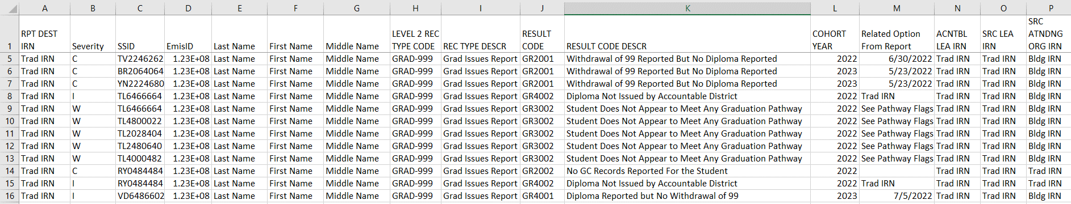
Grad Issues Report
Seven result codes
  A student can generate more than one result code
“Related Option From Report”
value contains additional
data based on the result code
We will filter on each result
code in the upcoming slides
Student’s cohort year
Notes:
Presenter can use (GRAD-999) Grad Issues-Please Review DEMO.xlsx

Slide 61
Filter by Result Code
Filter on result code GR1001
  Enrolled after diploma year (Fatal)
    Verify diploma date reported in 22G is correct
    Will be generated once the student is reported in the FY23 school year
    Graduating district would see this if re-reporting the student in FY23 after they were reported as a graduate
    Graduating district will also see this if student enrolls in a different district after being reported as a graduate
Filter on result code GR3003 (Currently Deactivated)
  Withdrawal date after diploma date (Warning)
  This check was active for a time but deactivated due to date issues
Notes:
These result codes are not on the DEMO file.
We are not going through the result codes in numerical order.
Result Code GR3003- I have confirmed that we will not be running that check going forward still. We may try to fix it, but at this point I am not sure if we have time to do so.
Thanks,
Chad Richardson
Data Administration Manager-EMIS
Office of Data Quality & Governance

Slide 62
Filter by Result Code, cont’d
Filter on result code GR2002
  No GC records reported for the student (Critical)
    Verify Student Graduation - Core Summary GC Records
      Preview/Submission files in Graduate Collection
    Could be received by an accountable district, such as the resident district of a STEM district student, or the resident district of a special education cooperative student
      Ignore if these records are not required to be reported by your LEA
      Verify that the educating district is reporting GC records

Slide 63
Complete Courses
Students must meet state minimum requirement of 20 credits*
  Districts may require more credits to graduate
*This is not a complete list of course/credit options. LEAs should consult the ODE website for additional information
Graduate Collection Level 1 Validations
GC.1002(A) Has credits but less than 20
GC.1002(B) Has zero credits
Notes:
Note that the graduation reports we are going to review today do not check to see if a student has completed their credit requirements. Districts should review the Student Graduation – Core Summary (GC) preview/review file to verify student credits.

Slide 64
Filter by Result Code, cont’d
Filter on result code GR2001
  Withdrawal 99 with no diploma date/type reported (Critical)
    Confirm accuracy of withdrawal reported
    Does a diploma date/type need to be reported?
    If 99 reported in prior year in error, then ignore
    In ODDEX, on the Grad Cohort tab, summer withdrawal dates will appear as 7/1/20XX and this is as intended
  We will talk about diploma date reporting next

Slide 65
Diploma Date Element Definition
The Diploma Date reported should be the date that students completed graduation requirements and finished formal secondary education. In most cases, that will be the last day of school for seniors.
Current rules are to allow graduates from the first day of school up to the day before the start of the next school year (using the date at which 50% of the school year start dates of all the calendars reported for a district); this data is loaded into REF_ORG_CAL and is used throughout the Graduation manifest. (EMIS Change 21-95)
For students with disabilities, the diploma date is the date that students completed their IEP goals and received a Free Appropriate Public Education (FAPE).
Notes:
Diploma date COULD be the date students receive their physical diplomas IF grad ceremonies take place on the date the student meets grad requirements and finished formal secondary education.

Slide 66
Diploma Date Clarification, cont’d
Per ODE-
  The rule is to use the date that is one day before the date when at least 50% of the schools become “open”
  For example, if a district has 10 schools and one opens in July and all the others open August 15th, it’s August 15th when they hit at least 50% being open, and thus the day before (August 14th) is the last day a student could graduate and be counted as being ‘on time’.
Verify that students are counting in the graduation rate as expected
Notes:
Marianne Mottley provided this explanation of how EMIS Change 21-95 works.

Slide 67
Filter by Result Code
Filter on Result Code GR4001 –
  Diploma reported but no 99-withdrawal code reported (Informational)
    Is the student a graduate and the reporting of a diploma is correct?
    If not, remove the diploma date
    If yes, then see the following steps to troubleshoot
    For the following examples, End of Year Student Collection (FY22) is closed and Beginning of Year Student Collection (FY23) or SOES Beginning of Year Student Collection (FY23) are open

Slide 68
Filter by Result Code, cont’d
Student withdrew on or before the last day of school for 21-22 and a withdrawal code of 99 was not reported
    Cannot report a Student Withdrawal Override (FC) record in 22G with a code of 99
      FC record in Graduate Collection can only be used with withdrawal codes 40, 42, 43, 45, 46, 48, 51, 52, 81
    Report a Student Withdrawal Override (FC) in 23S
      Will clear the student from the Missing Student report in 23S
      Will also clear up the GR4001 result code
Student is a summer graduate, after the last day of school for
21-22 and before the first day of school for 22-23
    Report the student’s withdrawal in FY23S
Notes:
During G reporting, ODE only accepts FC Withdrawal Reason Codes that impact whether or not the student is included in the cohort at a district. A '99' withdrawal code is not an accepted code, because the reporting of the diploma itself is how the student gets included in the numerator. If a 99-withdrawal code is reported in G it generates a Level 1 fatal (FC.0010)

Slide 69
Filter by Result Code, cont’d
Another situation that could cause the GR4001 result code
  The diploma is reported, and the student has been withdrawn but the withdrawal code is not a 99
  Example: The student dropped out in February and was withdrawn with a 7x withdrawal code
    The student shows up at the end of school and asks the district to accept credit for online classes the student took from a non-EMIS entity after the student dropped out
    The district gives credit for the courses and issues the student a diploma
    The district would report the student as a graduate but would not change the withdrawal code, so there would not be a 99-withdrawal code reported

Slide 70
Filter by Result Code, cont’d
Filter on result code GR4002
  Diploma not issued by accountable district (Informational)
  Could be special education cooperative student
    Diploma reported by educating district
    Student accountable at resident district
  Could be a Dropout Prevention and Recovery (DPR) school student in the 6, 7 or 8-year cohort who didn’t graduate
  Verify the data for accuracy

Slide 71
Filter by Result Code
Filter on result code GR3002
  Student does not meet any pathway – See Pathway Flags (Warning)
    This check is looking at a file that is created when the Grad Cohort Pathway reports are updated in Received Files
    Grad Cohort Pathway Reports are not updated nightly
    Only looks at the Ohio’s State Test Pathway, the College and Career Readiness Test Pathway, and the Industry-Recognized Credential and score on Workforce Readiness Test Pathway
Notes:
Remember- Grad pathway (columns AD- AF) reports are only updated whenever Pathway Files are updated. Pathway files are received files which are not updated nightly. This section of the report can be out of sync with reported grad data used for grad cohort reports and may not indicate the latest reported grad data.
From ODE-
“The columns FY18_Adtnl_Gen_Pthwy_Flag and FY18_Adtnl_CTE_Pthwy_Flag are really outdated and do not take into consideration the Graduation Related Program Codes - 520021 or 520022. Please make sure that the students are being reported with the appropriate Program Codes, Seals, Diploma Dates and Types...and if they are reporting that correctly they can disregard the GR3002 rows on the Grad Issues Report for their students.”

Slide 72
Quick Check
Have your graduates been reported with correct diploma dates and withdrawal dates?
Have you investigated each student on the report to verify data accuracy?
Are you saving your work between report reviews?
The Grad Issues report provides checks that can be used to verify graduation data. The report should be reviewed often as it is updated nightly and could change based on another LEA’s reporting.

Slide 73
Graduation Gen Issues Reports

Slide 74
Gen Issues for LEAs reporting Graduates
Level 2 Reports in the Graduate Collection
Appear only for the LEAs for which the check applies
Typically, are generated 6 to 8 weeks prior to the end of the close of the collection and are generated once or twice per week
Refer to the (GNIS-xxx) General Issues Report Explanation for additional information regarding these checks
When a Gen Issues check appears, review the data and make corrections as appropriate. If the data is already correct, then ignore the check
Notes:
See Resources slide for the location of report explanations on the ODE website.

Slide 75
Gen Issues 4yr and 5yr Checks
Four checks on the 4YR Graduation rate and the 5YR Graduation rate
  Graduation rate is equal to zero
  Graduation rate is greater than or equal to 100%
  Graduation rate is appearing as a null value
  Graduation rate has changed 5% or more since the previous year
Contact Adam Schiming for assistance if needed
  adam.schiming@education.ohio.gov

Slide 76
Additional Gen Issues for DPR Schools
Two checks on 6YR, 7YR, and 8YR Graduation rates for dropout recovery community schools*
  Graduate rate is equal to zero
  Graduation rate has changed 5% or more since the previous year
Contact Karlyn Geis for assistance if needed
  karlyn.geis@education.ohio.gov
Notes:
DPR- Drop Out Prevention and Recovery schools
*On Slide 76 there are two types of checks/flags listed. Those are the only flags they are likely to see in their reports, but I do also run a check that flags schools when a rate is greater than or equal to 100%. No school has been flagged with it for years but I suppose one could have it at some point if they really mess up their reporting.
Karlyn Geis
Data Administration Manager
Office of Data Quality and Governance

Slide 77
Quick Check
Are you receiving Gen Issues reports in your Graduate collection level 2 reports?
Are you able to identify if the issue is just stating a fact or if further investigation is needed?
Do you need to reach out to the ODE contact responsible for the Gen Issues check?
Gen Issues reports are generated by offices outside of EMIS. They are intended to help LEAs identify potential issues with their data. Investigate the issue and contact the appropriate ODE contact for assistance as needed.

Slide 78
Graduation Cohort Pathway Reports

Slide 79
Class of 2022 Graduation Pathways
Grad Cohort Pathway Reports look at three specific pathways
  Ohio’s State Test Pathway
    Assessments, Substitute tests, Graduation Exemption (FE) Records
  College and Career Readiness Tests Pathway
    Assessments
  WorkKeys and Industry Credential Pathway
    Assessments
Notes:
Received files appear in the Data Collector without names. Districts can use V- Look up to add names to these reports.

Slide 80
Assessments used in Pathway Reports
Report all assessments that students took
  AC – American College Testing Assessment (ACT)
  AP – Advanced Placement Assessments*
  GE – End of Course Tests*
  GW – Industry Credential
  GX – High School Alternate Assessment (OGT)
  IB – International Baccalaureate Assessment*
  WK – WorkKeys Assessment
  SA – Scholastic Aptitude Test
Report substitute tests that are used in the Ohio’s State Test Pathway
  CCP course grades substitution for End of Course tests in certain subjects
  Some subject specific AP and IB assessments are also considered to be
  substitute tests
Notes:
Assessments reported to EMIS will appear on some of the graduation reports and will be in the Assessment tab in ODDEX History.

Slide 81
Ohio’s State Tests Pathway Substitute Tests
Substitute tests
  See specific information as to timelines, subjects and graduation points for substitute tests at
    http://education.ohio.gov/Topics/Ohio-s-Graduation-Requirements/18-Points-on-State-Tests
  It is recommended that you consult the EMIS Manual and the ODE website for details regarding the reporting of substitute tests
Notes:
Substitute test data will appear on the Non-EOC Points Detail pathway report.

Slide 82
2022 Graduation Cohort Pathway Reports
Ohio’s State Test Pathway
    2022_GRAD_Cohort-EOC-Path-Req-Stat_2022XXXX.xls
    2022_GRAD_Cohort-EOC-Asmnt-Detail_2022XXXX.xls
    2022_GRAD_Cohort-Non-EOC-Pts-Detail_2022XXXX.xls
College and career readiness tests pathway
    2022_GRAD_Cohort_SAT-ACT_Path_Req_stat_2022XXXX.xls
Industry-recognized credential and score on workforce readiness test pathway
    2022_GRAD_Cohort_WK-IndCred_Path_Req_stat_2022XXXX.xls
These reports do not reflect graduation requirements for the Class of 2023 and beyond. Information related to those graduation requirements will be included in ODDEX in the coming months.
Notes:
The Ohio’s State Test Pathway has three reports, and the other two pathways have one report. There are no pathway reports for students reported via Graduation Pathway Program Codes. These reports are updated occasionally by a data manager at ODE and are not part of the nightly report generation process.
Students entering ninth grade between July 1, 2017, and June 30, 2019, have the option to meet the new requirements outlined for the class of 2023 and beyond or meet the requirements of the original three pathways to graduation. (This includes students in the FY22 grad cohort.)

Slide 83
2022 Graduation Cohort Pathway Reports
Three pathway reports and two assessment detail reports
  All five reports contain the same students (could be sorted differently)
  Updated about once a month beginning in late spring of the cohort graduation year and will be updated more frequently through the end of the graduate collection
  Indicate met or not met for a specific pathway
  Include assessments reported by any LEA
  Do not contain students who most recently tested with an Alternate Assessment
  Do not calculate total points for students who have any transfer credit reported (SNR = Y)
    Those students will appear on the detail reports with information, but all totals on the pathway report will appear as blank
Notes:
Presenter should check for and let the attendees know the latest updated date for these reports in Received Files.
Note that students who meet graduation requirements via alternate assessments will appear on the Level 2 Grad Cohort reports with a “Y” in the column MET BY ALT ASESMNT FLAG but will not appear on the pathway reports.
SNR = Y – Student transferred in with course already completed out of state or while being homeschooled; number of required points reduced.

Slide 84
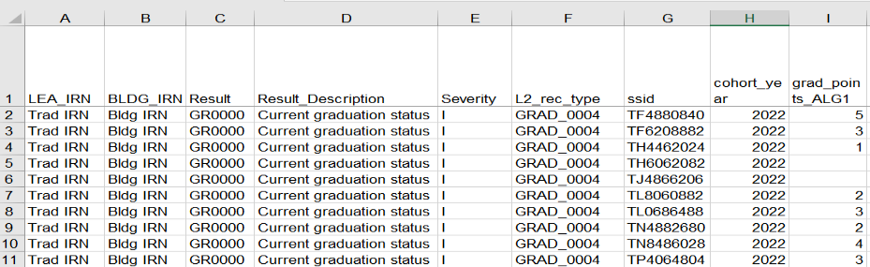
2022_GRAD_Cohort-EOC-Path-Req-Stat_2022XXXX.xls
Result, Result Description, Severity, and L2_rec
_type columns currently contain default values
Report is by cohort and contains
one row per student
Notes:
Presenter can use 2022_GRAD_Cohort_EOC-Path-Req-Stat_DEMO and toggle between the PowerPoint and the DEMO file. These screenshots do not include names so note that column headers could be different if the district has performed a VLOOKUP to add names to the file.
Please note that columns A- H are the same on all 5 Ohio State test Pathway reports.

Slide 85
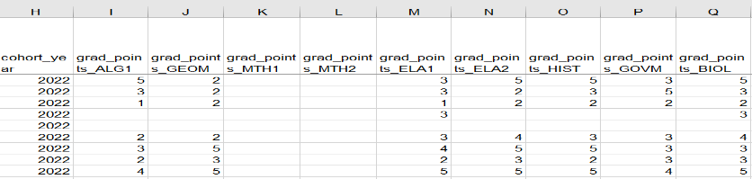
Graduation Points
After the cohort year column, the next 9 columns contain graduation points earned by subject
Graduation points are calculated from actual assessments taken, substitute tests, and graduation exemptions that are reported to EMIS
When both a substitute test and an actual test taken are reported to EMIS, the higher score will be used on the pathway reports
Values will be blank when the student
has no points in an assessment area

Slide 86
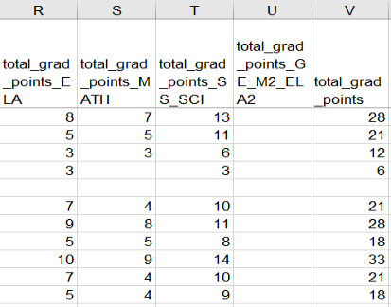
Total Graduation Points
The next 5 columns provide total graduation points earned for ELA, Math, and Social Studies/Science
Required - 4 points on English tests, 4 points on Math tests, 6 points on Science and Social Studies tests
Total of 18 points required with
subject area required points met
Notes:
Note that points are not populated in the total_grad_points_GE_M2_ELA2 (column U) as they are included in columns R, S, and T.

Slide 87
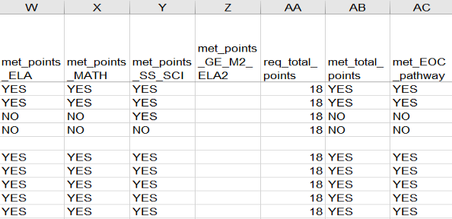
Points/Pathway Met
Columns to the far right of the report indicate if the pathway has been met or not met
When not met, the met points columns will indicate which area has not been met
Students with a “YES” in
the last column have
met the pathway
Notes:
Note that values are not populated in the met_grad_points_GE_M2_ELA2 (column Z) as they are included in columns W, X, and Y.

Slide 88
2022 GRAD Cohort EOC Asmnt Detail
Contains EOC assessment data by subject
  Assessments that were actually taken by students
  Highest score and graduation points earned
  Assessment date and test type
  Alternate assessment students are not included
  Assessments can appear that were reported by another LEA
Notes:
Presenter can use 2022_GRAD_Cohort-EOC-Asmnt-Detail_DEMO and toggle between the PowerPoint and the DEMO file.

Slide 89
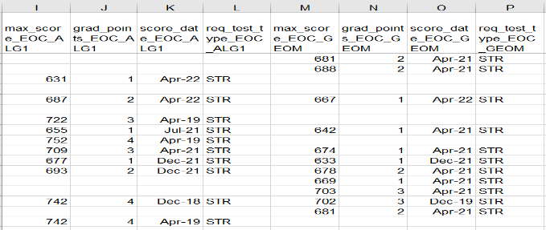
EOC Assessment Detail
Report contains the highest score and graduation points along with the test type and test date in eight assessment areas
This screenshot contains the
first two assessment areas, Algebra 1 and Geometry

Slide 90
2022 GRAD Cohort Non EOC Pts Detail
Contains data from Substitute Tests
  Highest score and graduation points earned
  Substitute tests included on the report
    EOC assessments (GE) with Score Not Reported reasons of W, X, and 2
      W- Includes FY20 and FY21 COVID Flexibility
      X- completion of a dual credit course
      2- non-public transfers
    AP or IB exams reported
Notes:
Presenter can use 2022_GRAD_Cohort-Non-EOC-Pts_Detail_DEMO and toggle between the PowerPoint and the DEMO file.
EOC assessments (GE) with Score Not Reported reasons of
W - Assessment score not reported because student received graduation credit for assessment area due to course completion prior to end of course assessment availability or due to an assessment administration being canceled due to the COVID-19 ordered school building closure in school year 2019-2020 or due to the COVID19 related flexibility for juniors and seniors in school year 2020-2021; number in score field represents number of graduation points earned
X- Assessment score not reported because student received graduation credit for assessment area due to completion of a dual credit course; for End of Course Tests (GE), number in score field represents number of graduation points earned; for CTE Technical Assessments (GY), value in score field represents student’s proficiency
2- Assessment score not reported because student received graduation credit for alternative Non-Public school EOC assessment prior to public district enrollment; Number in score field represents number of graduation points earned

Slide 91
2022 GRAD Cohort Non EOC Pts Detail, cont’d
Contains assessment data for students with disabilities who have been exempted from the consequences of the EOC
  Student Special Education Graduation Requirement (FE) Record must be reported
  Report assessments that the student takes or was required to take and did not test
  Three graduation points will be awarded for each area of exemption where the student attempts the EOC and whose score earns less than three points
Notes:
Remind districts that graduation exemptions must continue to be reported as IEPs are written to let ODE know if the student is still exempted or if they are no longer exempted.

Slide 92
2022 GRAD Cohort Non EOC Pts Detail, cont’d
Based on the highest number of graduation points earned via a substitute test or a special education exemption, the maximum graduation points for each assessment area will be included on the report
Assessments can appear that were reported by another LEA
Not all substitutes apply to all subject areas

Slide 93
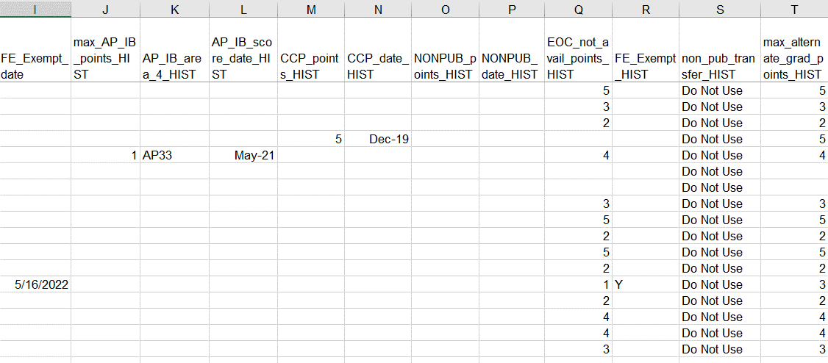
Non-EOC Points Detail
EOC records reported
for courses taken prior
to EOC availability
Maximum Non-EOC points for History
EOC records reported
for CCP Courses
AP and IB test data
Non-Public transfer
assessments
Student reported with Graduation Exemption (FE) for
History, three graduation points awarded with assessment
Notes:
Since there are many columns and lots of different tests, it might be wise to color code, or rearrange columns. “Do Not Use” appears in the nonpublic transfers column for all subjects. Note that History, Government, and Biology each have 11 columns specific to those subjects while Algebra 1, Geometry, Math 1, Math 2, ELA 1, and ELA 2 do not have AP/IB or CCP columns.

Slide 94
College and Career Readiness Tests Pathway
2022_GRAD_Cohort_SAT-ACT_Path_Req_stat_2022XXXX.xls
  Contains highest score earned across all administrations of the ACT or SAT
  Scores must come from either the ACT or the SAT and cannot be a combination between both tests
  ACT test scores are used for Reading, Math, and English
  SAT test scores are used for Reading, Math, and Writing
  Remediation free scores will be indicated on the report as “YES”
  If no points have been reported in an assessment area, the data for that student in that assessment area will be blank
  When a pathway is met for ACT or SAT, the report will indicate “YES”
Notes:
Remediation free scores cannot be combined between ACT and SAT tests but must be attained by having remediation free scores on either the ACT or the SAT tests.

Slide 95
SAT ACT Pathway Reports Update
SAT/ACT Reports
  Contain all SAT/ACT records reported for each student in the 2022 cohort
  Should be reviewed to ensure reporting accuracy and completeness
  Reports are reflective of current graduation requirements to meet the SAT/ACT college ready pathway
  For additional information on scores and timelines go to http://education.ohio.gov/Topics/Ohio-s-Graduation-Requirements/College-and-Career-Readiness-Test
Notes:
Presenter can use 2022_GRAD_Cohort_SAT-ACT_Path_Req_Stat_DEMO and toggle between the PowerPoint and the DEMO file.

Slide 96
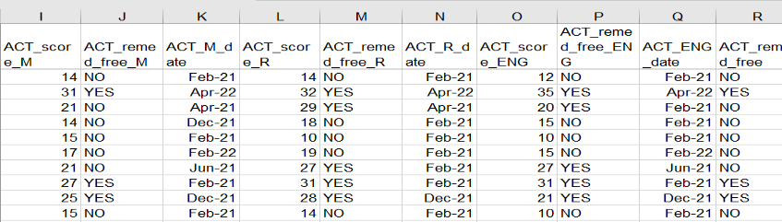
2022 GRAD Cohort SAT ACT Path Req Stat
This is a section of the report that contains ACT data
  ACT scores and the date of the exam appear along with a Yes or No value to indicate a remediation free score

Slide 97
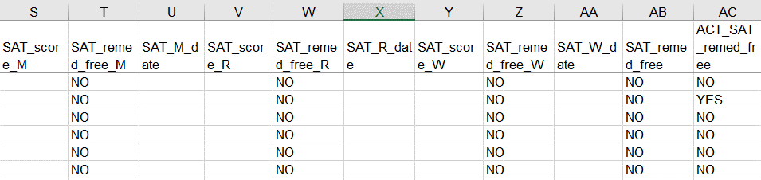
2022 GRAD Cohort SAT ACT Path Req Stat
This is a section of the report that contains SAT data and pathway values
  SAT scores and the date of the exam appear along with a Yes or No value to indicate a remediation free score
  Final column indicates if the student has met either ACT or SAT pathway with a Yes or No value

Slide 98
Industry Credential and Workkeys Pathway Report
Contains all Workkeys and Industry Credential records reported for each student in the 2022 cohort
  Report all assessment scores received
  Reports are reflective of current graduation requirements to meet this pathway
  Review to ensure reporting accuracy
  For more information on this graduation pathway including graduation flexibility, go to http://education.ohio.gov/Topics/Ohio-s-Graduation-Requirements/Industry-Recognized-Credentials

Slide 99
2022 GRAD Cohort WK Ind Cred Path Req Stat
Contains the highest score from the Workkeys assessment
Contains Industry Credentials earned
Student must meet remediation free score of 14 on the Workkeys exam (at least three points in each subject area)
  AND obtain 12 points for industry credentials in a single career field
Assessment data for a student on this report will be blank if not earned or reported
Last column will contain a Yes or No value to indicate this pathway as met or not met
Notes:
Presenter can use 2022_GRAD_Cohort_WK-IndCred_Path_Req_stat_DEMO and toggle between the PowerPoint and the DEMO file. Suggest that attendees review the FY22 CTE Program and Assessment Matrix for questions regarding career fields.

Slide 100
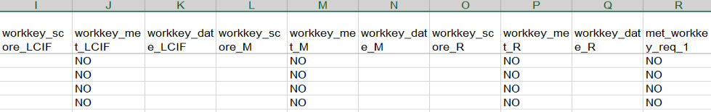
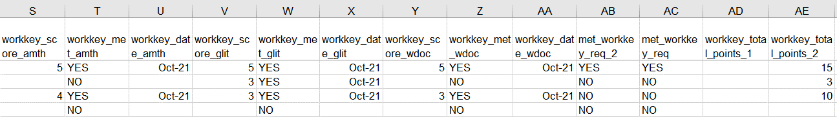
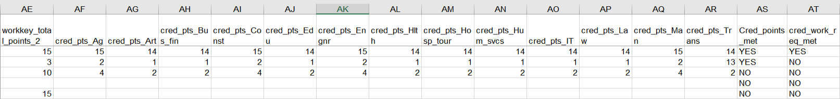
2022_GRAD_Cohort_WK-IndCred_Path_Req_stat
WorkKeys
Version 1
WorkKeys
Version 2
Totals for both versions
Industry Credentials
Pathway Met
Notes:
There are two versions of the WorkKeys assessment. Version 1 has Locating Information (LCIF), Mathematics, and Reading. Version 2 has Applied Math (AMTH), Graphic Literacy (GLIT), and Workplace Documents (WDOC).
Many of the 1-point credentials count for a number (or all) of the career fields. Things like CPR, for instance, count toward more than one field which will display as 1 or a 2 across multiple credential areas.

Slide 101
Quick Check
Are all expected 2022 cohort students appearing on the pathway reports?
Is there EMIS data missing from the report that needs to be reported?
Are these reports being shared with others in the district to verify accuracy and completeness of the data?
Graduation reports contain EMIS data that is used to determine if the student has met one or more graduation pathways. The data should be reviewed now to look for additional EMIS data that still needs to be reported.

Slide 102
Report Card College, Career, Workforce, and Military Readiness Report
Notes:
New report, replaces Prep for Success Report

Slide 103
2022_RPTCRD_CCWMRdy Report
Replaces the Prepared for Success Report on FY22 Report Card
Based on students in the 4-year graduation cohort only
Decisions related to the data in this file are ongoing and subject to approval by the State Board of Education
  ODE will provide updates to data elements and calculation decisions as they are determined
File contains a single tab showing SSID level information for many metrics and industry credential points earned
Contact Letitia Linville- Letitia.Linville@education.ohio.gov
Notes:
Report Card College, Career, Workforce, and Military Readiness report- also known as the 2022_RPTCRD_CCWMRdy Report
No names on report since it is a received file- districts can use V Look up to add names.
Good morning Jean,
I am not sure yet of the timing of this report – it will not be produced until after the current report card is released. It does use lagged data and will be updated for the Class of 2022. The goal is to have reports out before the close of the FY22 graduation collection so districts can review and update data if necessary.
Hope this helps!
Let me know if you have any other questions.
Have a great day,
Letitia E. Linville, Ph.D.

Slide 104
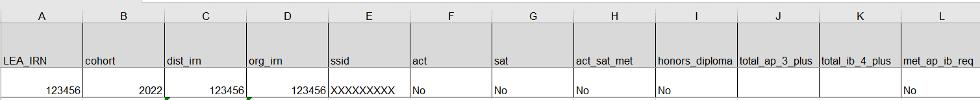
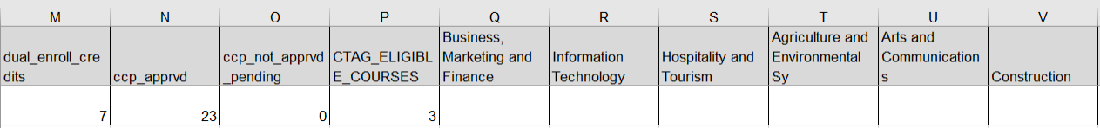
2022_RPTCRD_CCWMRdy Report
ACT and SAT
HONORS DIPLOMA
AP and IB
CCP
CTAG
INDUSTRY CREDENTIALS
INDUSTRY CREDENTIALS
Notes:
Screenshot of report issued June 2022.
see 2022_RPTCRD_CCWMRdy report explanation for details
A- IRN of district receiving the report; B- Cohort of the student; C- District IRN; D- Bldg IRN; E- SSID
AD- Yes or No- 12 credential points in one field; AE- Yes or No- pre-apprenticeship program complete;
AF- Yes or No- Ohio Means Jobs Readiness Seal; AG- Yes or No- 250 hours of work-based learning experience

Slide 105
Summary
FY22 Graduation reporting closes October 14,2022 and will be followed by an appeal period that begins October 18, 2022 through November 1, 2022
Carefully review all graduation reports for accuracy and completeness
Refer to and review grad cohort data in ODDEX as you troubleshoot graduation reports
Contact your ITC for assistance

Slide 106
Resources
Current EMIS Manual
  ODE Home > Topics > Data > EMIS > Documentation > EMIS Manual
Report Explanations
  Home > Data > EMIS > Documentation > EMIS Validation and Report Explanations
Graduation Requirements
  ODE Home> Topics > Graduation Requirements > Earning an Ohio High School Diploma for the Class of 2022
If you have questions about graduation requirements
  call (614) 466-1317
  email gradrequirements@education.ohio.gov

Slide 107
Questions?
If you would like a certificate of attendance for this
training, you must complete the below feedback form
within 5 business days of this training
https://tinyurl.com/EA-District-Feedback

