Slide 1
Troubleshooting Federal Child Count Reports

Slide 2
The Ohio Department of Education funds development of EMIS training materials as part of the EMIS Alliance grant. There is an expectation that ITCs will utilize these materials in training provided to your districts. That said, there are restrictions on use of the EMIS Alliance materials as follows: Materials developed as part of the EMIS Alliance program must be provided at no cost to your training participants. If you utilize the EMIS Alliance training materials – in whole or in part – you must not charge participants a fee to attend the class where the materials are used. Likewise, you may not use the materials or any portion thereof in any event where a fee is charged to attend. Exceptions must be approved in writing by the Department of Education in advance of scheduling/promoting any event which may violate these restrictions.
Questions regarding appropriate use of EMIS Alliance materials, or requests for exception to the restrictions noted above, should be directed to Melissa Hennon [Melissa.Hennon@education.ohio.gov].

Slide 3
Overview
The Federal Child Count (FCC)
Includes students with disabilities who are receiving special education services according to their IEPs as of October 31
Is used in determining the amount of Special Education Part-B IDEA and Early Childhood Special Education funds allocated to the state
Is collected from all LEAs except for ESCs and JVSDs through the Education Management Information System (EMIS) and is submitted to the US Department of Education (USDOE)
This presentation will focus on troubleshooting the EMIS FCC Reports, which are generated throughout the EMIS data submission process
Notes:
ESC’s and JVSD’s do not receive a Federal Child Count Report. FY23 Federal Child Count Reports are currently being generated. It is recommended to have access to the Federal Child Count Detail Report and Federal Child Count Statement of Assurances Report Explanation from ODE’s website under the EMIS Validation and Report Explanations webpage when going through this presentation.

Slide 4
EMIS Data Collections and the FCC Snapshot
Collections containing the FCC report
Beginning of Year Student (S) Collection
SOES Beginning of Year Student (S) Collection
Collections are scheduled to close December 19, 2022
FCC will close when the above collections close
There is no appeal for the FCC

Slide 5
FCC Reports
Level 2 Reports
(FCCD-001) Federal Child Count Detail
(FCCS-001) Federal Child Count Statement of Assurances
FCC Reports are updated nightly
Can contain data reported by other LEAs
Review the most recent version of the reports throughout the data collection process
Submit updated EMIS data to make corrections to the reports
Notes:
Explain the importance of reviewing FCC Reports throughout the EMIS reporting process and that data from other entities can be used when reports are generated.

Slide 6
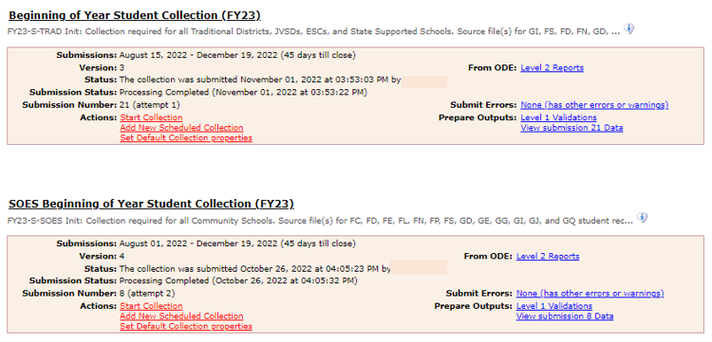
Level 2 Reports
Select the Level 2 Reports link
Notes:
Log in to the Data Collector and demonstrate how to locate the collections and have attendees log into the Data Collector and follow along. This example includes the Level 2 link for both the Beginning of the Year Student Collection and the SOES Beginning of the Year Student Collection.

Slide 7
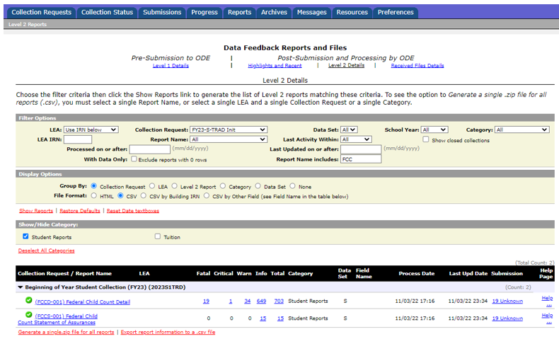
FCC Reports
FCC was added to the
filter in this example
Select “Show Reports”
Notes:
Demonstrate how to generate the FCC Reports in the Data Collector. This screenshot uses the Beginning of the Year Student Collection (FY23) after clicking on the Level 2 Report link. Also demonstrate selecting the Federal Child Count Report using the “Report Name” dropdown menu. Allow attendees to open their reports and have them ready to format in the next series of slides.

Slide 8
Formatting the FCC Detail Report
Open the (FCCD-001) Federal Child Count Detail Report
Wrap text header row
Freeze top row
Expand all columns
Apply filters
Better yet, run your macro!
Notes:
Presenter open the (FCCD-001) Federal Child Count Report Detail DEMO spreadsheet. Toggle between this PowerPoint and the demo file during each step of this formatting process or after this series of slides to demonstrate all the formatting steps at the same time. It would be wise to save the CSV file as an Excel file so that all Excel functionality is available. Demonstrate these steps of preparing the report and the attendees can prepare their own report as you demonstrate the Basic Excel steps. Select top row and select Wrap Text from the Home Tab. While the top row is selected, from the View tab, select Freeze Panes and Freeze Top Row. Select entire spreadsheet (click cell between Row 1 and Column A) then place cursor on the line between any two column headers and double click. While spreadsheet is highlighted, from the Data tab, choose Filter (or from the Home Tab select Filter)

Slide 9
Quick Check
Are you using the most recent version of the report?
Are you able to open and format the CSV report to begin the review process?
Can you apply filters to all columns?
The Federal Child Count Detail Report contains student detail data as it pertains to the count. This report is critical in the data review and error correction process and should be carefully reviewed for accuracy and completeness.
Notes:
As a best practice, encourage districts to keep notes from previous troubleshooting of these reports to save time as the reports continue to be generated.

Slide 10
Troubleshooting the Federal Child Count Detail Report

Slide 11
Troubleshooting the FCC Detail Report
The next series of slides will review data contained in the report including
Severity Codes and Numbers
Federal Child Count Flag
Who is and is not included in my FCC?
FCC Report Data
Status Codes and corrective actions
Notes:
Throughout the remainder of the workshop, keep the (FCCD-001) Federal Child Count Detail DEMO spreadsheet open.

Slide 12
Severity Codes
Severity Codes
Report is sorted least severe to most severe
Severity Code will be noted for each Status Code
Review all students regardless of Severity Code
I – Informational
W – Warning
C – Critical
F – Fatal
Notes:
Severity Code is in column C and Error Severity Number is in column Y.

Slide 13
Federal Child Count Flag
FED CCT FLAG
Y – Student is intended to be included in the Federal Child Count
N – Student not included in the Federal Child Count
Review all students on the report regardless of flag
Notes:
Be sure to revisit this report throughout the reporting period as changes to EMIS data by your district or other districts can impact this report.

Slide 14
Who is included in my FCC?
In most cases, students count at their resident district except for students attending -
Community Schools
STEM Districts
Ohio School for the Blind
Ohio School for the Deaf
Buckeye United (DYS)
Pilot Programs
Non-Public students receiving related services count at the traditional district providing the related services if active IEP event is reported as of October 31
Notes:
Note that non-public students receiving related services will be included in the count if reported with an active IEP event reported as of October 31. ISP events are not considered when including a services only non-public student in the Federal Child Count and will appear the FCC Detail report with status code FC0005, as not meeting inclusion filters.
New updated from 12/21/2022 Ohio School for the Blind, Ohio School for the Deaf and Pilot Program students count back at the resident district, only DYS students count at the DYS, the report explanation has not been updated but noted in helpdesk ticket 102354 that the documentation is not correct.

Slide 15
Who is not included in my FCC?
Students with a disability as of October 31, who are not being reported with an active IEP event as of October 31
Students reported with the following IEP outcomes
IEPR – IEP Complete – Parental Refusal
IENS – IEP Complete – Not Served
IEDP – IEP Resulted in Due Process
Refer to the FCC Level 2 Report Explanation, section “Include in USDOE Count” for additional information and exceptions

Slide 16
FCC Report Data
Disability Condition Code
Student must be reported to EMIS with a disability as of October 31 to be included on the report
Review for accuracy
Student Age Number
Student’s age as of October 31
Notes:
Demonstrate where these values are located on the (FCCD-001) Federal Child Count Detail DEMO spreadsheet.

Slide 17
FCC Report Data, cont’d
Legal District of Residence
FED CCT ALT IRN
Populated for Status Code FC0006 with LEA IRN where the student will count
Sent Reasons and IRNs
Displays if relevant to the FCC
Notes:
Note that the Admission Date values on the demo file are zeros however district files will contain actual admission dates from EMIS data in the district reports.

Slide 18
FCC Report Data, cont’d
FED CCT LRE Code – Least Restrictive Environment Code
If this is blank, the student is not included in the count
Value comes from IEP, FN270, or is derived
DIST LRE SRC CODE and DIST LRE SRC DESCR
Source codes indicate what data the report is looking at
Use in combination with the Status Code value to determine what is being reported for each student
Notes:
We will talk more about LRE SRC Codes on the next two slides.

Slide 19
DIST LRE Source Codes
1 - No Disability on October 31
3 - Student’s age is not 3 – 21
5 - No IEP Reported
7 - FN270 Override
8 - GE Record
Notes:
These examples demonstrate how the Status Code and DIST LRE SRC CODE can reflect the same information or show what data the report is looking at. (FY29) No instance of “1 – No Disability on October 31” was found when creating this presentation.

Slide 20
DIST LRE Source Codes, cont’d
9 - How Received = 6
FED CCT LRE CODE will be IE39 Ages 5 and up, Not Grade Level PS
FED CCT LRE CODE will be IE39 Ages 6 and up, Grade Level PS
C - How Received = 6 and Grade Level = PS
FED CCT LRE CODE will be IE51 if Ages 3 to 5 and Grade Level PS
A - Sent Reason = AU or JP
FED CCT LRE CODE will be IE39 if age 6 or older and IE51 if age 3-5
B - Changed to DYS LRE (Appears only on DYS report)
Notes:
Note that LRE Source Code 9 has been updated to include 5-year-old students who are in kindergarten and no longer gives 3 to 5-year-old students who are in preschool an LRE of IENS as in years past. 3 to 5-year-old students reported with a How Received of 6 and (starting in FY21) grade level of PS will appear with the LRE Source code of C. Students with a How Received value of 6 who are reported with a grade level of preschool and who are 6 and older will be shown with an LRE Source Code of 9 and will have an LRE of IE39 on the FCC Detail report. These students could also appear on the Gen Issues 483 report because of the unusual age/grade level combination. Note that these students must have an active IEP in place on October 31st to be included in the FCC.

Slide 21
Quick Check
Are all students appearing on the report as expected?
Has someone verified the data for accuracy?
Has updated EMIS data been submitted to correct any inaccuracies on the report?
The Federal Child Count Detail Report contains data specific to students with disabilities. Understanding each column of data is important to begin analyzing the data for accuracy and completeness. There is not an error for everything, so time spent reviewing all data on the report is recommended.
Notes:
As a best practice, encourage districts to keep notes from previous troubleshooting of these reports to save time as the reports continue to be generated.

Slide 22
FED CCT Status Codes
FED CCT STATUS CODE and FED CCT STATUS CODE DESCR
Indicates the status of a student as it relates to inclusion in the count
Indicates that a data issue exists or that no errors are identified
Data with no errors on the report should still be reviewed for accuracy
Notes:
As we proceed through the next series of slides, filter on the FED CCT STATUS CODE column as each status code is explained. If a specific issue is not addressed in this presentation and resolution cannot be determined, then a ticket should be created in the EMIS Helpdesk. Currently there are eight Status Codes on the FCC Detail Report.

Slide 23
FED CCT Status Code FC0001
Filter on FC0001
On Oct 31 Student age is outside the 3-21 included range (Fatal)
Source Code 3 - Student age is not 3 – 21
FED CCT FLAG - N
View the student’s reported date of birth on the Student Demographic (GI) Record to confirm age
If the student’s date of birth is incorrect, make the correction and submit updated EMIS data
Notes:
Show where the date of birth can be found in the student information system. Note that if a date of birth is changed, SSID/IBM data would also need to be corrected

Slide 24
FED CCT Status Code FC0002
Filter on FC0002
Unable to translate LRE-must report FN270 element (Critical)
Source Code 7 - FN270 Override
or Source Code 8 - GE Record
FED CCT Flag - N
As of October 31, the student’s IEP Outcome (LRE) must agree with the student’s age and grade level
For ages 3-5 and in preschool, the LRE should be in the IE51 to IE72 range, if not report an LRE within this range on the FN270
For ages 5 and over and in kindergarten or higher, LRE should be in the IE13 to IE39 range, if not report an LRE within this range on the FN270
Notes:
Show where the student‘s IEP events can be found in the student information system. If the student’s age is not correct, another LEA could be reporting the student with a different date of birth. ODE will use the earlier date of birth reported.

Slide 25
Age, Grade Level, and Expected LRE
Age 3 to 5, Preschool Grade Level - Count as Preschool Student
Preschool LRE Expected (IE51-IE72)
Age 4, Kindergarten Grade Level - Count as Preschool Student
Preschool LRE Expected (IE51-IE72)
Age 5 and up, Kindergarten Grade Level - Count as School Aged Student
School Aged LRE Expected (IE13-IE39)
Age 6 and up, Any Grade Level, including Preschool - Count as School Aged Student
School Aged LRE Expected (IE13-IE39)
Notes:
The student’s age and grade level will determine how students will count and which type of LRE is expected. Reporting of the Updated October 31 IEP Outcome, FN270 will be discussed in an upcoming slide.
Note also that there is a Gen issues report 482 which looks for kindergarten students who’s last ETR outcome was ET16. These students need a new ETR with an appropriate outcome in place by 12/1. Removed from GNIS Report on 2/1/2021 no longer valid.

Slide 26
Reporting the FN270 Element
Updated October 31 IEP Outcome Element (FN270)
The current IEP outcome and FN270 values should not be the same
When the FN270 value is reported correctly the LRE that aligns with the student’s age and grade level will appear in the column FED CCT LRE CODE
When reported incorrectly the FED CCT LRE CODE column will be blank
Correct
Incorrect
Notes:
Demonstrate where the FN270 element is located in the student information system. Do not elaborate you have 2 more slides on FN270.

Slide 27
Additional Information on FN270 Reporting
When completing the Federal Child Count, the Department will review the LRE on the latest reported IEP event effective as of October 31
The value the FN270 element will take precedence
Reporting of an FN270 value is not limited to PS and KG
For this element to be valid for the Federal Child Count, the student must already have an IEP reported to the Department that is valid on October 31. If no reported IEP is valid on October 31, then the value in this element will be ignored

Slide 28
Additional Information on FN270 Reporting , cont’d
In general, the LRE will not change without a new IEP being completed and reported, but there are some cases, especially with IEPs reported in the prior year that are still in effect on October 31, where the LRE could change
Examples include but are not limited to
a student whose parent originally consented to services but pulled the student from services prior to October 31
situations where an expelled student is given an alternative placement that will be in effect on October 31
a preschool student (especially for those who are part time), a parental placement in a private preschool program could change the LRE for that student
Questions on FN270 reporting should go to the ODE EMIS Helpdesk

Slide 29
FED CCT Status Code FC0003
Filter on FC0003
CIEP most recent IEP - should be no disability (Warning)
Source Code 8 - GE Record
FED CCT FLAG - N
Verify the CIEP event and confirm that the student’s disability code is being reported as ending on the date of the CIEP event
If the student’s disability code on the Student Attributes - Effective Date (FD) Record is not reported as ended, make the correction and submit updated EMIS data
Notes:
Show where the CIEP (IEP consent withdrawn by parent) event and the FD record are in the Student Information System to verify the dates are being reported correctly.

Slide 30
FED CCT Status Code FC0004
Filter on FC0004
No IEP reported for Oct 31 date (Fatal)
Source Code 5 - No IEP Reported
FED CCT Flag – N
FED CCT LRE CODE – Blank
Verify the student’s special education event records as of October 31
Verify the most recent IEP was reported to EMIS
Report an NIEP if appropriate
Notes:
In prior years, the FED CCT Flag was set to Y and the FED CCT LRE Code was set to IENS that indicated students with disabilities as of October 31 who were not being served. Starting in FY21 these values are set to N and blank.

Slide 31
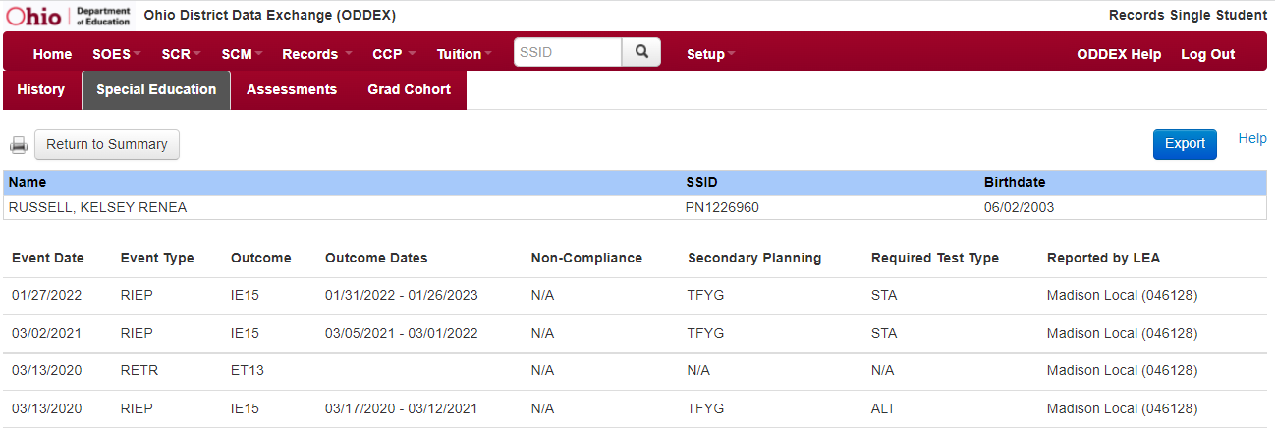
ODDEX Records
Special Education Data Tab
Use to verify if the student’s IEP events were reported to EMIS
Notes:
This ODDEX screen will show the LEA that reported the event (indicated to the far right and cut out of this screenshot). This is a fast and easy way to confirm that an IEP event was reported to EMIS by the LEA. Users may need an additional OEDS role if they are unable to access the Special Education tab in ODDEX Records. Another way to verify that an IEP event was reported to EMIS is by locating the files in the Data Collector. This would be a great time to demonstrate where to find submission files from prior collections.

Slide 32
NIEP Date Type - No IEP
NIEP events for expired or non-transferable IEPs
10 - Student newly transferred in; IEP adoption determination not complete; services being provided based on prior IEP
11 - IEP expired; new IEP not in place; services being provided based on prior IEP
NIEP events using the non-compliance reason of 12 can be used until the end of the IEP that did not get reported to EMIS
Notes:
There was previous discussion that NIEPs should be reported for no longer than 30 days but that was never made into a rule.

Slide 33
FED CCT Status Code FC0005
Filter on FC0005
Student does not meet inclusion filter in this district (Warning)
Source Code 5 - No IEP Reported
or Source Code 7 - FN270 Override
or Source Code 8 - GE Record
FED CCT Flag – N
Shared students can have this Status Code at the educating district
Shared students where IEPs are not reported can also have this Status Code with Source Code 5 – No IEP Reported
Refer to the Federal Child Count Report Explanation, section “Include in USDOE Count”
Notes:
Look up students in the student information system or in the Student Standing (FS) file within the Data Collector Submission files to see the student’s EMIS coding. Then open the Federal Child Count Detail Report and Federal Child Count Statement of Assurances Report Explanation and refer to section “Include in USDOE Count” to show the inclusion criteria for the Federal Child Count. Are the students appearing correctly on the FCC Report based on EMIS coding and inclusion criteria? Also review special education events in ODDEX to verify events reported for non-public related services students to determine if they should be included in the FCC or not.

Slide 34
FED CCT Status Code FC0005, cont’d
Filter on FC0005
Student does not meet inclusion filter in this district (Warning)
Source Code 9 – How Received = 6
FED CCT Flag – N
Non-Public special education students receiving related services from reporting district with No IEP reported on October 31
Report does not consider ISPs
If no IEP in place on October 31, then the student is not included in the FCC

Slide 35
Multiple District Tie Breakers
1. Will count at Buckeye United if reported by Buckeye United (060988)
2. Will count where Reporting IRN = District of Residence IRN ~OR~ counts where Reporting IRN is reporting a How Received code of M (Community School) or K (STEM District)
3. If multiple entities are claiming the student in the same way (as #2 above), then the student is included at the entity with the later admission date
4. If entities are claiming the student in the same way (as #2 above) and reporting the student with the same admission date, then the student will not count for any district
Notes:
Tie Breakers are used for the FC0006 status. When two EMIS reporting entities are reporting a student in such a way that the student appears to qualify as counting in both entities for the Federal Child Count, these tie breakers are used to determine where the student will count and sometimes will cause the student to not count at any EMIS reporting entity. The next two slides will reference these tiebreakers used in the inclusion criteria of the Federal Child Count Reports.

Slide 36
FED CCT Status Code FC0006
Filter on FC0006
Student counting in alternative district - does not count in your district (Warning)
Source Code 5 – No IEP Reported - verify if special education events need to be reported for this student
or Source Code 7 - FN270 Override
or Source Code 8 - GE Record
or Source Code 9 - How Received = 6
or Source Code A - Sent Reason AU or JP
FED CCT Flag - N
Student counts at the IRN in the FED CCT ALT IRN column
Review data in ODDEX to compare how data is being reported
Communicate with the alternative district to determine how this student should be reported
Notes:
In this situation two entities are reporting the same student, and both appear to qualify to include the student in both entity’s Federal Child Count. The tie breaker rules have been applied and the student is counting in the Federal Child Count at the entity whose IRN appears in the FED CCT ALT IRN column. Depending on a student’s individual situation, use SOES, SCR or Records modules of ODDEX to determine the data reporting issue.

Slide 37
FED CCT Status Code FC0007
Filter on FC0007
Student excluded -conflict in where student should count (Fatal)
Source Code – 7 FN270 Override
Or Source Code – 8 GE Record
FED CCT Flag - N
Could not determine where this student should count, so the student will not be counted at either entity
Review data in ODDEX to compare how data is being reported by both entities
Communicate with the other entity to determine how this student should be reported
Notes:
In this situation two entities are reporting this student, and both appear to qualify to include the student in their Federal Child Count. The tie breaker rules have been applied and the student is excluded from the Federal Child Count at both entities. Depending on a student’s individual situation, use SOES, SCR or Records modules of ODDEX to investigate the data reporting issue.

Slide 38
FED CCT Status Code FC0008
Filter on FC0008
No errors identified in ODE processing (Informational)
Source Code 7 – FN270 Override
or Source Code 8 – GE Record
or Source Code 9 – How Received = 6
or Source Code A – Sent Reason = AU or JP
or Source Code B – Changed to DYS LRE (appears on Buckeye United FCC Report)
or Source Code C – How Received = 6 and Grade = PS
FED CCT Flag – Y
Data for the students should be reviewed for accuracy
Apply filters to verify elements such as disability conditions and LREs
District staff can be very helpful in verifying data accuracy and completeness
Notes:
District staff who work with the students can sometimes find data issues even when no errors are generated, such as an incorrect disability condition or students who are not appearing on the report at all.

Slide 39
Quick Check
Have all status codes been reviewed, and all reporting issues corrected?
When corrections have been made in the student information system (SIS), has that updated data been submitted to EMIS?
Based on inclusion criteria are all of your special education students being counted correctly?
The Federal Child Count Detail report will display students who are and who are not included in your count. The report will also indicate students with issues preventing them from being included. Check this report often as it can be affected by another entity’s EMIS reporting.
Notes:
Presenter, keep the (FCCD-001) Federal Child Count Detail DEMO spreadsheet open as we will use it in the next section.

Slide 40
Troubleshooting the Federal Child Count Statement of Assurances Report

Slide 41
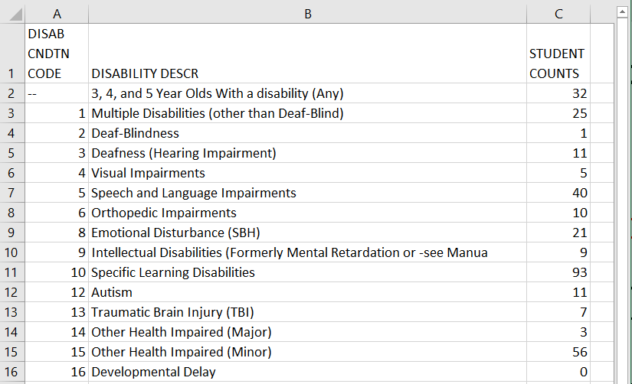
Open the FCC Statement of Assurances Report
Format the report
by wrapping the
text in the header
row and expanding
all columns
Notes:
Presenter open (FCCS-001) Statement of Assurances DEMO spreadsheet. Remind attendees to use the most recent version of the Summary Report and if matching it to the Detail Report, use the same version. Explain that if the student is not appearing correctly on the Detail Report they will also appear incorrectly on this report. This report has not been updated with changes that have been applied the FCC Detail report.

Slide 42
Understanding Statement of Assurances
The report includes
only students who have a FED CCT Flag = Y
all students age 3 to 5 in the first category
students age 6 to 21 in each disability specific category
Using the above criteria, the next series of slides will match the FCC Detail Report against the FCC Statement of Assurances Report
When you are told that the counts on this report are incorrect, filtering allows you to show which students are included or not included
Notes:
This session is intentionally using a more basic filtering comparison. For those of you that are Excel experts, feel free to add additional Excel tips for matching the data between reports such as a pivot table if your audience is ready for that level of Excel instruction.

Slide 43
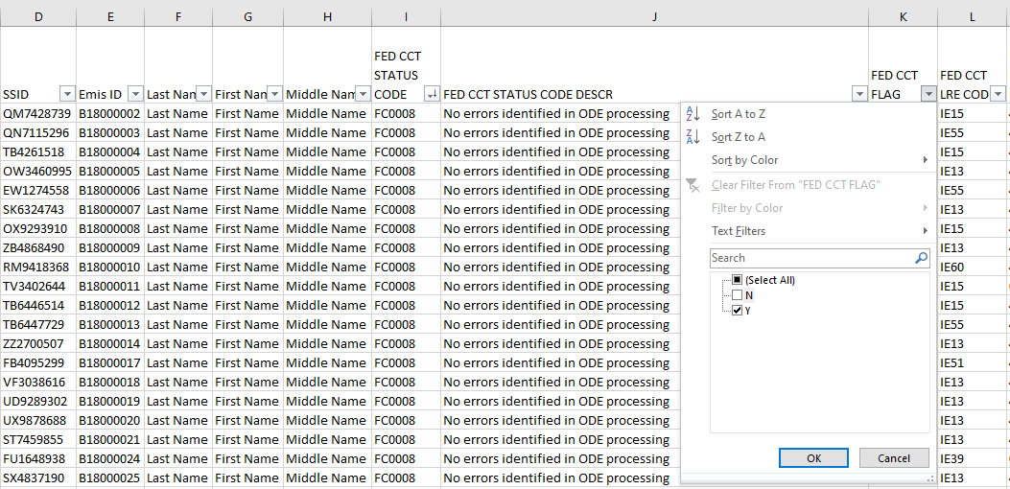
Filter on FCC CCT Flag
Select Y on the
FED CCT Flag Filter on
the FCC Detail Report
These are the students
who are included in
the Statement of
Assurances Report
Notes:
We are going to leave this first filter on as we add additional filters.

Slide 44
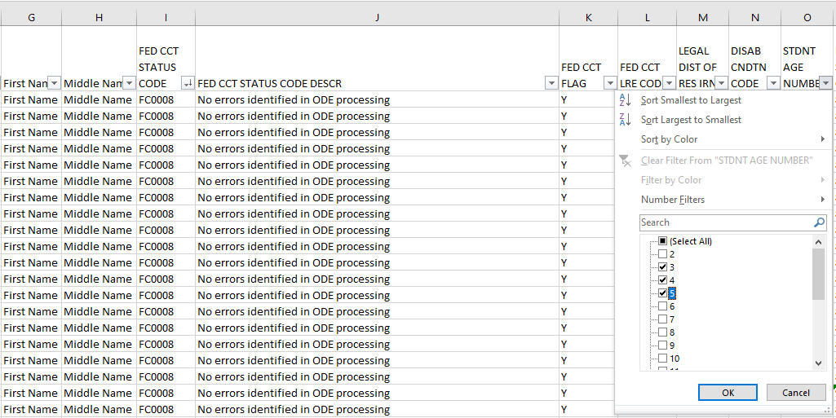
Add Second Filter on Student Age Number
Select ages 3, 4 and
5 on the Student Age
Number Filter
These students are included in the 3,
4, and 5-year-olds with any disability on the Statement of Assurances report
Notes:
We are adding a second filter to further narrow down the selection.

Slide 45
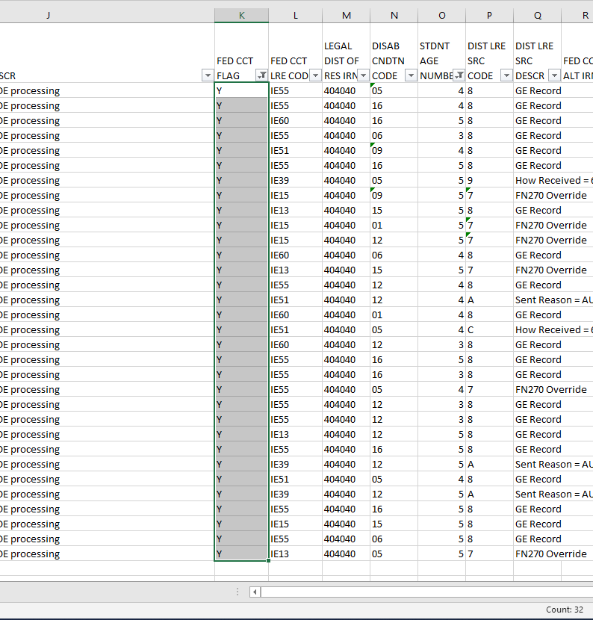
Matching Data Between Reports
2. This will match the count on the Statement of Assurances.
1. From the filtered students on the FCC Detail Report, select a range of cells and see the “count” appear at the bottom of the spreadsheet.
Notes:
Selecting a range of cells that contains numerical values will give you three values at the bottom, Average, Count, and Sum. Be sure to use the Count value in this example. When selecting a range of cells that contains values other than text, Excel will display just a Count value. It could be less confusing to users to select a range of cells with text values such as the FED CCT Flag column that only contains N and Y values.

Slide 46
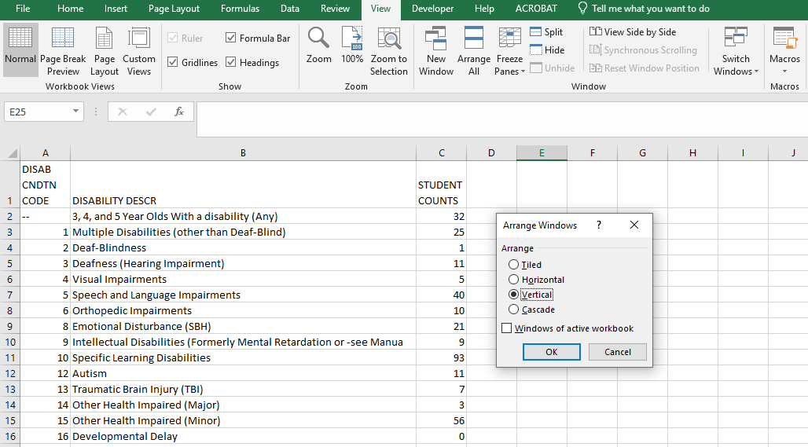
Arrange All
With two spreadsheets
open at the same time, from the View tab select “Arrange All” and then “Vertical” and “OK”
Notes:
Using the Arrange All feature in Excel will allow users to easily view both reports at the same time. People with two monitors might not need this but others might find it very useful.

Slide 47
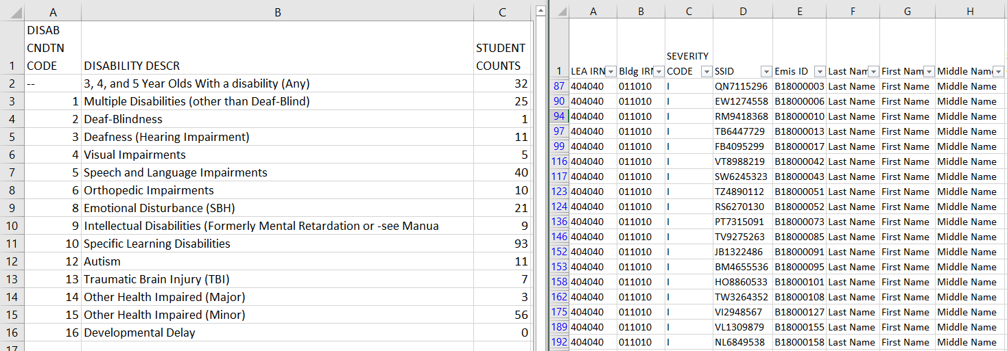
Arrange All cont’d
“Arrange All” allows both spreadsheets to be viewable at the
same time
Notes:
When spreadsheets are side by side it is much easier to compare the data.

Slide 48
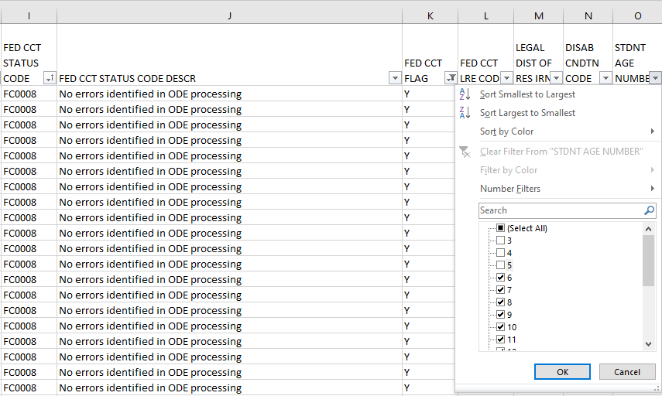
Change the Student Age Filter
Leave the FED CCT Flag
Column filter set to
show only Y values
Change the filter for the Student
Age Number column to include
all ages except 3, 4, and 5
Notes:
Next we are going to look at each specific disability category.

Slide 49
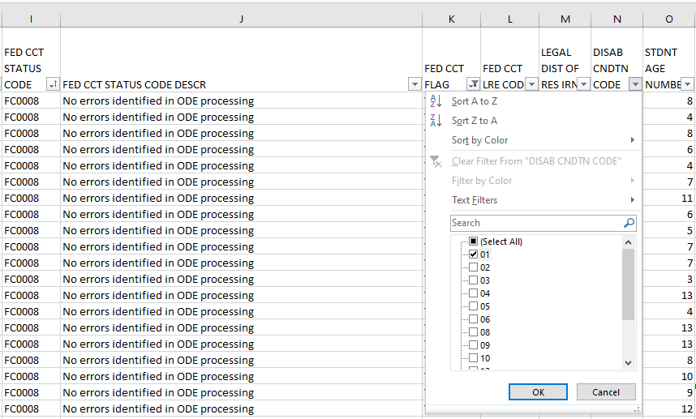
Add a Third Filter
Add a third filter in the DISAB CNDTN CODE column
Select one disability
code at a time
Notes:
Start the Disability filtering process by selecting disability code 1. Demonstrate how this matches the Statement of Assurances Report for each disability code.

Slide 50
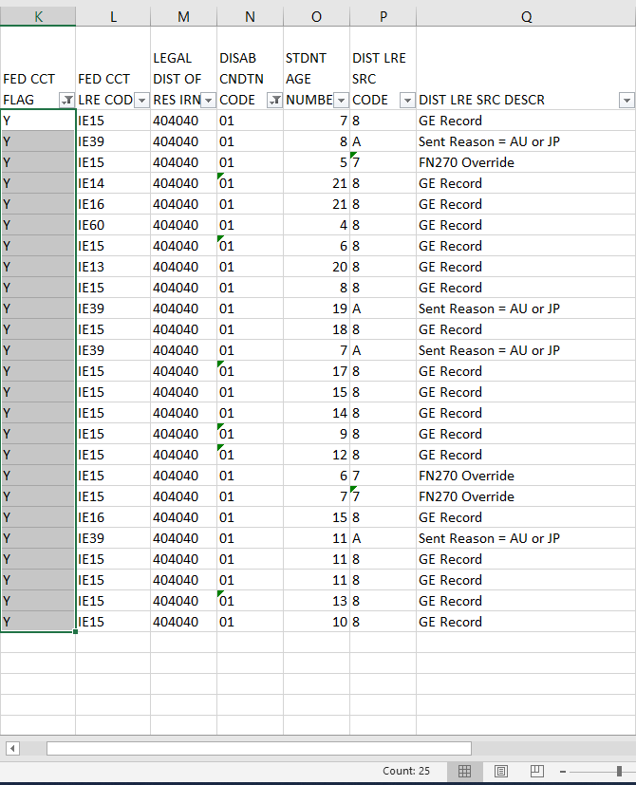
Match the Data Between the Reports
1. From the filtered students on the
FCC Detail Report, select a range
of cells and see the “count” appear
at the bottom of the spreadsheet.
2. This will match the count on the Statement of Assurances.
Notes:
Continue to work through each disability code to match the data between the reports. To see the total number of students, unselect the disability and age filters and select all records in the FED CCT Flag column and see the Count value. This will match the Sum value of the Student Count column on the Statement of Assurances Report.

Slide 51
Quick Check
Can you match the data between the two reports using filters?
Are you seeing the numbers of students that you were expecting?
Has this data been shared with others in your district?
The Federal Child Count Statement of Assurances Report is derived from the same data that is on the FCC Detail Report. Using filters, you can match the data between the reports. The Statement of Assurances is sometimes requested by auditors.

Slide 52
Summary
The FCC Reports contain both data to verify and issues to correct
Some issues can be corrected, and some are simply stating the fact that the student cannot be included in the count
Work with district staff to verify that the data is both correct and complete
“No errors” does not necessarily mean that your data is accurate

Slide 53
Resources
Federal Child Count Detail Report and Federal Child Count Statement of Assurances Report Explanation
ODE Home > Data > EMIS > Documentation > EMIS Validation and Report Explanations
EMIS Manual
ODE Home > Data > EMIS > Documentation > EMIS Manual
Your district staff
Your ITC

Slide 54
Questions?
If you would like a certificate of attendance for this
training, you must complete the below feedback form
within 5 business days of this training
https://tinyurl.com/EA-District-Feedback
Notes:
Presenter- Insert your contact information on this slide.

