Slide 1
Troubleshooting the Teacher Licensure Course Status Report
Notes:
It would be helpful for attendees to have a copy of the TLC Status Report Explanation as well as access to the EMIS manual.
See Ticket 104996 for details:
Q. I have received questions from some district EMIS Coordinator "inquiring minds" related to potential changes in EMIS staff requirements due to the nationwide teaching shortage. Do you know if anything is in the works with our legislation to allow more flexibility for licensure requirements as related to the TLC report?
A. To our knowledge, there have been no changes to the requirements relating to teachers being licensed for the courses they teach. These requirements are set forth in Ohio Revised Code, and the Ohio Legislature has made no changes to the law, whether temporary or permanent.

Slide 2
The Ohio Department of Education funds development of EMIS training materials as part of the EMIS Alliance grant. There is an expectation that ITCs will utilize these materials in training provided to your districts. That said, there are restrictions on use of the EMIS Alliance materials as follows: Materials developed as part of the EMIS Alliance program must be provided at no cost to your training participants. If you utilize the EMIS Alliance training materials – in whole or in part – you must not charge participants a fee to attend the class where the materials are used. Likewise, you may not use the materials or any portion thereof in any event where a fee is charged to attend. Exceptions must be approved in writing by the Department of Education in advance of scheduling/promoting any event which may violate these restrictions.
Questions regarding appropriate use of EMIS Alliance materials, or requests for exception to the restrictions noted above, should be directed to Melissa Hennon [Melissa.Hennon@education.ohio.gov].

Slide 3
Overview
Teacher Licensure Course (TLC) Status Report
  Includes all courses reported to EMIS and the proper certification status of the teacher of record
  Is generated for all EMIS reporting entities and updated nightly
  Is used to provide data for Local Report Cards (LRC), certain state and federal funding, and for ODE program evaluation and planning
This presentation will focus on troubleshooting the TLC Status Report, which is generated during the Initial Staff and Course (L) Collection
Notes:
The FY23 Initial Staff and Course Collection is scheduled to close on January 31, 2023.

Slide 4
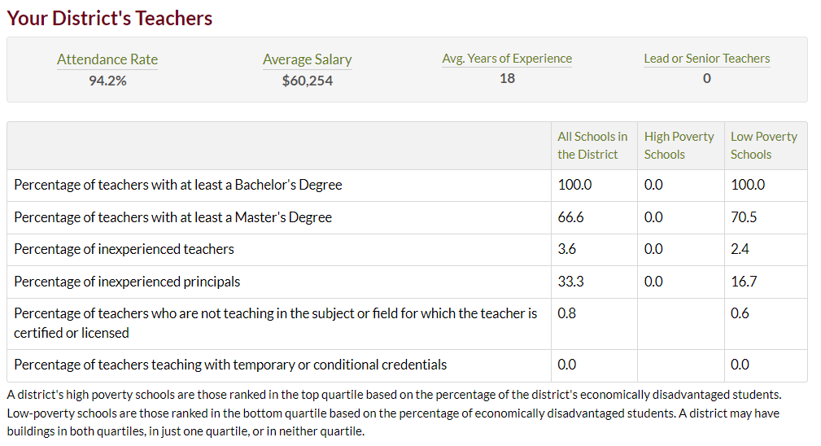
Certification Data on LRC
The LRC contains data from the Initial Staff and Course Collection that is used to populate the school or district details
https://reportcard.education.ohio.gov
Notes:
This is just a segment of the data that appears on the LRC using data from the initial staff and course collection. Temporary and conditional credentials can be seen in the Educator Profile Search.

Slide 5
TLCS Data Uses
ODE Federal Programs Office to audit the use of Title I Funds to generate the ESSA State Licensure Assurances Report
  20##L_PRIN_ESSA_Licensure_Assurances_<file date>.pdf
  Arrived as a Received file in FY22 in February 2022
  Displays all core courses, by staff member, and building
  Report contains instructions and ODE contact information
  See EMIS Validation and Report Explanations > File Descriptions on the ODE website for additional information
  ESSA requires schools and programs receiving Title I funds to ensure that all teachers and paraprofessionals working in a program supported with these funds meet applicable State certification and licensure requirements
  Wrong staff name on ESSA report?
    two districts report the same state ID but with different names attached
    Incorrect name does not impact actual data since ODE only uses State Staff ID
Notes:
ESSA file description: “This Assurances report reflects the State certification and licensure determination for each core academic course. It is based on the EMIS Teacher Licensure Course Status Report”
Changes made to data in Final Staff and Course (L) will not be included in this report. When a staff name appears incorrectly on the report, multiple districts could be reporting the State Staff ID with different names or spellings OR the state staff ID is incorrect for one of the schools. An incorrect name does not impact actual data since ODE only uses the State Staff ID. See ticket 105907 for details.
Wrong staff name on the ESSA report. ODE does not use the name, the state ID is used. As long as the state ID is reported correctly, the calculations and numbers and such will be correct. And in these situations, the name could change from report to report. It’ll depend on the order in which the data is processed and whether the right name came first or last. And that can change. If districts have this issue, they can have their ITC put in a helpdesk ticket. We do find the other district and reach out to try to get them to correct the data.

Slide 6
TLCS Data Uses, cont’d
By the ODE Office of Educator Effectiveness to provide districts the Equitable Access Analysis Tool to use for Title I equity planning
  Contains Percent and FTE of teachers who are not properly certified
  Same as last year, districts will access this via the SDC in January
    Uses previous year’s data – FY22 reporting will be used by your district in FY23
  Questions – equity@education.ohio.gov
  Local equitable access planning requirement in the ED STEPS
    The tool allows educators to identify where, and to what extent, any inequities in access to excellent educators exist
    https://education.ohio.gov/Topics/Teaching/Educator-Equity/Educator-Equity-in-Ohio/Local-Equity-Plan-1
Notes:
See Ticket 103549 details:
Q. Supt has the following question: The Local Equitable Access Planning Analysis Tool reported that we had "out of field courses" being taught at McCormick (022244). This would by for FY21. How can we determine which courses those were?
I searched some other tickets - most of them didn't pertain or said to contact equity@education.ohio.gov. Another mentioned to see the Departments resources on Local Equity Plans. In looking at the Resource guide - I see that "Out of Field Teachers" (not courses) - defined as "A teacher who is teaching a core academic course that he or she is not licensed to teach". In reviewing the district's TLC for FY21 - there were 4 critical errors for teachers/courses but all 4 of those were not certified because there were no students in the course.
Is this the reason for the district having "out of field courses"?
A. Yes, if a course is judged to be not properly certified because it has been reported as having 0 student enrollment, that would show up in the Equitable Access tool. Reviewing the TLC Status report or the ESSA Assurances report is one way to see this.
Note that for 2022, the list of such courses is immediately available to each district through the Equitable Access Analysis Tool in the SDC under the “District Out of Field Courses” tab.

Slide 7
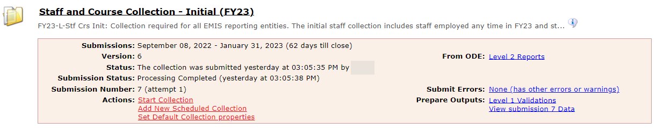
TLC Status Report
To access the TLC Status Report, select the Level 2 Reports link from the Staff and Course Collection – Initial (FY23)
But first, let’s take a quick look here
Notes:
First look at the “View submission” link and then demonstrate how to generate the TLC Status Report in the Data Collector by following the Level 2 Reports link in the Staff and Course Collection – Initial FY23 Collection.

Slide 8
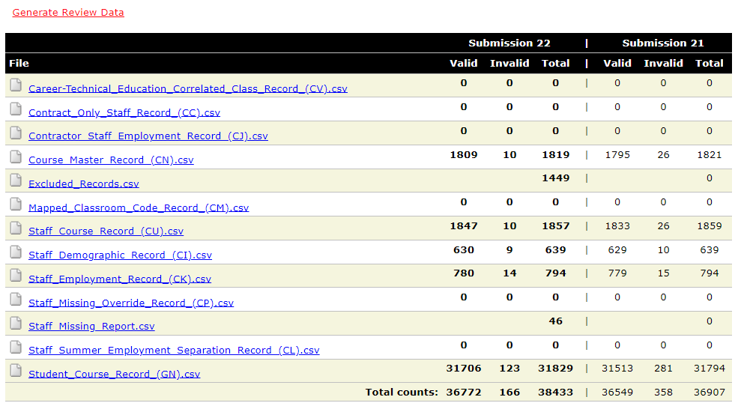
View Submission Data > Generate Review Data
Verify data in the Initial Staff and Course Collection
Are there invalid records that need to
be corrected? Review Level 1 Validations.
Are there Excluded Records
that are preventing data
from being reported?
Are there missing staff records?
Incorrect data = Incorrect TLC Report
Notes:
If this data is not correct, they should expect their TLC Status report to have incomplete or inaccurate data. If there are courses that are not making it onto the report your LRC data will be incorrect.

Slide 9
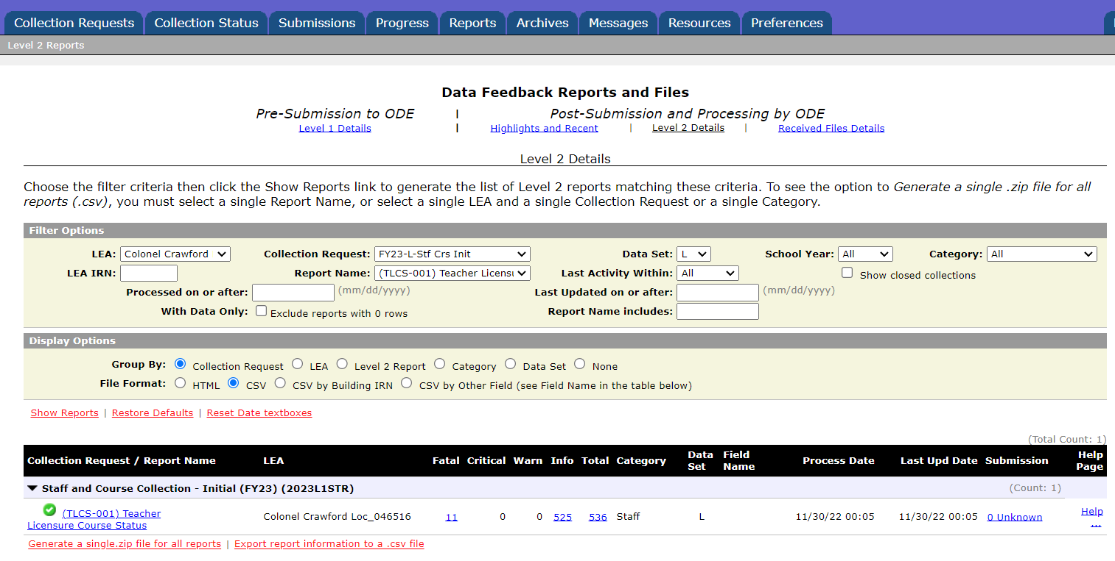
TLC Status Report - Level 2
Verify that filters are correct
then select “Show Reports”
Notes:
Demonstrate the steps to access the TLC Status report. Note that TLC Report was selected in the “Report Name” filter. Allow attendees to open their reports and prepare them on the next slide.

Slide 10
Formatting the TLC Status Report
Open the (TLCS-001) Teacher Licensure Course Status Report
  Wrap text header row
  Freeze top row
  Expand all columns
  Apply filters
Better yet, use your macro! EMIS Alliance Excel
  https://community.mcoecn.org/display/EM/FY22+EMIS+Alliance+Using+Excel+to+Troubleshoot+EMIS+Data
  https://community.mcoecn.org/display/EM/FY21+EMIS+Alliance%3A+Using+Excel+to+Troubleshoot+EMIS+Data
  https://community.mcoecn.org/display/EM/FY20+EMIS+Alliance%3A+Using+Excel+to+Troubleshoot+EMIS+Data
  https://community.mcoecn.org/display/EM/FY19+EMIS+Alliance%3A+Using+Excel+to+Troubleshoot+EMIS+Data
  https://community.mcoecn.org/display/EM/EMIS+Alliance%3A+FY18+Using+Excel+to+Troubleshoot+EMIS+Data
Notes:
Presenter can use the (TLCS-001) Teacher Licensure DEMO.xlsx report for this demonstration.
Demonstrate these steps of preparing the report and the attendees can prepare their own report as you demonstrate the Basic Excel steps.
Select top row and select Wrap Text from the Home Tab.
While the top row is selected, from the View tab, select Freeze Panes and Freeze Top Row.
Select entire spreadsheet (click cell between Row 1 and Column A) then place cursor on the line between any two column headers and double click.
While spreadsheet is highlighted, from the Data tab, choose Filter (or from the Home Tab select Filter)

Slide 11
Quick Check
Are you using the most recent version of the report?
  TLC
  ESSA State Licensure Assurances
  Equity Analysis
Have you corrected Level 1 Validation errors, excluded records, and missing staff?
Are you able to open and format your TLC Status report?
The TLC Status Report is updated nightly and should be reviewed throughout the Initial Staff and Course Collection. Data on your report could appear based on another entity’s reporting, so review the report even when you are not reporting any changes.
Notes:
As a best practice, encourage districts to keep notes from previous troubleshooting of these reports to save time as the reports continue to be generated.

Slide 12
Understanding the TLC Status Report

Slide 13
TLC Status Report Data
Data from the following collections are used to generate the TLC Status Report
  Staff and Course (L) Collection - Initial
  Final Calendar (C) Collection
  Beginning of Year Student (S) Collection
  Midyear Student (S) Collection
  SOES Beginning of Year Student (S) Collection
  SOES End of Year Student (S) Collection
Verify data is correct and complete in ALL noted collections
Report is generated nightly with data submitted by 5pm throughout the Initial Staff and Course Collection
The TLC Status Report is finalized at the close of the Initial Staff and Course (L) Collection
Notes:
It is important to understand that the TLC Status Report is finalized when Initial Staff and Course (L) closes. Since the TLC Status Report uses data from many collections it is necessary to carefully and thoroughly verify that the data is correct and complete.

Slide 14
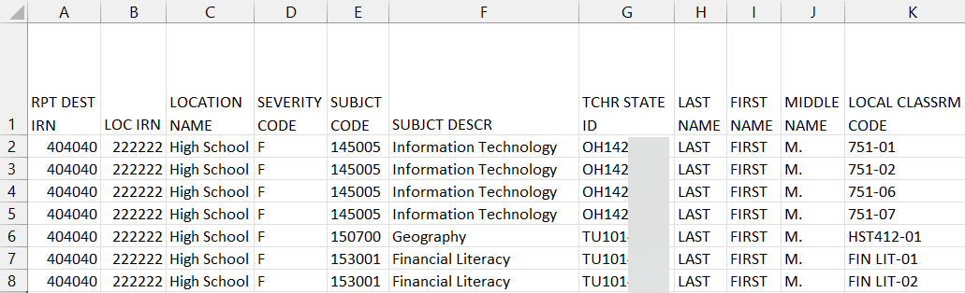
TLC Status Report Data
Contains one row per Local Classroom Code
  First 11 columns A- K include:
    Location IRN of the building where the course is being taught
    Subject Code, Description, and Local Classroom Code
    Teacher of Record and State Staff ID
    Blank or incorrect staff name
      CJ record issue – not reported by another EMIS reporting entity (example: ESC)
      Could be due to upper- and lower-case letters in state staff ID - Verify ID
        Create helpdesk ticket to ask ODE about blank or missing names if needed
Severity Codes align with Result Codes which
will be discussed in upcoming slides
Notes:
We are going to move across the report to discuss the data that is contained in the report. Note that the RPT DEST IRN is the entity that is receiving the report. If the staff name on the report is incorrect for the state staff ID you are reporting, create a ticket to the EMIS helpdesk for assistance.
Be sure state staff ID is uppercase

Slide 15
Verify Staff and Courses
Do not focus on errors only; review the entire report for accuracy and completeness
  Are all building IRNs appearing on the report?
  Are all teaching staff appearing as they should?
  Are all courses for each building appearing on the report?
Remember that total courses are the denominator for Local Report Card staff percentages, so it’s important that every course is accounted for

Slide 16
Teacher of Record
The teacher who appears on the TLC Status Report is based on
  Teacher with greater amount of time teaching the course
  Multiple teachers teaching the same amount of time
    Uses first teacher the report finds who is properly certified
    If none are properly certified, the report uses the first teacher it comes to
      It could change from report to report depending on the processing order
  No proper credential found
    Uses first teacher reported on the course
See ODE ITC EMIS Training November 2021 & 2022 for additional information
  https://education.ohio.gov/Topics/Data/EMIS/EMIS-Resources/EMIS-Training
Notes:
See Ticket 105931 for details:
Q. District is noticing some discrepancies on their TLC report for course CEHS-BUS101. All sections of this course are taught by the same two teachers, each for half of the semester while the other teaches the other half. One teacher is certified to teach the course and one is not. We thought the teacher who teaches the course for the longer period of time would be the one to appear on the TLC report, but this does not seem to be the case.
For example, CEHS-BUS101-11 is taught by the certified teacher for 46 days and is taught by the non-certified teacher for 45 days, yet the non-certified teacher is who is appearing on the report. Could you clarify who the TLC report chooses in cases like this and why?
A. It's a little more complicated than simply counting the days the teachers are assigned to the course. We look at:
The greater of the staff course start date and the course start date and the least of the course end date and the staff course end date.
We count those days.
We also count the days between the course start and end dates.
We then take the percentage of those two values to determine the teacher's percent of time for the course.
We do that for all teachers reported as the teacher of record for the course.
The teacher with the greater percent of time is the person assigned to the course on the TLCS report.
It counts all days between the relevant course dates.

Slide 17
Course and Calendar Dates
Dates are used to determine a “course calendar”
  Grade Schedule (DL) Record - First and Last Day of School
  Course Master (CN) Record - Course Start and End Date
  Staff Course (CU) Record - Staff Course Start and End Dates
  Student Course (GN) Record - Course Enrollment Start and End Date
The “course calendar” is then used to determine
  Teacher who was with the course the longest
  Students who are counted as being in the class
  Location IRN is used for course calendar assignment
Misaligned dates can cause teachers to appear as not properly certified
Notes:
See ticket 105817 for details
Q. TLC report for Logan Hocking has a course listed with a result code TL0006 -
Course is Not Properly Certified as no students scheduled into the course and the Student Counts are all showing 0. Looking at the Student Course Record, the one student in the course is listed.Local Classroom code is 000000021246-3201D-4
Student assigned to course on 9/14/2022
A. It looks like they're reporting a student enrollment end date of May 25 and a course end date of December 16. One of those needs to be corrected.

Slide 18
Location IRN-Column B
The building IRN where course is being taught
  District IRN should not be reported as the Location IRN
  Applies to LEAs that have both district and building IRNs
    Traditional Districts
  Refer to reporting instructions in the EMIS Manual for Location IRN in section 4.2 Course Master (CN) Record
  Filter TLC Report for Location IRN
    Unselect local building IRNs
    Verify Location IRN’s reported outside of District
    Local district IRN should be changed to building IRN (when applicable)
Notes:
There are additional reporting instructions for Location IRN in the above referenced section of the EMIS Manual that should be carefully reviewed. It is very important to report a building IRN as the Location. LEAs that have both district and building IRNs should not report their district IRN as the Location IRN.

Slide 19
Location IRN Column-B
A few exceptions (not a complete list)
  IRN of college who is granting credit for CCP course
  For CCP Course with delivery method of CP report the IRN of the location of the course per the CTE-26
  IRN of the location of the JVSD satellite course
  IRN of the building associated with the preschool license
  See additional reporting instructions for the Location IRN in the 4.2 Course Master (CN) Record section of the EMIS Manual
Notes:
There are additional reporting instructions for Location IRN in the above referenced section of the EMIS Manual that should be carefully reviewed. It is very important to report a building IRN as the Location. LEAs that have both district and building IRNs should not report their district IRN as the Location IRN.

Slide 20
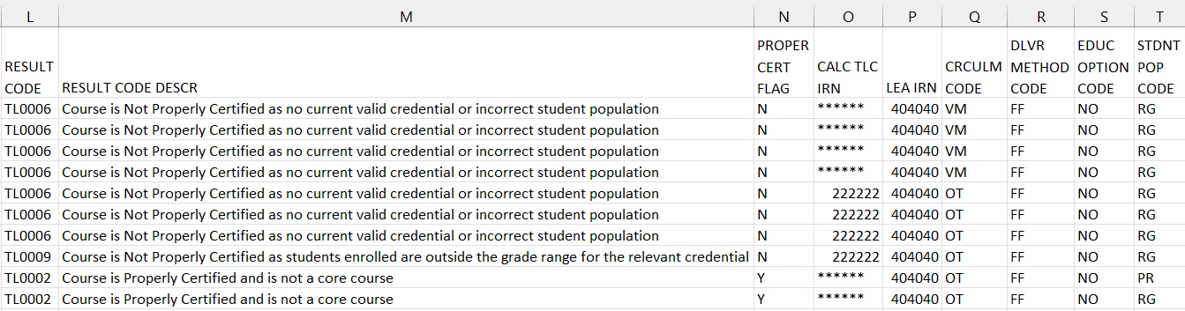
TLC Status Report Columns
Moving to the right, the next set of columns L through P contain
  Result Codes with Descriptions L-M
  Proper Certification Flag (Yes or No) N
  Calculated TLC IRN (derived from reported data) O
  LEA IRN (IRN of the LEA reporting the course) P
Calculated TLC IRN is derived from reported data
  LEA IRN is entity reporting the course
Notes:
Note that result codes could change between reports if the staff member has more than one applicable result code for a course.

Slide 21
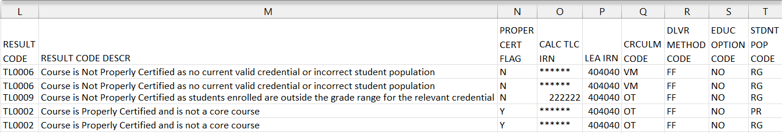
TLC Status Report Columns, cont’d
Course elements – appear on the report for ease in troubleshooting Q-T
  Curriculum Code Q
  Delivery Method Code R
  Education Options Code S
  Student Population T
    Population of students for whom the curriculum is intended and not about the students who are actually enrolled
Different errors for the same staff member over multiple reports
  Both result codes (TLxxxx) could apply
  Error can change due to the order in which things are processed
  Could potentially change from report to report
Notes:
We will review the Result Codes and Descriptions as well as the Calculated TLC IRN on upcoming slides. Note that the Student Population element is the population of students for whom the curriculum is intended and not about the students who are actually enrolled.

Slide 22
Special Ed vs Regular Student Population
Student population reported based on the content/structure of the course
  If modified for special education population, report with an SE student population
    Teacher must hold a special education license to appear as properly certified for an SE course
    Certification and Licensure Search does not include courses coded with a student population = SE
    As far as the TLC Status Report is concerned, someone with a special ed license can teach any subject in a special ed classroom
  If not modified for special education population, report with an RG student population
    Teacher must hold a regular education license to appear as properly certified for an RG course
  Do NOT modify student population to remove an error
  Always report “What is”
Notes:
http://webapp1.ode.state.oh.us/emis/certification/disSearch.asp
Intervention specialist license, the teacher would be properly certified to teach special education courses. They would not be properly certified to teach regular education courses.
Special Ed. Intervention License
Must have 50% or more SE students
SE student population on course
Teacher must have 230/999414 position/assignment area
1 single student enrolled in course on a 504 plan will not pass cert. check
Ticket 101462 –
The student population should be reported based on the structure of the class. If it was modified for a special education population, then it should be reported with an SE student population.
If it was not modified for a special education population, then it should be reported with an RG student population.
If the course is reported with an SE student population, then the teacher needs a special education license to appear as properly certified on the TLC Status report
If the course is reported with an RG student population, then the teacher needs to have a regular education license to appear as properly certified.
Remember that the certification and licensure search does not include courses coded with a student population of SE. For those rules, see this link: http://webapp1.ode.state.oh.us/emis/certification/disSearch.asp.
As far as the TLC Status Report is concerned, someone with a special ed license can teach any subject in a special ed classroom.
Note that the general rule for special education licenses can be found here http://webapp1.ode.state.oh.us/emis/certification/disSearch.asp.

Slide 23
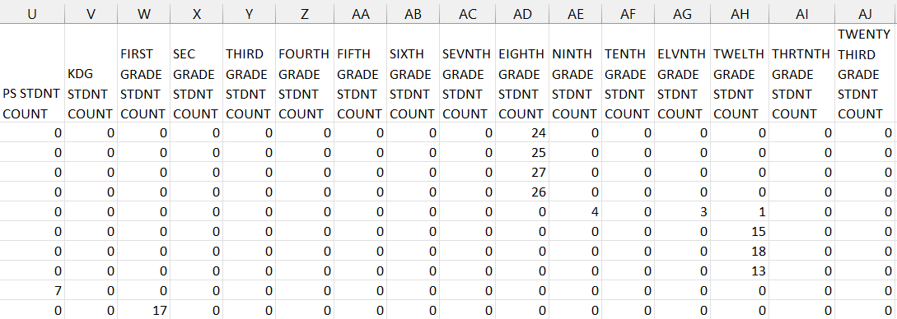
TLC Status Report Columns, cont’d
Columns U through AJ contain
  Count of students enrolled in the course by state equivalent grade level (both regular education and students with disabilities)
Cells can be blank if there are no students enrolled in the course
Or the students are not being populated onto the report
Notes:
The report looks at grade level at the time the data is processed to generate the report. Sometimes the data in these rows can be blank if there are no students enrolled in the course, or when the student data isn’t being populated onto the report. We will talk about this in upcoming slides.

Slide 24
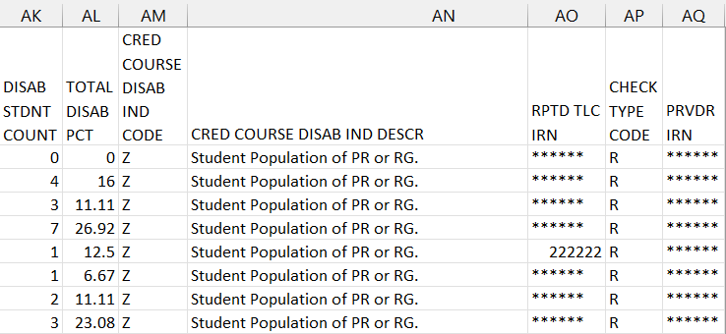
TLC Status Report Columns, cont’d
Far right columns contain AK-AQ
  Counts of students with disabilities and the percentage of those students in the course
  Credential Course Disability Indicator Code with Description
  Reported TLC IRN, Check Type Code and Provider IRN
Notes:
We will talk at length about the Credential Course Disability Indicator Code and Description as well as the Check Type Code, TLC IRN, and Provider IRN.

Slide 25
Reported TLC IRN-AO
IRN of the building where this course will be used in the calculation of the percentage of core courses taught by properly certified/licensed staff
Local, exempted village, or city school districts can report the IRN of one of their own buildings but should not report their district IRN for the TLC IRN
Refer to EMIS Manual 4.3 Staff Course (CU) Record to review all reporting instructions for this element

Slide 26
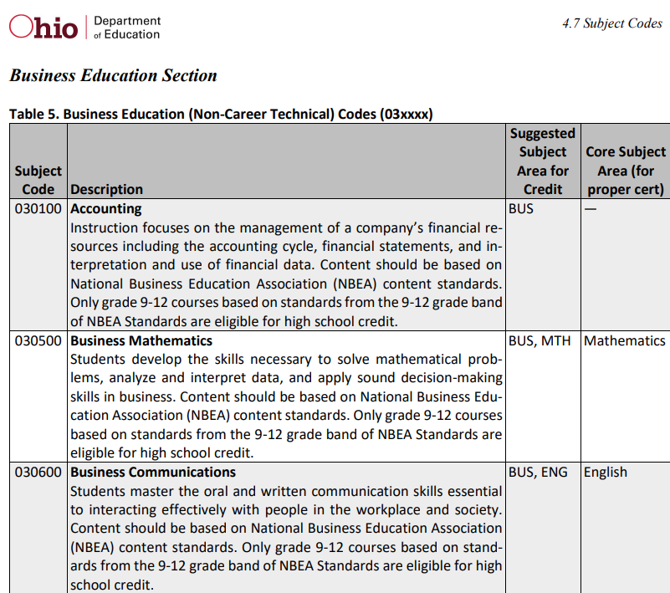
Core or Non-core?
A value in this column
indicates CORE subject
area while “—”
indicates a non-Core
subject code
EMIS Manual section 4.7 Subject Codes
Non-Core subject code
Core subject codes

Slide 27
Reported TLC IRN, cont’d
Report ****** for non-core courses and for core courses where
  Curriculum element is
    OC – Expert Contracted from Outside Company/Organization for Credit Flex, PS- College Credit Plus, or PI – Postsecondary Instructor (not CCP)
  or Delivery Method is
    CC – Correspondence Course, ET – Educational Travel, or OL - Online, and Educational Option is Yes
  or Delivery Method is
    ID – Interactive Distance Learning, IM – Internship/Mentorship, TO – Test Out, or CI – Computer as Instructor
  or Student Population is
    D8 – Preschool Special Education, DP – Preschool Special Education Hearing/Visual, or PR – Preschool General Education
Notes:
A link to additional Credit Flex information is provided in the resources section of this presentation.
Presenter should open the TLC IRN reporting instructions from section 4.3 Staff Course (CU) Record of the EMIS manual to view all of the reporting instructions for this element.
Credit Flex
http://education.ohio.gov/getattachment/Topics/Ohio-Education-Options/Credit-Flexibility-Plan/Credit-Flexibility-Guidance-and-Information-2018.pdf.aspx?lang=en-US

Slide 28
Reported TLC IRN, cont’d
When contracting a teacher of record from an EMIS reporting entity
  Two common situations-
  Contracted teacher is teaching only your students in a course in your building
    Report the building IRN as the TLC IRN (same as Location IRN)
  Contracted teacher is teaching students from multiple districts
    Report the district IRN of the contracted entity (Location IRN is building where class is being taught)
See 4.3 Staff Course (CU) Record section of the EMIS Manual for additional reporting instructions
Notes:
Note that some softwares will translate a blank value for TLC IRN to be the building where the course is being reported.

Slide 29
Reported TLC IRN, cont’d
Courses reported with a TLC IRN of another EMIS Reporting LEA should appear on both LEA’s TLC Status Reports when reported correctly
  Contractor Staff Employment (CJ) Records are required to be reported by the entity employing the staff member but are not needed for the course and staff to appear on both contracted entity’s TLC Status report
Work with contracted EMIS Reporting entities to verify that teachers and their courses are appearing correctly
Reporting Example
  District A reports courses
  ESC reports CJ record
Notes:
ODE ITC EMIS Training Q/A
Q14 How could another district’s reporting impact my district’s TLC Status Report?
A14 A common example is when a district contracts with an ESC for a teacher. If that ESC is not reporting a Contractor Staff Employment (CJ) Record that points to your district, then your report will show the related courses as not properly certified and with no staff data. It could also be that the ESC was reporting the CJ Record and then stopped reporting it. This would cause courses on your report that had previously appeared as properly certified to change to not properly certified with no staff data. This is why it is important to continue reviewing your report, even after you have finished reporting for your district.

Slide 30
Staff Provider IRN AQ
Reported on the Staff Course (CU) Record
  District IRN of the EMIS Reporting entity who employs the contracted staff
  Cannot be an IRN of a Non-EMIS Reporting entity
  Should be reported as ****** if the staff member is not being contracted from another EMIS reporting entity
  Must be reported when the entity reporting the course is not reporting Staff Demographic (CI) and Staff Employment (CK) records for the staff member
  Filter on Staff Provider IRN to verify accuracy of reporting
    Unselect ******
    Verify remaining Staff Provider IRN for accuracy
Notes:
CJ Contractor Staff Records
Explain guidance in reporting staff ID & provider IRN
Explain district responsibility to have that employee on TLC report

Slide 31
Derived Elements on TLC Status Report
Calculated TLC IRN - O
  In most cases the calculated TLC IRN will match the TLC IRN reported for core courses
  could be set to match the Location IRN when TLC IRN is reported as ****** or reported with an IRN that is not a valid public school
  non-core courses will be set to ******
Credential Course Disability Indicator- AM
  derived from reported student population and students with disabilities who are enrolled in the course
  are used to determine the Check Type
Check Type Code- AP
  indicates the credential check that was used
Notes:
We will explore the Credential Course Disability Indicator and Check Type Code on the next slides.
If a teacher that actually has an invalid cert that can’t be resolved, the IRN’s can play a bigger role for the building LRC because the building takes a hit and of course principals don’t want another building employee on the building level LRC. Verify Staff Provider, Location & Building IRN’s carefully.
I go an extra step in the pivot table and add filters to select them by building or I add it as the 1st option in rows.

Slide 32
Credential Course Disability Indicator -AM
Filter on A - Student Population of DP or SP
  DP-Preschool Special Education Hearing/Visual
  SP-Special Education K-12 Hearing/Visual
  More than 50% of the students in the course must have a disability condition
    Of these students, more than 50% must have a disability condition of
      1 (Multiple Disabilities-Other than Deaf-Blind)
      2 (Deaf-Blindness)
      3 (Deafness-Hearing Impaired)
      Can be all 3s or some combination of these three disability conditions
  Check Type Code is S – Special Situation Check
Notes:
This indicator is generated when a student population of DP or SP is reported. The report checks for a valid number of students with disabilities and also checks for the specific combination of disabilities. If it does not find the correct number/combination of students with disabilities, the indicator D will be assigned. Note that this check may not work correctly for preschool courses.

Slide 33
Credential Course Disability Indicator AM
Filter on B - Student Population of DP or SP
  DP-Preschool Special Education Hearing/Visual
  SP-Special Education K-12 Hearing/Visual
  More than 50% of the students in the course must have a disability condition
    Of these students, more than 50% must have a disability condition of
      1 (Multiple Disabilities-Other than Deaf-Blind)
      2 (Deaf-Blindness)
      4 (Visual Impairments)
      can be all 4s or some combination of these three disability conditions
  Check Type Code is S – Special Situation Check
Notes:
Just like indicator A, this indicator is generated when a student population of DP or SP is reported. The report checks for a valid number of students with disabilities and also checks for the specific combination of disabilities. If it does not find the correct number/combination of students with disabilities, the indicator D will be assigned. Note that this check may not work correctly for preschool courses. Credential Course Disability Indicator B is not on the DEMO file.

Slide 34
Credential Course Disability Indicator AM
Filter on C - Student Population of D8 or SE
  D8 - Preschool Special Education
  SE - Special Education K-12
  More than 50% of the students enrolled in the course must have a disability condition
  Course cannot fit into codes A or B
  Check Type Code is S – Special Situation Check
Notes:
This indicator is generated when a student population of D8 or SE is reported. The report checks for a valid number of students with disabilities enrolled in the course. If it does not find the appropriate number of students with disabilities, then indicator D is assigned.

Slide 35
Credential Course Disability Indicator AM
Filter on D - Student Population of DP, D8, SE, or SP
  DP - Preschool Special Education Hearing/Visual
  D8 - Preschool Special Education
  SE - Special Education K-12
  SP- Special Education K-12 Hearing/Visual
  50% or fewer of the students enrolled in the course have a disability condition
  Check Type Code is R – Regular Check
Notes:
This indicator is generated when a student population of DP, D8, SE, or SP is reported, and the check does not find the appropriate number of students with disabilities enrolled in the course. Since the course does not have the appropriate number of special education students enrolled, the report runs a Regular Check on the staff member’s credentials.

Slide 36
Credential Course Disability Indicator AM
Filter on E - Student Population of GA or GE
  GA - Gifted Education in arts delivered by trained arts instructor K-12
  GE – Gifted Education K-12
  Check Type Code is S – Special Situation Check
Filter on Z - Student Population of PR or RG
  PR – Preschool General Education
  RG – Regular/General Education
  Check Type Code is R – Regular Check
Filter on X – Does not fit into categories A, B, C, D, E, or Z
  Rare
  Means none of the above
  Verify proper certification flag has been set properly
Notes:
Courses reported as gifted courses do not look at student gifted records. Note that in rare cases, a Credential Course Disability Indicator of X could appear. X is essentially “none of the above”, meaning it does not fit into categories A, B, C, D, E, or Z. If you see an X, just verify the proper certification flag has been set correctly.

Slide 37
Regular Check Type Code AP
Filter on R – Regular Check
  Majority of courses
    Educational Option = No
    Student Population
      RG - Regular/General Students K-12
      PR – Preschool General Education
    Delivery Method = FF – Face to Face and OL – Online
    Curriculum code
      AP – Advanced Placement
      IA – International Baccalaureate AB INITO
      OT – Curriculum not specifically covered by another option
      Career Tech Codes
Notes:
The Regular Check Type Code looks for a non-special education certification for the teacher of record. Note that when a Regular Check is done on a course with a special education student population, it indicates that there are not more than 50% of the students with disabilities enrolled in the course.

Slide 38
Special Situation Check Type Code AP
Filter on S – Special Situation Check
  Educational Option = No
  Student Population
    DP - Preschool Special Education Hearing/Visual
    D8 - Preschool Special Education
    GA - Gifted Education in arts delivered by trained arts instructor K-12
    GE - Gifted Education K-12
    SE - Special Education K-12
    SP - Special Education K-12 Hearing/Visual
Notes:
The Special Situation Check Type Code looks for an early childhood, special education, or gifted intervention specialist certification for the teacher of record.
Special Ed. Intervention License
Must have 50% or more SE students
SE student population on course
Teacher must have 230/999414 position/assignment area
1 single student enrolled in course on a 504 plan will not pass cert. check
Ticket 101462 –
The student population should be reported based on the structure of the class. If it was modified for a special education population, then it should be reported with an SE student population.
If it was not modified for a special education population, then it should be reported with an RG student population.
If the course is reported with an SE student population, then the teacher needs a special education license to appear as properly certified on the TLC Status report
If the course is reported with an RG student population, then the teacher needs to have a regular education license to appear as properly certified.
Remember that the certification and licensure search does not include courses coded with a student population of SE. For those rules, see this link: http://webapp1.ode.state.oh.us/emis/certification/disSearch.asp.
As far as the TLC Status Report is concerned, someone with a special ed license can teach any subject in a special ed classroom.
Note that the general rule for special education licenses can be found here http://webapp1.ode.state.oh.us/emis/certification/disSearch.asp.

Slide 39
Any Certification Check Type Code AP
Filter on A – Any Certification Check
  Educational Option = YS *OR*
  Delivery Method of
    CI – Computer as Instructor
    ID – Interactive Distance Learning
    IM – Internship/Mentorship
Filter on N – No check required
  Courses with Curriculum Element
    OC – Expert Contracted from Outside Company/Organization for Credit Flex
    PI – Postsecondary Instructor
    PS – College Credit Plus
  Educational Options = YS
    Delivery Method = TO, ET, IS, IM, OT (community service, work-based learning)
Notes:
The A Check Type looks for any certification for the teacher of record. The N Check Types indicates that no check is required. Educational Options include - testing out, educational travel, independent study, internships, community service, work-based learning.
Clarification on Educational Option – Cherwell ticket 6874, Question asked for additional clarification and if a course being offered online with no other unique elements/circumstances could be reported as an Educational Option. Response from ODE- “Educational options are largely determined locally. However, there is generally more to them than just being taught online. As you said, there needs to be an instructional plan and oversight. And it is true that often the courses are not taught by district teachers. Though that's not always the case. They're also generally unique to a student, not to an entire class of students. So, for instance, there may be one student traveling abroad and a plan has been developed to allow that student to learn while traveling and incorporates their travels into their curriculum. Unfortunately, I really cannot provide more guidance on educational options. However, I can say that if the district is essentially just providing their regular classes online--whether the entire district is doing online education or students can elect to attend online or in person--it is not an educational option. Many districts are offering online courses this year; some are 100% online, some are hybrids between face to face and online. They shouldn't be reporting them as educational options. They're making changes to keep kids and communities safe; they're not creating special instruction plans to offer educational options.”

Slide 40
Community School Check Type Code AP
Filter on C – Community School Course
  Traditional district regular checks are run and if the Properly Certified Flag is set to N, additional checks are run that allow for any regular teaching license or any substitute license
  This does not apply to special education checks

Slide 41
Quick Check
Have you reviewed your EMIS data for accuracy and completeness?
Are all courses and teaching staff appearing on the report?
Have you shared the data with staff who can assist with data verification?
The TLC Status Report uses a wide variety of data from many different collections. Taking time to verify that EMIS data is correctly reported will result in a clearer, more accurate TLC Status Report.

Slide 42
CORE Educator Search and Certification and
Licensure Search

Slide 43
CORE Database
The TLC Status Report
  looks at each course and at data regarding the teacher’s current credentials from the CORE database
  determines if the staff member is appropriately credentialed to teach the
    subject code
    student population
    grade level(s) of the students scheduled in the course
  Use the CORE Database/Educator Search to review teacher licensure information

Slide 44
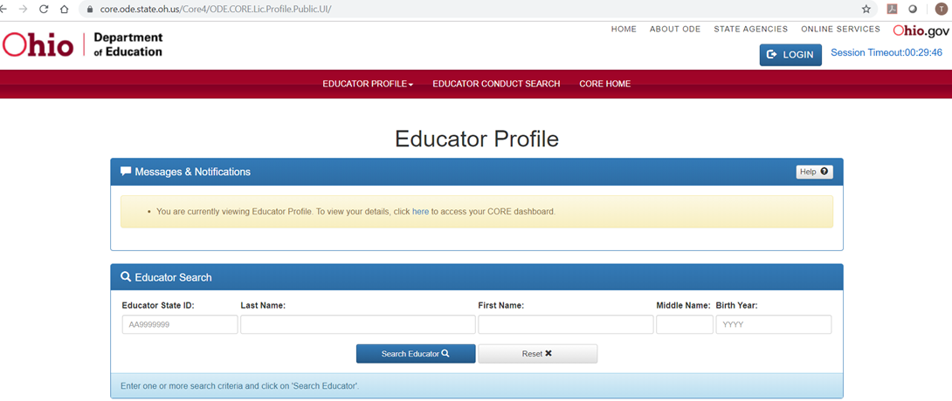
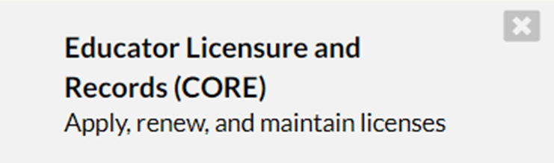
Educator Licensure & Records > Educator Profile
Access publicly from this page
https://core.ode.state.oh.us/Core4/ODE.CORE.Lic.Profile.Public.UI/
OR click either link to log into OH|ID to access the CORE App
OR
CORE App
Notes:
Search the ODE website for “Educator Profile Search”. Bookmark the education search tool for quick access or log into your OH|ID account to access the Educator Licensure and Records (CORE) App. Searching by Educator State ID is the fastest way to find a specific person. Note the “Help” link which contains the User Manual, web page link, and contact information for the Office of Educator Licensure.

Slide 45
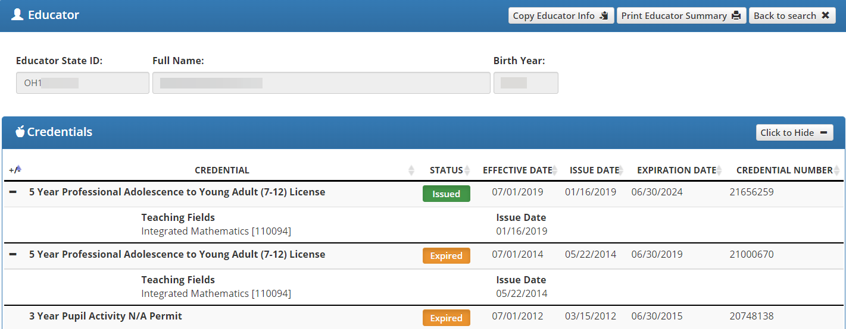
Demographic Information
Credentials are listed along with additional information below
Note the active license/certification
and teaching fields
Notes:
In the prior version of the educator search, it was necessary to click on “credentials” to view license information. Additional information includes application status, documents, account information, and assignment data. An active credential should have a status of “Issued”. Other statuses include inactive and expired. You can view the application status if you scroll down the screen.

Slide 46
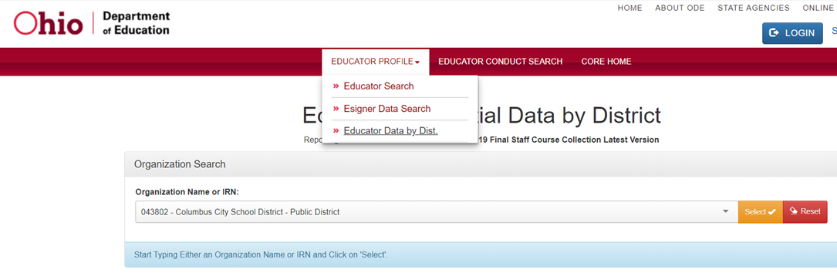
Educator Credential Data by District
In the Educator Profile dropdown menu, select Educator Data by District
Choose a school and then “Select” to download a spreadsheet of educator data
Notes:
This is a great way to get all data for a school/district into Excel. Note that the search also brings back nonteaching staff and expired certifications/licenses. Filter to exclude expired records from spreadsheet.

Slide 47
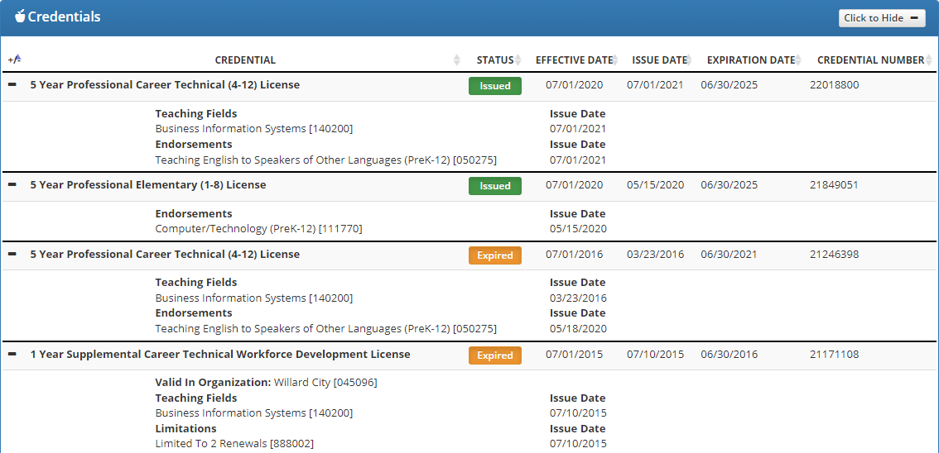
Teacher with Two Licenses
This teacher had a one-year license that is only valid in this district as well as a 5
year license
Note any limitations, teaching fields, or endorsements that may be listed
Notes:
Point out the “Issued” vs “Expired” status as well as the teaching fields, endorsements and limitations. Endorsements are similar to teaching fields and would be listed on the credential.
Teacher Cert Assignment Data (assigned to district)
OH|ID
Educator Licensure & Records (CORE)
Educator Profile
Assignment Data
Check if assigned to district

Slide 48
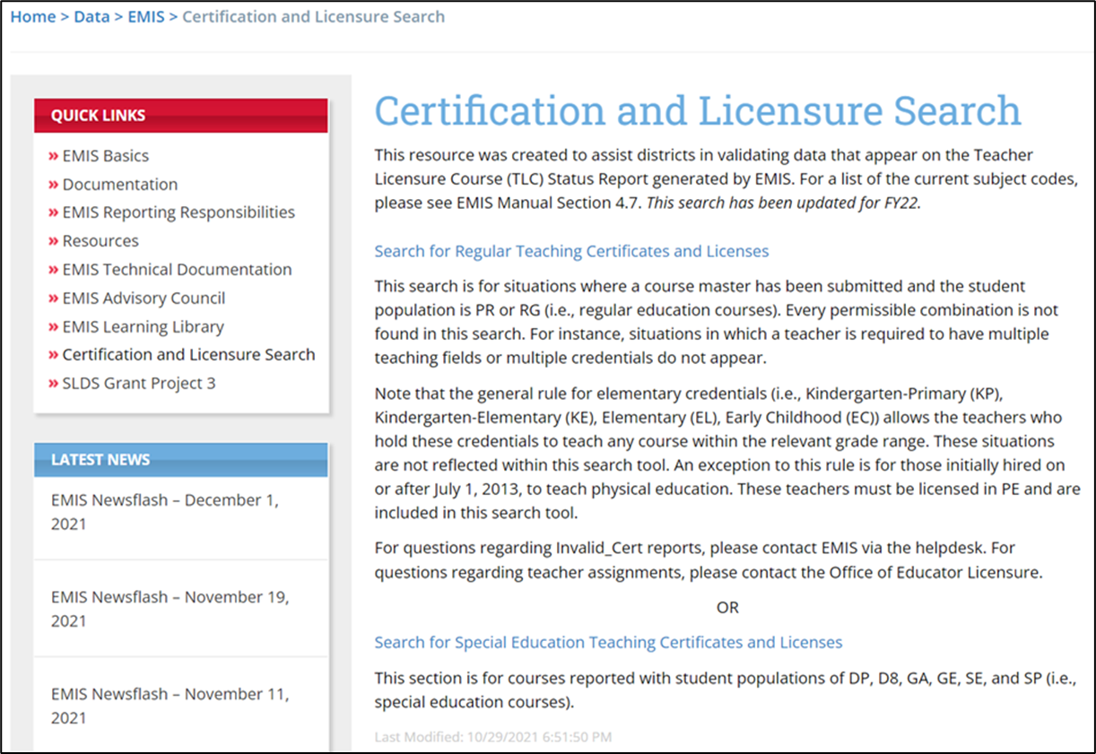
Certification and Licensure Search
READ ME
Student Population
PR – Preschool General Education
RG – Regular/General Students K-12
Link 2
Student Population
DP – Preschool Special Education
Hearing/Visual
D8 – Preschool Special Education
GA – Gifted Education in Arts…K-12
GE – Gifted Education K-12
SE – Special Education K-12
SP – Special Education K-12
Hearing/Visual
Link 1
Notes:
Please read the information on this page and discuss with the group. As it explains, not everything is searchable, and some situations will require districts to reach out to ODE EMIS or the Office of Educator Licensure. On the next two slides we will follow link 1 and link 2. Note that the Early Childhood Education Qualification element is used to report early childhood education teachers who have a degree but not a certificate or license and is reported on the Staff Demographic (CI) Record. See EMIS Newsflash – January 10, 2020, For any of your district’s preschool courses that are appearing on the Teacher Licensure Course (TLC) Status Report with a proper cert flag of N, be sure to review this element for the relevant teacher(s). For preschool teachers who meet one of the numeric options (1–6), accurate reporting will allow their preschool courses to appear on the TLC Status Report as properly certified. PS is not included in the proper cert numbers on the report card.

Slide 49
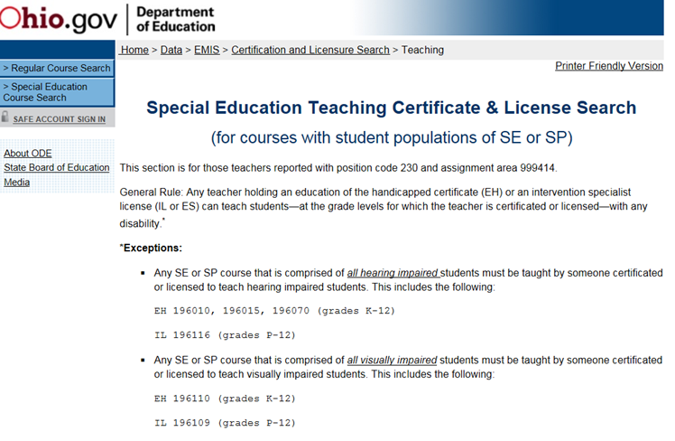
Link 1 – Special Education
Special Education Certification Information
Student Population
SE – Special Education K-12
SP – Special Education K-12
Hearing/Visual
READ ME
Assignment area 999414
Special Education K-12
General Rule
and Exceptions
Notes:
Explain that this is not a search but an explanation of the certification criteria for special education teachers.

Slide 50
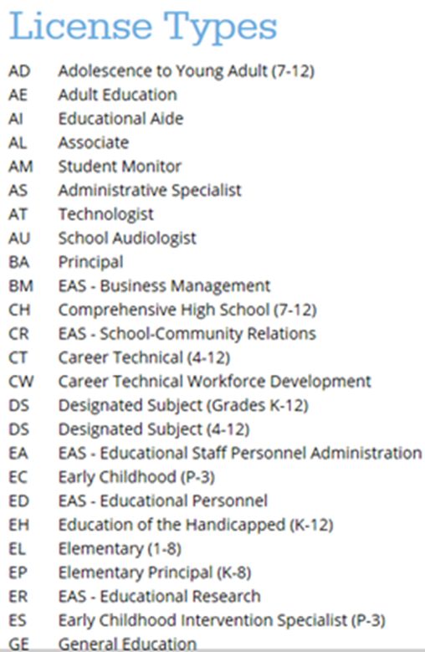
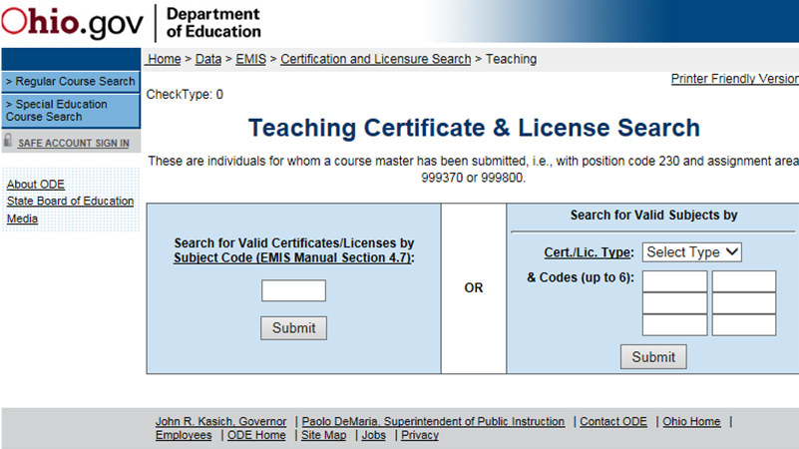
Link 2 - Teaching Certificate & License Search
Click on the Cert/Lic. Type link
to see a list of License Types
(this is not a complete list)
999370 - General Education K-12
and 999800 Career-Technical
Programs/Career Pathways
Notes:
If you look at the landing page for the search or the first page in any of the dictionary documents, you'll see the general rule for elementary credentials:
"Note that the general rule for elementary credentials (i.e., Kindergarten-Primary (KP), Kindergarten-Elementary (KE), Elementary (EL), Early Childhood (EC)) allows the teachers who hold these credentials to teach any course within the relevant grade range. These situations are not reflected within this search tool. An exception to this rule is for those initially hired on or after July 1, 2013, to teach physical education. These teachers must be licensed in PE and are included in this search tool."

Slide 51
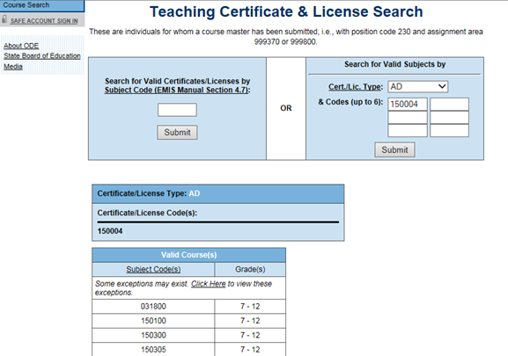
Search for Valid Subjects
Search by Certification/
License Type and Teaching Fields and Endorsements
Results are a list of subject codes and
grades that this combination of
Certification/License Type and codes
is properly certified to teach

Slide 52
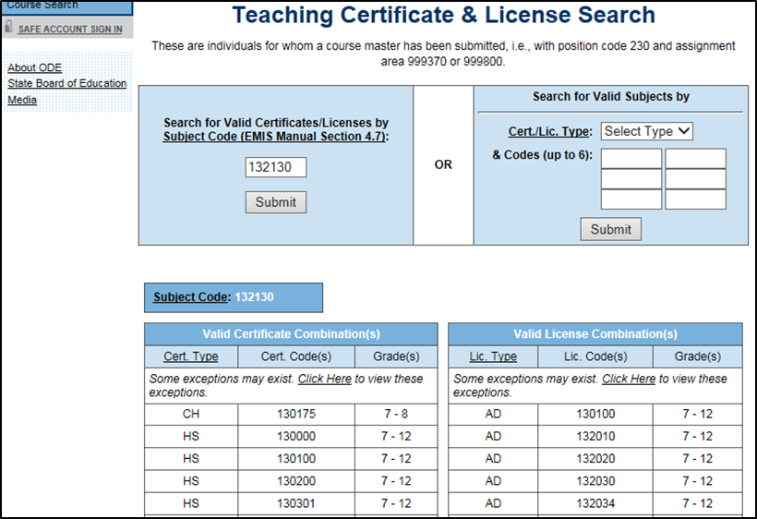
Search for Valid Certificates/Licenses
Search by
Subject Code
Results are lists of certificates/licenses along with teaching fields and grade levels that can teach this subject code
Notes:
Ticket 105755 - Computer Science 290245 (Manually address late Jan. or early Feb. if not updated):
Q. Can you guys please update the Teaching Certificate and License search page to add the Ohio subject code 290245 (Comp Sci K-8).
A. Because we don't have checks from the business office for these computer science courses, we have had to update the TLCS report manually. This is actually done by the data managers in the Office of Educator Licensure and is done either at the very end of the Initial Collection or just after it closes.
I am still trying to get those checks from the business office. My understanding was that they were close to having them ready, but I have not received them. I'm still hopeful we'll get these so that the report can correctly reflect these courses. However, if this doesn't happen, we are aware of this issue and we will manually address it... but not until late January/early February.

Slide 53
Quick Check
Are you able to use the CORE Educator Search Tool to view certification data?
Can you search using the Certification and Licensure Search by certification or subject code?
Are you involving your district’s Human Resources staff in this process?
The TLC Status Report checks against the CORE database to determine if a teacher is properly certified to teach a specific course. Searching the database can aid in troubleshooting the report.

Slide 54
TLC Status Report Result Codes

Slide 55
Properly Certified Result Codes L
Filter on TLC Result Code TL0001 (Informational)
  Core Course
  Proper Cert Flag = Y
Filter on TLC Result Code TL0002 (Informational)
  Not Core Course
  Proper Cert Flag = Y
Verify the data to be correct and complete
Notes:
As a best practice, encourage districts to keep notes from previous troubleshooting of these reports to save time as the reports continue to be released.

Slide 56
Not Properly Certified - No Students in Course
Filter on TLC Result Code TL0005 (Critical)
  Student Grade Count columns for this course will contain blank values
  Verify that no students are enrolled in the course
    These courses will not negatively impact the LRC and can be reported, however, the row will remain as a critical
    These courses could negatively impact CTE funding. If this is a future term course, schedule students into the course or you will need to request an override from CTE if it is not CTE FTE funded
Notes:
If the students enrolled in the course are not being reported due to a date issue, correct the dates so that the students get reported.

Slide 57
Not Properly Certified - No Students in Course, cont’d
Continue filtering on TLC Result Code TL0005 (Critical)
  Are there students being reported as enrolled in the course?
    Check the dates to be sure they are aligned
      Calendar start and end dates
        Uses the most common calendar dates for the majority of students in the course
      Course Master (CN) Record start and end dates
      Staff Course (CU) Record start and end dates
      Student Course (GN) Record enrollment start and end dates
  If there are truly no students enrolled in the course at any point during the school year and this is not a CTE course, then result code can be ignored
Notes:
If the students enrolled in the course are not being reported due to a date issue, correct the dates so that the students get reported.

Slide 58
Not Properly Certified – Credential/Course
No Current Credential or Incorrect Student Population
Filter on TLC Result Code TL0006 (Fatal)
  Staff not certified to teach this subject code or student population
    Check certification to see if they can teach the subject code
    Check the student population, is it correct?
      Check the students who are enrolled in the course to verify that they align with the student population element
    Filter by that staff member to see all courses and student populations to verify
Notes:
Ticket 106019 –
Q. Gifted endorsement teaching regular ed class. If a teacher has gifted endorsement and is teaching a regular education course that is not marked gifted, would the teacher need to have valid certification in the specific subject area?
A. It is correct that this teacher will appear as not properly certified for courses that are being evaluated as regular ed classes. To appear as properly certified, she would need need additional licensure.

Slide 59
Not Properly Certified – Credential/Course, cont’d
Could be a career technical course that requires an override
  VM overrides are now automated
  Questions regarding CTE overrides can be sent to
    CTETeacherOverride@education.ohio.gov
  Will continue to be not properly certified on the TLCS Report

Slide 60
Not Properly Certified – Credential/Course, cont’d
ODE ITC EMIS Training (Nov. 2022) Q/A
  Q1. IF a CTE teacher is on the TLC Status Report as not properly certified, do we need to request a CTE override for that teacher?
  A1. Remember that the override allows the funding to flow but does not change that the teacher is not properly certified. These overrides impact your CTE FTE report, not your Teacher Licensure Course (TLC) Status Report; teachers will continue to appear as not properly certified even when an override is granted.
  Q2. I have teachers teaching courses without the appropriate credential. In the second semester, the teachers will change to those with proper licensure. Will that be reflected correctly in the Final Staff and Course (L) Collection?
  A2. Yes, the Final Staff and Course (L) Collection will have those teachers reported; however, remember that the TLC Status Report only uses data reported in the Initial Staff and Course (L) Collection. If the teacher change is not reported in the initial collection, the new teacher will not be reflected on the report.

Slide 61
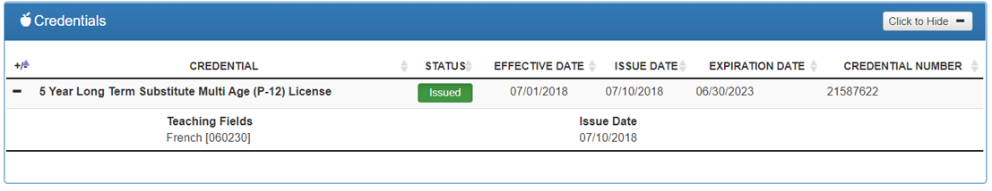
Not Properly Certified - Substitute
Substitute Credential for traditional districts
Filter on TLC Result Code TL0007 (Fatal)
  A long-term substitute can appear as properly certified when reported by a community school
  Substitute teachers who are providing instruction and assigning grades should be reported as the teacher of record, even if the teacher will be returning

Slide 62
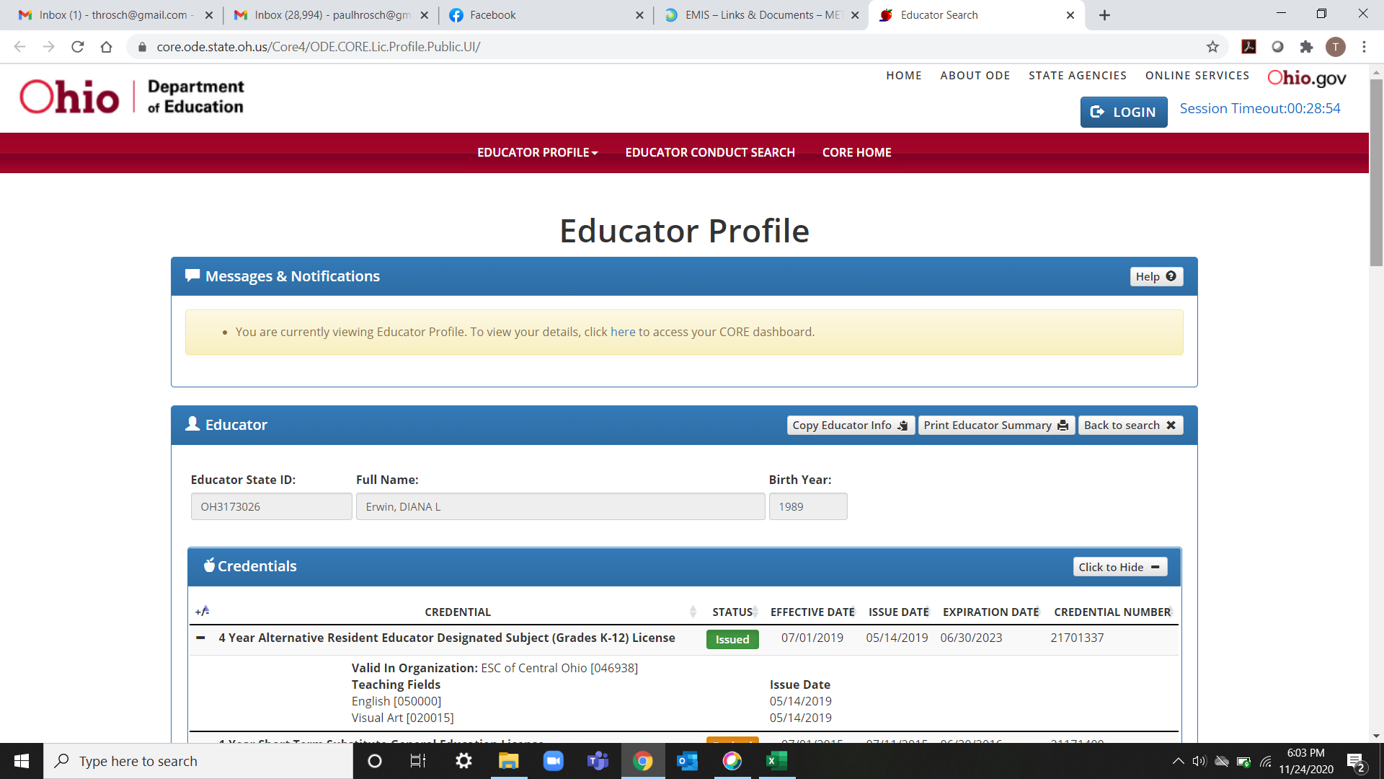
Not Properly Certified - Org IRN
Org IRN Not Matching
Filter on TLC Result Code TL0008 (Fatal)
  Questions about these situations should be directed to the Office of Educator Licensure
Notes:
This credential indicates that this teacher will only be properly certified at this specific IRN.

Slide 63
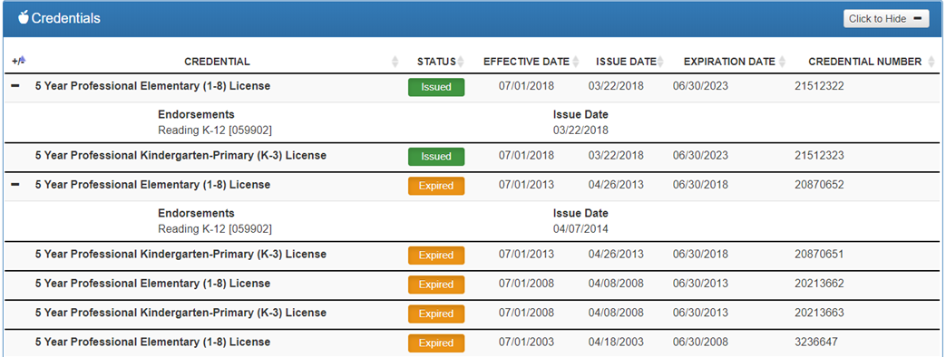
Not Properly Certified – Grade Level
Students Outside Grade Range for Credential
Filter on TLC Result Code TL0009 (Fatal)
  More than 50% of students enrolled must be within the grade levels on the teacher’s credential
These credentials allow the teacher to teach students in grades K-8
Notes:
Ticket 462 – subject accelerated student in 6th grade in a course being taught with a staff member who has a 7 -12 certification could generate result code TL0009 if for example they are the only student(s) in the course or make up more than 50% of the students enrolled in the course
Ticket 7734 –
delivery method CI, Computer as Instructor
student population SE
curriculum code OT
education option NO
Student population "trumps" delivery method. So the person overseeing a CI course that is a special ed course would need to be appropriately credentialed for special education.

Slide 64
Not Properly Certified – No Staff Course Record
No Staff Course (CU) Record
Filter on TLC Result Code TL0010 (Fatal)
  Teacher name will not appear on the TLC Status Report
  Check Level 1 Validations for fatal or dependent errors that could cause the Staff Course (CU) Record to not be reported
  Check for State Staff IDs that contain lower case letters
  Check for missing CJ records from a contracted staff reporting relationship

Slide 65
Quick Check
Are you reviewing the TLC Status Report regularly?
Are you reporting data accurately to EMIS?
Are you working with district staff to verify the data?
The TLC Status Report performs teacher certification checks using your EMIS data, as well as data from other LEAs, against the CORE database. Verify that your data is correct prior to the close of the Initial Staff and Course Collection.

Slide 66
TLCS Excel Tips

Slide 67
Color Fill and Sort
Review the report by teacher
  Clear all filters
  Data tab > Sort (A-Z) by Proper Cert Flag column Highlight all rows with Proper Cert Flag = N
    Color Fill – select a color ☺
  Select Cell A1
  Data tab > Sort by Last Name and First Name
Scroll through report and note-
  Staff member’s courses are showing as properly certified
  Staff member’s courses are showing as not properly certified (highlighted rows)
  Staff member’s courses are appearing with some courses properly certified and some not properly certified (non-highlighted rows)
Notes:
Sort can be done in data tab or home tab
This exercise does not work well with the provided DEMO file. Districts should follow this exercise on their own TLCS report.

Slide 68
Pivot Table – Proper Cert Flag by Teacher
Create Full Name Column using Concatenate
  Select column K
  Right click and select “Insert”
  Select cell K1, add title “Full Name”
  Select cell K2
  Enter the formula =CONCAT(H2," ", I2, " ", J2)
  Copy formula down (double-click or drag down + in corner of cell)
  Select column K
  Right click and select “Copy”
  Right click again and select - Paste Value 123 icon

Slide 69
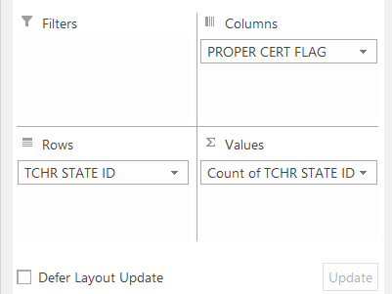
Verify Teacher Course Pivot Table - Proper Cert Flag
Create Pivot Table
  From Insert Tab, select Pivot Table
  Select OK
  Pivot Table Fields to select:
    Columns
      PROPER CERT FLAG
    Rows
      FULL NAME
      **Optional CALC TLC IRN
    Values
      Count of TCHR STATE ID
    Filters
      ** Optional CALC TLC IRN
Notes:
Presenter should use TCHR STATE ID for the “Rows” columns since teacher names are scrambled.

Slide 70
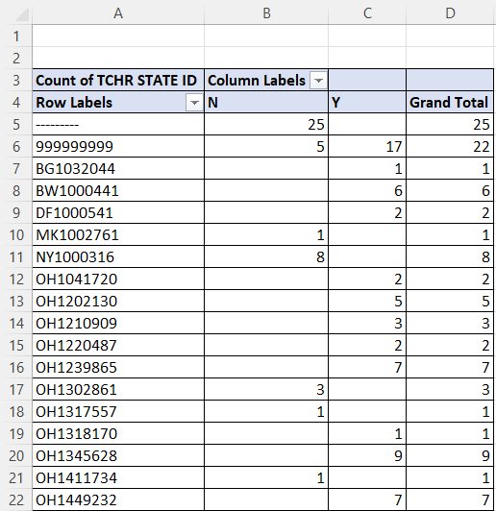
Verify Teacher Course Pivot Table, cont’d
Verify Total by Teacher
  Why is the teacher certified in some courses but not others?
  Does the teacher have too many courses?
  Do all teachers appear in the pivot table?
Tip - Add “All Borders” from Home Tab

Slide 71
Summary
The TLC Status Report contains both data to verify and issues to correct
Some issues can be corrected, and some are simply stating the fact
Work with district staff to verify that the data is both correct and complete
“No errors” does not necessarily mean that your data is complete and accurate
Use Excel functions to make troubleshooting easier

Slide 72
Resources
(TLCS-001) Teacher Licensure Course Status Report Explanation
  ODE Home > Data > EMIS > Documentation > EMIS Validation and Report Explanations
EMIS Manual
  ODE Home > Data > EMIS > Documentation > EMIS Manual
Credit Flex Information
  https://education.ohio.gov/Topics/Ohio-Education-Options/Credit-Flexibility-Plan

Slide 73
Resources, cont’d
Educator Search
  https://core.ode.state.oh.us/Core4/ODE.CORE.Lic.Profile.Public.UI/
  OH|ID Portal App - Educator Licensure and Records (CORE)
Certification and Licensure Dictionary
  https://education.ohio.gov/Topics/Teaching/Licensure/Additional-Information/Certification-and-Licensure-Dictionary
Office of Educator Licensure
  614-466-3593 or 877-644-6338
  educator.licensure@education.ohio.gov
Your district staff and your ITC
Notes:
Note the Certification & Licensure Dictionary was last updated in November 2020. Plans to update have not been released. It’s still a useful tool as it has the names of credentials and courses included and includes some of the things the online lookup does not include (i.e., 2-part checks). Just need to be aware of the last time it was updated. Districts can always tell when a particular document was update as it’s in the footer of each pdf.

Slide 74
Questions?
If you would like a certificate of attendance for this
training, you must complete the below feedback form
within 5 business days of this training
https://tinyurl.com/EA-District-Feedback
Notes:
Presenter- Insert your contact information on this slide.

