Slide 1
Troubleshooting FTE Reports Part One

Slide 2
The Ohio Department of Education funds development of EMIS training materials as part of the EMIS Alliance grant. There is an expectation that ITCs will utilize these materials in training provided to your districts. That said, there are restrictions on use of the EMIS Alliance materials as follows: Materials developed as part of the EMIS Alliance program must be provided at no cost to your training participants. If you utilize the EMIS Alliance training materials – in whole or in part – you must not charge participants a fee to attend the class where the materials are used. Likewise, you may not use the materials or any portion thereof in any event where a fee is charged to attend. Exceptions must be approved in writing by the Department of Education in advance of scheduling/promoting any event which may violate these restrictions.
Questions regarding appropriate use of EMIS Alliance materials, or requests for exception to the restrictions noted above, should be directed to Melissa Hennon [Melissa.Hennon@education.ohio.gov].

Slide 3
Overview
FTE Reports
generated using EMIS data from traditional districts, JVSDs, ESCs, community schools and STEM schools
contain student annualized full-time equivalent enrollment (FTE) figures
cross-checked against EMIS data from other local education agencies (LEAs)
contain adjustments to FTEs
This presentation will focus on troubleshooting the FTE Reports in order to resolve data reporting issues and verify data for accuracy and completeness
Notes:
This session is designed to be conducted as a workshop where districts are looking at their own data. Attendees should have access to their FTE Reports, and it is recommended that they have a copy of the most recent FTE Detail Report Explanations (printed or electronic)

Slide 4
Outline
Accessing and Preparing Data Collector FTE Reports
Troubleshooting the FTE Adjustment Report
Understanding the FTE Detail Report
Integrating the Partial Enrollment Funded Gifted Student Report
Reviewing the Resident Students Educated Elsewhere Report
Notes:
In this workshop we will locate, open, and prepare the FTE Reports from the Data Collector and then discuss each report listed on the slide.

Slide 5
FTE Reports
Traditional, JVSDs, and ESCs
Beginning of Year Student collection
Midyear Student collection
End of Year Student collection
Community schools and STEM schools
SOES Beginning of Year Student collection
SOES End of Year Student collection
Collections must be processed by ODE for reports to be generated
FTE Reports use data from the Calendar collections and can also use data from the Staff and Course collections
Notes:
Talk about the various collections that are used in the generation of the FTE Reports and which collections are open at the time of your workshop. Districts need to understand that all collections should be as clean as possible and submitted regularly. As an FYI on the last bullet, the FTE Reports can use the Location IRN on a course (from the course master record) during the Calendar Determination process.

Slide 6
Accessing and Preparing Data Collector FTE Reports

Slide 7
Level 2 Reports
FTE Reports are available in the Level 2 Reports link
Notes:
Clarify that the Level 2 Reports link is available after the collection is submitted and is processed by ODE overnight.

Slide 8
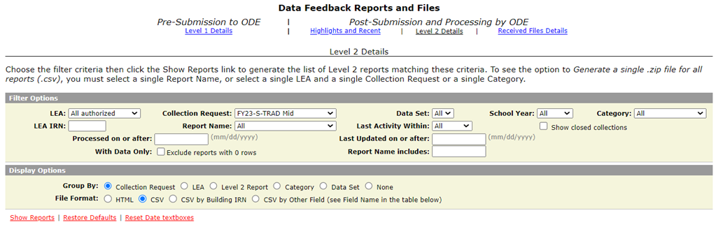
Generate and Open Level 2 Reports
Select “Show Reports”
Notes:
A live demonstration of this process could be helpful to attendees. Verify that all attendees can accomplish this task during the session.

Slide 9
Generate and Open Level 2 Reports, cont’d
Part 1 of this presentation will cover four reports
Notes:
Note that reports starting with FTED are “detailed” reports that contain student level data. Reports that begin with FTES are “summary” data and do not contain student names.

Slide 10
Level 2 Report Dates
Process date – when ODE successfully processed the data used in the report for the entire state
Last Updated date – when report was updated with data that added, changed or removed rows. If no rows changed then the date remains unchanged
Submission – when LEA submitted data
Notes:
ITC Staff note- If nightly processing at ODE does not complete, the Level 2 will not update. Go to Settings, Level 2 Report Tables, then scroll down and select “Show Last Updated Dates”. The “Updated Date” column should contain the date following nightly processing. Cherwell ticket 106921 - Why are we seeing Last Updated Dates and that are days after the process date? It's usually an issue of timing. The time stamp for when the 2023S2TRD manifest was processed was around 5:16 PM on 1/28/2023, so the Process date is 1/28/23. Many of the FTE Detail reports were updated around 2:30 AM on 1/30/23, so the Last Updated date is 1/30/2023. I believe that normally, the Last Updated date is a day later than the Process date, but it could be later if there are any issues with processing. Thanks, Bill

Slide 11
FTE Report Error Categories
Fatal rows are those where the Adjusted FTE
is zero or where the Fund Pattern Code
indicates that this is a non-fundable student
All other rows are classified
as Warning or Informational
Critical rows are those where the Adjusted
FTE is greater than zero, but less than the
Original FTE
It is recommended to view the entire
report and not just focus on errors
Notes:
See the FTE Detail Report explanation for a chart called the Adjustment Report that classifies each adjustment. Encourage districts to open each report to see all students regardless of error classification.

Slide 12
Troubleshooting the FTE Adjustment Report

Slide 13
Open and Prepare the FTE Adjustment Report
Select Header Row and Wrap Text
Freeze Top Row
Justify column width
Apply Filters
Better yet, use a macro!
Notes:
We are going to begin with the FTE Adjustment Report. Please use the (FTED-003) FTE Adjustment DEMO file. Attendees should use their own FTE Adjustment Report.
Demonstrate these steps of preparing the report and the attendees can prepare their own report as you demonstrate the Basic Excel steps.
Presenter demonstrate report preparation.
Select top row and select Wrap Text from the Home Tab.
While the top row is selected, from the View tab, select Freeze Panes and Freeze Top Row.
Select entire spreadsheet (click cell between Row 1 and Column A) then place cursor on a line between any two column headers and double click.
While spreadsheet is highlighted, from the Data tab, choose Filter (or from the Home Tab select Filter).

Slide 14
FTE Adjustment Report
Subset of the FTE Detail Report
Contains students who have an adjusted FTE
Result Codes and descriptions indicate an issue causing an adjustment
Adjustment start and end dates help to identify the timeframe of the adjustment
Notes:
Demonstrate where the Result Code is located along with the Result Code Description column that includes helpful information when troubleshooting the report. Note that the DEMO file combines scrambled data from multiple LEA types in order to show examples of various result codes.

Slide 15
FTE Adjustments and FTE Detail
Review the FTE Adjustment Report and FTE Detail Report together to see the complete picture for a specific student
FTE Detail Report contains the FTE that will be funded “ADJSTD FTE”
FTE Adjustment Report contains the amount being adjusted “ADJSTD FTE”
FTE Detail Report
ADJSTD FTE is the
amount of FTE
generated
FTE Adjustment
Report ADJSTD FTE
is the amount of FTE
that is reduced
Notes:
Be sure to use reports from the same date so that the data is aligned. Some students with multiple lines and adjustments can be complicated to troubleshoot but using the data from the two reports together can provide clues as to the issue that is causing the adjustment. For Student One, the adjustment FT0005 is a reduction to the “Adjusted SpecEd Cat FTE” For Student Two, the adjustment FT0002 is showing as an “Adjusted FTE”.

Slide 16
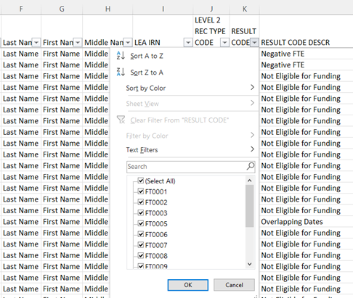
FTE Adjustments
The next slides will review each adjustment and possible resolutions
Filter on the Result Code column
as each adjustment is discussed
Some adjustments are not fixable
and will remain on the report
Notes:
Presenter, ask attendees to filter on each error as you proceed through the PowerPoint. If no one has the error, it can be skipped or briefly discussed.
Explain to the attendees that some adjustments can be resolved while others have no resolution depending on that specific student’s situation.
Most adjustments appear in the DEMO file except for a few rare adjustments. The adjustment slides that have no example in the DEMO file will be noted.

Slide 17
Adjustment Over One FTE
Filter on FTE Adjustment Result Code FT0001 (Warning)
When multiple districts report enrollment for a student (subsequent enrollment) and there are no overlapping enrollment dates, if the total FTE is greater than one, an adjustment is made to the student’s FTE for the district reporting the latest enrollment date
Review data in ODDEX SOES, Records, and SCR for enrollment dates
Note that districts cannot see how much of a student’s total FTE has been used by each entity
Notes:
Use the (FTED-003) FTE Adjustment DEMO file to filter on the FT0001 adjustment. If attendees have this adjustment, explain how the adjustment occurs. Using a “piece of the pie” explanation is helpful. The next slide contains an example of a student situation that causes this adjustment.

Slide 18
Over One FTE Example
A full-time student is enrolled at district A from the start of their school year, then withdraws and subsequently enrolls at district B
District A: based on enrollment dates will receive part of the student’s one FTE for the school year
District B: based on enrollment dates will receive no more than the remainder of the student’s one FTE for the school year
A district can “use-up” a disproportionate amount of the student’s one FTE prior to enrolling at a subsequent district
An adjustment will be made to district B’s FTE in the case where the enrollment periods are generating more than one FTE
Notes:
If data is being reported correctly and the subsequent district is receiving an adjustment, the situation is valid and cannot be resolved. Watch for incorrect enrollment or withdrawal dates that could cause this error as well as calendar start dates that can allow a district to get “a piece of the pie” when they were not actually enrolled, especially in the case of a summer withdraw prior to the start of school. Remind districts that this situation should not be a factor in the enrollment of a student.

Slide 19
Over One FTE Example, cont’d
This adjustment can also occur within the same district
Student is enrolled in Building A, then leaves Building A to attend Building B
Building A’s calendar has a different start and/or end dates than Building B’s calendar
This situation could generate an FT0001 adjustment
Verify that enrollment and calendar data
If incorrect, make corrections
If correct, then ignore the adjustment

Slide 20
Adjustment Overlapping Dates
Filter on FTE Adjustment Result Code FT0002 (Warning, Critical or Fatal depending on amount of adjustment)
Occurs when a student is enrolled in two districts at the same time (invalid concurrent enrollment) or when How Received or Sent To codes are being reported incorrectly
For days that overlap, the student’s percent of time is set to zero and the FTE is recalculated
Review data in ODDEX SOES, SCR, and Records for overlapping enrollment dates or incorrect coding, and work with the other LEA to resolve the issue
Notes:
Remember that enrollments are in the morning and withdrawals are at the end of the day to avoid same day overlaps. If a student’s enrollment date is on Monday, that means that the student attended on Monday. If a student withdraws on Monday, that means that the student attended or was absent on Monday. Communications with other educating entities is often required for these types of adjustments.
Example of the adjustment during a valid concurrent enrollment situation; a student attends 50% at a community school and 50% at the JVS. This is valid. The community school reports Sent Reason CR and the JVS reports How Received 2. This is incorrect…the correct Sent Reason is CT. An overlapping adjustment will be created and will go away once the Sent Reason is changed to CT. Can be caused when JVS reports an incorrect district of residence.

Slide 21
Overlapping Dates Example
Student was enrolled at district A from August 12 to March 23. Then enrolled at district B on March 18, which created a 5 day overlap in enrollment
For the 5 overlapping days, neither district will be funded and both districts will see an adjustment to their FTE
FTEs for both entities are reduced for the span of the overlap; correcting this overlap will adjust the FTE values to fund the student for the appropriate amount of time

Slide 22
Adjustment Percent of Time on Overlapping Dates
Filter on FTE Adjustment Result Code FT0003 (Critical)
Occurs when a student is enrolled at multiple entities and the percent of time exceeds 100% (valid concurrent enrollment)
An adjustment is made for the excess percent of time reported
The percent of time will be reduced at the reporting entities for the portion that exceeds 100%
Often occurs when there are changes to enrollments between districts and JVSD’s at the change of the course term
Look in ODDEX Records and SCR for the percent of time reported by each entity; consult the other LEA to reconcile the data
Notes:
Districts and JVSDs must be careful to divide the percent of time not to exceed 100%. Comparisons of this data could be done prior to the data being reported to EMIS to avoid these types of errors.

Slide 23
Percent of Time on Overlapping Dates Example
Student was reported by the resident district and the JVSD as educating the student at the same time; the JVSD reports the student as 20% of time, while the sending district reports the student as 86% of time
Both entities will see an adjustment to the student’s FTE for the excess percent of time, that brings the student’s total funded FTE to one
In this example one or both entities should adjust their percent of time so that it does not exceed 100%
Notes:
Student percent of time values can change during the year depending on the student’s course enrollments and should be reviewed for accuracy over the course of the school year. If time allows, districts can look at these students in ODDEX to attempt to resolve the adjustment.

Slide 24
Adjustment Disability Not Funded
Filter on FTE Adjustment Result Code FT0005 (Critical)
Occurs when a student with a disability is reported without an active IEP in place
Impacts special education weighted funding and not the base FTE
JVSDs and ESCs are dependent on the District of Residence or sending district to report the special education events
Be sure all students with disabilities have active IEPs in place that are reported to EMIS
Report an NIEP special education event if the situation qualifies
Notes:
The FTE Report explanation mentions a 14 Day Grace Period. The grace period allows a district to continue to receive special education weighted funding for 14 days after an IEP is expired. On day 15, if the new IEP has not yet been reported to EMIS, the adjustment will be generated. This does not allow a 14-day grace period between the time that an IEP expires and when a new IEP is written. Note that districts can see these adjustments for students whose funding flows through their district such as community school students. It is the responsibility of the community school to report the special education events for their students.

Slide 25
Adjustment Disability Not Funded, cont’d
Filter on FTE Adjustment Result Code FT0005 (Critical)
Impacts special education weighted funding and not the base FTE
FTE Adjustment Report
FT0005 Adjustment
appears in ADJSTD
FTE Column and
reduces the ADJSTD
SPECED CAT FTE
FTE Detail Report
Notes:
.

Slide 26
Adjustment Student 22 or older
Filter on FTE Adjustment Result Code FT0007 (Warning)
If a student is age 22 or older on the effective start date, admission date, or school year start date (whichever is later), the student is not eligible to be funded
An FTE adjustment will occur that reduces the FTE for the student to zero
Verify the student’s age and enrollment dates
If the data is accurate, the error is informational, and no FTE will be generated for this student
Notes:
This adjustment is typically just stating a fact that the student will not be funded due to age, but it is always recommended to double check the data for accuracy.

Slide 27
Adjustment Negative FTE Adjustment
Filter on FTE Adjustment Result Code FT0009 (Informational)
When multiple FTE adjustments for a student result in a negative total FTE, an adjustment is generated that brings the total FTE to zero
If the student data is being reported correctly, this adjustment is informational
Example: A student has more than one flag. There may be two adjustments for -1 and then a Negative FTE adjustment of 1 to bring the total FTE to zero. The Negative FTE adjustment is always a positive value as it brings a negative FTE to zero.
Notes:
This adjustment that should be uncommon but if it is discovered, check ODDEX Records or SOES to determine what is being reported and or flagged on the student to cause this adjustment. Note that adjustment FT0010 – Rounding was eliminated in FY22 as the payment system now maintains six decimal places.

Slide 28
Adjustment Preschooler at DOR and ESC
Filter on FTE Adjustment Result Code FT00014 (Informational)
Adjustment for preschoolers who attend both the Resident District and the ESC
Occurs only when the following is reported:
District of Residence reports the Preschool student as Sent to = ES and
Both DOR and ESC report the Preschool student as educated >0% and
Both DOR and ESC report the DN record TFRPSESCYS element (indicated Yes, funds should be transferred to the ESC)
Corrects the transferred amount for both the DOR and the ESC
Adjustment is also created for preschoolers who attend two different traditional districts, or who attend both an ESC and a County Board of Developmental Disabilities
Notes:
Note that adjustment FT0013 is no longer active. Presenter could demonstrate where to find the DN element in the SIS. Note that the adjustment on the report still says “50%” but the adjustment can occur with any percent of time greater than 0%.

Slide 29
Adjustment Scholarship Program
Filter on FTE Adjustment Result Code FT0030 (Warning, Critical or Fatal depending on amount of adjustment)
Adjustment for overlapping dates with scholarship program
The adjustment report will show the student’s enrollment at the district with no reference to the scholarship provider
Districts may need to contact the scholarship program to resolve the issue
If the issue cannot be resolved, then submit an EMIS helpdesk ticket
Notes:
Someone in the district has access through their SAFE account to verify scholarship students and this person could be helpful in determining who the educating entity is that needs to be contacted. Districts can reach out to scholarship contacts at ODE to assist as well. Search “Scholarship” on the ODE website to locate scholarship contacts at ODE.

Slide 30
Adjustment Withdrawal No Attendance
Filter on FTE Adjustment Result Code FT0031 (Warning)
Occurs when a student is withdrawn during the school year with no attending hours
Not applicable to students withdrawn with a code of 81 - Student Reported in Error
Verify the student’s withdrawal situation and attendance are correct
Remember that a newly enrolled student cannot be absent before they attend at least one day
Notes:
If a student was enrolled last school year and is a no-show at the beginning of the subsequent school year and the student has no attending hours prior to their withdrawal, this adjustment will reduce their FTE to zero. A newly enrolled student who has no attendance hours should be withdrawn with an 81 as the district has no reporting requirements for this student.

Slide 31
Adjustment Not Eligible for Funding
Filter on FTE Adjustment Result Code FT0032 (Warning)
Adjustment occurs when the student is not eligible for funding
Most common occurrence is for a preschool student without a disability which will result in a Fund Pattern Code that is non-fundable (NFRG)
Could occur when a student is incorrectly coded which will result in a Fund Pattern Code that is non-fundable (NFER)
Can occur when a student is court/foster placed from out of state (DOR = 999999)
Verify that preschool students with this adjustment do not have a disability
If student is school-aged, use ODDEX Records to verify the student’s Student Standing (FS) coding is correct between LEAs
Notes:
Example of a school aged student with incorrect coding- home-schooled or non-public student who direct enrolls at a JVSD and the resident district is not in the jointure of the JVSD. If the JVSD reports a How Received code of X, then the fund pattern code of NFER will be assigned to the student and the FT0032 adjustment will be generated because the coding is incorrect. The How Received code of X is only used for students whose resident district is within the jointure of the JVSD. Cherwell ticket 102201 explains the instance when a student is court placed from out of state.

Slide 32
Adjustment JVSD Students Grade 5 and Below
Filter on FTE Adjustment Result Code FT0033 (Fatal)
New FTE adjustment (FT0033) for JVSD students in grades 5 and below
Can also appear as an adjustment for district of residence/sending district
Verify the student’s grade level and if grade 5 or below, the adjustment should be ignored
Preschool students at a JVSD will only generate the FT0033 adjustment if the student does not have a disability
Otherwise, the student will generate FTE....fund pattern will be PSNR
Notes:
This adjustment is in place to reduce CTE FTEs to zero when the student is reported in grade 5 or below as they do not generate CTE FTE funding.

Slide 33
Adjustment Board of Developmental Disabilities
Resident districts sending students to a Board of Developmental Disabilities (BDD) must report the Sent to Reason of MR. BDDs also submit data to ODE that is compared to data submitted to EMIS by districts. An FTE adjustment may result if the district and BDD data do not match.
If both entities are reporting that they are educating, the “over 1 FTE” adjustment would apply (FT0001)
In situations where student is being educated part-time at BDD and part-time at JVS or traditional district, if total percent of time adds up to more than 100%, the “percent of time on overlapping dates” adjustment would apply (FT0003)
Notes:
For additional information on BDD students, consult the EMIS Guide and the FTE Detail Report Explanation.

Slide 34
FTE Adjustments Community School Students
While the previous adjustments could occur with any student, the following adjustments only occur with community school students
Community school student adjustments will no longer appear on the district of residence FTE Reports
These students will appear on the (ENRL-001) Resident Students Educated Elsewhere report for districts of residence
Notes:
The community school adjustments should be reviewed even when there are no community school EMIS staff in the workshop.

Slide 35
Adjustment E-School Cap
Filter on FTE Adjustment Result Code FT0004 (Warning)
Total funding e-schools receive is capped based on the prior year’s enrollment, and the cap amount could vary from school to school and from year to year
If the e-school reports FTEs in excess of their cap amount, then the FTE for each student is reduced to bring the school’s total FTE back to their capped amount
This adjustment does not impact special education weighted funding
This adjustment is made after any other adjustments have already been made to the student FTEs
Notes:
Additional information regarding E-School caps can be found on the ODE website.
Not on DEMO file.

Slide 36
Adjustment 72 Hour Rule
Filter on FTE Adjustment Result Code FT0006 (Warning)
When a student is reported with a Withdrawal Reason of 76 (72 hours of continuous unexcused absences) along with zero excused absences and zero days of attendance, the student’s FTE will be set to zero
Verify that the student was withdrawn with a code of 76 and that the student had no attending days or excused absences
If the data is accurate, the error is informational, and no FTE will be generated for this student
Notes:
Traditional districts cannot withdraw due to the 72 Hour Rule however, community schools can and should be using this withdrawal code when it is appropriate.

Slide 37
Adjustment Age 5 KG No Early Entrance Policy Adjustment
Filter on FTE Adjustment Result Code FT0008 (Critical)
Adjustment for kindergarten students at community schools who are under the age of 5 on the date by which a student must be 5 years old in order to enroll and the community school has no early entrance policy reported
Verify the student’s age
Check the Organization – General Information (DN) Record
C_STUEEPOL Student early entrance policy flag (Yes or No)
STUKGBRDAY Date student is required to be 5 years old to be admitted into kindergarten (August 1 or September 30)
Notes:
Presenter can demonstrate where the date of birth as well as the DN record data is entered into the Student Information System (or other source system) for community schools.

Slide 38
Adjustment ODE Override Reduction FTE Review Percent or Amount Reduction
Filter on FTE Adjustment Result Codes FT0011 and FT0012 (Informational)
Adjustment applied to individual students after a community school FTE review by an Area Coordinator
Primarily for ODE purposes regarding how the adjustment was applied; a percentage of the school’s FTE across all students, or a reduction for an individual student
Notes:
Community schools should already be aware of the situation when receiving this adjustment. If not, they can contact their area coordinator. It might be helpful to search “area coordinator” on the ODE website to show the page where area coordinator contact information is located.
Neither result code on DEMO file.

Slide 39
Adjustment CS Invalid Grade Level
Filter on FTE Adjustment Result Code FT0021 (Fatal)
For community school students who are reported with a grade level for which the community school has not been approved
Verify that the student grade level is being reported correctly
If the data is correct, then the adjustment is informational
Notes:
This is a good place to demonstrate OEDS and what grade levels the school is approved to educate.
Not on DEMO file.

Slide 40
Adjustment ODE Override Adjustment
Filter on FTE Adjustment Result Code FT0023 and FT0024 (Informational)
FT0023 percent reduction due to Open/Close dates
FT0024 FTE reduction due to Open/Close dates
Pertains to community schools and is not a common occurrence
This adjustment backs out all or part of student FTEs when a community school
closed but never withdrew the students
never opened but had reported some enrollment
didn’t have enough enrollment to be eligible for funding until a specific date sometime after the school year had been set to start
Notes:
If a community school sees this adjustment, they would most likely already be aware of the situation. If not, they can contact their Area Coordinator or put in a helpdesk ticket.
Neither result code on DEMO file.

Slide 41
Future FTE Adjustment
The 30-Day Adjustment is for situations where a student is not reported to EMIS through the Student Cross Reference Collection within 30 days of enrollment or withdrawal
The district will only be funded for the 30-day window and will not be funded for any days beyond the 30 days when the enrollment or withdrawal is not reported
It is very important to submit the Student Cross Reference Collection frequently and regularly to avoid the 30-day adjustment if or when it is turned on.

Slide 42
Quick Check
Are any adjustments correctable?
Some adjustments can occur based on another reporting entity’s data. Do you need to contact another LEA?
FTE Adjustment Reports should be checked regularly and frequently even when your data hasn’t changed.
The FTE Adjustment Report contains codes that indicate an adjustment to a student’s FTE. Some codes indicate situations that could be corrected which can result in an increased FTE. Some situations cannot be corrected.
Notes:
Create a baseline document to track data as it is verified. Note actions taken to avoid duplication of effort. Document communications with other LEAs in case an issue needs to be revisited.

Slide 43
Understanding the FTE Detail Report and Integrating the Partial Enrollment Funded Gifted Student Report

Slide 44
Prepare the FTE Detail Report
Select Header Row and Wrap Text
Freeze Top Row
Justify column width
Apply Filters
Better yet, use your macro!
Notes:
Trainer demonstrate these steps using (FTED-001) FTE Detail DEMO
Select top row and select Wrap Text from the Home Tab.
While the top row is selected, from the View tab, select Freeze Panes and Freeze Top Row.
Select entire spreadsheet (click cell between Row 1 and Column A) then place cursor on a line between any two column headers and double click.
While spreadsheet is highlighted, from the Data tab, choose Filter (or from the Home Tab select Filter).

Slide 45
FTE Detail Report
Contains student FTE data with related EMIS data
All FTE Detail Report data should be reviewed for accuracy
Data issues can exist that do not generate errors
When a student has no FTE adjustment, their base FTE, weighted funding elements, or other data could still be incorrect
In the upcoming slides we will discuss the data elements contained in the report and suggest ways to verify the data
We will also briefly discuss the (FTED-006) Partial Enrollment Funded Gifted Report in this section

Slide 46
FTE Report Row by Row
Students can have multiple dated rows on the FTE Reports because of changes to their EMIS data
Additional rows for a student can be generated for changes such as,
Enrollment
Weighted factors
Attending situation
Calendar
Grade level
Building
A Base FTE is calculated for each row of data that contains a specific start and end date (see Columns N and O), and an FTE Fund Pattern Code is assigned to each row
FTE Adjustments can be made to any specific row of data
ENRL START DATE is the latest of the
FS/FD effective start date, FS admission
date, and calendar start date
Notes:
By the nature of this report, it will get longer as students change their situations and attributes over the course of the school year. Consider subtotaling the report by student as was demonstrated in the FY19 EMIS Alliance “Using Excel to Troubleshoot EMIS Data” presentation. Also note that there are summary reports that provide the data by student and by student and fund pattern code. We will look at those reports in part two of this presentation.

Slide 47
FTE Detail Report Column by Column (A-L)
“Not Available” can appear for students your
LEA is not reporting to EMIS but whose funding
flows through your district
IRNs of LEA receiving the report
LEA IRN is the IRN of
the educating entity
Severity Code (See FTE Adjustment report for C and F)
I – Informational
C – Critical – Adjusted FTE is reduced but not to zero
F – Fatal – Adjusted FTE is reduced to zero
Notes:
“Not Available” in EMIS ID and Name fields indicates that the student is not being reported in the district where the report is being received. A student who is directly enrolled to a JVS (home schooler or non-public student) is an example of a student who could appear this way. When an SSID for a BDD student appears as all numeric, ODE assigns a generic ID when the SSID cannot be found. In many cases the DOB is reported differently between the district of residence and the BDD. When an all numeric SSID appears for a BDD student, the district should contact the County Board to resolve the difference. Once the corrected data is submitted to ODE (BDD’s report their student data in spreadsheet form via FTP) then the student will appear with the correct SSID. Cherwell tickets 5157 and 5666.

Slide 48
FTE Fund Pattern Codes – Column M
EMIS data as reported or as derived are used in determining the FTE Fund Pattern Code which indicates the flow of funding for that specific row of data
Another LEAs data can be used for students appearing on your report
It is possible for one student to have more than one FTE Fund Pattern Code assignment when that student has multiple rows
With recent changes to the funding model, certain situations allow funding to flow directly to the educating entity, some FTE Fund Pattern Codes may no longer appear on your report such as open enrolled out students
Notes:
Incorrect EMIS Data can cause the assignment of an incorrect fund pattern code. See the FTE Report Explanation for a complete list of FTE Fund Pattern codes. Also see Appendix 2 for the FTE Fund Pattern Code Lookup Table to see what EMIS data is used to assign an FTE Fund Pattern code to a specific row of data.

Slide 49
DOR and Inclusion Codes – Columns V and AG
FULL – The full FTE is included in the ADM of the district receiving the report
PART – A portion of the FTE is included in the ADM of the district receiving the report (Resident Student at JVS)
NONE – None of the FTE is included in the ADM of the district receiving the report
Example - SPCO – Special Education Cooperative Student
SPCO FULL at District of Residence (Column V)
SPCO NONE at Educating Entity (LEA IRN Column I)
Notes:
Special Education Cooperative and Contract Career Tech students are funded at the sending entity and funding is later transferred to the educating entity on the SFPR.

Slide 50
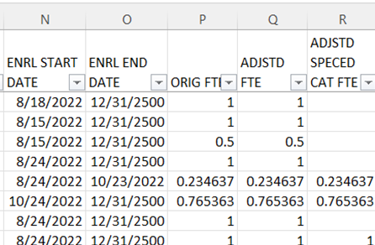
Base (aka Original) FTE and Adjusted FTE
The Adjusted FTE will be the Base (ORIG) FTE minus adjustments from the FTE Adjustment Report
The Adjusted Special Education CAT FTE will indicate state weighted FTEs for students with disabilities minus any FT0005 Adjustments from the FTE Adjustment Report
We will explain the
Base (ORIG) FTE on
the next few slides

Slide 51
Base FTE Calculation
The Base FTE (ORIG FTE column)
Numerator is the student’s total enrolled hours multiplied by the student’s percent of time
Denominator is the total instructional hours on the assigned calendar
Is calculated for each row on the report
If the student is not withdrawn, the Base FTE is calculated as though they will be enrolled through the last day of their calendar
When a student is reported as withdrawn prior to the last day of their calendar, their Base FTE is recalculated
Notes:
The numerator is calculated using district data. The denominator uses the assigned calendar which may or may not be the calendar the district is reporting – see “calendar determination”. It is important to verify that the Base FTEs are being calculated correctly.

Slide 52
Calculating the Base FTE for Grades KG - 23
(Hours Enrolled x Percent of Time) $÷$ Hours on Calendar = FTE
Full time student enrolled all year
(1030 hours x 100%) $÷$1030 hours = 1.00 FTE
Half time student enrolled all year
(1030 hours x 50%) $÷$1030 hours = 0.50 FTE
Full time student withdraws prior to the end of the school year
(950 hours x 100%) $÷$1030 hours = 0.92233
Notes:
Note that a student reported with a Sent to CE and a district relationship of 3 will have a base FTE generated as though they were a 100% student.

Slide 53
Calculating the Base FTE for Grade PS
The numerator is based on the student’s calculated enrollment days (percent of time is not applied)
Preschool students without a disability are not funded
FTE Fund Pattern Code NFRG
Enrolled days/Calendar days = Base FTE
PS Base FTE Example: Enrolled 178 days $÷$ 178 calendar days = 1.00
PS Base FTE Example: Enrolled 89 days $÷$178 calendar days = 0.50
PS Base FTE Example: Enrolled 40 days $÷$178 calendar days = 0.224719
Notes:
Preschool students with disabilities generate FTE funding as an adjusted headcount and percent of time is not included in the calculation. Preschool students without disabilities are not funded. Verify that Special education preschool students are appearing with correctly calculated FTEs.

Slide 54
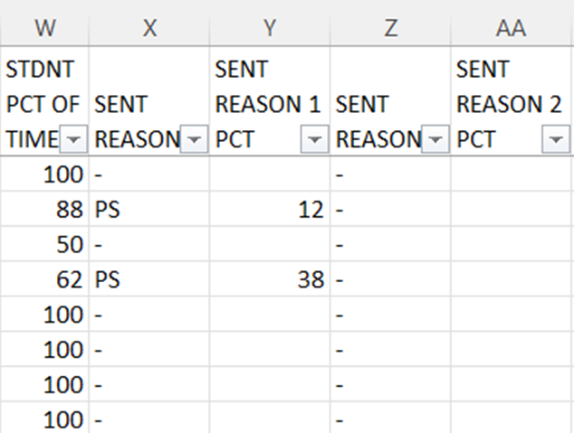
Percent of Time and Sent To Percent of Time (W-AA)
Percent of time is a critical element in the calculation of the Base FTE
Verify percent of time values are calculated and reported correctly
Sent to Percent of time values are included on the FTE Detail report when included in the Base FTE
NP – Non-public placement at district expense
PI – Proprietary Institution Program Placement
PS – College Credit Plus Program Participant

Slide 55
Percent of Time - Hours per Day Calculation
Calculate a student’s percent of time by dividing the number of hours per day the student attends by the number of hours per day on the student’s calendar
Full time student
6.5 hours per day on the student’s calendar
Student attends 6.5 hours per day
Percent of time = 100%
Half time student
6.5 hours per day on the student’s calendar
Student attends 3.25 hours per day
Percent of time = 50%

Slide 56
Percent of Time – Five Credit Rule
A high school student (grade 9 and above) who is attempting five credits for the school year can be reported with a percent of time of 100%
High School student is attempting at least 5 credits for the school year
5 Credits/5 Credits = 100%
High School student is attempting 4 credits for the school year
4 Credits/5 Credits = 80%
Notes:
Let’s begin with this example of the difference between the hours per day calculation and an attempted credits calculation for a high school student. Demonstrating additional examples might be helpful in understanding these calculations. Note that there are some scenarios where student percent of time should be considered such as home instruction, students being educated by an ESC, etc. Please consult the EMIS Manual, FS Standing 2.4, Percent of Time for additional student percent of time information.

Slide 57
Percent of Time Calculation
Hours per day or attempted credits
Students in grades PS through 8 should be calculated using the “Hours per Day” calculation
High school percent of time can be calculated using the method that generates the highest percent of time
Note that community schools cannot use the attempted credits method to calculate percent of time
Detailed instructions on percent of time calculations for community school students can be found in the Community School Full Time Equivalency (FTE) Review Manual on the ODE website

Slide 58
Sent to Percent of Time for CCP
College Credit Plus Participants
Will have a
Sent to of PS – College Credit Plus Program Participant
Sent to Percent of Time that represents the time spent participating in College Credit Plus
Physical location of the CCP course and the teacher of the course should have no impact on the Sent to Percent reported
Combined total Percent of Time and Sent to Percent of Time must not exceed 100
If Sent to Percent is 100%, report a district relationship of 1
The reported Sent to Percent of Time does not send funding to the post secondary institution
Notes:
Districts should be sure they are calculating these percent of time values as close to what is actually happening as possible and be consistent in their calculations. Just like PSEO, the Sent To percentages will be included in the district FTE for the student. If the student is sent to more than 2 places, then combine the sent to PS as needed. Example, the student attends a CTC and two colleges for CCP. Report the Sent to 1 as JV with 0% of time, then combine the two colleges into one value and report the Sent to as one college (choose one)

Slide 59
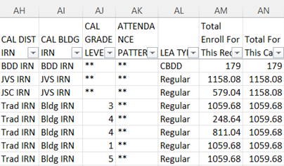
Calendar and Hours/Days
Student’s calendar per Calendar Determination Process is contained in Columns AH – AK
Calendar enrollment and totals can be found in columns AM and AN
Educating entity’s LEA Type
can be found in Column AL
Preschool students will show
days in columns AM and AN while
all others will show hours
Notes:
Note that if a student appears on an incorrect calendar on the FTE Detail report, the values in columns AM and AN will reflect hours/days from the incorrect calendar.

Slide 60
EMIS Calendars
Used as the denominator in the calculation of student FTEs
Reported in a separate collection from student data
Meet student data on the FTE Report
Can be assigned to a student when an exact match is not found
See “Calendar Determination” in the FTE Report Explanation
If the FY23 State Calendar is assigned,
Appears as 999999-999999-**-**
Began on 8/25/2022 and ends on 5/23/2023
Has 1008 hours of instruction (6 hours per day, 168 days)
Notes:
Explain that the student data and calendar data are reported in separate EMIS collections and that there is no error when a student’s data doesn’t match up with the calendar collection data. The data comes together on the FTE Detail Report.

Slide 61
Reporting Incorrect EMIS Calendar Example
Incorrect calendar data can negatively impact student FTE calculations
Example, seniors attend three days less than other high school students
Seniors are placed on the default calendar (1080 hours) and withdrawn on their last day, which is three days before the end of the default calendar (1062 hours)
(1062 x 100%) divided by 1080 = Student FTE 0.98
Seniors are placed on a calendar that represents attendance days for their attending situation (1062 hours)
(1062 x 100%) divided by 1062 = Student FTE 1.00
Notes:
In this example of seniors who withdraw three days early and are placed on a default calendar, these students will never be fully funded since the denominator is larger than any of these students will be enrolled. Remember that FTEs use enrollment dates over potential enrollment dates and attendance is no longer part of the calculation.

Slide 62
New Adjusted Gifted FTE Column (S)
Adjusted Gifted FTE is generated for students who are reported as identified in any number of areas of giftedness
Adjusted Gifted FTE uses the first day of the month they are identified in the current year
Students identified in a prior year will begin generating Adjusted Gifted FTE from their first day of school (continue reporting as identified gifted)

Slide 63
(FTED-006) Partial Enrollment Funded Gifted Report
Contains only students who are identified for the first time in the current school year - based on enrollment versus date identified as gifted
Students can have multiple rows that align with the FTE Detail report and this report shows the gifted FTE per row
First row student is gifted after the enrollment dates on this row and is not funded as gifted for this row
Second row student is identified as gifted after the start date of the row, so student generates a partial gifted FTE for this row
Third row student is reported as identified gifted during the entire timespan of this row and is fully funded as gifted for this row
Notes:
Presenter can use (FTED-006) Partial Enroll DEMO.

Slide 64
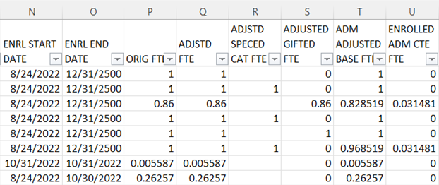
New Enrolled ADM Columns (T&U)
Enrolled ADM Adjusted Base FTE
Enrolled ADM CTE FTE
Notes:
We will discuss the new columns on the next slide.

Slide 65
New Enrolled ADM Columns
The Adjusted FTE for students in grades 4-12 from the FTE Detail Report is compared to the Adjusted CTE FTE from the CTE FTE Detail Report (excluding any CTE FTE for Senior-Only Credential programs) and split into a non-CTE and a CTE amount
Enrolled ADM Adjusted Base FTE
The non-CTE portion of the Adjusted FTE
Enrolled ADM CTE FTE
The CTE portion of the Adjusted FTE
Enrolled ADM Adjusted Base FTE + Enrolled ADM CTE FTE = Adjusted FTE
Students are still funded for CTE FTEs as in year’s past
See the CTE FTE Detail Report for CTE weighted FTE data
Notes:
It might be helpful to revisit the previous slide to look at the new Enrolled ADM values.

Slide 66
Student Attributes - FD
Verify EMIS elements that generate additional funding on FTE Reports
Special Education Disability Conditions/Categories
Economic Disadvantgement
English Learner
Changes in FD attributes result in additional lines of data on the FTE Detail Report for the same student
Weighted EMIS elements should be reported accurately as they affect funding and accountability

Slide 67
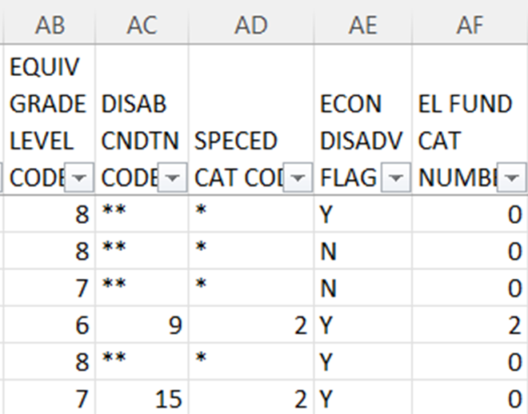
FD Attributes – Columns AB - AF
Verify student data and effective dates on the FTE Detail Report for each (FD) Record attribute element
English Learner Category
• If student became proficient in English more than two years prior to the current school year, then EL FUND CAT NUMBER = 0
• Else if student became proficient in English in the two school years prior to the current school year, then EL FUND CAT NUMBER = 3
• Else if LEP CODE = ‘L’ then EL FUND CAT NUMBER = 1
• Else if LEP CODE = ‘Y’ or ‘S’ then EL FUND CAT NUMBER = 2
• Else if LEP CODE = ‘M’ then EL FUND CAT NUMBER = 3
• Else if LEP CODE = ‘N’ then EL FUND CAT NUMBER = 0
Notes:
Are all Special Education, Disadvantaged, and English Learner students appearing on this report correctly? Are the change dates for these elements correct?
The date 12/31/2500 is used when there is no end data on a record. Remember that this data is also used in accountability measures.

Slide 68
Quick Check
Are all students appearing on the report as expected?
Are student Base FTE’s being calculated correctly?
Are student attributes, and Gifted FTE values correct?
The FTE Detail Report contains a great deal of data that should be verified for accuracy and completeness. Much of the data on this report can be incorrect and generate no error.

Slide 69
Reviewing the Resident Students Educated Elsewhere Report

Slide 70
Residents Educated Elsewhere
EN0001 - Open enrolled to another district
EN0002 - Open enrolled to another district and attending a JVSD
EN0003 - Open enrolled to a non-Jointure JVSD (not in DORs jointure)
EN0004 - Enrolled into a Community School
EN0005 - Enrolled into a STEM District
Additional categories of students may be added in the future

Slide 71
Residents Educated Elsewhere, cont’d
Names will populate if the student was reported to EMIS within your ITC during the current fiscal year
Students can often be found in Records or SOES in ODDEX
All Severity Codes are Informational
Report name
Notes:
The names get added to the report by doing a join to the VRF_EMIS_Rvrs_Lookup table at your ITC (using the max IRN) for the current fiscal year. So, if a student is educated at a district within the same ITC, the name can be found…but unfortunately if the student is educated at a district from a different ITC, it cannot find the name.

Slide 72
Residents Educated Elsewhere, cont’d
Result codes are assigned based on where and how the students are attending elsewhere
IRN and name of educating LEA
Indicates students with disabilities
FTE start and end at the educating LEA along with their adjusted FTE

Slide 73
Quick Check
Are all students appearing on the report as expected?
Are you reporting open enrollment students as appropriate?
Are you seeing the community school and STEM students in ODDEX SOES?
The Resident Students Educated Elsewhere report included many students that used to appear on the FTE Detail Report. It can be useful tool to communicate these students to district staff.

Slide 74
Resources
Current EMIS Manual
ODE Home > Topics > Data > EMIS > Documentation > EMIS Manual
Level 2 Report Explanations
ODE Home > Topics > Data > EMIS > Documentation > EMIS Validation and Report Explanations
FTE Report Explanations (multiple)
Your ITC
Your Area Coordinator

Slide 75
Questions?
If you would like a certificate of attendance for this training, you must complete the below feedback form within 5 business days of this training
https://tinyurl.com/EA-District-Feedback
Notes:
ITC Staff insert your contact information on this slide.

