Slide 1
EMIS USERGROUP MEETING
Agenda
  FY24 changes
  Manifest checks

Slide 2
EMIS USERGROUP MEETING
Changes
Change 24-2 Delete two grad pathways program codes
This change deletes program codes 520001 and 520002. The class of 2019 was the 8-year grad rate for FY23, so these two codes are no longer needed.
Change 24-4 Updates to CTE-related curriculum codes
This change updates a few of the Curriculum Element option descriptions. The updates reflect updated CTE language. Clarification for reporting

Slide 3
EMIS USERGROUP MEETING
Change 24-5 Adds options for Type of Accommodation
  This change adds new options for Type of Accommodation.
  Valid Options
  ** Not Applicable, student did not take the assessment being reported or accommodations not reported on assessment taken
  NO Student did not receive accommodations on the standard assessment (STR) or took an alternate assessment (ALT)
  Y1 Student took the standard (STR) format of the assessment with 504 plan accommodations
  Y2 Student took the standard (STR) format of the assessment with IEP accommodations
  Y3 Student took the standard (STR) format of the assessment with EL accommodations other than the use of a dictionary and/or extended time
  New Options
  Y4 Student took the standard (STR) format of the assessment with both 504 plan accommodations and EL accommodations other than the use of a dictionary and/or extended time
  Y5 Student took the standard (STR) format of the assessment with both 504 plan accommodations and IEP accommodations
  Y6 Student took the standard (STR) format of the assessment with both IEP accommodations and EL accommodations other than the use of a dictionary and/or extended time
  Y7 Student took the standard (STR) format of the assessment with 504 plan accommodations, IEP accommodations, and EL accommodations other than the use of a dictionary and/or extended time

Slide 4
EMIS USERGROUP MEETING
Changes
Change 24-6 Updates foreign exchange student element
This change updates the Foreign Exchange Student Graduation Plan Element. The name of the element is being changed to Foreign Exchange Student Element and it now asks only if the student is a foreign exchange student.
Valid Options
* Not applicable (Student is not a foreign exchange student)
L Foreign exchange student plans to graduate in Ohio but leave the United States after graduation
N Foreign exchange student does not plan to graduate in Ohio
S Foreign exchange student plans to graduate in Ohio and stay in the United States
after graduation
Y Student is a foreign exchange student

Slide 5
EMIS USERGROUP MEETING
Changes
Change 24-8 Updates Score Not Reported Option L
This change updates the EMIS Manual to clarify that exempted domains should be reported with a Score Not Reported reason of L. This reporting will allow the OELPA proficiency to be calculated properly for both funding and graduation purposes.
Valid Options
  L Student has a disability condition for which no vendor accommodation exists
Option L. Use this code if a student’s IEP requires an accommodation that is not available for the assessment being reported and the student therefore did not take the assessment. For the OELPA and Alt OELPA, this option is used to report the exempted domain(s) of either test. Districts may exempt students from no more than three of the four domain tests on the OELPA and Alt-OELPA (listening, reading, writing, and speaking) if the student’s disability is such that the student cannot participate in the stated domain test per the IEP or 504 plan with existing accommodations.

Slide 6
EMIS USERGROUP MEETING
Changes
Change 24-9 Remove How Received option F
This change removes How Received option F – Student receiving Career Assessment Services Only. This option is no longer

Slide 7
EMIS USERGROUP MEETING
Changes
Change 24-11 Update reporting guidance and validation for PS students
This change corrects the EMIS Manual where it states that PS students can be Jon Peterson Scholarship Program students. It also updates the related EMIS validation check from a warning to a fatal so that PS students cannot be reported as JPSN students.

Slide 8
EMIS USERGROUP MEETING
Changes
Change 24-12 Clarifies MOA IRN reporting for preschoolers
This change clarifies the reporting of the Majority of Attendance IRN for preschoolers.
  Preschool Students educational Service Centers. ESCs are required to report this element for preschool students with the IRN of the ESC. ESCs reporting preschool students must report either “******” or the ESC IRN. All other entities reporting preschool students must report either “******” or their own IRN.

Slide 9
EMIS USERGROUP MEETING
Changes
Change 24-13 Adds guidance for reporting dyslexia screening
This change adds guidance for reporting dyslexia screening. Elements are being added, other elements are being updated, and reporting guidance is being included. This change updates EMIS Manual Sections 2.6, 2.8, 2.8.1, and 2.9.
  Valid Options
  AR Assessed, at risk
  NR Assessed, no longer at risk
  ** Not assessed
Reporting instructions. Per Ohio law (ORC §3323.251), districts and community schools are required to complete Tier 2 dyslexia screening for certain students. For those students required to be screened, districts and community schools should report that the student was assessed and found to be at risk for dyslexia, assessed and found to be no longer at risk for dyslexia, or not assessed.

Slide 10
EMIS USERGROUP MEETING
Changes
Change 24-14 Updates to include ALT OELPA
This change adds the Alternate OELPA to the EMIS Manual.
ALT Alternate Assessment (Standards-based alternate assessment) as required by IEP (GA, GF, and GX Assessment Types only)
* For the FY24 reporting year, districts will be able to report results from the field test given in the FY23 school year.

Slide 11
EMIS USERGROUP MEETING
Changes
Change 24-14 Updates to include ALT OELPA
This change adds the Alternate OELPA to the EMIS Manual.
ALT Alternate Assessment (Standards-based alternate assessment) as required by IEP (GA, GF, and GX Assessment Types only)
* For the FY24 reporting year, districts will be able to report results from the field test given in the FY23 school year.

Slide 12
EMIS USERGROUP MEETING
Changes
Change 24-17 Review and revise EMIS Manual Chapter 3
This change involves a comprehensive review and revision of EMIS Manual Chapter 3. A summary of the changes to each section are included in this document. The detailed changes are in the documents below.

Slide 13
EMIS USERGROUP MEETING
Changes
Change 24-17 Review and revise EMIS Manual Chapter 3-3.1 Staff Records Overview
Contracted Staff. There are a few different terms related to contracted staff situations that are important to understand. EMIS Manual Section 3.2 Reporting Contracted Staff includes information on which entity reports course, staff, and student data and records in contract situations. EMIS Manual Sections 3.5
Contractor Staff Employment (CJ) Record and 3.6 Contract Only Staff (CC) Record also include reporting guidance specific to contracted staff.
• Contract This refers to an agreement with another entity or individual to provide instruction or services to a district’s students. The nature of the contract may range from a formal written document to a general agreement between district leaders.
• Contracting District This refers to the resident or educating district contracting for the instruction or service.
• Contractor. This refers to the entity with which the resident or educating district is contracting. This is typically the employing entity.

Slide 14
EMIS USERGROUP MEETING
Changes
Change 24-17 Review and revise EMIS Manual Chapter 3 3-3.1 Staff Records Overview
Employee ID. Staff members must all be reported with a unique Employee ID. Employee IDs are local numbers assigned to staff members. The same Employee ID should be reported for a staff member on each staff record reported for that individual by that District.
State Staff ID. This is a unique statewide ID used to match a staff member to EMIS data reported
by multiple districts and across multiple years. This ID is also used to match staff members to their Department-issued licensure. If a staff member has a state staff ID, that is the number that must be reported here.

Slide 15
EMIS USERGROUP MEETING
Changes
Change 24-17 Review and revise EMIS Manual Chapter 3 3-3.1 Staff Records Overview
Substitute Teachers. There are two different types of substitute teachers.
One is reported to EMIS; one is not.
1. Daily (as needed) substitutes. These are individuals the district contacts on an as needed basis
who are not on the district’s salary schedule. Instead, these individuals are paid the daily substitute rate. These daily substitutes are not reported to EMIS.
2. Full-time substitute teachers (permanent). These are individuals who are hired as full-time
(permanent) substitute teachers. These individuals have a contract with the district, are placed
on the district’s salary schedule, report to the district for work daily, and are subject to different
daily teaching assignments. These substitutes are reported to EMIS with position code 225.
Teacher of Record. The teacher of record for a course is a licensed staff member who is responsible
for developing or reviewing the course’s curriculum, providing or supervising instruction, and evaluating student performance. These teachers are reported to EMIS with position code 230.

Slide 16
EMIS USERGROUP MEETING
Changes
Change 24-17 Review and revise EMIS Manual Chapter 3 3-3.1 Staff Records Overview
Staff Not Reported to EMIS.
EMIS reporting entities do not report the following individuals to EMIS.
• Daily (as needed) substitutes
• Student employees
• Board of education members
• Adult education teachers
• Game officials, ticket takers
• Part-time help. These are non-employees whose work is sporadic or occurs at irregular intervals.
Examples would be people who are paid to build sets for a school play or someone who is paid to play violin at a school function
. • Volunteers serving in the district

Slide 17
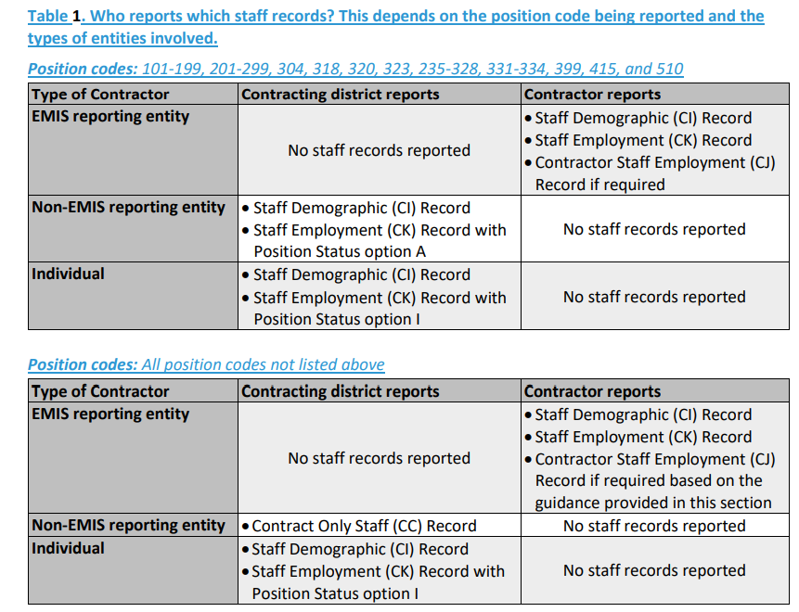
EMIS USERGROUP MEETING
Changes
Change 24-17 Review and revise EMIS Manual Chapter 3 Section 3.2 Reporting Contracted Staff

Slide 18
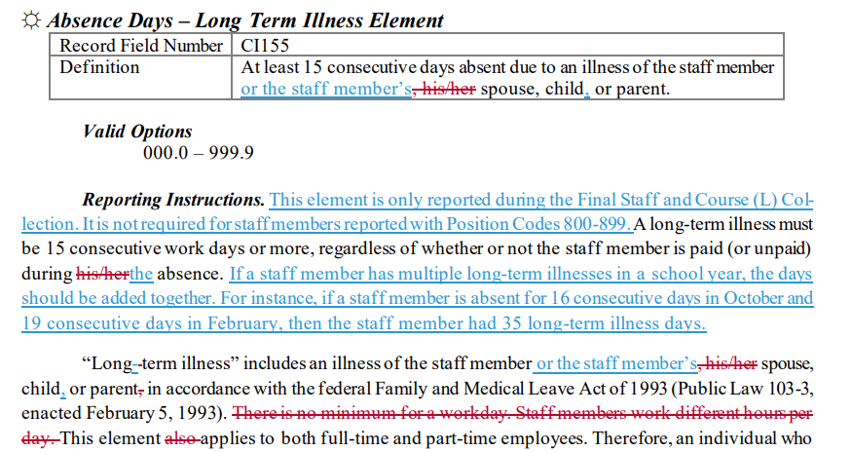
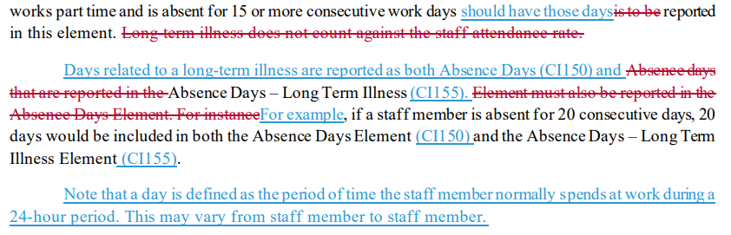
EMIS USERGROUP MEETING
Changes
Change 24-17 Review and revise EMIS Manual Chapter 3 Section 3.3 Staff Demographic (CI) Record, updated May 18, 2023

Slide 19
EMIS USERGROUP MEETING
Changes
Change 24-17 Review and revise EMIS Manual Chapter 3 Section 3.3 Staff Demographic (CI) Record, updated May 18, 2023
Authorized Teaching experience
Should be reported for all teachers reported with Position Codes 212 or 230.
The number of authorized teaching experience years reported for an employee should be the same in both Staff and Course (L) Collections of the current school year.
Authorized teaching years include teaching service in the following Ohio entities.
• Public schools
• Nonpublic schools
• Educational Service Centers (ESCs)
• Community schools
• Special education programs A maximum of 5 years of active military service in the U.S. armed forces can be included. Eight continuous months or more of active military service should be counted as 1 year of authorized teaching experience. See Ohio Revised Code §3317.13 for more detailed information on what qualifies as authorized years. Districts may include the following in authorized teaching years.
• Teaching in public or nonpublic schools outside of Ohio.
• Acting as an educational assistant (other than a classroom aide) employed under the work experience program (see ORC §5107.541).

Slide 20
EMIS USERGROUP MEETING
Changes
Change 24-17 Review and revise EMIS Manual Chapter 3 Section 3.3 Staff Demographic (CI) Record, updated May 18, 2023
EMPLOYEE ID
When reporting the Employee ID Element, districts can use the staff member’s credential ID, a district-assigned Z-ID, or a locally-assigned number as long as the same value is used for the Employee ID Element across all records reported by a district.
Principal Experience Years Element
Reporting Instructions. If fewer than 10 years, report a leading zero. This includes years of licensed service as a school leader with the duties and responsibilities typical of principals and assistant
principals. Include years served in Ohio and in other states in all of the following types of organizations.
  • Public schools
  • Vocational schools
  • State-supported schools
  • STEM schools
  • Community schools
  • Department-licensed preschools
  • Chartered nonpublic schools (i.e., independent private schools and parochial schools)

Slide 21
EMIS USERGROUP MEETING
Changes
Change 24-17 Review and revise EMIS Manual Chapter 3 Section 3.3 Staff Demographic (CI) Record, updated May 18, 2023
Semester Hours
Reporting Instructions .ESCs are required to report this element for gifted coordinators and gifted teachers who are employed by the ESC. In all other cases, reporting semester hours is optional.

Slide 22
EMIS USERGROUP MEETING
Changes
Change 24-17 Review and revise EMIS Manual Chapter 3 Section 3.4 Staff Employment (CK) Record
Reporting Teachers and Principals Who Move Buildings Midyear. When an educator or principal changes buildings within a given school year, the situation is similar to when an educator works in multiple buildings. A district has the following two choices when reporting a Staff Employment (CK) Record for an educator who has changed buildings within the school year.
1. Report One Staff Employment (CK) Record
The district may report one Staff Employment (CK) Record for the staff member. The district
updates the Building IRN element to reflect the building of the new position.
2. Report Multiple Staff Employment (CK) Records
The district may report multiple Staff Employment (CK) records. In this reporting method,
each record is reported with a different building IRN in the Building IRN element. This reflects
each building to which the educator has been assigned during the school year. The district
should make sure to report a separation date and reason for the original position. Each record
is required to be reported during any remaining collections during the same school year.

Slide 23
EMIS USERGROUP MEETING
Changes
Change 24-17 Review and revise EMIS Manual Chapter 3 Section 3.4 Staff Employment (CK) Record
Reporting Teachers and Principals Who Move Buildings Midyear. When an educator or principal changes buildings within a given school year, the situation is similar to when an educator works in multiple buildings. A district has the following two choices when reporting a Staff Employment (CK) Record for an educator who has changed buildings within the school year.
Pay Elements and FTE. When the a teacher or Building Manager principal has the same position in multiple buildings within the district during the year—whether that situation arises from working in multiple buildings concurrently or from moving buildings midyears—
the Local Contract Code Element is required to be unique on each Staff Employment (CK) Record. In this case, the Position FTE Element on each record represents the proportion of time spent in that building, as related to the total FTE for the position. The Scheduled Work Days Element should be the same for each employment record. If the Pay Type Element is annual, the Pay Amount/Rate Element represents the Position FTE Element times the Total Annual Salary Element for the position. If the Pay Type Element is an hourly rate, the Pay Amount/Rate Element is to be reported the same for each Staff Employment (CK) Record

Slide 24
EMIS USERGROUP MEETING
Changes
Change 24-17 Review and revise EMIS Manual Chapter 3 Section 3.4 Staff Employment (CK) Record
Reporting Staff Separations.
When a staff member separates from a position, the district should report that separation by reporting the appropriate Position Separation Reason and Position Separation Date. These elements are required reporting when a staff member leaves a position even if the staff member is remaining in the district. Do not report these separated positions in subsequent years. When reporting a separation in the school year in which it occurs, the Position Status should not be changed to option U. See the Position Status reporting instructions for more information.
Grade Level High and Low
Removing the requirement to report grade level High and low.
Extended Service Element
Remove requirement to report extended service days
ESP reporting
Removed ESP reporting

Slide 25
EMIS USERGROUP MEETING
Changes
Change 24-17 Review and revise EMIS Manual Chapter 3 Section 3.4 Staff Employment (CK) Record
Position Status Element
Valid Options
C Current position in the district
C – Current position in the district. All current staff members should be reported with at least one CK Record with a Position Status of C. When someone leaves a position during the school year, the Separation Date and Separation Reason should be updated on the relevant CK Record(s). The Position Status should remain “C”.
A Contracted personnel - Agency
When the resident/educating district is contracting with a non-EMIS reporting agency (not an individual) for staff to provide services or teach a course.
I Contracted personnel - Individual
When the resident/educating district is contracting with a non-EMIS reporting individual (not an agency) to provide services or teach a course.

Slide 26
EMIS USERGROUP MEETING
Changes
Change 24-17 Review and revise EMIS Manual Chapter 3 Section 3.4 Staff Employment (CK) Record
Position Status Element
Valid Options
P Leave of absence
The individual was employed by the current district during the previous year but
was granted a leave of absence. It does not matter if the employee is being paid
while on leave.
P – Leaves of Absence. If a staff member has any attendance to report for a school year before going on a leave of absence, then do not update the Position Status in the first year of leave. If the staff member’s leave extends into a second year, then report Position Status option P beginning in the second year of leave.
U No longer employed by district in this position

Slide 27
EMIS USERGROUP MEETING
Changes
Change 24-17 Review and revise EMIS Manual Chapter 3 Section 3.6 Contractor Only Staff (CC) Record
Position Fund Source Element
Valid Options
A State Auxiliary Funds
B State Funds Other
F Federal Special Education Part-B IDEA Grant (School-age) [formerly VI-B]
G Federal Title I Funds
I Disadvantaged Pupil Impact Aid (DPIA)State Poverty-Based Assistance Funds
J Federal Head Start Program Funds
L Local/State Foundation Funds
N TANF (Temporary Assistance to Needy Families)
O Other Federal Funds
P Federal Preschool Special Education Part- B IDEA Federal Grant Funds for preschool students with disabilities
S State Funds – Early Childhood Education Programs (formerly Public Preschool Programs)
T Private/Tuition
X Federal Reading First Grant
Y Title III

Slide 28
EMIS USERGROUP MEETING
Changes
Change 24-18 New Manual Section 5.1.1 Reporting Calendars Overview
See Hand out
Change 24-23 Eliminate Student Transportation (FP) Record
Transportation record for Community Schools no longer needs to be reported.
Change 24-27 All LEAs able to report student contact information
This change makes student contact information reportable by all LEAs. Though still only required reporting for community schools, the Student Contact (FF) Record and the Student Contact Address (FG) Record will now be reportable by all EMIS reporting entities. This reporting will be used with the new direct certification process for the National School Lunch Program, which may result in more students being identified as eligible without having to complete family income verification forms.
  Other EMIS reporting entities that participate in the National School Lunch Program are strongly encouraged to report the FF Record. This reporting allows
  for a more effective and efficient completion of the direct certification process.

Slide 29
EMIS USERGROUP MEETING
Changes
Change 24-29 Remove District Testing Record
Change 24-31 Clarify reporting of staff overrides
This change updates EMIS Manual Section 3.8 Staff Missing Override (CP) Record to clarify the reporting of staff overrides via the ITCs.
  Not all overrides needed for staff will be possible via reporting this record. For example, a staff member who was reported in the prior year with a local Z-ID and is being reported in the current year with a state credential ID will still need an override to remove the Z-ID from the Missing Staff report, but that override must be requested via your ITC and the EMIS Helpdesk. If the Z-ID was reported in the current year before the credential ID was reported, then an override is not needed. As with overrides reported via the CP Record, overrides requested via an ITC do not correct misreported data; these overrides merely remove the staff member from the Missing Staff report.

Slide 30
EMIS USERGROUP MEETING
Changes
Change 24-32 Updates SSID information and guidance
Other Ohio state agencies also issue SSIDs to students from early childhood through college age. It is therefore possible that a student who has never attended an Ohio PK-12 public school may already have an SSID. In cases where a district finds that a student has multiple SSIDs, which SSID is maintained and reported depends on factors such as the entity that requested the SSIDs, the entity that has reported the SSIDs, and when and how long the SSIDs have been reported. If only one of the SSIDs has previously been reported to EMIS by a PK-12 school, then that is the SSID the newly enrolling district should use. If more than one SSID has been reported to EMIS by PK-12 schools, the newly enrolling district should consider the following when determining which SSID to use.
• If the student was a high school student at only one of the previous districts, the newly enrolling district should always use this high school SSID.
• If the student was a high school student at more than one of the previous districts, the newly enrolling district should evaluate the data reported under both (or all) SSIDs to determine which to report.
• If the student was not a high school student at any of the previous districts, the newly enrolling district should evaluate the data reported under both (or all) SSIDs to determine which to report.
When it is not clear which SSID to use (e.g., when multiple SSIDs were reported for high school), the newly enrolling district should consider things like how long the SSIDs were reported, how much data is associated with each, and which was reported with more assessment or progress toward graduation related data when determining which to report.
All non-selected SSIDs that are not being reported in the current school year should be deactivated and mapped into the selected SSID.
For non-selected SSIDs that are being reported in the current school year, all districts currently reporting the student must coordinate to keep only one SSID and to deactivate all others. If an SSID that is currently being reported is deactivated, the reporting district will receive fatal errors. These fatal errors will likely lead to the reporting district reactivating the prior SSID and deactivating the SSID selected by the newly enrolling district.

Slide 31
EMIS USERGROUP MEETING
Changes
Change 24-33 Updates to expulsion reporting
Definitions of Terms Related to Attendance
Expelled Students. “When a student is expelled, the student is reported with Sent Reason option EX as of the date of expulsion and This reporting requires a new FS Record. The Sent to IRN is reported as 999999. For students who are not receiving education or services during the expulsion, report 0 for Sent to Percent of Time and option 3 for District Relationship. For students who are receiving education or services during the expulsion, report the appropriate amount for Sent to Percent of Time and option 1 for District Relationship.
Sent to reasons 1 or 2
Valid Options EX Expelled
Reporting Instructions. When a student is expelled, report Sent Reason option EX and Sent To IRN 999999.
If the student is not receiving education or services during the expulsion, report 0 for Sent to Percent of Time and option 3 for District Relationship.
If the student is receiving education or services during the expulsion, report the appropriate value for Sent to Percent of Time and option 1 for District Relationship.

Slide 32
EMIS USERGROUP MEETING
Changes
Change 24-33 Updates to expulsion reporting Continued
Special Education Before withdrawing a special education student, districts must ensure that they have complied with all laws and regulations regarding the education of students with disabilities. For instance, the IDEA requires that districts provide an alternative setting for the education of students who are truant. For more specific information regarding special education students, refer to the Department’s Office for Exceptional Children.
If a student attending a JVSD is expelled by either JVSD or the educating district, then both districts report Sent Reason option EX and Sent to IRN 999999. Sent to Percent of Time and District Relationship reported depend on whether the student is receiving any education or services during the expulsion. See Example Question 11 and EMIS Manual Section 2.4 Student Standing (FS) Record for more information

Slide 33
EMIS USERGROUP MEETING
Changes
Change 24-33 Updates to expulsion reporting Continued
EXAMPLES
Question 11. JVS had an enrolled student who received a suspension followed immediately by an expulsion. On the first day of the student’s suspension, she was placed in a JDC. She was released from the JDC before the period of her suspension had expired. How does JVS report this student? The student is withdrawn to her resident district for the dates of her incarceration at the JDC. When the student leaves the JDC, she is re- enrolled in the JVS. Finally, the JVS and the resident district should both report her with Sent Reason option EX as of the start of her expulsion.
If the student is not receiving education or services during the expulsion, then report as follows:
Sent to Percent of Time = 0
Sent to IRN = 999999
District Relationship = 3
If the student is receiving education or services during the expulsion, then report as follows:
Sent to Percent of Time = the percent of time the student is receiving education or services
Sent to IRN = 999999
District Relationship = 1

Slide 34
EMIS USERGROUP MEETING
Changes
Change 24-34 Adds program codes to collect related services
This change adds program codes to collect the related services that students receive.
Special Education Related Services. Report the appropriate related service code(s) as indicated
on the child’s IEP. Multiple related service program codes may be reported for a child with a disability
condition. The EMIS reporting entity (e.g., the resident district or the ESC) providing related services to a
preschool child with a disability is required to report the appropriate special education related service program codes.
For students reported with Disability Condition option 05–Speech and Language Impairments, program code 215013–Speech and Language Services is not reported.

Slide 35
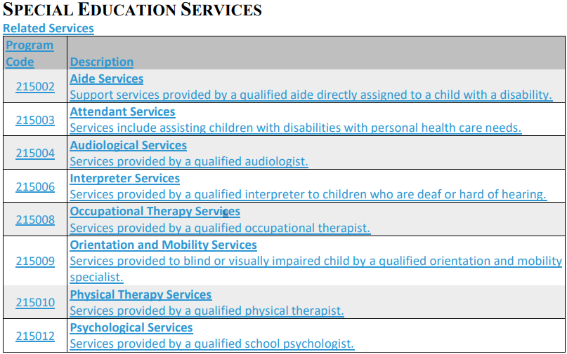
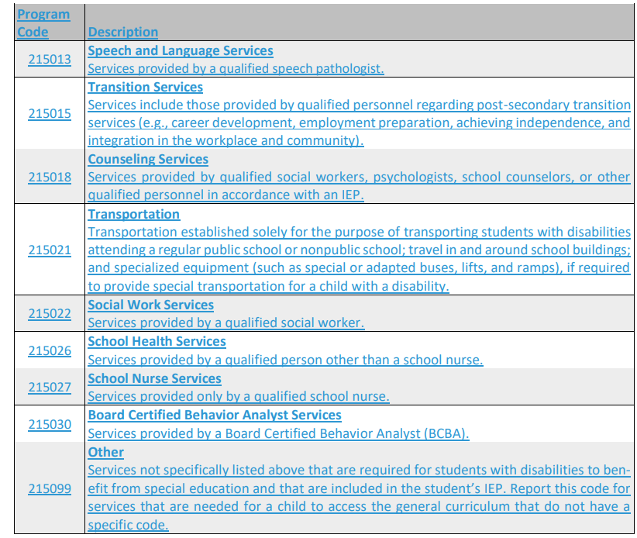
EMIS USERGROUP MEETING
Changes
Change 24-34 Adds program codes to collect related services- continued

Slide 36
EMIS USERGROUP MEETING
Changes
Change 24-40 Expand course grade collection
This change updates the reporting guidance for this record to encourage the reporting of grades for additional courses. The expanded guidance is to allow for more complete information in the Early Warning System.
Note that when reported, grades for middle school (grades 6-8) math and English courses will be utilized in the Early Warning System. We therefore encourage the reporting of grades for these courses.
Change 24-41 Student acceleration reporting
This change removes the Accelerated Level Count Element. It also adds an option to the Subject Area Element updates the reporting guidance to allow (not require) districts to report a single record for students who are whole grade accelerated.
Valid Options
A All subjects
C Social Studies
M Mathematics
R Reading/Writing
S Science

Slide 37
EMIS USERGROUP MEETING
Changes
Change 24-41 Student acceleration reporting-Continued
Students who would previously have been reported with option W should now be reported with option R.
Students who have been whole grade accelerated can be reported in one of two ways. Districts can continue to report one record for each subject or districts can report a record with option A. If a record with option A is reported, also reporting records for specific subjects will not have an impact.
Early Entrance students should be reported with option A if they were evaluated per local policy and found to be eligible to begin kindergarten or first grade early

Slide 38
EMIS USERGROUP MEETING
Changes
Change 24-42 Remove EL trial mainstream option
This change removes English Learner Status option M–EL Trial Mainstream.
Change 24-47 Updates to extended standards subject codes
This change updates the titles and descriptions for the 19xxxx subject codes for exceptional children
Educators should use extended standards to provide content that is directly aligned to Ohio’s Learning Standards. Teachers should consider incorporating instruction with individual accommodations or supports students need to access the curriculum as well as non-academic skills needed for student success such as communication, self-determination, fine/gross motor, and social/emotional skills. Daily living and life skills are often represented within the standards as reading, speaking, listening, writing, and economics skills and should be taught and integrated with the extensions. Educational plans should also include any other additional skills necessary for each child’s individual education needs and transition planning goals..

Slide 39
EMIS USERGROUP MEETING
Changes
Change 24-47 Updates to extended standards subject codes - continued
196340
Learning Progressions (K-2) NEW
Course uses learning progressions to inform instruction with individual accommodations or supports students need to access the curriculum as well as non-academic skills needed for student success such as
communication, self-determination, fine/gross motor, and social/emotional skills. Daily living and life skills are often represented within the standards as reading, speaking, listening, writing, and economics skills and should be taught and Integrated with the extensions.
196350
Adaptive Living Skills (K-3) Basic skills for students with severe motor, sensory, or intellectual disabilities that present unique and significant challenges to participation in other courses. Grades K - 3
Extended Standards (grade 3)
Course uses extended standards to inform instruction with individual accommodations or supports students need to access the curriculum as well as non-academic skills needed for student success such as communication, self- determination, fine/gross motor, and social/emotional skills. Daily living and life skills are often represented within the standards as reading, speaking, listening, writing, and economics skills and should be taught and integrated with the extensions.

Slide 40
EMIS USERGROUP MEETING
Changes
Change 24-47 Updates to extended standards subject codes - continued
196360
Adaptive Living Skills (4-6) Basic skills for students with severe motor, sensory, or intellectual disabilities that present unique and significant challenges to participation in other courses. Grades 4 -– 6
Extended Standards (grades 4-6)
Course uses extended standards to inform instruction with individual accommodations or supports students need to access the curriculum as well as non-academic skills needed for student success such as communication, self-determination, fine/gross motor, and social/emotional skills. Daily living and life skills are often represented within the standards as reading, speaking, listening, writing, and economics skills and should be taught and integrated with the extensions
196370
Adaptive Living Skills (7-8) Basic skills for students with severe motor, sensory, or intellectual disabilities that present unique and significant challenges to participation in other courses. Grades 7 - 8
Extended Standards (grades 7-8)
Course uses extended standards to inform instruction with individual accommodations or supports students need to access the curriculum as well as non-academic skills needed for student success such as communication, self-determination, fine/gross motor, and social/emotional skills. Daily living and life skills are often represented within the standards as reading, speaking, listening, writing, and economics skills and should be taught and integrated with the extensions. Educational plans should also include any other additional skills necessary for each child’s individual education needs and transition planning goals.

Slide 41
EMIS USERGROUP MEETING
Changes
Change 24-47 Updates to extended standards subject codes - continued
196380
Adaptive Living Skills (9-12)
Basic skills for students with severe motor, sensory, or intellectual
disabilities that present unique and significant challenges to participation in other courses. Grades 9 – 12.
Extended Standards (grades 9-12)
Course uses extended standards to inform instruction with individual accommodations or supports students need to access the curriculum as well as non-academic skills needed for student success such as
communication, self-determination, fine/gross motor, and social/emotional skills. Daily living and life skills are often represented within the standards as reading, speaking, listening, writing, and economics skills and should be taught and integrated with the extensions. Educational plans should also include any other additional skills necessary for each child’s individual education needs and transition planning goals

Slide 42
EMIS USERGROUP MEETING
Changes
Change 24-48 Updates reporting guidance for EL Status
This change clarifies the reporting guidance for the English Learner Status Element when reporting preschool and kindergarten students.
Preschool students are identified differently than school-aged students. Options N and Y are the only valid options for PS students. For kindergarten students, option Y should only be reported if the student is in the third year of kindergarten and option S should only be reported if the student is in the second year of kindergarten
Change 24-53 Collect district SIS
DSTRCTSFTW is used to report the primary software used by the district for organizing and
maintaining EMIS submission data.
Valid Options
SIS-ES PowerSchool eSchoolPlus
SIS-EV Evolve SIS
SIS-FF EMIS Flat File Editor
SIS-IC Infinite Campus
SIS-PS PowerSchool SIS
SIS-SI ProgressBook StudentInformation
    SIS-OT Other Student Information System

Slide 43
EMIS USERGROUP MEETING
Changes
Change 24-53 Collect district SIS Continued Fiscal Software
FIN-EF eFinancePlus
FIN-FF EMIS Flat File Editor
FIN-TM Tyler Munis
FIN-US USAS (Uniform School Accounting System)
FIN-OT Other Financial System
HRP-EF eFinancePlus
HRP-FF EMIS Flat File Editor
HRP-TM Tyler Munis
HRP-US USPS (Uniform Staff Payroll System)
HRP-OT Other HR/Payroll System

Slide 44
EMIS USERGROUP MEETING
Changes
Change 24-58 Updates reporting guidance for ELA and COS
This change updates the reporting guidance for the COS and the ELA to clarify that Autism Scholarship students are not required to take these two assessments.
Childhood Outcome Summary (COS; GM). All preschool students with a disability are required to be assessed using the Childhood Outcome Summary (COS) instrument. The only exception is students enrolled in the Autism Scholarship program; these students are not required to be assessed with the COS. The COS is a record of progress on specific outcomes as required by federal law.
Early Learning Assessment (ELA; GB).
All preschool students with a disability and preschool students who are Early Childhood Education (ECE) grant funded are required to be assessed using the Early Learning Assessment (ELA). The only exception is students enrolled in the Autism Scholarship program; these students are not required to be assessed with the ELA.

Slide 45
EMIS USERGROUP MEETING
Changes
Change 24-60 Adds program codes for entering kindergartners
This change adds new program codes for entering kindergartners. These codes describe the student’s preschool experience. This reporting is required by ORC §3301.0714(B)(3)(b). Reporting these program codes is optional for FY24; it will be required in FY25.
Major Program Code Groupings Pre-Kindergarten Experiences. This set of program codes (8000xx) should be reported for every kindergarten student upon entering kindergarten for the first time. This information likely will come from what the parent and/or guardian shares with the school when the child enrolls in kindergarten. These codes are not required to be reported for students who have already completed one or more years of kindergarten. The purpose of these codes is to report the student’s attendance at a preschool program in the 2 years prior to starting kindergarten. The time that students attended a Department-licensed preschool that reports preschool students to EMIS does not need to be included. Department-licensed preschools are operated by public districts, community schools, Educational Service Center, JVSDs, and the State Schools for the Blind and Deaf (OSB and OSD). Multiple program codes can be reported; for example, if a child attended a Head Start when they were 3 years old and a private preschool when they were 4 years old, report both program codes.

Slide 46
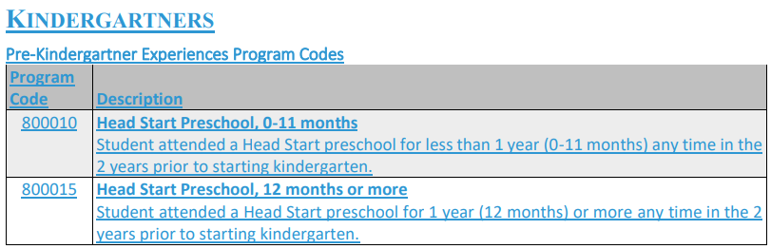
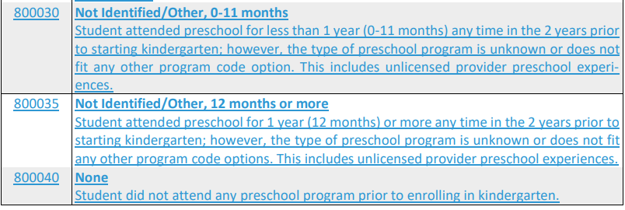
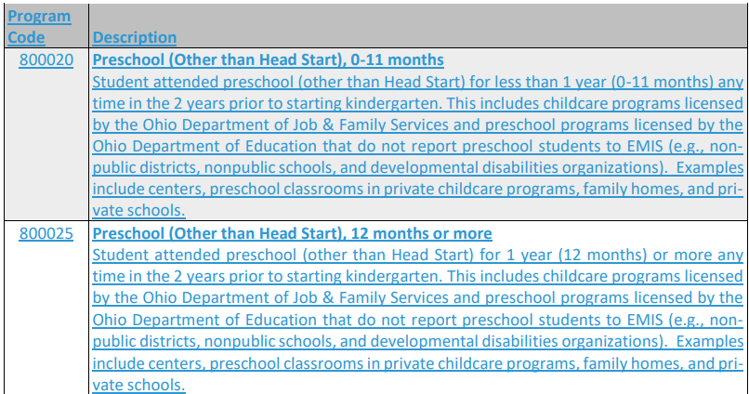
EMIS USERGROUP MEETING
Changes
Change 24-60 Adds program codes for entering kindergartners- Continued

Slide 47
EMIS USERGROUP MEETING
Changes
Change 24-62 Adds KG survey data to EMIS
This change adds new attributes to the Organization–General Information (DN) Record to gather information previously collected via the KG survey.
STUKGLFREE Count of all-day kindergarten students who pay tuition and are eligible for free lunch
Is the attribute used to report the total number of kindergarten students enrolled in all-day kindergarten who are charged tuition and are eligible for free lunch under the National School Lunch Act. This information should be reported at the district level. All-day kindergarten is defined as kindergarten that is in session for not less than the same number of hours each week as students in grades 1 through 6 but no less than 910 hours per academic year.
Valid Options 0000000000 – 0000009999-- This is a headcount and does not include implied decimals
STUKGLRCED Count of all-day kindergarten students who pay tuition and are eligible for reduced price lunch
This the attribute used to report the total number of kindergarten students enrolled in all-day kindergarten who are charged tuition and are eligible for reduced price lunch under the National School Lunch Act. This information should be reported at the district level. All-day kindergarten is defined as kindergarten that is in session for not less than the same number of hours each week as students in grades 1 through 6 but no less than 910 hours per academic year.
STUKGNFEES Maximum amount charged to all-day kindergarten students for fees
Is the attribute used to report the maximum amount of fees charged per year to kindergarten students enrolled in all-day kindergarten. Only report this attribute if you serve students in all day kindergarten. Report $0 if you serve students in all- day kindergarten but do not charge fees. All-day kindergarten is defined as kindergarten that is in session for not less than the same number of hours each week as students in grades 1 through 6), but no less than 910 hours per academic year.

Slide 48
EMIS USERGROUP MEETING
Changes
Change 24-62 Adds KG survey data to EMIS Continued
STUKGNFEES Maximum amount charged to all-day kindergarten students for fees
Is the attribute used to report the maximum amount of fees charged per year to kindergarten students enrolled in all-day kindergarten. Only report this attribute if you serve students in all day kindergarten. Report $0 if you serve students in all-day kindergarten but do not charge fees. All-day kindergarten is defined as kindergarten that is in session for not less than the same number of hours each week as students in grades 1 through 6), but no less than 910 hours per academic
Reporting Instructions. There are no implied decimals; report whole dollar amounts. Examples of “fees” include extra money collected from every student for school supplies, art supplies, workbooks, books and materials, or instructional, general, or district fees. Do not include fees if they are optional or only apply to certain situations. For example, do not include a transportation fee that applies only to students who live within a certain distance from their school, an optional technology protection fee, or optional insurance fees. If a fee is required but can be reduced or waived for certain student populations (such as students with disabilities or students who qualify for free or reduced lunch), report the maximum amount that can be charged when the fees are not reduced or waived. In general, this information can be reported at the district level. However, if a building(s) in a district charges a significantly different amount than that reported for the district, then the building(s) that is different than the reported district amount should be reported with an additional record.
STUKGTUITN Maximum amount charged to all-day kindergarten students for tuition

Slide 49
EMIS USERGROUP MEETING
Changes
Change 24-62 Adds KG survey data to EMIS Continued
STUKGTUITN Maximum amount charged to all-day kindergarten students for tuition
is the attribute used to report the maximum amount of tuition charged per year to
kindergarten students enrolled in all-day kindergarten. This includes tuition charged to either resident or
non-resident students. Only report this attribute if you serve students in all-day kindergarten. Report $0 if
you serve students in all-day kindergarten but do not charge tuition for any students. All-day kindergarten
is defined as kindergarten that is in session for not less than the same number of hours each week as students
in grades 1 through 6 (ORC 3321.05), but no less than 910 hours per academic year.
Valid Options
0000000000 – 0000009999
Reporting Instructions. There are no implied decimals; report whole dollar amounts. If tuition is
required but can be reduced or waived for certain student populations (such as students with disabilities or
students who qualify for free or reduced lunch), report the maximum amount that can be charged when
    tuition is not reduced or waived.
    In general, this information can be reported at the district level. However, if a building(s) in a district charges a significantly different amount than that reported for the district, then the building(s) that is different than the reported district amount should be reported with an additional record

Slide 50
EMIS USERGROUP MEETING
Changes
Change 24-63 Updates to Percent of Time for PK/KG
This change updates the reporting guidance for Percent of Time for preschoolers and kindergartners in EMIS Manual Section 2.4. The additional guidance regards part-time vs full-time students. This change also updates Section 5.1.1 (see change 24-18) to assist with reporting preschool calendars. Finally, this change corrects the valid options range for the Hours Per Day Element in Section 5.2.
As stated in law, schools offering full-time kindergarten through grade 6 are required to be open for instruction for a minimum of 910 hours in the school’s calendar year. This should be reflected in the EMIS calendar reported for these grades. Although a minimum school year for preschool students is not in law, districts should use this same 910-hour requirement when reporting preschool calendars and calculating the percent of time to report to EMIS for preschool students.
Question 10. My district has a part-time preschool program. This program operates 455 hours a year. Should the students in this program be reported as 100% of time on a calendar that includes 455 hours?
Answer 10. No, these are part-time students and should be reported as such. Full-time preschool is a minimum of 910 hours. Students attending a program that is 455 hours should be reported as 50% of time. For some preschool students, this could result in fairly small percentages of time being reported. That is fine, as long as that percentage represents the correct number of hours of attendance for the students.

Slide 51
EMIS USERGROUP MEETING
Changes
Change 24-67 Adds guidance for collecting reading diagnostics
This change adds guidance for reporting reading diagnostics. Elements are being deleted, elements are being updated, and reporting guidance is being included. This change updates EMIS Manual Sections 2.6, 2.8, and 2.8.1. – Removes FN reporting of Diagnostics
Required Collections The Student Assessment (FA) Record and the relevant elements are to be reported as follows.
Reading Diagnostic – RD
Unit of Literacy Achievement and Reading Success. Please refer to the Department’s website for additional information regarding the Tier I Dyslexia Screeners (DS) and the Reading Diagnostics (RD)
Reading Diagnostic (RD). Based on the Third Grade Reading Guarantee, districts/schools must administer a reading diagnostic assessment to all students in grades K-3. The reading diagnostic must be administered by September 30 for grades 1-3 and by the twentieth day of instruction for kindergarten students. The traditional district, STEM district, community school, or state organization in which the student is enrolled when the test is taken is responsible for reporting the results. The RD is reported in the Reading Diagnostic (A) Collection. The particular test given to a student is reported via the appropriate Assessment Area Code.
Star Assessments (Star; GD). Dropout Prevention and Recovery (DPR) programs report student results from the Star Assessments, provided by Renaissance Learning. All results for the current school year should be reported. Entities that give the Star Assessments for internal uses should not report the Star results to EMIS. Entities that give the Star Assessments for Third Grade Reading Guarantee purposes should report the results to EMIS via the Reading Diagnostic (RD) assessment type. Entities that give the Star Assessments as a dyslexia screener should report the results to EMIS via the Tier 1 Dyslexia Screener (DS) assessment type

Slide 52
EMIS USERGROUP MEETING
Changes
Change 24-67 Adds guidance for collecting reading diagnostics-Continued
Score
Valid Options
APP Approaching
ATR At Risk
BL Below level
BLW Below
ECD Exceeds
FLG Flagged
HGH High risk
LOW Low risk
MED Medium risk
MTS Meets
NAR Not at Risk
NBL Not below level
NFL Not Flagged
Refer to the FA manual for additional reporting instructions.

Slide 53
EMIS USERGROUP MEETING
Changes
Change 24-71 Removes graduation points reporting from SNR
This change removes graduation point language from the Score Not Reported options.
X -Assessment score not reported because student received graduation credit for assessment area due to completion of a dual credit course; for End of Course Tests (GE), number in score field represents the grade the student received in the course number of for CTE Technical Assessments (GY), value in score field represents student’s proficiency
X. To determine the number to report for End of Course test scores, see the crosswalk on the Department’s webpage. The number in score field represents the grade the student received in the course
2-Removed option
W- Removed Option

Slide 54
EMIS USERGROUP MEETING
Changes
Change 24-81 Clarifies preschool poverty level reporting
This change clarifies the preschool poverty level reporting guidance.
This element is used for Early Childhood Education (ECE) Grant funded students. Family income only needs to be identified for this element if the preschool student is ECE funded, with the few exceptions defined in the ECE Grantee Manual. For information on determining family income, refer to the ECE Grantee Manual (search for “ECE Grantee Manual” on the Department’s website). If the preschool student is not ECE funded, option P can be reported.
A preschool student whose family is experiencing homelessness as defined by the McKinney Vento Act and has that status reported on the Homeless Status Element (FD150).

Slide 55
EMIS USERGROUP MEETING
Changes
Change 24-82 Updates withdrawal reporting guidance
This change updates the reporting guidance for student withdrawals. This includes a new element to report updated status information discovered later in the school year.
General Guidelines
If the incorrect reason is reported due to a data entry error, then the district should correct their reporting. If the withdrawal reason is incorrect due to a change in situation, then the timing will determine the district’s reporting. Take, for example, a student reported as moved, not known to be continuing who is later found to have enrolled in a school outside of Ohio. If it is found that the student moved out of state prior to the documented withdrawal date reported, then the district should update the Withdrawal Reason and Effective End Date for that student based on the new information. If it is found that the student moved out of state after the documented withdrawal date reported, then the district should not update the withdrawal information. In this situation, the district should report the Updated Exit Status to reflect the student’s move out of state.

Slide 56
EMIS USERGROUP MEETING
Changes
Change 24-82 Updates withdrawal reporting guidance -Continued
Question 13. District A reported a student with a withdrawal code of 48—Expelled 74–Moved, Not Known to be Continuing. Later in the year, the student moved out of state. District A received a note from the parents and a records request from an out of state school. Can District A now change this student’s withdrawal code to 40—Transferred to Another School District Outside of Ohio? .
It depends on the timing of the student’s move out of state. If the student moved out of state prior to the reported withdrawal date, then the district should update the withdrawal information reported. If the student moved out of state after the reported withdrawal date, then the district should not update the reported withdrawal information. In this case, the district should report the Updated Exit Status to reflect the student’s move out of state.

Slide 57
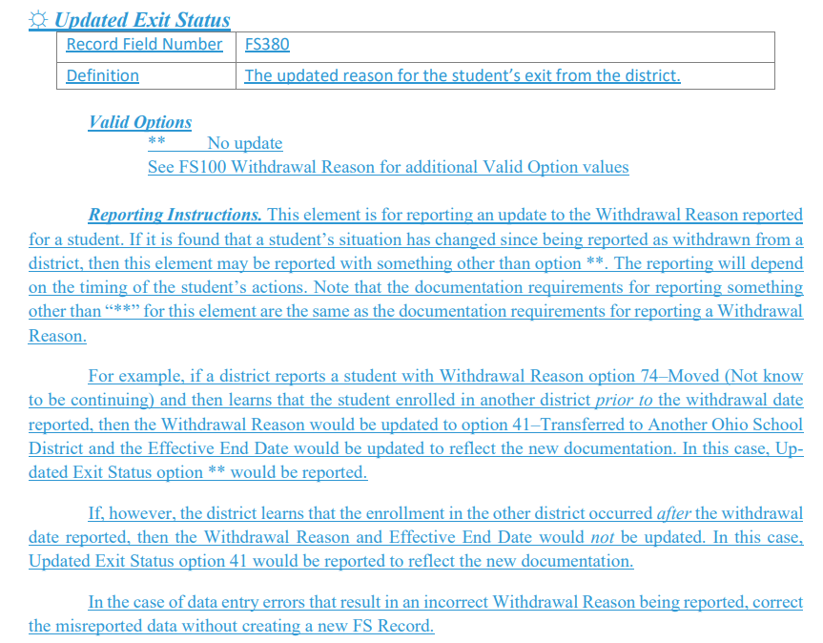
EMIS USERGROUP MEETING
Changes
Change 24-82 Updates withdrawal reporting guidance -Continued

Slide 58
EMIS USERGROUP MEETING
Changes
Change 24-87 Update Immigrant Status reporting instructions
This change updates the reporting instructions for Immigrant Status regarding foreign exchange and international students.
Foreign exchange and international students who meet the definition of immigrant children and youth under the ESEA can be counted as immigrant youth for purposes of Title III.

Slide 59
EMIS USERGROUP MEETING
Manifest Checks
Applies to all Manifests
Level 1 validations
Always check the Level 1 validations before checking the preview reports. The level
1 validations will tell you why you have invalid or fatal records in the previews.
Level 1 validations are checks that the Manifest runs on your data.
In your level 1 validations you have
Fatal- Record will not go to ODE- Will cause invalid records either Fatal or Dependent
Critical- Something is wrong with the data but ODE will accept the record
Warning- ODE sees something that could be an issue. Check it out, if you are reporting correctly, you can ignore the warning.
Level 2 Validations- Post processing checks.
ODE processes the data, then runs checks cross districts to see if there are issues.
Could be reports that ODE is pushing out to you.
Your level 2 reports will also have
Fatal
Critical
Warning
Informational

Slide 60
EMIS USERGROUP MEETING
Manifest Checks
Preview Reports to make sure you look at- Student Manifest
Counts of DN Records Excluded –Records that you have submitted for District DN record that ODE does not need for this particular manifest
Excluded Records – Most times these are GE records that belong to PS students. SI sends over all GE records for PS students. The manifest will only look at GE records within the 7/1/xx to 6/30xx time frame. Since SI sends them all for PS, the ones outside those dates will be excluded.
The only exception to this is a newly enrolled student. If they are newly enrolled in the current school year, SI will send them over and ODE will accept them.
You could have other records types in the excluded. If you do you will need to investigate why they are not going through
Missing Report- Organization Attribute DN
This will be missing building and district records.

Slide 61
EMIS USERGROUP MEETING
Manifest Checks
Preview Reports to make sure you look at- Student Manifest Continued
Missing Report PhysEd Only
This will be missing records on the DN Building record for the PHYS testing.
Missing Report
This will be students the ODE has seen previously that they are not seeing in this manifest.
There are 2 error messages
Missing Data- ODE is not seeing this student at all and they have previously but they have not seen the student withdrawn
Fatal or Dep-There is a level 1 validation that is causing and issue with the student

Slide 62
EMIS USERGROUP MEETING
Manifest Checks
Preview Reports to make sure you look at- Student Manifest Continued
Things to look for when a student is missing
Change in SSID
Student marked No to EMIS
Student Whacked after being reported.
Type Archive in the go to box at the building level
Withdrawn-Student was whacked
Summer withdraw Student was withdrawn properly

Slide 63
EMIS USERGROUP MEETING
Manifest Checks
Preview Reports to make sure you look at- Staff Manifest
Excluded Records
CN-No Corresponding LCC in the Staff Course Record
Staff reporting on the Course record is not matching a staff member reported in USPS.
GN- Local Class Room Code Not Found In Course Master(CN) Record
These will go away once the CN is fixed
CU- Staff Member Does Not have a Valid CI Record Reported
Staff member on the course is probably not marked Y to EMIS in USPS

Slide 64
EMIS USERGROUP MEETING
Manifest Checks
Preview Reports to make sure you look at- Assessment Manifest
Excluded Records
Excluded records for the Assessments work differently than the other manifests.
The count of Assessment records excluded is the number of TYPES of assessments that are being excluded. If you are running the EOC-GE then you would see all other types such as AP, ACT etcetera in this file. If you see GE it could be due to a date out of range.
The Excluded Student Assessment Record would be the actual test record for the students in the Count of Assessment Records excluded.

Slide 65
EMIS USERGROUP MEETING
Manifest Checks
Preview Reports to make sure you look at- Calendar
Check your Calendar Display to make sure hours per day and total hours are correct
DN records – a list of EMIS exceptions that you have reported
DL records- List of each building calendar dates- First Day and Last Day

Slide 66
EMIS USERGROUP MEETING
MISC
Students that have 5 credits and are 100% of time but do not attend all day
ODE Ticket
Here is a ticket that was put to ODE 00140448
As Bill stated in the other ticket, the students should be on a calendar that meets the minimum hours requirement for the year. And they can be reported as 100% of time as long as they meet the 5 credit hour rule. The students would not be marked as absent for the time they are not expected to be in the building. They should only be reported for absences when they're not there when they should be.So if the student is expected to be at school from, say, 10 to 1 every day and shows up on Monday at noon, then from 10 to noon, they're absent. But from the start of the day to 10 and from 1 to the end of the day, the student would NOT be considered absent. I know this goes against our usual "report what is" direction, but with this 5-hour rule, this is how the reporting should work. Hopefully this makes sense.

