Slide 1
Understanding your
LGR reports

Slide 2
Understanding your LGR reports
There are 2 reports that you will use to make sure your grad rate is as high as possible
  Longitudinal Grad Rate
    Shows all students that are in the cohort and whether or not they are counting as graduates
  Grad Info- not generated until G reporting has begun.
    Shows all students that are being reported in the G reporting period as graduates and will point out issues with data that has been submitted.

Slide 3
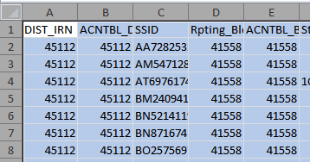
Filtering LGR spreadsheets
Open your LGR Spreadsheet
Click on the box above the 1 and to the left of A
This will highlight the entire spreadsheet

Slide 4
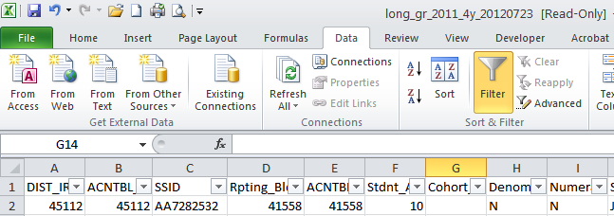
Filtering LGR spreadsheets
Click on Data and then on Filter
This will place a down arrow at the top of each column

Slide 5
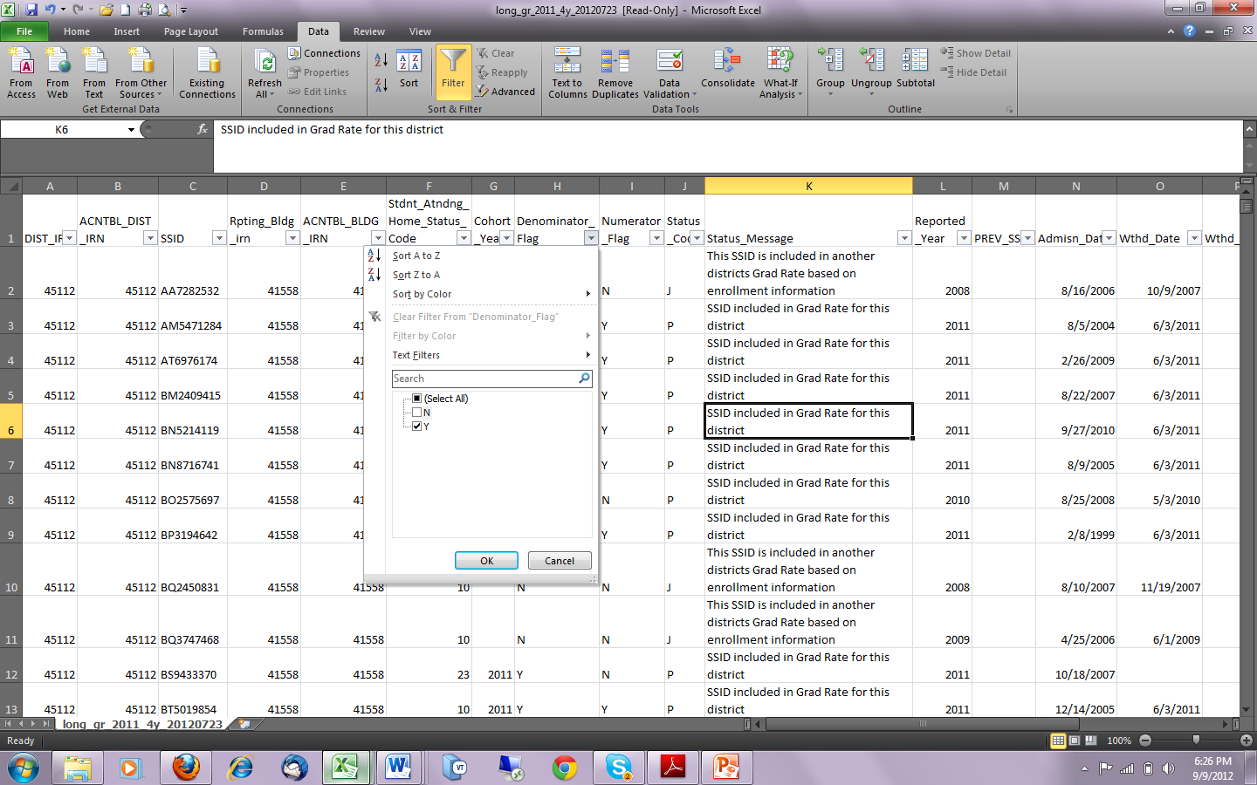
Filtering LGR spreadsheets
Go to Column J and click on the down arrow
Unclick the N box
Click OK
This will give you all students included in the cohort

Slide 6
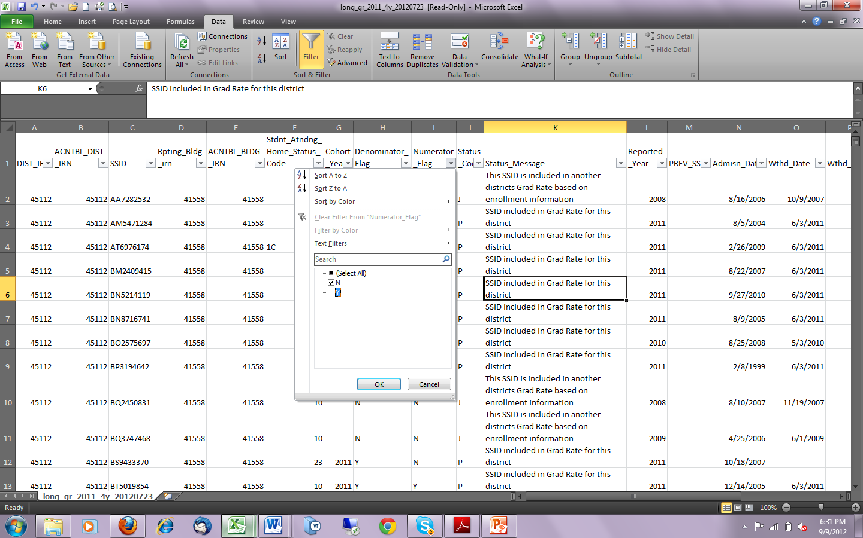
Filtering LGR spreadsheets
Go to column K and click on the down arrow and uncheck the Y box.
Click Ok
This will give you all students not counting as graduates.

Slide 7
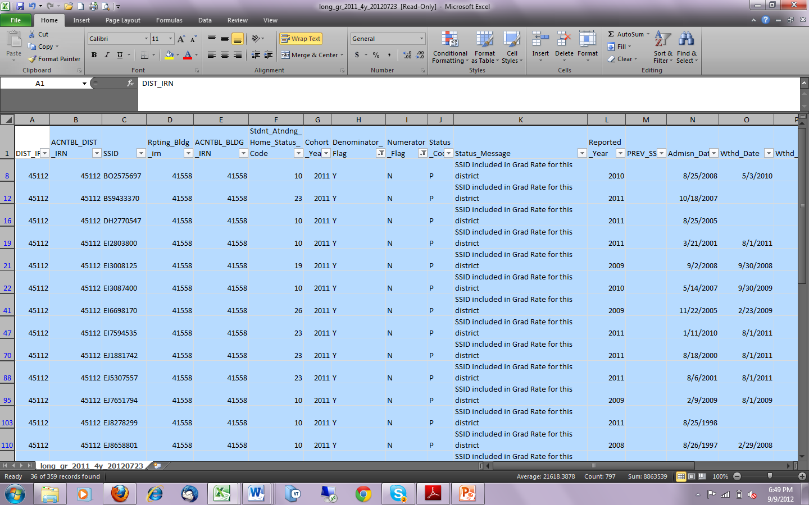
Filtering LGR spreadsheets
At this point you have the data that you need to work with, so to keep you from having to continue to work with the entire spreadsheet:
Click on the box above the 1 and to the left of A to highlight the entire spreadsheet.

Slide 8
Filtering LGR spreadsheets
Click Copy
Open a new spreadsheet

Slide 9
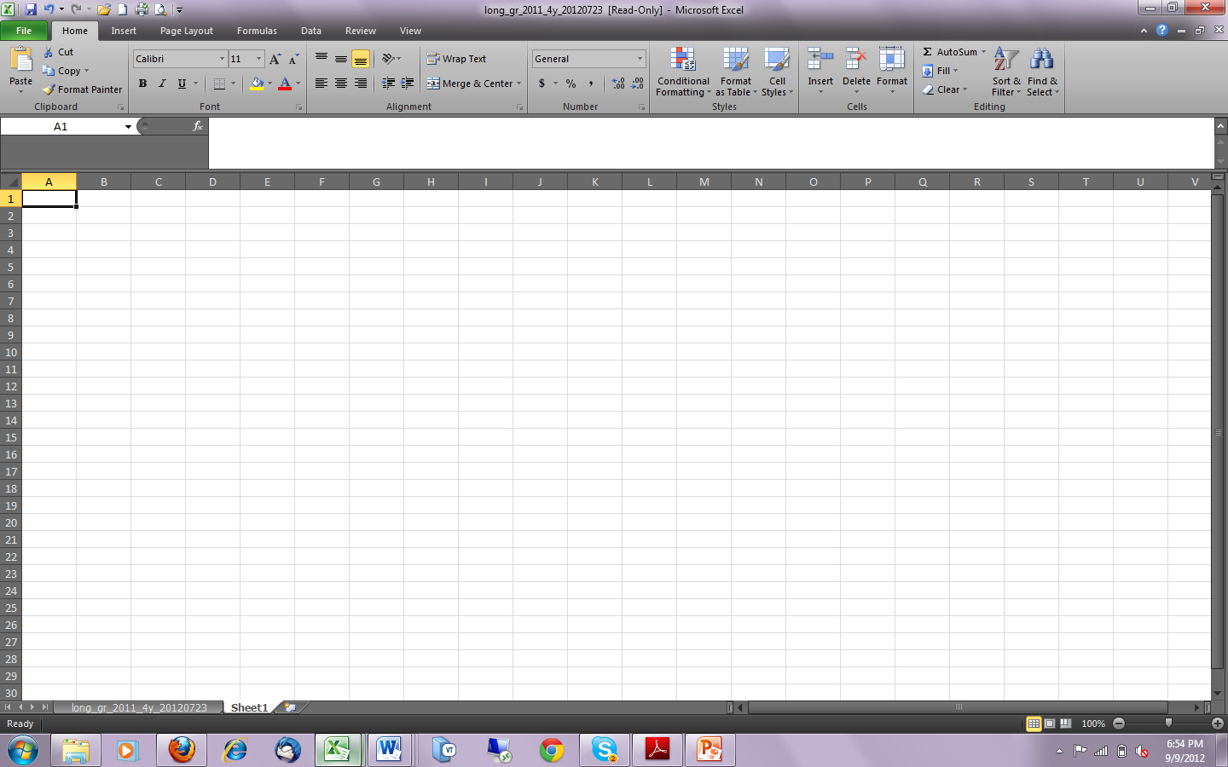
Filtering LGR spreadsheets
Have your cursor in the A-1 cell and click paste.
This will enter the data from your filtered spreadsheet into the new spreadsheet. Now you can begin to look at the students that are not counting and find out why.

Slide 10
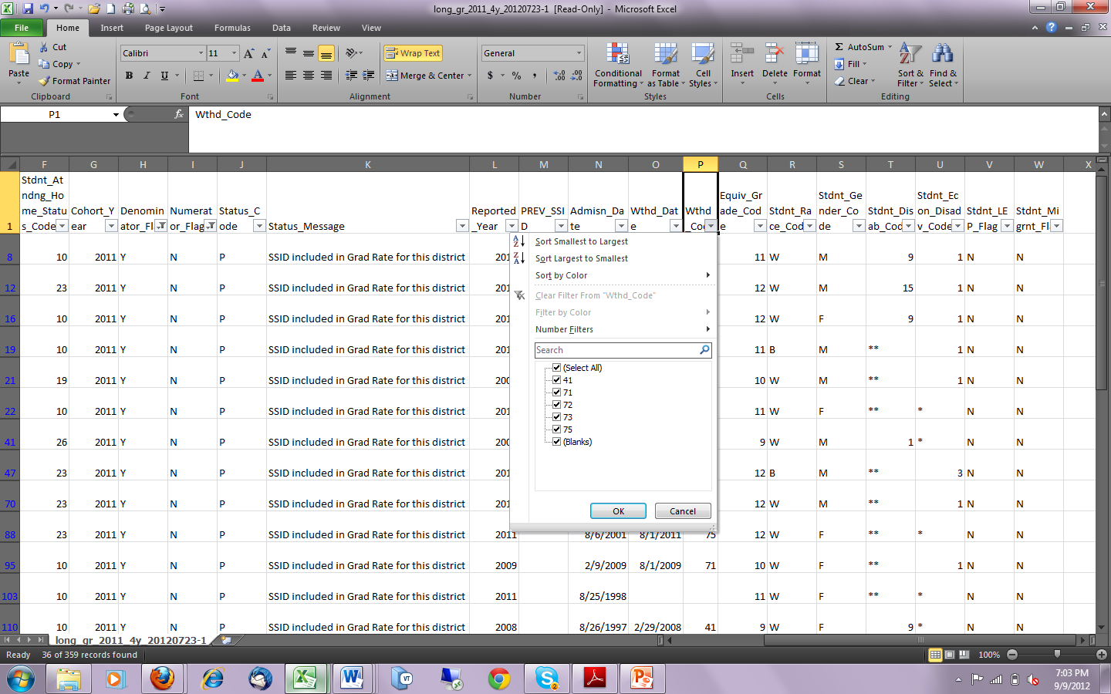
Filtering LGR spreadsheets
You want to start by looking at the withdraw codes of the students that are not counting.
Click on the down arrow on column R.

Slide 11
Filtering LGR spreadsheets
You can eliminate all the 7* codes, they are dropout codes and will count as non on-time graduates for you.

Slide 12
Filtering LGR spreadsheets
Unclick all the 7* codes leaving the 41 and the blanks.
Click Ok.

Slide 13
Filtering LGR spreadsheets
It is a very good chance that the blanks are either students that have been retained sometime during their High School years or they are grade level 23 students.
The 41 students are ones you need to concentrate on.

Slide 14
Filtering LGR spreadsheets
Reasons they are not showing as graduates.
  They were withdrawn incorrectly
    Should have been a 40-out of state
    42-private school
    43- home schooling
  They withdrew to another district but the new district is using a different SSID.
    This will take a lot of investigation, but if you can find the student and the new SSID you can have them removed from your cohort and your grad rate will go up.

Slide 15
Filtering LGR spreadsheets
The following withdraw codes will not count against you. These students will be taken out of the calculations.
  40- Out of state
  42- Private School
  43- Home Schooling
  48- Expelled
  51- Medical reasons

Slide 16
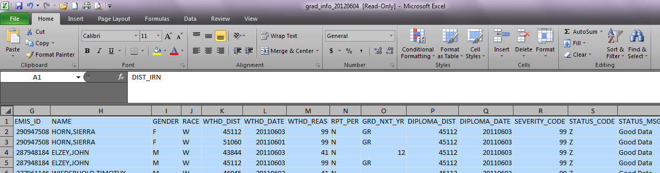
Grad Info Report
Open your Grad Info Report
Go to columns P and Q
Typically if you have a 99-Z your students have passed all checks and have no issues.

Slide 17
Grad Info Report
If you have anything other than 99-Z, then you need to investigate more. The Grad info report explanation will give you a full explanation of all the status codes and severity codes.

Slide 18
Situations to be careful of!
Scenario 1:
  District A withdrew three students on 8/17/10 out of state (code 40).
  However, all three were still counted in the denominator against the district.
  ODE was contacted and responded that District A “allegedly” reported a school year start date of 8/10/10.
  The LGR only picks up “summer” graduates.
  Therefore, since the students “allegedly” did not withdraw before school started, they did not get out within 4 years and so will included in the denominator as non-graduates.
  There is no way to dispute what ODE says they are seeing.
So be sure your “District/Building” start dates are correct.
  District A’s District/ Building records were accurate but they have no recourse for correction.

Slide 19
Situations to be careful of!
Scenario 2:
  District A had a student reported as open enrolled from District B who withdrew (or so they thought) back to District B on 8/17/10.
    They withdrew the student as code 41 which is supposed to back the student out of the denominator.
  The student went back to District B and apparently indicated they were going to a private school.
    District B then withdrew the student on 8/23/10 to the private school with code 42.
  Problem!
    The 8/23/10 date was before the first day of school for District B. This meant that the student did not attend during B’s “school year”.
    Therefore, since the private school does not report via EMIS and the student did not re-enroll at B, does this mean that district A takes the hit because they were the last district reporting the student during their school year?

Slide 20
Situations to be careful of!
Scenario 3: (AND THIS IS THE SCARY ONE!!)
  District A had a student in the 2011 cohort who withdrew 4/5/09 with SSID “XX7406847”.
    They withdrew the student as code 41 which is supposed to back the student out of the denominator as long as the student enrolls elsewhere.
  The student enrolled at District B on 4/6/10 and graduated from there May 2011 which should have then backed the student out of A’s cohort.
  Wrong!!
    District A reported the student with a DOB of 9/13/93.
    When District B enrolled the student, they listed the DOB as 9/16/93 thus creating SSID “XX1930454”
  SO….District A takes a hit on their grad rate because one of the two districts had the wrong DOB even though the student did graduate within 4 years!
  Further, while District B used “XX1930454”, the student was at a JVS which was still using the “XX7406847” number from 2 years previous.
  So even though District B and the JVS reviewed their SSID conflict and corrected them, District A would never have been contacted and therefore would not know to change this and would still take the hit.

Slide 21

Questions?

