Slide 1


Local Property Tax

Slide 2
Agenda
Valuation
Rates
Levy Types
Revenue Estimates
Deductions & Reimbursements
CAUV

Slide 3
Frederick C. Stocker, Tax Economist
The property tax “resembles a
structure designed by a
mad architect, erected on a shaky
foundation by an incompetent builder,
and made worse by the well-
intentioned repair work of hordes of
amateur tinkerers.”

Slide 4
2008 Statewide Poll
Who is responsible for setting
the property tax rate in your county?
#1 Response: “Don’t Know” (30%)
Voters: (25%)
County Auditor: (23%)
County Commissioners: (17%)
County Treasurer: (4%)

Slide 5
Basic Property
Tax Formula
Value x Rate = Tax

Slide 6

Auditor Sets Market Value
Based upon market research, valid sales, etc.
Goal is 92% to 94%
3 Year Cycles
Taxed at 35%

Slide 7
Property Classes
Class I
  Agricultural (CAUV) + Residential
Class II
  Commercial + Industrial + Public Utility Real
Public Utility Personal

Slide 8
Value Sheet

Slide 9
Exempt Property
Government buildings, churches, etc.
Abatements
TIFs - Tax Increment Financing

Slide 10
Public Utility Personal Property
Power Generation Equipment
Transmission & Distribution Lines
Full Tax Rate
Appeals to ODT

Slide 11
Public Utility Personal Property
Legislative Proposal
  Eliminate power generation tax
  Complex reimbursement procedure
  Line item vetoed out of state budget

Slide 12
The Tax Rate
Mostly determined by voters in the taxing jurisdiction
Voted levies + inside millage

Slide 13
Inside Millage
No more than 10 mills
Determined by Budget Commission
Consistent, not subject to adjustment factors

Slide 14
Property Classes & Rates
Class I Effective Rate
Class II Effective Rate
Full Property Tax Rate

Slide 15
Adjustment Factors
Effective Rate adjusted to target previous year’s revenue
Values Effective Rates
Values Effective Rates
Levies cannot grow

Slide 16
Adjustment Example
Union City
2015 Comm. Effective Rate: 17.49 Mills
Commercial values increased 175%
2016 Comm. Effective Rate: 14.08 Mills

Slide 17
Adjustment Example
Northridge Schools
2014 Res. Effective Rate: 46.88 Mills
Residential values decreased by 22%
2015 Res. Effective Rate: 53.02 Mills

Slide 18
Capped Levies
Values Effective Rates
Effective Rate cannot surpass rate approved by voters
Levy loses money
Permanent loss because rates target previous year’s revenue

Slide 19
Levy Types
New “Additional” levy
Renewal levy
Replacement levy

Slide 20
Additional
Seeks new money
Can be placed on ballot any time
Homeowner DOES NOT receive property tax rollbacks

Slide 21
Renewal Levy
Extends the life of the levy
Raises same amount of money
Maintains effective tax rates
Homeowner DOES receive property tax rollbacks
Renewal with increase

Slide 22
Replacement Levy
Extends the life of the levy while raising new money
Replaces the old levy using updated property values, increasing effective tax rate
Homeowner DOES NOT receive property tax rollbacks

Slide 23
Replacement Levy Example
New Lebanon Village
1998 Fire Levy, 5.0 Mills
4.30 Effective Rate, $180K Revenue
Next Year:
5.00 Effective Rate
$210K Revenue

Slide 24
Levy Purposes
Operating
Fire, Police, Parks, Roads, Etc.
Permanent Improvement
Bond
Emergency
Substitute

Slide 25
Bond
Passed to service debt, usually for new school building project
Tax rate adjusted annually so as to bring in enough money to service the debt
May never be renewed or replaced
Not subject to adjustment factor

Slide 26
Bond Fund Excess
Can be transferred to Permanent Improvement fund
Needs Budget Commission approval
Brookville LSD, New Lebanon LSD

Slide 27
Emergency
Rate set to produce a fixed revenue sum
May be renewed, but never replaced
May be for up to 10 years, but not continuing
Not subject to adjustment factor

Slide 28
Substitute (2008)
Substitutes an emergency levy with a levy that has a built-in growth factor
May never be renewed or replaced, but may be substituted again
Not subject to adjustment factor

Slide 29
Basic Property
Tax Formula
Value x Rate = Tax

Slide 30
Value Sheet

Slide 31
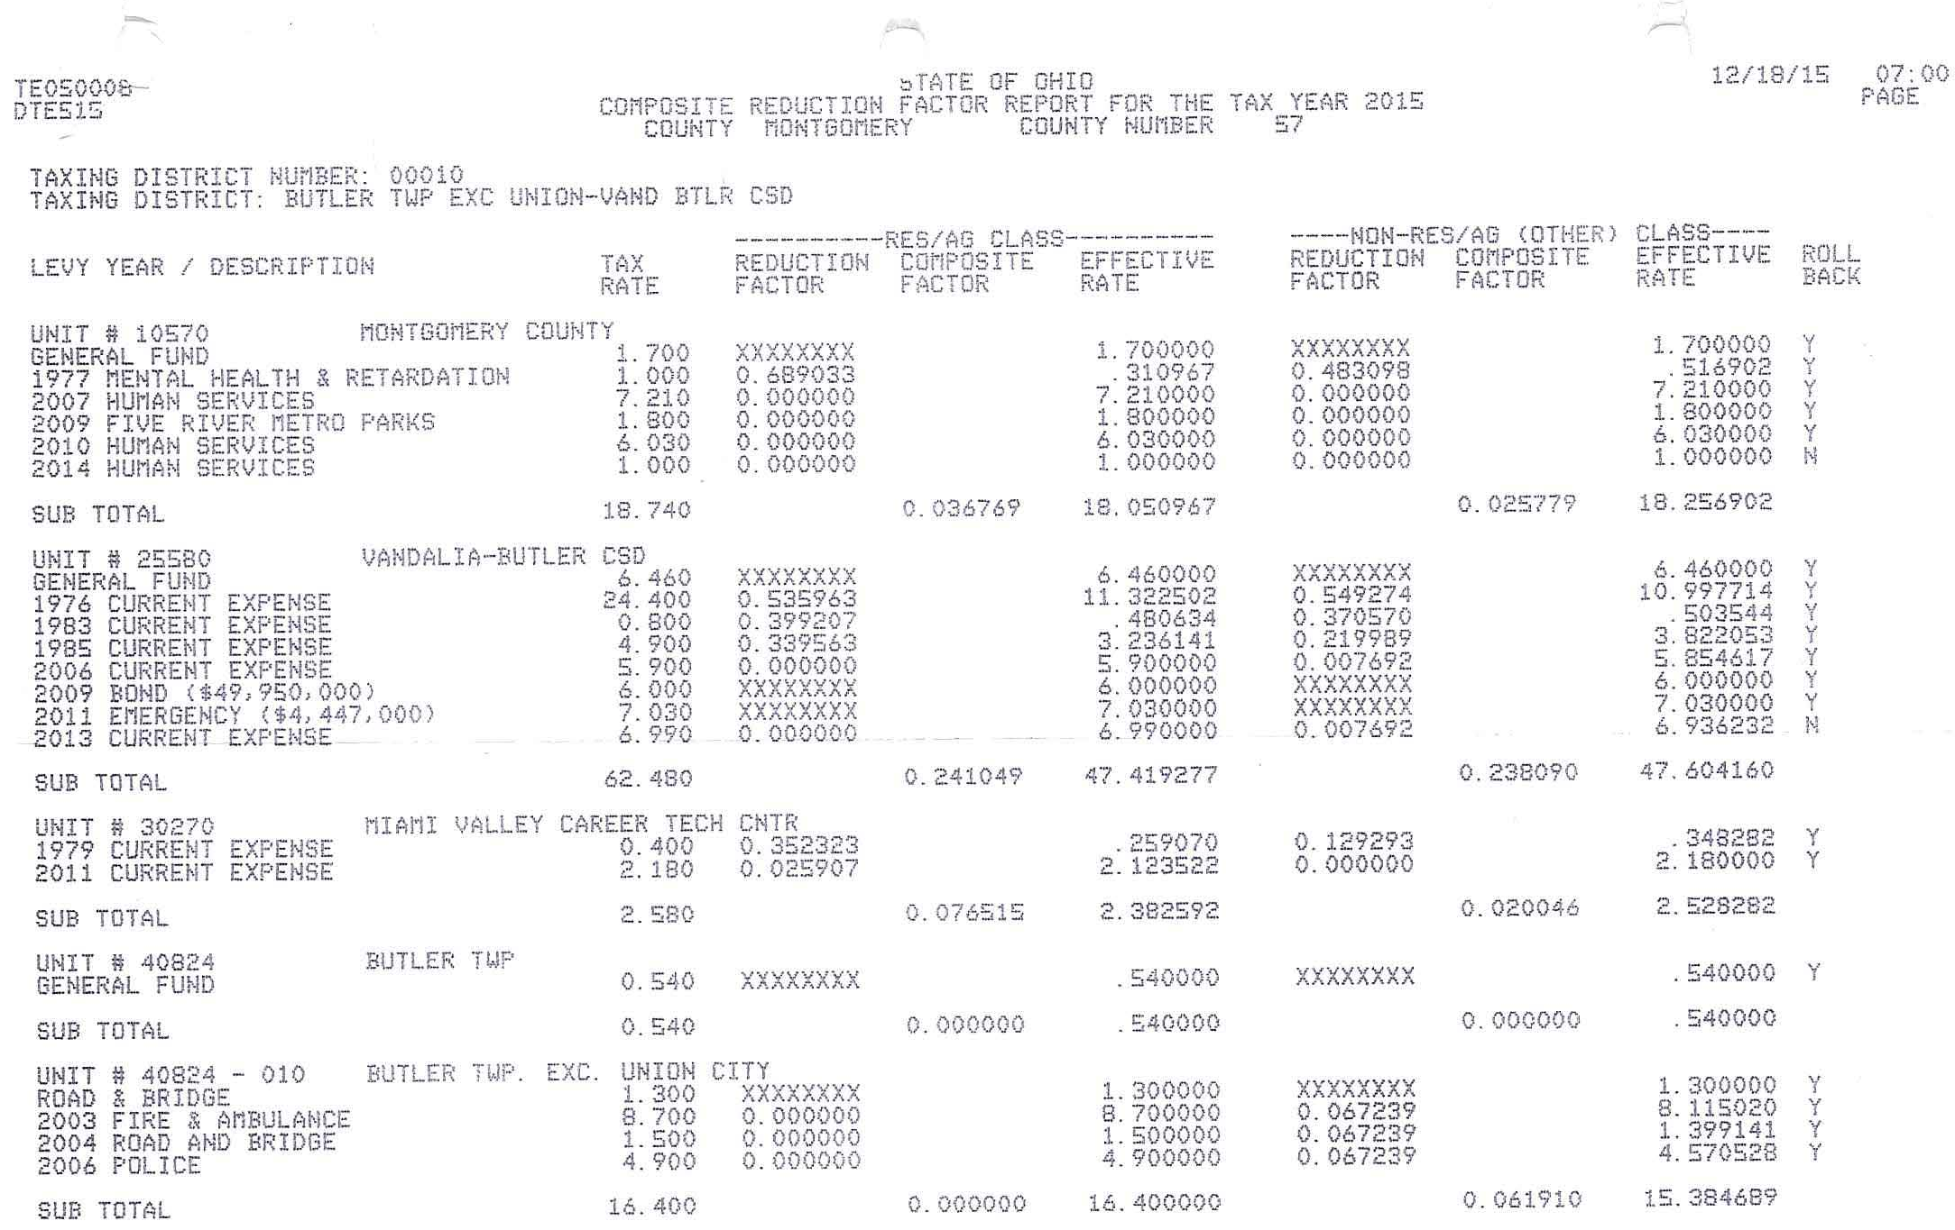
Tax Rates DTE-515

Slide 32
Estimating Revenue
Class I Value X Class I Effective Rate
1000
+
Class II Value X Class II Effective Rate
1000
+
PUP Value X Full Rate
1000

Slide 33
Estimating Revenue
Add Together
Class I Rev + Class II Rev + PUP Rev
Multiply by 0.95

Slide 34
Why 95%?
Some tax payers don’t pay on time
Volatile delinquent collections
Protects you from value appeals
Late adjustments

Slide 35
Tax Reduction Programs
Residential (10%) Rollback
Owner-Occupied (2 ½%) Rollback
Homestead Exemption
Jurisdictions Reimbursed by State

Slide 36
Tax Reduction Programs
2013 Law Change:
Rollbacks No Longer Apply for New or Replacement Levies
Income limits for Homestead
New levies more expensive

Slide 37
Computing New Levy Cost
New 5.0 mill levy
Previous law:
35,000 X 5 (.875) = $153.13
1000
New law:
35,000 X 5 = $175.00
1000

Slide 38
Outlook
State has eliminated or phased out:
Rollbacks for new/replacement levies
TPP reimbursement
Dereg reimbursement
Estate Tax
Public Utility Personal?

Slide 39
Outlook
Good old days are gone
Urban Core/Inner Ring flat
Outer suburbs growing
CAUV dominated areas?

Slide 40
What is CAUV?
A tax reduction program that allows
qualified agriculture land to receive a
lower tax valuation based on its current
agricultural use instead of fair market
value.

Slide 41
What is Agricultural Use?
Must be for a commercial purpose
Animal or poultry husbandry, aquaculture, apiculture, commercial timber or timber contiguous to other qualifying land, field crops, tobacco, fruits, vegetables, nursery stock, ornamental trees, sod, or flowers

Slide 42
CAUV Intent
The intent of the program was to preserve farmland and value agricultural land at around 50% of market value.
In 2005 CAUV provided a 90% reduction in value
In 2010 the reduction was 77%
In 2014 the reduction was 62%
In 2015 the reduction was 52%

Slide 43
How is CAUV Calculated?
The CAUV value is based upon a formula containing five factors applied to three crops: corn, soybeans and wheat. The factors are:
1. cropping pattern
2. crop prices
3. crop yields
4. Non-land production costs
5. Capitalization Rate

Slide 44
Explanation of Calculation
CAUV land values are calculated by the capitalization of net income from agricultural products assuming typical management, cropping and land use patterns, and yields for given types of soils.
There are 3,514 different soil types with slopes of 25% or less.

Slide 45

Who Calculates the Formula?
OHIO DEPARTMENT
OF TAXATION
Order
AGRICULTURAL ADVISORY COMMITTEE
COUNTY AUDITOR
Notes:
We need to get a list of everybody that’s on the agricultural advisory committee and probably add a slide or an addition to this slide that lists the people that are part of the program

Slide 46
Can You Appeal CAUV Values?
No. CAUV values are established based on the formula.
The CAUV values are less than market value even after the recent increases.

Slide 47
Legislative Efforts
The CAUV values based on the formula increased dramatically across the state and specifically in Montgomery County during the 2014 revaluation.
In some cases, our CAUV values doubled or tripled.

Slide 48
Legislative Efforts continued
There have been attempts to address this increase by changing the formula utilized by the Ohio Department of Taxation.
There have been attempts to pass bills in the Ohio Legislature to address this issue.
Revised formula currently under consideration by the Agricultural Advisory Committee will not result in substantial reduction.

Slide 49
When Are CAUV
Values Effective?
They become effective as of the next revaluation or triennial update.
CAUV values are updated every three years. The next update in Montgomery County will be in 2017 payable in 2018.

Slide 50
Auditor’s Website
www.mcauditor.org
www.mcauditor.org/fiscalservices
www.mcrealestate.org

Slide 51

Discussion/Questions

