Slide 1
eFinancePLUS
Enterprise Resource Planning Briefing
Speaker name, title
Date

Slide 2
Important Notifications
The accompanying program, product, investment and other information provided in this presentation is part of on-going negotiations between the MC•OECN and SunGard K-12.
As such, all information contained herein is subject to change. The MC•OECN will make every attempt to notify ITCs and LEAs of any significant changes should they occur.

Slide 3
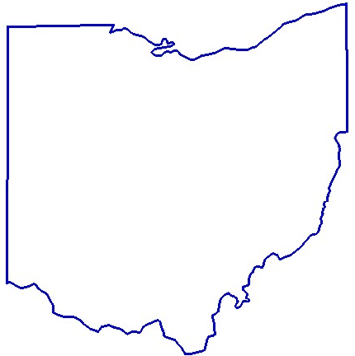
Background

Slide 4
Program Background
School districts have been using state-developed finance, accounting and payroll software since 1979
  State software is currently being re-written but currently runs on an aging computing platform

Slide 5
Importance of This Work
Notes:
When we think about the types of applications that school districts in Ohio need to run their business, while we often take it for granted, it goes without saying that fiscal and HR software is truly the backbone of a school district’s business operations.
When we consider that the combined annual revenues of public school districts alone in our state is in excess of $17.45B, and the hundreds of thousands of expense transactions, paychecks, reports, purchase orders, invoices and much, much more, the implications are staggering.
If we all did an exercise in disaster recovery and business continuity and we had school districts prioritize what applications they wanted to come up first after a disaster; accounting and payroll is likely to be first on their list.
While there are clearly other applications that are important to schools on a daily basis - finance is the pulse of public education. Without access to capital and the ability to “pay the bills” public education comes to a standstill pretty quickly.
Historically, the state has recognized this as an important priority - the creation of state software and Information Technology Centers is central to the notion that accounting, finance and payroll is surely one of the most important things we do.

Slide 6
Efficacy of Prior State Efforts =
Lower TCO and Higher Value
Adoption of Standards Reduces Costs and Improves Results
  lower hardware and software costs
    development or licensing
    reporting or customization
  knowledge capital flourishes - users share expertise across the system and environment
  improved business processes and productivity
  higher data quality and decision making
  improved business owner and public confidence
software
hardware
IT staff
datacenter
training
cost of downtime
lost productivity
opportunity costs
value of customer buy-in
Notes:
Our track record with state software has been a great story to tell and is something we should all be proud of.
And the reason folks is rather simple - without having a state standard for accounting and payroll software, many schools simply would not have an affordable way to manage their business operations.
While a few schools use alternatives to state software, the vast majority do - and “ad hoc” standard results not just in a lower total cost of ownership for those that do - but all better results.
Those results come from shared knowledge and expertise in using the system - in other words all of you in this room and the many more outside of these walls that could not be here with us today.
When we work together to minimize costs that allows us to invest more in functionality for the business - that means better business processed, better data quality, better reporting and more confidence by the business owner, government stakeholders and most importantly the citizens we serve.
And working together we have achieved that with state software....

Slide 7

State Software
Many Districts are at an Important Inflection Point...
USAS written
OpenVMS Introduced
Itanium Introduced
Alpha introduced
State Accounting Re-Write begins
State Payroll Re-Write begins
Alpha discontinued
2020 2016 2015 2011 2010 2009 2007 2001 1992 1979 1977
State Software Rewrite In Testing
Itanium EOL
Age and support of current environment suggest a new finance, accounting HR platform for Ohio schools is inevitable
USAS-Rewrite is an option to maintain legacy of low TCO and high value-add for some Ohio’s schools
Many ITCs and districts have been exploring their own alternatives due to critical need, or desire for more functionality
OpenVMS sold
Alpha support ends
State Software Rewrite In Production
Itanium support ends
Notes:
Given the age of the current system and many uncertainties around its future, migration to a new finance and accounting platform is inevitable.
And, with our state’s tremendous success in use of the current state software platform, the re-write of state software is an option to maintain the legacy of low total cost of ownership and the best value for some of Ohio’s schools.
As successful as state software has been, and despite the STRONG DESIRE by ITCs and schools to stay committed to state software, it seems clear that for many the state is at an important reflection point.
To address the risks of the current platform - ITCs and schools must have adequate time to plan and manage the migration. They need clarity around what they can do to be prepared, and they need confidence that the state software alternative will be in production soon. And for others who want more or expanded functionality, those schools may explore other options.
______________________
Other Notes For this slide
One question we all must face is whether the current state software system remain sustainable moving forward?
The underpinnings of the current environment - technically sound and well designed for their time - are showing their age.
Retaining staff (or training new staff) with COBOL programming expertise is an on-going and expensive challenge.
Recent decisions by HP to sell OpenVMS to industry start-up VMS, and decisions to end product support for the alpha and Integrity platforms have implications on long-term sustainability.
Without successfully porting OpenVMS to the x86 platform, will OpenVMS survive? Will the porting occur in time for ITCs to migrate off of their current environments successfully? What happens if the current environment fails?
Beyond sustainability issues, we also have to consider that beyond the need for core functionality in state software, than all ITCs have invested in external software that expands the functionality of state software.
While state software is “free” these additional investments require on-going investment and support by school districts in areas that are vital to their business operations.
When considering the sustainability issues for state software, we have to include sustainability of the larger state software ecosystem into the equation.
And that means considering how external applications will migrate into the new state software system.
============================================
Speaker’s additional notes only:
Cobol
Designed in 1959
Compiled language first written for mainframe and midrange environment
Declining use in distributed computing
Retirements leading to loss of talent pool
Challenges adding functionality
OpenVMS
First introduced in 1977 by DEC
Sold by HP to start-up VMS Software in 2014
VMS Hardware
DEC Alpha - introduced 1992, sales discontinued by HP April 2007
HP Alpha OpenVMS support ending June 2016
HP/Intel introduces Itanium 2001
Lackluster sales for Itanium = market death 2011/13
Itanium (Integrity) support for version 8.3 ending 2018 (suggests HP is dropping support)
Integrity support for version 8.4 through December 2020

Slide 8
ERP Landscape
From silos to one integrated solution
Finance & Accounting
Data
Data
Finance & Accounting
Payroll & Benefit Management
Inventory Management
Reporting
Purchasing
Purchasing
Payroll & Benefit Mgt.
Data
Data
Reporting
Inventory Management
Data
Data
Notes:
This idea derived from
the simple notion that
instead of having multiple
disconnected systems, it
would be more effective
and efficient to have one
integrated system to track
and manage on-going
Business operations

Slide 9
Statewide ERP
Program Overview

Slide 12
MCOECN Enterprise Resource Planning
About the MCOECN
Technology Advocate for Ohio’s K12 Stakeholders
  The Management Council of Ohio Education Computer Network is an Ohio regional “council of governments” supporting the efforts of the OECN through a statewide network of twenty-one Information Technology Centers that serve public school districts, career centers, educational service centers, community schools and other local educational agencies.
Goals
  Promote the value and benefits of the OECN
  Be an advocate for technology innovation and continuous improvement
  Support statewide educational technology programs and services
  Implement partnership arrangements and purchasing agreements
Notes:
Large group of ITCs interested in possible options for schools to consider in the accounting and human resources space.
Membership recommended that interested ITCs work together with the MCOECN to competitively seek a commercial off the shelf alternative
BOT in March agreed that the work needed to continue and tasked MCOECN staff with facilitating the process
Thirteen ITCs are currently participating.
Components of the Request for Partnership - Invitation to Quality include:
Vendor Background and References
Mandatory Minimum Functional Requirements
Partnership Requirements
Software Licensing, Installation and Knowledge Transfer costs
Emphasis of the committee has been not just on the quality of the software platform as a “solution” but a commitment of the vendor to PARTNER with ITCs in planning and adoption of their solution with participating school districts.
The feeling is that it will take both a great product and a strong relationship for the partnership to be successful over what is anticipated to be a 5 to 10 year relationship at the minimum.
Six vendor submitted proposals in July

Slide 13
ERP
Goals of the Program
February 15, 2016
Reduce acquisition costs for all participating districts through an enterprise licensing program achieved through economies of scale enabled by school district and ITC participation and commitment
Reduce implementation costs, build capacity and expertise to assist schools with ERP adoption that leads to school district efficiencies achieved through improvements in business processes
Reduce technology infrastructure operating costs
Focus support resources on end-user software use and adoption
Understand and mitigate shared platform migration risks
Build “communities of practice” around ERP adoption, implementation and on-going use

Slide 14
ERP Program
Timeline | Date | Status
RFP-ITQ Issued | 6/9/15 | 3
Vendor Responses Due | 7/13/15 | 3
Phase I Complete | 8/26/15 | 3
Phase II - Proof-of-Concept Demonstrations | 11-2015 | 3
Committee Phase II Review | 11-2015 | 3
Phase III – Relationship Interviews | 12-2015 | 3
Phase III – Clarifications & Final Use Cases | 1-2016 | 3
District Solicitation | March-April 2016 | 3
Final Negotiations | March-May 2016 | In-process
Waves Commence | 7-2016 to 7-2021 | Planning underway
Competitive Selection Process
Main Phases of Evaluation
  Phase 1: Compliance, Relationship and Investment Review
  Phase 2: Functional Requirements Proof-of-Concept
  Phase 3: Relationship Interviews
  Final Use Case Vendors
Six Vendors Submitted
  McGladrey-Microsoft (Dynamix AX)
  CherryRoad-Oracle (PeopleSoft)
  SunGard (eFinancePLUS)
  Tyler (Munis)
  Weidenhammer (Alio)
  James Group (SavvyMariner)
Round Two/Three
  McGladrey-Microsoft (Dynamix AX)
  SunGard (eFinancePLUS)
  Weidenhammer (Alio)
Finalist
  SunGard K-12 (eFinancePLUS)
Notes:
This is the overall project timeline fro the project
The RFP-ITQ was issued on 6-9, and Phase I of the evaluation was completed on 8-26
Phase II - the Proof-of-Concept Demonstrations (more on that later), are being planned for October or November.
After Phase II is complete, we will move forward with Customer Solicitation, Final Negotiations and commencement of the first wave of adoption.

Slide 15
ERP Process Overview
Main Evaluation Components
  Phase 1 – Completeness, Qualitative Review, TCO Licensing Comparisons
  Phase 2 – Structured Review of Most Critical Use Cases
  Phase 3 – Relationship Review & Final Review of Remaining Use Cases
Structured Evaluation
  15 Detailed Uses Cases
  Criteria per Vendor with Weights
    Completeness (25%)
    Business Logic (25%)
    User Interface (20%)
    Risk & Questions (30%)
50 Evaluators
  24 ITC Evaluators
  26 School Districts
5,352
People Hours of Effort
3.25 FTE
7 Months

Slide 16
ERP Example Use Case
Candidate Scenario #15 – Payroll
1. Provide an overview of the Payroll Administration module.
2. Demonstrate combination edits including both hard and soft error exception conditions that require correction before payroll can be run or allow final pay processing to proceed. Edits should include both on-line and batch input such as data required for new employees, changes for current employees on the master file, deduction changes, valid cost accounting data elements, hours, over-time hours, exception hours, and leave balances.
3. Demonstrate how adjustments can be made to payroll data prior to making the final run.
4. Demonstrate how the system provides a payroll proof list of all payroll calculations, gross-to-net, before school district certification of final payroll run including: hours by type, earnings by type, employee tax liabilities, employee deduction amount, employer contribution amount, employee ID and name, agency, employer portion of all taxes, any user-specified chart of account elements or combination of fields totals by employee, chart of account elements, FLSA code, payment type, (check or EFT), and taxable gross federal/state exemption status the setup and processing of additional pay.
5. Demonstrate how the system must allow for school district certification of final payroll run.
6. Simulate a final Payroll cycle run.
7. Demonstrate how the system provides for online access to all detailed payroll data.
8. Demonstrate how the system maintains salary, deductions, and pay history for each employee for user-defined number of periods.
9. Demonstrate how the system provides a complete audit trail of all records updated on-line.
10. Demonstrate how the system provides the capability to retrieve the full pay & related HR history for an employee (e.g., for PERS verification, deferred comp, Social Security, etc.).
11. Demonstrate how the system provides the ability to print/display special messages on the electronic advice or paper stub for an individual employee, all employees, or other user-defined groups.
12. Demonstrate a payroll register, deduction and other earnings reports, including: employee ID, employee name, hours by earnings code, earnings by type (e.g., shift, special duty), employee tax liabilities, employee deduction amount, employer contribution amount, employer portion of all taxes, any user-specified chart of account elements or combination of fields, totals by employee, FLSA code, payment type (check/EFTs), salary range, title, employment type, taxable gross, federal/state exemption status, and retirement contributions.
13. Demonstrate how the system provides the ability to drill down on payroll register subtotals to the employee level, including employee ID and name, hours by type, earnings by type, employee tax liabilities, employee deduction amount, employer contribution amount, user-specified coding block elements or combination of fields, and taxable gross.
14. Demonstrate how the system produces other reports including:
· Dollar tracking reports by Chart of Account elements
· Leave taken by Leave Type (personal, Comp Time, FMLA, etc.)
· Leave balance report by Leave Type
15. Demonstrate how to set-up and run a supplemental payroll cycle.
16. Demonstrate the calculation and processing of salary, additional pay, vacation and compensatory leave, and longevity for employee termination for a lump sum payment or installment payments.
17. Demonstrate the notification and viewing of the online earnings statement.

Slide 17
ERP – eFinancePLUS Scored Highest t
# | Description | Score | Grade | n
1 | General Functional Software Capability | 390 | A+ | 50
2 | Financial Overview | 408 | A++ | 13
3 | General Ledger | 363 | A- | 50
4 | Budget | 413 | A++ | 13
5 | Cash Management | 425 | A++ | 12
6 | Accounts Payable | 375 | A | 50
7 | Accounts Receivable | 392 | A+ | 12
8 | Procurement Overview | 396 | A+ | 13
9 | Purchasing | 387 | A+ | 50
9 | Contract Management | 395 | A+ | 12
10 | Grant Management | 400 | A+ | 12
11 | Recruitment | 433 | A++ | 11
12 | Core HR | 352 | B+ | 50
12 | Time and Attendance | 413 | A++ | 12
13 | Benefits | 426 | A++ | 12
15 | Payroll | 336 | B | 50
 | Average Score | 394 | A+
Round 1
Round 2

Slide 18
ERP Relationship – SunGard K-12’s Commitment To Ohio
Total Score - All Evaluators, n=7,8 | Score | Grade
Program Management Office | 450 | A++
Software Adoption Plan | 427.5 | A++
Solutions Architecture | 440 | A++
Technical Support Model | 420 | A++
Customer Marketing & Outreach Plan | 430 | A++
Pricing | 378.75 | A
Total | 2546.25 | A++
Overall Vendor Ranking | 1st
Approach to migrating districts to eFinancePLUS
Standardized & Repeatable Processes
Sustainable Technical Architecture
Integrated Support – from District to ITC and SunGard K-12
Commitment to education and training
Best overall investment value

Slide 19
SunGard K-12 Company Profile
Office Locations
Bethlehem, PA
Chico, CA
Long Island, NY
Technology
100 % web-based software Microsoft SQL Server
Windows operating system
Professional Services
Project Management
Business Process Review
Onsite, remote, and eLearning Training
Specialized consulting services
Toll-free call center, automated call tracking, and Internet support site
Online documentation
Custom programming services
Data warehouse development
Disaster Recovery and Remote System Administration
Hardware configuration and installation
Employees
400
Product Design
Intuitive browser-based user interface
Centralized, real-time, district-wide database
Integrated workflow
Easy to deploy and maintain
Data and navigational integration between products
Parent Company
FIS

Slide 20
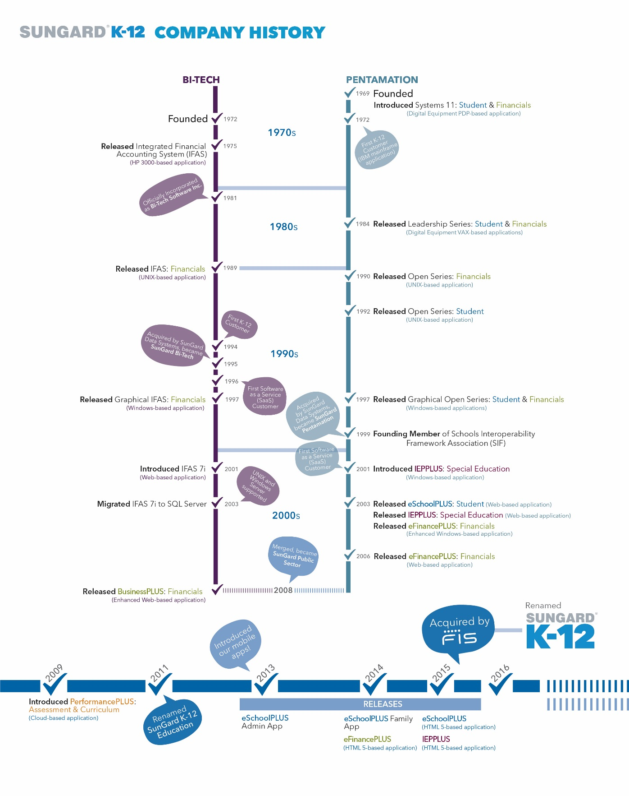
SunGard K-12 Company History

Slide 21
SunGard
K-12
Company History

Slide 23
ERP Components
What’s Included

Slide 25
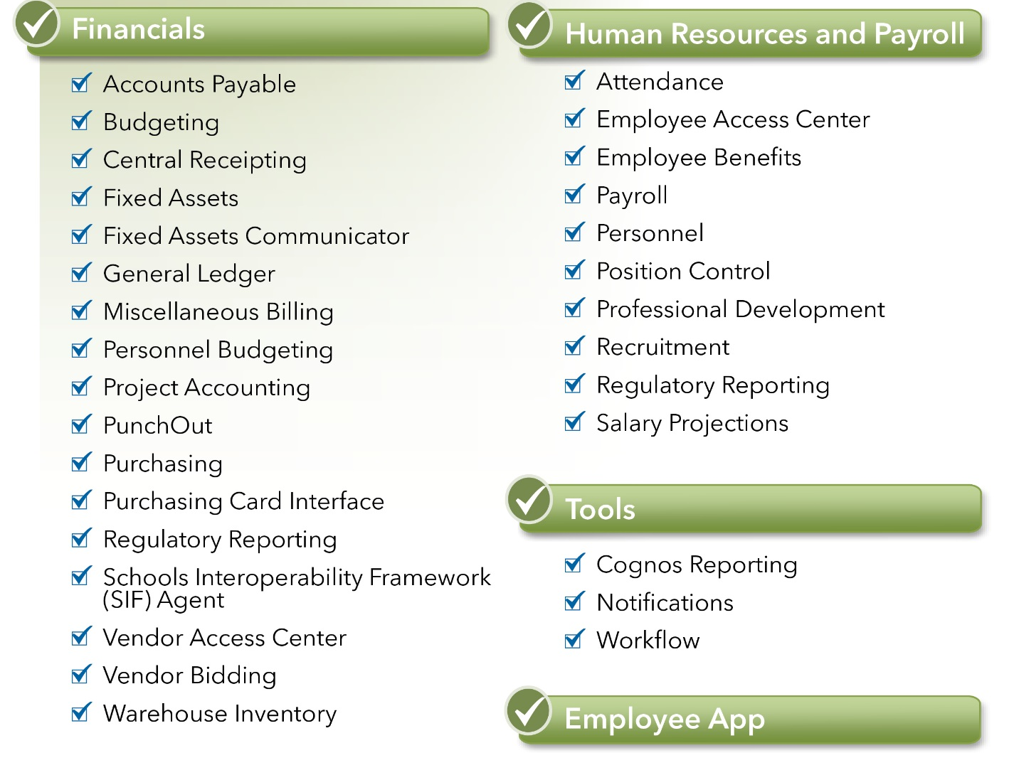
Solutions Available
*
*SIF in the base bundle ensures all districts will be state reporting compliant. If a district wants to use SIF for anything beyond state reporting, they will need to purchase the full bundle.
Full Only
Notes:
There are 2 solutions available through this program: Base and Full
The full solution includes all items listed here; the Base version includes all, except for those with the orange box.

Slide 26
Modules Overview
Finance
Financial Accounting
  eFinancePLUS’ real-time database maintains fiscal, purchasing, and budgeting information and makes it easy for district staff to manage daily fiscal operations, financial accounting, and purchasing processes while adhering to all GAAP, GASB, and GAAFR requirements.
General Ledger
  Improve the efficiency of your business operations with default templates for journal entries, easy reversals, ability to work in multiple periods, simple displays and drill downs, and the ability to attach and view documents associated with transactions.
Project Accounting
  See the full picture of how much money your district has received and spent by tracking grants and projects across multiple fiscal years. Never miss a transaction with automated linking to the general ledger chart of accounts and track detailed information on projects and grants.
Purchasing
  Quickly enter requisitions with full access to available vendors, commodities, budget balances, and more. Purchasing staff can view all approvals and attachments and, in one step, convert requisitions into purchase orders and encumber the funds. Plus, every step along the way, approvers can be notified by email to review requisitions and personnel can receive email notifications on the progress of their purchases.

Slide 27
Modules Overview
Finance
Workflow
  Manage the routing of requisitions, purchase orders, change orders, accounts payable, budget adjustments, and budget transfers through the approval process, notifying the requester as progress is made.
Warehouse Inventory
  Fully integrated with the general ledger and purchasing systems, view up-to-date information to requisition from stock, process approvals, generate pick pack lists, and reorder quantities right within your inventory list.
Budgeting
  Pull year-to-date actuals, estimate costs to the end of the year, and produce multiple versions of what next year’s budget may look like. As soon as you get the version you are satisfied with, put it in the hands of your administrators to make adjustments. Easily tie personnel details to budgeted line items and create other shortcuts like these to allow you to efficiently manage your budgeting process from start to finish.
Accounts Payable
  Enter a batch or post directly online, you choose how you wish to pay your outstanding invoices. Pay existing encumbrances quickly or if it is a new invoice, put the details in the system and charge to the appropriate accounts. Keep copies of the invoice right alongside the details for easy reference.

Slide 28
Modules Overview
Finance
Personnel Budgeting
  Easily and automatically feed positions and employees’ salary and benefit information into a budgeting environment and use this information to create unlimited versions of next year’s budget. Human Resources module needed to make this work best.
Miscellaneous Billing
  Easily generate a one-time invoice or set up recurring invoices based off of details including the type of service, drop in the standard fees, and track potential penalties or interest. Plus, have the ability to produce bills and take payments over the counter or through the mail with optional central receipting.
Fixed Assets
  Create new or automatically generate asset records over a defined dollar amount or from capital accounts. Track depreciation costs to post to the general ledger and automatically batch files for review, all while adhering to reporting requirements.
Fixed Assets Communicator
  An automated interface identifies the differences between your system and your appraisal company and allows administrators to update the details in your fixed asset files for consistency. It’s that easy.

Slide 29
Modules Overview
Finance
Vendor Access Center
  Efficiently manages the vendor registration process, reduces routine vendor requests, and distributes vendor forms. Through this secure web-based portal, vendors can view orders, submit invoices, and check the status of payments. Includes: Vendor 1099 Forms, Invoices, Purchase Orders, Payment Status
Vendor Bidding
  Easily create consolidated bid lists from requisitions. After the vendor responds, plug in the costs and the system automatically calculates the lowest bidder. Once the bid is awarded, the system will create a purchase order to provide to the awarded vendor.
Purchasing Card (PCard) Interface
  The PCard Interface enables you to efficiently administer credit card use for employees. Easily assign, specify roles, and track transactions without the burden on staff.
Vendor PunchOut
  Streamline the purchasing process by enabling your organization to shop directly on a vendor’s website using negotiated pricing and catalogs. When a user checks out from the website, PunchOut seamlessly imports their shopping cart as an eFinancePLUS requisition to be automatically pre-encumbered and follow the district’s standard workflow approval routing.

Slide 30
Modules Overview
Human Resources
Personnel
  All current and historical information needed for an employee is accessible as designated by district-defined security preferences for easy reference regarding absences, training, certifications, emergency information, previous positions, salaries, and much more just by glancing at an employee’s record. It’s simple to set up new employees in the system with easy step-by-step guidance from an online wizard.
Workflow
  Manage the routing of employee leave requests, new hires, terminations, applicant recommendations, and more right from within eFinancePLUS.
Payroll
  Payroll management in eFinancePLUS is fast, efficient, accurate, and versatile enough to handle the complexities of your district’s payroll without error. Complete with step-by-step guidance, process payroll without the hassle with a unique payroll wizard to guide personnel through the process of setting up a pay run, timecard entry, calculating and running reports, and more.
Attendance
  Remove the hassle of requests and attendance monitoring. Leave requests are automatically routed to the appropriate individuals for approval and posted to time sheets without any extra steps. Track leave balances and accrue leave with flexibility according to leave types based on years of service, hours worked, or over a certain period of time.

Slide 31
Modules Overview
Human Resources
Position Control
  Track robust job and personnel information through the years, including specific position details. Accurately account for and easily identify budgeted positions and provide tight controls over positions that are being filled or transferred within the district.
Professional Development
  Increase your service levels to employees and reduce administrative workload by allowing employees to enroll in courses and monitor their own progress. Manage course catalog requests, employee and external participant registration, wait-listing, and more.
Employee Time Sheets
  Take the hassle out of clocking in and out by providing employees an intuitive and simple interface for recording their daily time. Time entered by employees gets routed to the approver, and once approved the time sheet automatically feeds into the payroll process.
Benefits Management
  Track all-inclusive employee benefit information including dependents and COBRA.

Slide 32
Modules Overview
Human Resources
Recruitment
  Manage the process, from position request through employee on-boarding, with ease and efficiency.
  Automate key tasks, reduce data entry, and maximize the reach of your job postings to increase the efficiency of your school district’s hiring process. Plus, ensure compliance with district and budget controls.
Salary Projections
  Calculate an increase or decrease to an existing employee’s or group of employees’ salary or schedule as a percentage, dollar amount, or both. Then, easily carry over a schedule into the payroll process to start the next cycle. Identify your bottom line costs with ease and re-run salary calculations as many times as needed.

Slide 33
Modules Overview
Demographics:
  Display address and contact information for employees to easily review and change. Security prevents items, such as social security number and birthdates, from being adjusted, but dependent and tax information can be changed as well as any demographic information when an employee’s lifestyle changes.
Benefit Enrollment:
  Share an online list of available benefits with your employees for their annual selection. Employees can choose their benefits, and payroll staff would need to just review and update.
Attendance History:
  Through an easy to read graphical calendar display, employees can quickly see their leave time.
  Employees can also request leave time through a simple web form, which is automatically routed to the appropriate individuals for approval.
Deduction/Benefit History:
  Employees can easily view monthly, quarterly, fiscal, calendar, and inception-to-date totals, and they can review and print all past paycheck details.
W2 Forms:
  Automatically make .pdfs of employee W2s available for viewing and printing, helping to relieve district staff from the burden.
  Past years’ W2 forms also remain available to the employee for as long as they have worked for your district.
Certifications and Skills:
  Employees can review and track their certifications, degrees, and job skills, including any renewal or expiration dates.
Human Resources
Employee Access Center (EAC)
  Through this convenient web portal, provide employees with anytime, anywhere access to their payroll and personnel information.
  Define what information can be viewed—demographics, benefit statements, benefit enrollment, attendance history, deduction/benefit history, payroll checks, certifications, and skills.
  Allow employees to update their personal information and route those changes to appropriate personnel for review and approval.

Slide 35
Ohio Reporting
SunGard K-12’s Commitment to Ohio

Slide 36
SunGard K-12 and Regulatory Reporting in Ohio
Regular User Group calls to discuss regulatory requirements, software enhancements and to promote dialogue among the customers.
Separate but integrated EMIS module within eFinancePLUS, written for Ohio
Work closely with customers to solve issues
  Identified areas in EMIS where the data could be stored independent of payroll and controlled by EMIS team
  EMIS DN table maintenance
  Provided Advance Years’ Experience utility
When new requirements occur, we work closely with the customers to design, develop and test the solution before releasing to the entire group of state customers.
SERS has indicated that there will be changes for the 2016-17 fiscal year, which we will work with the customers and the state on
User friendly reports
Meeting biweekly, developing new features to meet the unique requirements in Ohio

Slide 37
ERP Investment
For the first time – the best and most affordable alternative
Speaker name, title
Date

Slide 38
What is Included
ERP Investment Components
Software Modules
    Client Licenses – licensed on student basis – no limitations on administrator or teacher access
    Cost of License and On-going Subscriptions & Maintenance
  Implementation
    Training
    Data Conversion
  Hosting & Integrated Support
Notes:
This is the overall project timeline fro the project
The RFP-ITQ was issued on 6-9, and Phase I of the evaluation was completed on 8-26
Phase II - the Proof-of-Concept Demonstrations (more on that later), are being planned for October or November.
After Phase II is complete, we will move forward with Customer Solicitation, Final Negotiations and commencement of the first wave of adoption.

Slide 39
District Investment: Implementation

Slide 40
What Is Included – Hosting & Managed Support
Hosting – MCOECN
Data Center
City of Westerville Owned
Managed and Operated by Involta
100% power uptime SLA
Separate power feeds from 2 providers
Generator backup
Monitored 24x7x365
Two-factor authentication (badge and biometric)
Infrastructure
Redundant architecture – no single point of failure
  Server, Storage, Network fully redundant
High performance, auto-tiered, scalable SSD backed storage
Current Intel CPUs (i.e. Haswell)
Highly configurable network services including load balancing
20 Gb redundant ring connection to the OARnet backbone
No ISP fees for intra-Ohio K-12, Government or HED traffic
Highly scalable: from hundreds to thousands of VMs
Remote Systems Administration – SunGard K-12
Operating System Admin
Monitor & modify operating system parameters
Install operating system patches
Provide first level of diagnosis of system hardware problems
Monitor hardware reliability, check error logs, and initiate corrective action
Oversee backup procedures
Perform recovery of specific files and/or entire systems
Create and maintain cron jobs, scheduled tasks and printer configurations
Monitor system performance and tune operating system parameters for maximum efficiency
Monitor disk and file system utilization/permissions and adjust as needed
Administer network connectivity settings
Administer printer connectivity
Create or Modify default gateway
Management
Serve as a point person for all communication between MCOECN and SunGard K12
Part of integrated helpdesk
Oversee system on daily and basis and report administrative activities
Database Admin
Maintain database security and permissions
Perform backup and restoration of specific database tables or an entire database environment
Perform checks for data consistency and monitor database performance
Monitor and modify data allocation
Add database space
Export and import databases as required
Create test (or other special purpose) databases as required
Install database system upgrades or downgrades as required (if included)
Security Administration
Monitor system acces via the Internet (SecureLink)
Investigate attempted security breaches
Monitor application software utilization and setup for correct authorizations
Monitor file and database permissions and accounts

Slide 41
District Investment: Usage

Slide 42
District Investment Examples:
Sample On-Going Investment

Slide 43
ERP Implementation
What you can do to get started
Speaker name, title
Date

Slide 44

Implementation
It’s All About Waves
What’s A Wave
Program Schedule
Time Lines
What You Can Do To Get Ready

Slide 45
SunGard K-12’s OnTrack Method
  Product Overviews
  Planning Meeting
  Goals and scope definition
Plan
  Major Configuration Decisions Finalized
  Conversion Orientation and Specifications
  Phase 1 Training – Configuration
Prepare
  1st Pass Data Conversions Completed
  Phase 2 – 4 Training – Daily and Periodic Processes
Execute
  Conversion Verification
  Test Pilot Parallels
  District continues Verification and Testing
Confirm
  End User Training
  Final Pass Data Conversions Completed
  Go Live Support
Go Live & Support
Notes:
This is a visual representation of SunGard’s proven implementation methodology. Is follows PMP best practices and is tailored to specifically meet the needs of the K-12 market and our solutions. It has been used successfully in 100’s of implementations nationwide including previous statewide implementations.

Slide 46
Program Management Timeline
 | Offering Period 1 | Project Planning | Group 1 Selection | Group 1 Implementation | Offering Period 2 | Lessons Learned | Group 2 Implementation | Offering Period 3 | Lessons Learned | Group 3 Implementation | Offering Period 4 | Group 4 Implementation
Start Date | 3/7/16 | 3/15/16 | 5/7/16 | 7/1/16 | 9/1/16 | 12/15/16 | 1/1/17 | 3/1/17 | 6/15/17 | 7/1/17 | 9/1/17 | 1/1/18
End Date | 5/7/16 | 6/25/16 | 6/7/16 | 1/1/17 | 12/1/16 | 1/15/17 | 7/1/17 | 6/1/17 | 7/15/17 | 1/1/18 | 12/1/17 | 7/1/18
Duration | 60 days | 100 days | 30 days | 180 days | 90 days | 30 days | 180 days | 90 days | 30 days | 180 days | 90 days | 180 days
Notes:
Criteria for Initial Wave Participation
Waves will need to be organized geographically so all participating districts and ITCs can gather in 1 physical location for onsite/in person training
We would like to limit each initial wave to no more than 2 ITC’s and their districts (up to 8 districts/wave) to limit initial complexity of each wave
Initial ITC participants will be required to have highly capable resources for each role identified in the previous slide
Ongoing, waves with training led by SunGard will still need to be organized geographically for the same reason
Core Product Implementation
Core include: Accounts Payable, Budgeting, Central Receipting, Fixed Assets, Fixed Asset communicator, general ledger, misc. billing, personnel budgeting, project accounting, punchout, purchasing, purchasing card interface, regulatory reporting, HR: attendance, employee access center, employee benefits, payroll, personnel, recruitment, regulatory reporting, salary projections.
These products will be implemented by all wave participants in the 6 month timeline identified above
Additional products will be trained via ITC university in an ongoing basis for implementation as desired by ITC’s and associated districts

Slide 47
Solutions Available
*
*SIF in the base bundle ensures all districts will be state reporting compliant. If a district wants to use SIF for anything beyond state reporting, they will need to purchase the full bundle.
Full Only
Notes:
There are 2 solutions available through this program: Base and Full
The full solution includes all items listed here; the Base version includes all, except for those with the orange box.

Slide 48
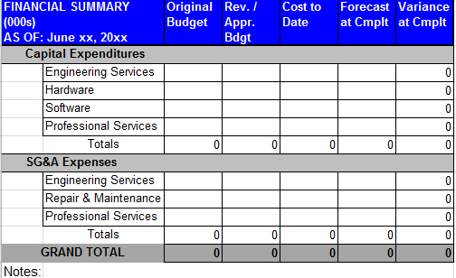
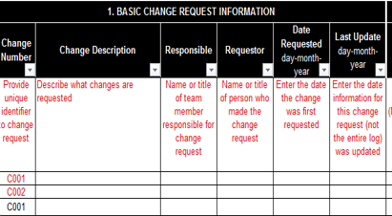
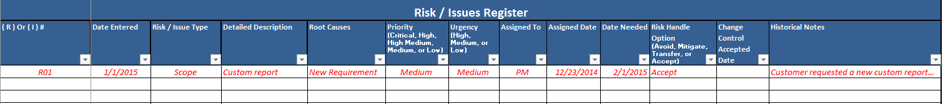
Building a Platform for Success
SunGard K-12 Repeatable Approach
  Project Charter
  Goals and Objectives
  Risk Matrix
  Communication Plan
  Change Mgt. Guide
  Implementation Schedule
  Project Management Status Reports
  Training and Trip Reports
  Milestone Checklists
  Defined Implementation Roles
Notes:
The items listed under “Repeatable Approach” will be used by SunGard during the wave implementations and provided to the ITC’s to lead their own subsequent implementations with additional districts. We will also review efficacy during and towards the end of our waves to revise and improve our tools.

Slide 49
Building a Platform for Success
Roles for ITCs and Districts
  Assign ITC Roles
    ITC Project Manager
    ITC HR Lead
    ITC Payroll Lead
    ITC Finance Lead
    ITC Technical Lead
  Assign District Roles
    District Activity Coordinator
    District Financial Core Team
    District HR Core Team
    District Payroll Core Team
    District Technical Support Team
What You Can Start Doing
  Clean-up Old Data
    Identifying or removing unused vendors
    Identifying leave codes, their accrual rates, and maximum amounts
  Document Pain Points
  Examining the chart of accounts and documenting deviations from the state-mandated dimensions, values, etc.
  Obtaining calendars and salary schedules for the go-live school year
  Obtaining district tax ID numbers and ACH information
  Reviewing deduction/benefit codes for old or unused ones, obtaining new year’s rates (if applicable)
Notes:
The ITC’s can begin working to identify the key roles listed on this slide. They will be assisting districts at the project level and learning how to implement the software while at the same time assisting their participating districts in task execution.
The District roles will be at the functional/doer level and will be the primary folks responsible for instituting our defined configuration, preparing for training and completing assigned tasks.

Slide 50
ERP
Adoption Plan
Speaker name, title
Date

Slide 51
Benefits of Statewide Adoption
ITC University
  Ohio specific training plan template and tools
  Ohio specific training agendas
  Ohio specific training handouts and supplements
  Ohio and ITC eLearning
  Ohio and ITC Seminar Series
  Configuration and setup plans
  Conversion Toolkit
  Train the trainer education and certifications
*Intent is for ITC’s to take implementation ownership
*ITC education is of paramount importance
ITC knowledge certification is a commitment to participate
Notes:
ITC University will deliver the tools required for ITC’s to lead their own implementations after successfully participating in a wave implementation. Success will be defined as passing SunGard’s required certifications to ensure product and implementation knowledge has been fully obtained.
ITC University will also deliver ongoing training and certification seminars to allow for additional module implementation beyond the core products and to account for staff turnover at the ITC level.

Slide 52
Continued Partnership
What We Do For You (Long-Term)
  Continuing Education Opportunities for ITC
  Ongoing Implementation Certifications
  Dedicated SunGard K-12 Executive Sponsorship
  SunGard K-12 Marketing Support
  Quarterly Executive Reviews
  Maximize Your ROI
Notes:
SunGard K-12 understands this is not a 1 time project, but rather a multi-year effort of significant strategic important to us and all entities in Ohio. We are fully committed to staying engaged quarter after quarter and year after year to ensure continuity of our relationship and a continued ROI for MOCECN, the ITCs, the districts and your students!

Slide 53
Implementation Benefit Examples
Through adoption of standards, ITC(s) and District(s) can share Financial Report Writer templates, host and participate in collaborative learning sessions, and develop shared eLearning content
The formation of a user group(s) specific to MC•OECN, ITC(s), and constituent districts becomes possible, and the benefits of such conferences are magnified when participants are using identical software packages
Move from silos to 1 solution with integration to the State or third-parties made feasible by adopting a standardized implementation model and configuration. Customization can be developed once and deployed state-wide

Slide 54
More Info
Powered by SunGard K-12 & the MCOECN
Speaker name, title
Date

Slide 55
More Info
Program Portal: www.sungardk12.com/mcoecn
Frequently Asked Questions Coming soon!
Your Local ITC http://www.mcoecn.org/about-the-mcoecn/itc-locations
MCOECN Contact Info: get-efinanceplus@mcoecn.org

Slide 56
Videos Available – links to come 3.8
4-5 Minute Overviews of Key Solution Areas
UI / Navigation Overview
HR/Payroll Overview
GL/Financials Overview
Data Reporting Overview

Slide 57


Literature to Use links to come 3.8
Financials Overview
HR Overview

Slide 58
Webinar Schedule
Live Weekly Webinars Focused on Solution Overview (90 minutes)
Date | Time | Link to Register
Friday, March 18th | 10:00 – 11:30 EST | Click to Register
Friday, March 25th | 10:00 – 11:30 EST | Click to Register
Friday, April 1st | 10:00 – 11:30 EST | Click to Register
Friday, April 8th | 10:00 – 11:30 EST | Click to Register
Friday, April 15th | 10:00 – 11:30 EST | Click to Register
Wednesday, April 20th | 10:00 – 11:30 EST | Click to Register
Friday, April 29th | 10:00 – 11:30 EST | Click to Register

Slide 59
Q&A
Powered by SunGard & the MCOECN
Speaker name, title
Date

