Slide 1

2026
EMIS Review
May 11, 2026

Slide 2
EMIS BASICS
EMIS Acronym | EMIS Description | State Software Knows It As
CI | Staff Demographic Record | Employee
CK | Staff Employment Record | Position AND Compensation
CJ | Contractor Staff Employment Record | EMIS Entry>Contractor (CJ)
CC | Contract Only Staff Record | EMIS Entry>EMIS Contracted Service (CC)
*NEW*
CR: Staff Vacancy Record – ODEW Reports: ‘This change adds a new record to EMIS reporting to collect data regarding staff vacancies. This record is still under development. The change document will be posted as soon as possible’

Slide 3
EMIS BASICS - continued
*NEW* CR Vacancy Record
What we know…
This new record will be included in the FY27 EMIS manual changes
Purpose: To collect statewide staffing shortages, vacancies that occur, how they are filled, and if the position does not get filled.
Required by state law
Will be collected in both Initial and Final Staff EMIS L Collections
Still waiting on SSDT and ODEW to advise on this record
Notes:
We’re waiting on SSDT to advise on whom this will affect and how this will be reported. We plan to send out updates as we receive them.

Slide 4
EMIS Reports – Checking Errors
Getting Started
Reports/EMIS REPORTS/Generate Employee Report
Reports/EMIS REPORTS/Generate Position Report
  *Run these reports as many times as needed until they are error-free.
If errors are on the Employee Report and/or Position Report
Email helpfiscal@mveca.org, and we will run the Debugging EMIS Report Errors.
Notes:
*We can run the errors through a Debugging tool in the AppLog grid. The debugging process provides details of the errors from the EMIS report.

Slide 5
EMIS Reports – Checking Errors
Getting Started
Use Level 1 Reports from the Data Collector to correct errors – Your EMIS coordinator can assist in providing you with a Level 1 error report.
If there are a large number of errors in the EMIS USPS report, ask your EMIS coordinator to run a staff collection to verify if there are errors that warrant these corrections.
EMIS Manual: Chapter 3 Element List
  Breakdown of each EMIS record. Lists every area that EMIS is looking at when it produces an error on the Level 1 report. Refer to this list for details when reviewing the Level 1 errors from EMIS.
Notes:
*Typically, the Level 1 error sheet will name one part of Element list within the error. Level 1 Report different than USPS EMIS report: It might mean the error may not be required to be fixed before submitting EMIS collection

Slide 6
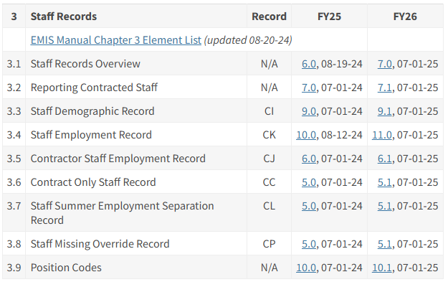
EMIS Reports – Checking Errors
Resources to Assist in Correcting Errors
ODEW EMIS Manual
https://education.ohio.gov/Topics/Data/EMIS/EMIS-Documentation/Current-EMIS-Manual

Slide 7
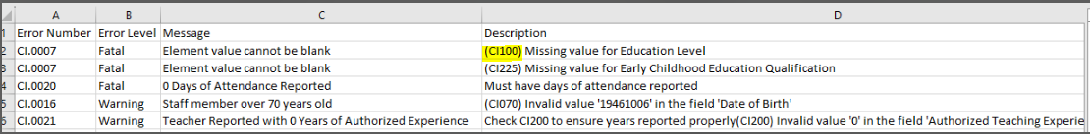
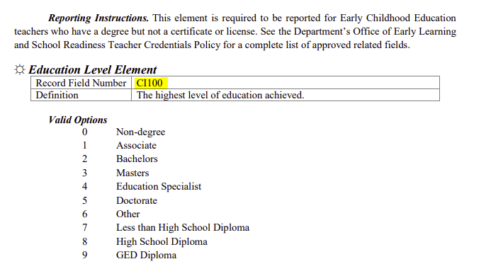
EMIS Reports – Checking Errors
Level 1 Errors:

Slide 8



EMIS – Error Prevention
EMIS Error Prevention Tools:
Staff and Course (L) Collection Checklist
Adding an Employee for EMIS Reporting.docx
EMIS Quick Reference Sheet.docx

Slide 9
EMIS – Error Prevention
EMIS Error Prevention Tools: Terminology – Redesign vs EMIS
STATE SOFTWARE | EMIS
Hours in Day Position>Hours In The Day or Compensation>Hours In Day | Length of Workday
Contract Workdays Position>Contract Work Days or Compensation>Contract Work Days | Scheduled Workdays
Pay Unit Calculated based on Position>Contract Amount, Hours In The Day, Contract Work Days, and Compensation>Pay Unit or Compensation>Contract Amount, Hours In Day, and Pay Unit. | Pay Type
Contract Amount Position>Contract Amount or Compensation>Contract Amount | Pay Amount/Rate

Slide 10
EMIS – Error Prevention
EMIS Error Prevention Tools: Understanding: ‘Hours In Day’ vs ‘Length of Work Day’
If a value is entered in Position > EMIS Related Information
  Hours in the Day field, that is the value that is reported to EMIS as the ‘Length of the Work Day’
  If a value is NOT entered in Position > EMIS Related Information
  Hours in the Day Field, Then the value in Compensation Hours in Day is reported
  to EMIS as the ‘Length of the Work Day’

Slide 11
EMIS – Error Prevention
EMIS Error Prevention Tools: EMIS Override Fields – Optional
Suggestion – In the Position grid under EMIS Related Information – Make the following changes to Headers:
  Full Time Equivalent > EMIS Override Full Time Equivalent
    Contract Amount > EMIS Override Contract Amount
    Contract Work Days > EMIS Override Contract Work Days
    Hours in The Day > EMIS Override Hours in The Day

Slide 12
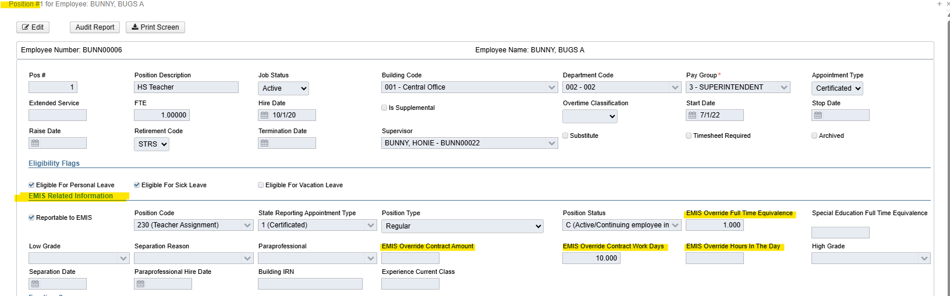
EMIS – Error Prevention
EMIS Error Prevention Tools: EMIS Override Fields – Optional

Slide 13
EMIS – Error Prevention
EMIS Error Prevention Tools: EMIS Override Fields – Optional
Suggestion – In the Position grid under EMIS Related Information – Make the following changes to Headers:
These new field names will help remind you that these fields are EMIS Override data
  *Use these fields with caution. These fields could report data that is different from
  what is in the Compensation record.

Slide 14
EMIS – Error Prevention
EMIS Error Prevention Tools: EMIS Override Fields – Optional
  To make these changes:
    Go to: System/Custom Field Definition/Applies to Position
Before
After

Slide 15
EMIS – Error Prevention
EMIS Error Prevention Tools: EMIS Override Fields – Optional
  This is how the Custom Field Definition change affects the EMIS Related Information fields on the Position Screen.

Slide 16

EMIS – Checking Errors
        Absences/Attendance
This is reported at the Employee level and returned with the Employee collection.
If the Employee “Report to EMIS” flag is True, then a count of attendance and absences occurs, and WILL be included in the collection
The system DOES NOT exclude Compensations when the EMIS flag is False.
Attendance and Absence records are counted if the record is assigned to a Compensation and the Activity Date falls within the ‘fiscal year’ date range

Slide 17
EMIS – Checking Errors
        Absences/Attendance
WORK AROUND: If you are receiving an EMIS error on attendance days that should not be reporting, Add a Compensation Calendar Stop Date using the date prior to the first attendance record posted. Then these attendance days will not report and will prevent errors.

Slide 18
EMIS – Checking Errors
        Absences/Attendance
Items to Consider:
  *Position/Termination Date is used in Attendance Days Calculation
  when counting days from the Job Calendar for the employee’s Position/Compensations.
  *If the Position Job Status is set to Terminated, then the STOP DATE used to find days on
  the calendars will be set to the Position Termination Date.
  *If no Position Termination Date is entered, then the Employee Termination date is used.
  *If no Employee Termination Date is entered, then the Compensation Calendar Stop Date is used.
  *If no Compensation Calendar Stop Date is entered, the Compensation Stop Date is used.
  *If none of these dates are entered, then the System Configuration EMIS Reporting Fiscal Year
  is used, which would be June 30th.

Slide 19
EMIS – Checking Errors
        Absences/Attendance
Hourly Employees:
  * If the employee has Hourly Absences and Attendances, they are converted
  to days. In the process of doing this, the system needs to know how many
  hours are in a day.
  * This happens by using the Compensation Hours in Day field that is assigned
  to the Absence and Attendance and the value is provided.
  * If there is no Compensation assigned, then the system looks to find an Active
  Compensation. Then the Compensation date range is used to convert hours to days.
  * The system looks for a Compensation where the Absence and/or Attendance Activity
  Date falls within the date range of the Compensation Start and Stop Dates.

Slide 20
EMIS – Checking Errors
        Absences/Attendance
Hourly Employees:
  * If there is no Compensation Hours in Day value, then the system looks at the Position
  EMIS Related Information for Hours in the Day and then that value is used in the conversion
  to hours.
  * If no hours in the day is found in either place, an error is returned.
  (no hours in a day found)
  * Once the system determines the hourly values the system uses the following conversion.
  The Conversion = Length of Attendance divided by Hours in Day

Slide 21
EMIS – Checking Errors
        Absences/Attendance
EMIS ADJUSTMENTS:
  * Core > Adjustments > Type: EMIS Attendance and EMIS Absence is available
  to adjust EMIS Attendance and Absences
  * The Transaction Date needs to fall within the EMIS fiscal year.

Slide 22
EMIS – Checking Errors
        Absences/Attendance
Reporting Entity - Count Summary Report
*Reports Menu
  *

Slide 23
EMIS – Checking Errors
        Absences/Attendance
Reporting Entity - Count Summary Report
*Helpful in verifying Attendance and Absence days for EMIS Reporting

Slide 24
EMIS – Checking Errors
        Long Term Illness
Long Term Illness Days are 15 Consecutive Absence Days.
  (Entered on Employee Record)
  * At least 15 consecutive days absent due to an illness of the staff
  member or the staff member’s spouse, child or parent.
  * Note that a day is defined as the period of time the staff member normally
  spends at work during a 24-hr period. This may vary from staff member to
  staff member.
  * Please remember that if you enter long term illness on the Employee Record
  you must also have Absences entered in Attendance to match otherwise
  EMIS errors will occur

Slide 25
EMIS – Checking Errors
        Staff EMIS Separation Scenarios FY26
Please reference the Staff EMIS Separation Scenarios for FY26 for all staff who are resigning or retiring from your district for the fiscal year.
None of the Scenarios have changed, but at the top of the document are the reporting periods.
Staff and Course Initial Collection ended February 4, 2026
Staff and Course Final Collection begins February 10, 2026, and ends August 5, 2026.
**ALL employees who are retiring or resigning need to be Separated in USPS BEFORE you close the fiscal year!!! (even if they’re still getting paid)

Slide 26

EMIS – Checking Errors
        Quick Check Tips and Tricks
Go to System > Configuration > EMIS Configuration. Make
sure the Fiscal Year is correct.
Is the Credential ID the valid number of characters (must be 9 digits) Type over Credential ID to make sure there are no white spaces.
Are all dates valid especially Hire Date and Birth Date

Slide 27
EMIS – Checking Errors
        Staff and Course Collection Reminder
  Final L Collection closes August 5, 2026

Slide 28
EMIS – Checking Errors
        Questions?

