Slide 1
Transmitter Control Codes (TCC)
Presented by
Penny Rucker and Bryan Janson

Slide 2
Introduction
Beginning in September 2022, access to the IR-TCC application to update
Need to create an “ID.me” account
Need driver’s license number to do this
Two official contacts from the district is necessary and both have to do an “ID.me” account
Notes:
How presentation will benefit audience: Adult learners are more interested in a subject if they know how or why it is important to them.
Presenter’s level of expertise in the subject: Briefly state your credentials in this area, or explain why participants should listen to you.

Slide 3
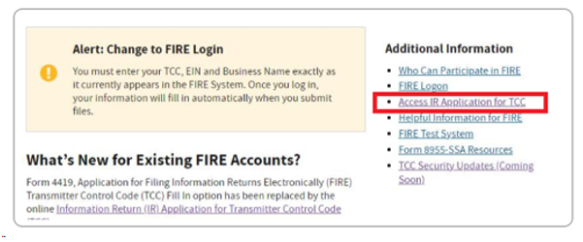
Let’s get started
Website: https://www.irs.gov/e-file-providers/filing-information-returns-electronically-fire
Then click link for “Access IR Application for TCC”
Your screen may look a little different – see next slide
Notes:
Lesson descriptions should be brief.

Slide 4
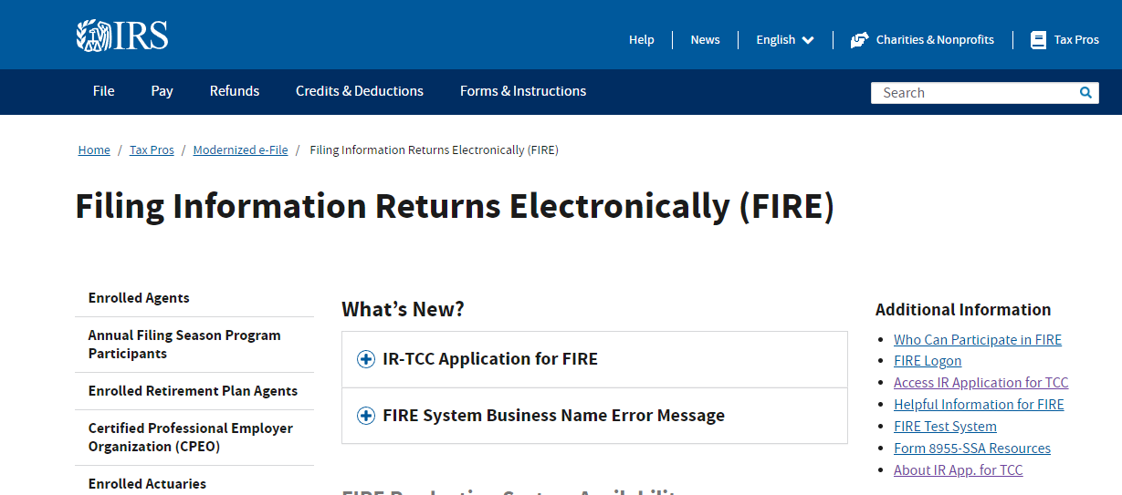
Let’s get started
Website: https://www.irs.gov/e-file-providers/filing-information-returns-electronically-fire
Then click link for “Access IR Application for TCC”
Notes:
Lesson descriptions should be brief.

Slide 5
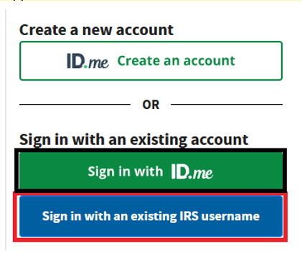
Account Needed: We need an “ID.me” account created
Notes:
Example objectives
At the end of this lesson, you will be able to:
Save files to the team Web server.
Move files to different locations on the team Web server.
Share files on the team Web server.

Slide 6
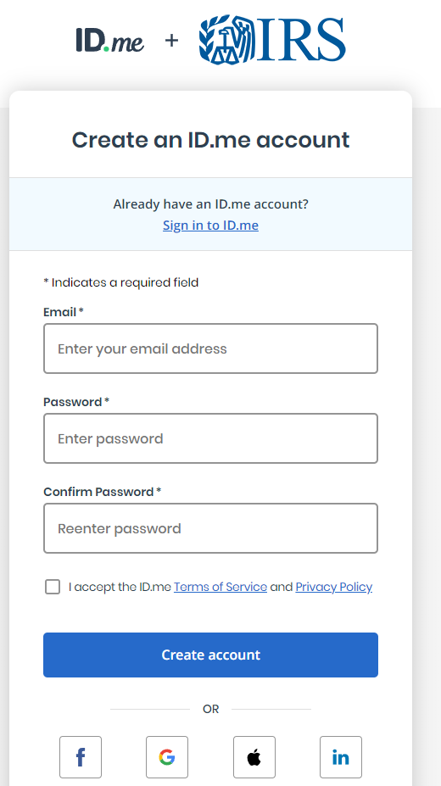
How To: just follow the “ID.me” process
Note that the account is created with
From here you create your account as noted
It will send you an email to your email address and do verification and validation checks
It will want personal identification information
It will need a phone number for authentication so make sure it is a cell phone number that you have on you or office number

Slide 7
Problems with the “ID.me” account set up:
If you are having any problems the best phone number to get help that I have found is:
(866) 455- 7438
Allow time for questions

Slide 8
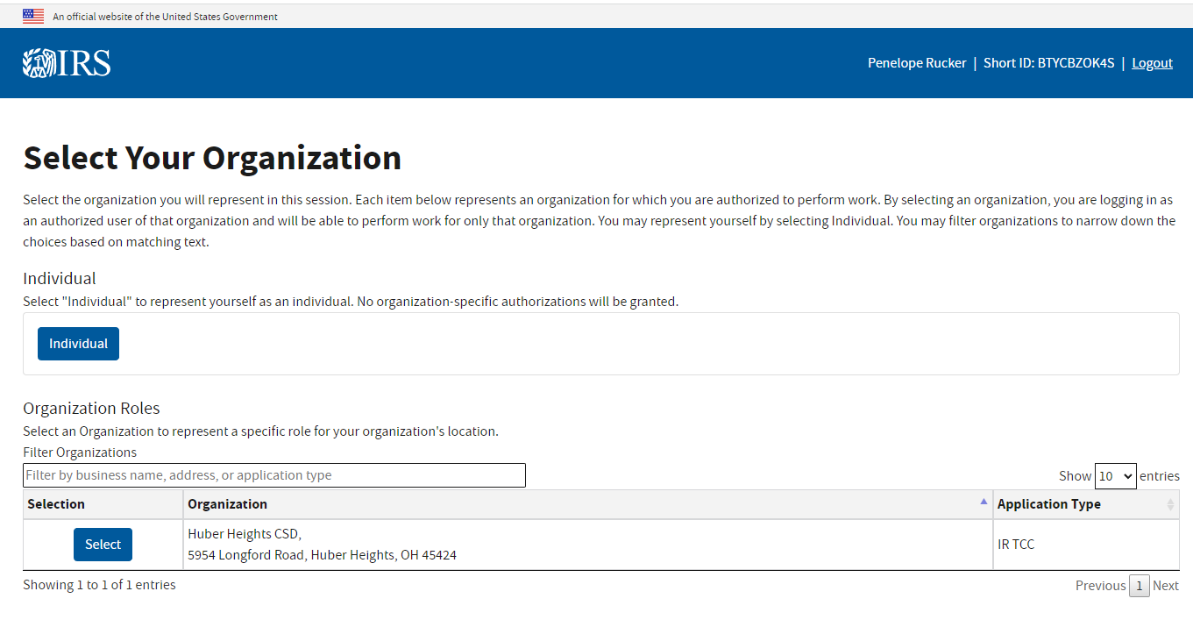
Select Your Organization

Slide 9
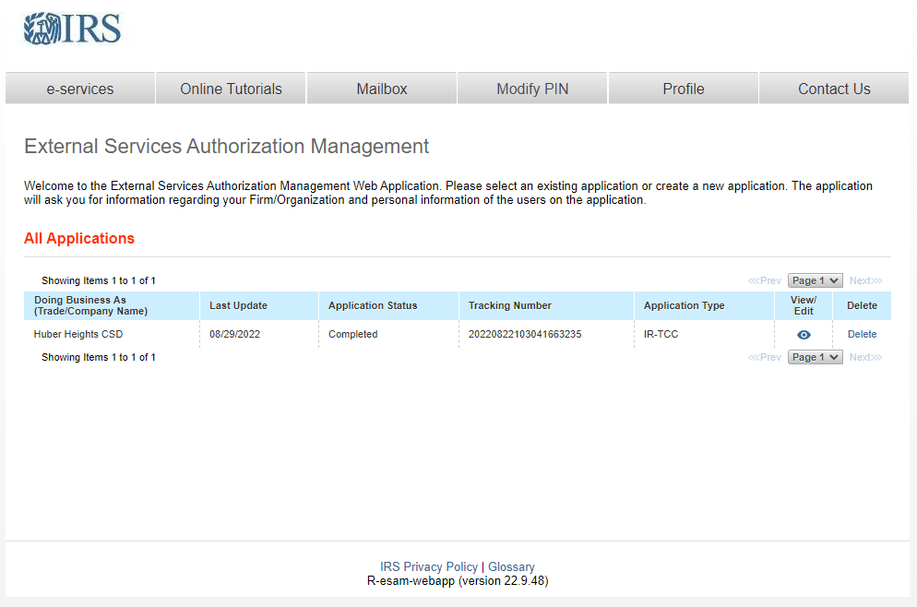
After completing all prompts:

Slide 10
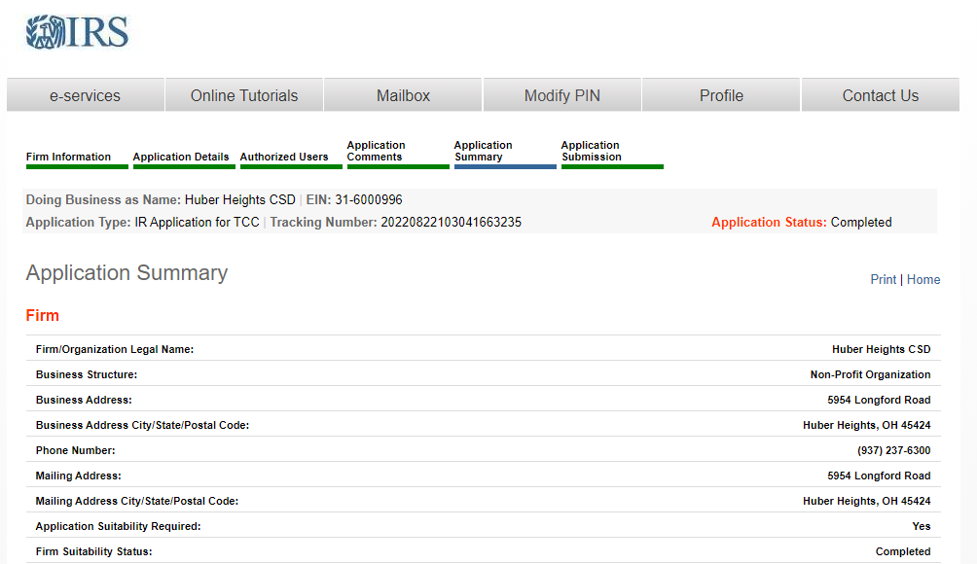
When you click view/edit

Slide 11
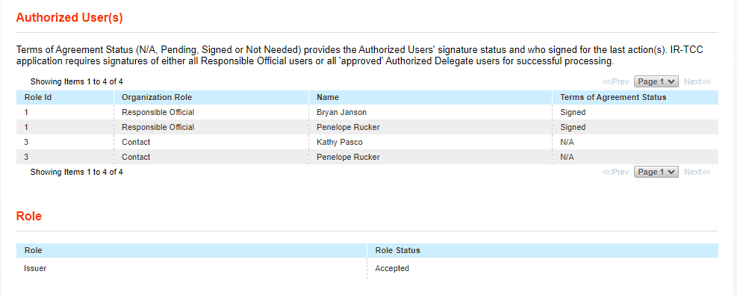
When you click view/edit

Slide 12
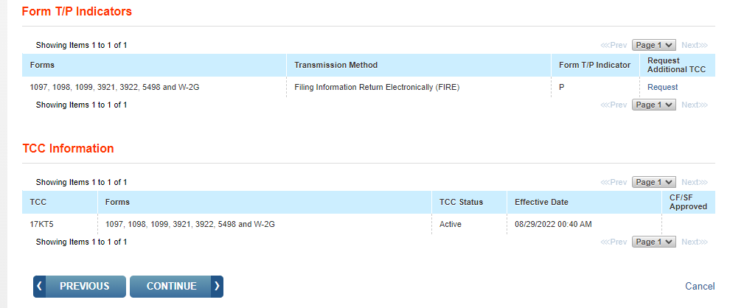
When you click view/edit

Slide 13
When you click CONTINUE

Slide 14
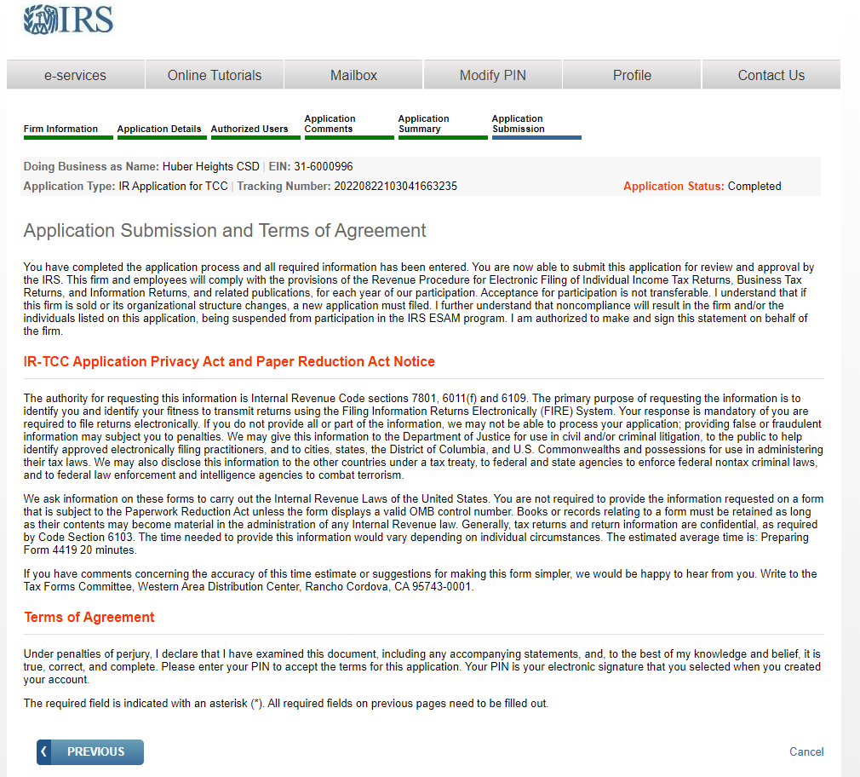
When you click CONTINUE

Slide 15
Thanks for listening!
These are the experiences that we had in completing the project
Others may have more/less information – feel free to share with each other
I am sure none of us have all the knowledge or all the answers but we are all willing to help each other and that is how we make it! ☺

