Slide 1
USPS Calendar Yearend Review
2015

Slide 2

Agenda
USPS-r
USPS CYE CHECKLIST
Before final pay of calendar year – things that affect withholding
Prepare for W2 Processing
W2PRO
W2 Instructions
Printing W2
ACA 1094/1095
WORXTIMEii
15L Final Staff Reporting

Slide 3

Goal
Understand the software treatment of income tax and how it translates to the W2 reporting
Federal, State, Municipal, OSDI and Medicare deduction fields

Slide 4
WAIVER
This is not the complete checklist. Use this presentation to supplement the USPS Calendar Yearend Checklist
Some commands have changed – do not use checklists from previous years
Notes:
This PPT steps through the checklist process adding detail to some topics. It’s not meant to be your checklist. The checklist has some flexibility. For example, anything in the “Before Last Pay” section can be done in any order but they all must be done. Do not use checklists from prior years. Some commands have changed.

Slide 5

Before Last Pay (Step 1) Employee Expense Reimbursement
Employee Expense Reimbursements
Some fringe benefits are Federal, State, and/or Medicare/FICA taxable
IRS Publication 15-B Employer’s Tax Guide to Fringe Benefits
Also, see IRS Presentation from 2014
IRS Publication Taxable Fringe Benefit Guide (p5137)

Slide 6
Day Meals
If the employer reimburses or pays for meals on a day trip then:
Include the cost of meal reimbursed to the employee in their payroll as a fringe benefit
Subject to Federal Income Tax, Medicare and SS if have SS wages
Revenue Ruling 75-432 & 75-170
Notes:
Employer provided vehicle, if you pay mileage for communiting – fringe benefits

Slide 7
Day Meals continued
If union contract says to pay for meals then reimburse but include in wages
If have policy to pay for meals if traveling out of county it is still taxable and included in wages
Must include in payroll the amount of lunch as a noncash item

Slide 8
Uniform Requirements
For uniforms to be nontaxable and not be included in the employee’s wages they must:
Be required by employer to be worn
Must be in written policy
Can’t be optional if they wear them
Not be adaptable to every day street wear

Slide 9
Examples of Non Uniforms
Ball Caps
T-shirts
Socks
All shoes unless steel toe (safety)
Tactical/BDU pants
Polo Shirts
Plain belts
Shorts
Under Armour
Sweatshirt
Carhart jacket
Jeans

Slide 10
Employer Provided Cell Phones
If provided for noncompensatory business reason then excluded from income:
Business use as working condition fringe benefit
Personal use as de minimis fringe benefit
Effective after 12/31/09
Notice 2011-72 & Publication 15-B

Slide 11
Cell Phones Reimbursements
Employee uses personal cell phone for business
Employer reimburses at a set amount for business use
Then don’t included in income if:
Reimbursement reasonably calculated
Not in excess of actual expense incurred
Review phone bill

Slide 12
Wendy Speelman 419-512-1809 Cell wendy.e.speelman@irs.gov
Adams | Allen | Auglaize | Brown | Butler
Champaign | Clark | Clermont | Clinton | Darke
Defiance | Delaware | Fayette | Franklin | Fulton
Greene | Hamilton | Hancock | Hardin | Henry
Highland | Logan | Lucas | Madison | Marion
Mercer | Miami | Montgomery | Ottawa | Paulding
Pickaway | Pike | Preble | Putnam | Ross
Sandusky | Seneca | Shelby | Union | Van Wert
Warren | Williams | Wood | Wyandot

Slide 13

Before Last Pay Employee Expense Reimbursement
Process Taxable Fringe Benefits in USPS
UPDCAL_CUR- NC3 pay type
Taxed when paid
Federal
Ohio
City (if applicable)
Medicare
OSDI
Not included in payroll total gross or the amount charged to the USAS pay account
Included in Adjusted Gross on PAYRPT
CHKUPD
adds NC3 amounts to the “Tax. Ben” field on the 001 deduction
Increases the total and taxable gross amounts on the Federal, Ohio, Medicare, OSDI and Municipality (if flagged “Y” to non-cash earnings)
Non-cash amount increased on job record.
Notes:
The document that you got in the pdf portfolio, “Expense Reimburse” gives different scenarios for getting taxable fringe benefits on the W2.
If it at all possible, it’s important to process fringe benefits through payroll. Employee and board will owe medicare tax. Typical fringe benefits are gift cards, uniforms

Slide 14
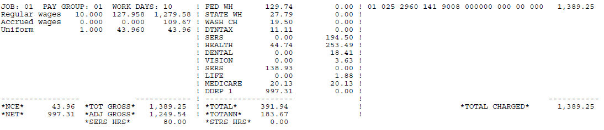
Before Last Pay Employee Expense Reimbursement
ADJ GROSS = GROSS – ANNUITIES-SERS + NC1 + NC3
NC3 Pay Type continued
CALCPAY
PAYRPT will list NC3 amounts in employee detail as Tax. ben
amounts will not be included in the total gross or total charged, but they will be included in the adjusted gross

Slide 15
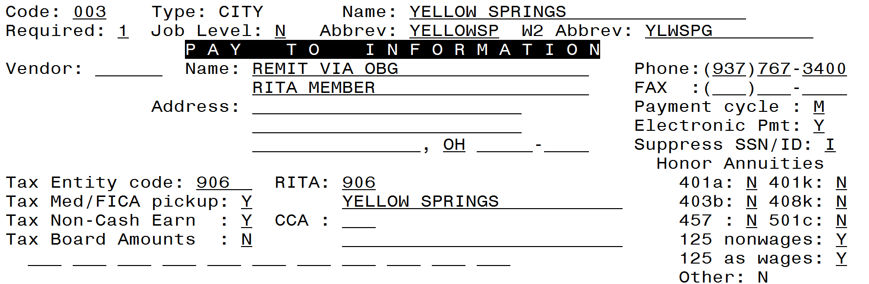
Before Last Pay Employee Expense Reimbursement
NC3 Pay Type continued
CHKUPD
Will increase the total and taxable gross amounts on DEDSCN by the amount of the NC3 payment on the Federal, Ohio, OSDI, Medicare and Municipality if “Y” to non-cash earnings.
Will also add the NC3 amounts to the non-cash earning fields on the third screen of JOBSCN

Slide 16
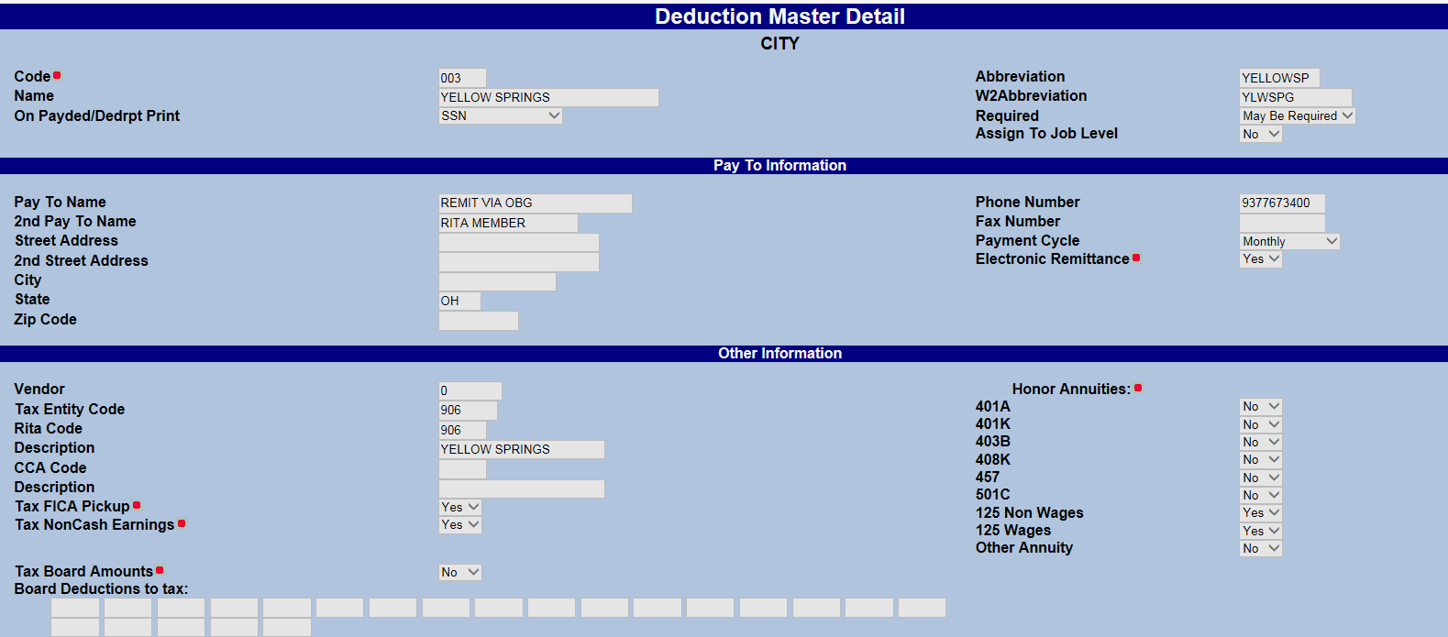
USPSWEB – Municipality Deduction
Notes:
If SSDT doesn’t send something by Friday – warn that this flag is not working. Explain they will have to make manual changes if they don’t get W2proc fixed before they run it to create a tape.

Slide 17
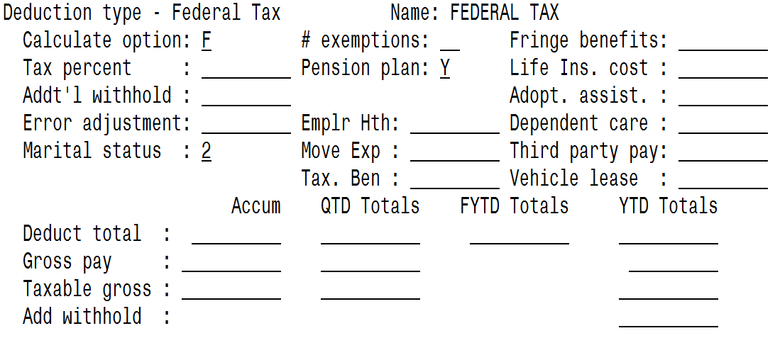
Tax. Ben= populated by the NC3 pay type at CHKUPD and will represent the non-cash taxable benefits amount
Does not appear, separately, on W2. It’s included in the wages
Fringe benefits=amount in this field is added to the total and taxable gross amounts on the federal and Ohio deduction taxable gross and placed in boxes 1 and 16 of W2. Employee pays tax when filing

Slide 18
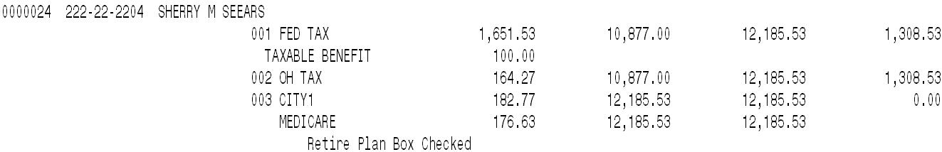
Before Last Pay Employee Expense Reimbursement
NC3 Pay Type continued
W2PROC
The taxable benefit amount will be listed on W2REPT under the employees federal information

Slide 19
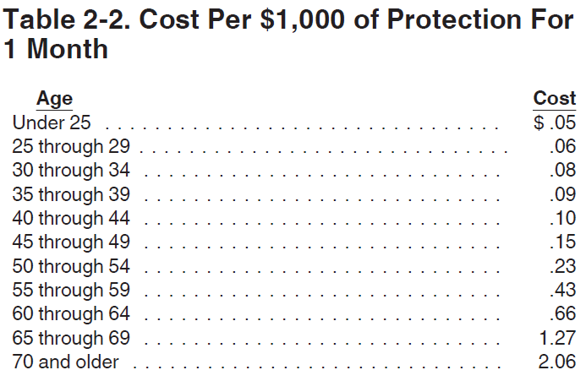
Before Last Pay (Step 2) Group Term Life Insurance
Group Term Life Insurance coverage over the limit- IRS Publication 15-B pages 11-14
(http://www.irs.gov/pub/irs-pdf/p15b.pdf) contains the calculation table to figure the cost.
Notes:
This option is, also, on the FYE checklist. Be sure to only process nc1 for remaining months.

Slide 20
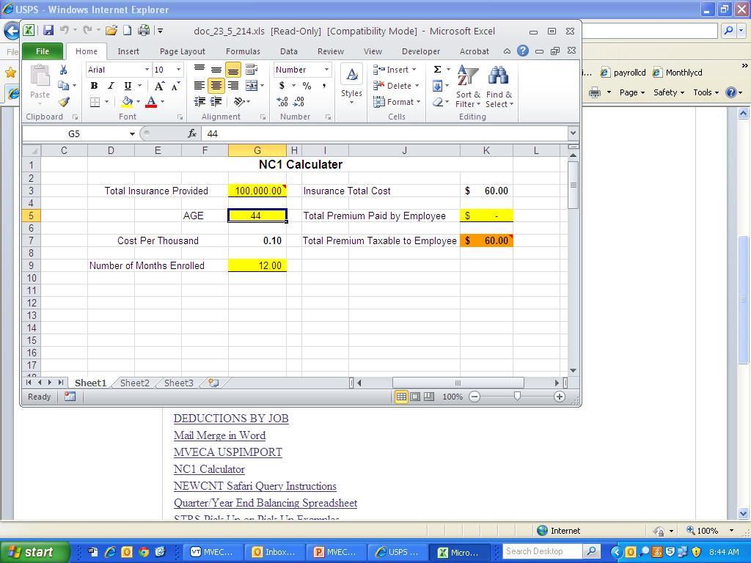
Group Term Life Insurance over 50K
NC1 Calculator
http://www.mveca.org/documents/contentdocuments/doc_23_5_214.xls

Slide 21
Before Last Pay Group Term Life Insurance Continued
Recommended to add NC1 pay types to UPDCAL_CUR to avoid INICAL balancing issues. Wait to add the NC1 after the final run of INICAL.
No Federal, Ohio, or OSDI tax amounts will be withheld
Medicare or Social Security employee and board amounts calculated and withheld
City tax withholding on non-cash earnings if "Tax non-cash earnings" flag is Y (yes)
CHKUPD
Amount of the NC1 payment will be added to the 001 federal tax deduction In the “Life Ins. Cost” field
Increases the total and taxable gross amounts on the Federal, Ohio, Medicare, and Municipality (if flagged “Y” to non-cash earnings)
Non-cash amount increased on job record.

Slide 22

Amount goes on W2 in Box 12 with Code C

Slide 23
FYI Group Term Life Insurance NOT processed before final pay
-- If life insurance was not entered before the last pay:
If the NC1 pay was not used prior to the last pay of the calendar year, the following manual procedure must be used in order for the NC1 pay to show correctly on the W2 form and to insure that the QRTRPT balances. Follow these procedures prior to generating W2 forms.
Increase the YTD gross and the YTD taxable gross figures on the federal tax record by the amount of the taxable premium.
Increase the YTD gross and YTD taxable gross figures on the state tax deduction record to reflect the taxable premium.
Increase the YTD gross and the YTD taxable gross figures on the municipality tax deduction record IF required by the municipality.

Slide 24
FYI Group Term Life Insurance NOT processed before final pay Continued
Increase the YTD gross and YTD taxable gross figures on the FICA and/or Medicare deduction records to reflect the taxable premium.
Obtain payment from the employee for the FICA (6.2% of the taxable premium) and/or Medicare (1.45% of the taxable premium) withholding amounts. Include this amount on the YTD Deduct Total field of the FICA/Medicare Deduction record(s). The board of education must match these same amounts calculated in this step (process as a USAS transaction).
Enter the taxable premium of life insurance on the federal tax deduction record in DEDSCN on the "Life Insurance Cost" line.
Enter the taxable premium of life insurance on the to-date fields for Non-cash earnings on JOBSCN (3 of 3). This will insure that the QRTRPT non-cash earnings will balance.

Slide 25
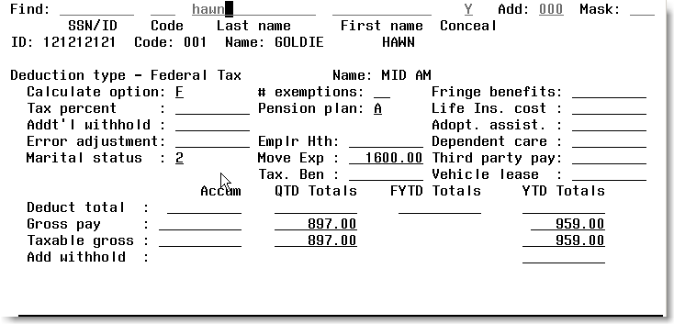
FYI Life Insurance (continued)
Only add if amount NOT processed as NC1

Slide 26
Before Last Pay (Step 3)
Run W2PROC before last pay of 2015 has been completed
Check W2ERR.TXT to determine if adjustments are needed on the next payroll
Review and correct warnings and errors, if needed

Slide 27
After Final Pay for 2015
Complete Month End Closing procedure for December (Step 4-6)
Start the Quarter End Closing process for the 4th quarter (Step 7-17)
Be sure to balance the W2REPT – Step 11

Slide 28
Processing W2s from backup
If you are pressed for time to process the first pay in January or you are waiting on Third Party Sick Pay from a vendor…
Option to do all W2 Processing from a backup data set
If you want to process W2s later
Run the backup, PAY_CYEBCK (Step 40)
End the Quarter End Closing process (Step 41-42)
Process first pay in January, 2016
Send email to helpfiscal@mveca.org to request a demo with your yearend backup
Complete W2 PROCESSING from demo account (Step 18-35)
Notes:
You may know of an employee that received 3rd party sick pay but you don’t have the info from the disability provider

Slide 29
W2-Prep.Employer Sponsored Health Care Cost on W2 - Step 18
The Affordable Care Act requires employers to report the cost of coverage under an employer-sponsored group health plan. Reporting the cost of health care coverage on the Form W-2 does not mean that the coverage is taxable. This is informational purposes only.
A flag was added to REG and ANN deduction screens in DEDNAM:
“Include as employer-sponsored health coverage?”
If answered “Y” the YTD deduction totals will be included in the total moved to the employees W2 – Box 12 with code DD
If both employee and board deductions are in USPS, W2PROC will calculate the total amount of all deductions flagged

Slide 30
W2-Prep.Employer Sponsored Health Care Cost on W2 – Step 18 Continued
Life, Dental and Vision are not required to be included in the total if they are separate plans and not included as part of the medical plan
The contribution amount by Employee and Employer for Health Saving Account (HSA) is NOT to be included as employer-sponsored health coverage. This is reported in Box 12 using(Code W).
This total includes both employee and employer contributions
Employer-sponsored Health coverage is required for employers who filed 250 or more W2’s for the preceding calendar year
http://www.irs.gov/uac/Form-W-2-Reporting-of-Employer-Sponsored-Health-Coverage

Slide 31
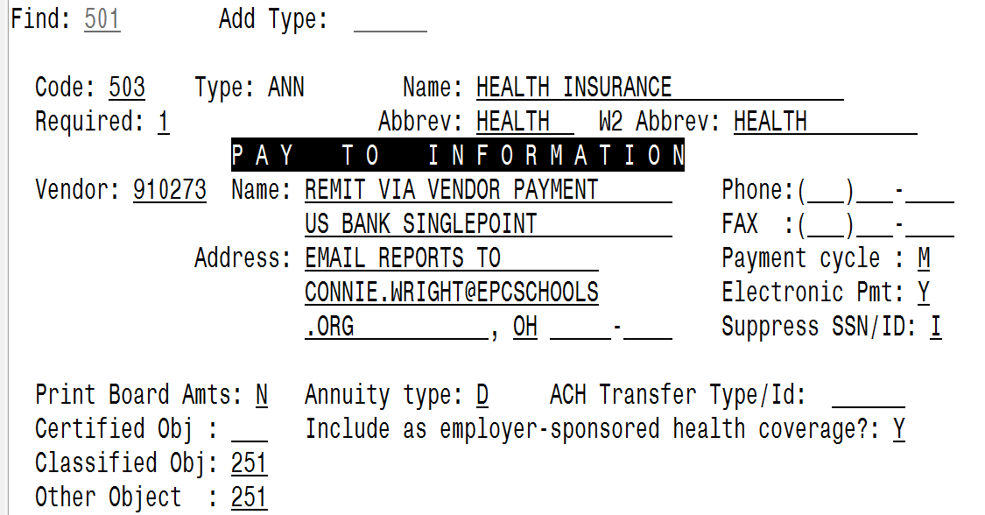
W2- Prep Employer Sponsored Health Care Cost on W2 – Step 18 Continued
Notes:
An HSA

Slide 32
W2-Prep.Employer Sponsored Health Care Cost on W2 – Step 18 Continued
If the employee and/or board premiums are not processed through payroll, complete these manual entries:
Add any amount paid by the employee for insurance out of pocket with the board share and enter the total in the‘Emplr Hth’ field on the employee’s 001 Deduction record.
Use USPLOAD to upload employee plus board totals if board amounts are not processed through payroll.
If the district only tracks the employee portion of health care costs in the USPS system, the district will need to create a spreadsheet with the employee YTD costs for health insurance and the Board YTD costs for Employee Health Insurance and then total these two amounts. This figure will need to be loaded into the field on the 001 Federal deduction record.
Spreadsheet must have EMPLOYEE_ID, DED_CODE (=001) and EMPLR_HEALTH_COV
The ‘Emplr Hth’ field on the 001 Federal deduction record overrides any DEDSCN records that have the DEDNAM records marked ‘Y’ for Employer Sponsored Health Care. This amount would then be reported on the Employee’s W-2.

Slide 33
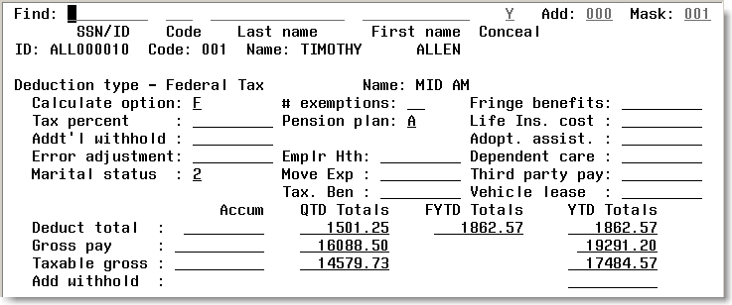
W2- Prep Employer Sponsored Health Care Cost on W2 – Step 18 Continued

Slide 34

W2- Prep Employer Sponsored Health Care Cost on W2
For future reporting district may want to start tracking Employer Sponsored Health Care portion through USPS
-If not wanting to use BRDDIS leave
OBJ code fields in DEDNAM record
blank.

Slide 35
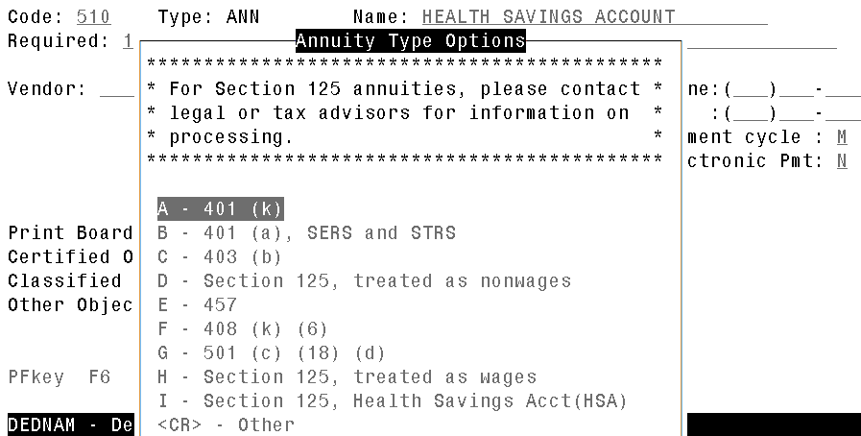
W2- Prep Deduction Annuity Type (Step 19)
Check Annuity Types
Health Savings Account (HSA)
Type in DEDNAM must be set to “I” even if there are no employee amounts withheld

Slide 36

W2 Prep Pension Plan (Step 20)
Check the Pension Plan fields on federal tax (001) deduction record
Default is “A” – automatically check the pension plan box if there is an active retirement record
Board members opting for FICA can be either an A or N since they would not have an active 590 or 591 deduction
Y=Yes, check the pension plan box regardless of the status or no retirement record
N= No, never check the pension plan box
Notes:
Run a query of the Federal Tax deduction to check the values
Ask advisor if student workers pension plan box should be checked

Slide 37
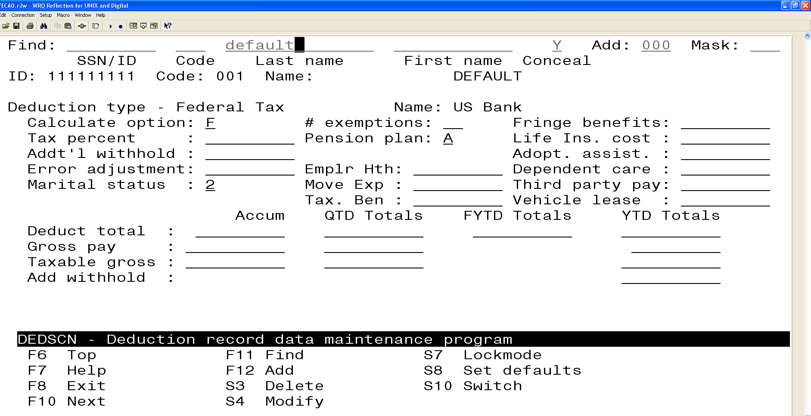

Slide 38
W2- Prep City Tax Deductions (Step 21-22)
Check the W2 Abbreviation – truncated to 6 characters on W2
Verify ‘Entity code’ in USPSDAT/DEDNAM is completed for any magnetic reporting to any city
CCA/RITA Reporting
Verify values in USPSDAT/DEDNAM are set
Both tax entity code and RITA/CCA code are required for tax data to be included on a submission file
See information from RITA/CCA web sites on codes as defined
Links provided on checklist
Xenia City requires a csv file. Must have a tax entity code
WCH needs an electronic file. Must have a tax entity code.
Check employee deductions to confirm that the

Slide 39
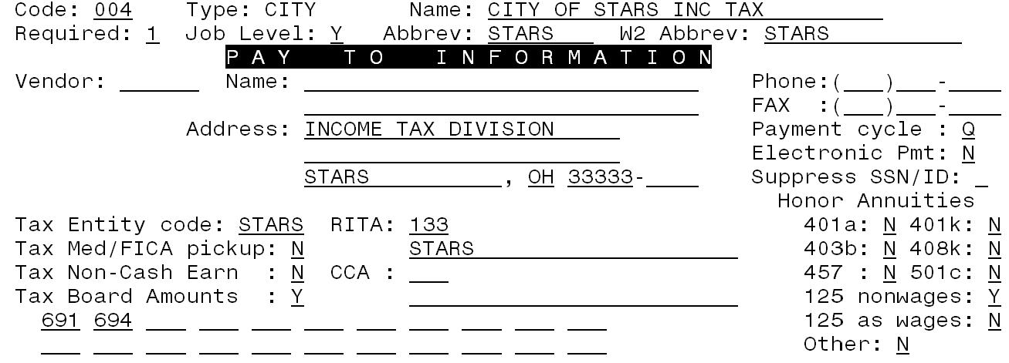
W2- Prep City Tax Deductions
Notes:
Xenia and Washington CH are now expecting a flat file for submission. Be sure to add XENIA, WCH or any other code in the tax entity code for any city that requires a different file than .SEQ.

Slide 40
W2- Prep City Tax Deductions

Slide 41
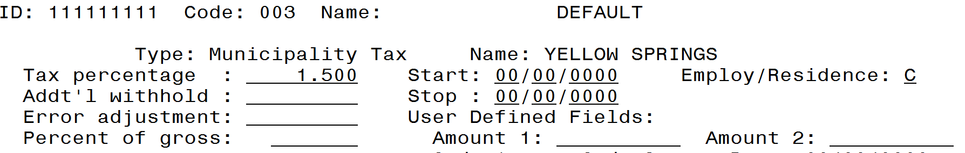
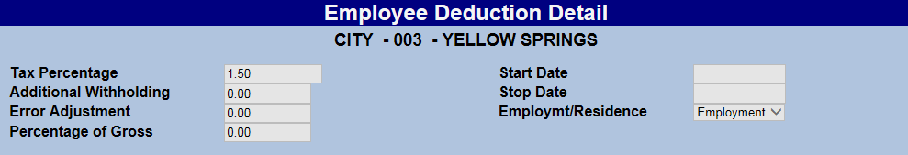
City DEDSCN
C=EMPLOYMENT; R=RESIDENCE

Slide 42
FYI City Tax Deductions
If ‘tax board amounts’ option on the city tax record is set to “N” on DEDNAM record
Tax Med/FICA Pickup should be “Y” if the city taxes the Medicare pickup
The Medicare pickup is added to the city total and taxable gross amounts on the W2REPT.
Employee pays tax when filing
If the ‘tax board amount’ on the city tax record is set to “Y” on the DEDNAM record
The tax is withheld during the payroll
No Medicare pickup is added to the city wages on the W2REPT. Even if the ‘Tax Med/FICA Pickup’ flag is “Y”

Slide 43
W2- Prep City Tax Deductions

Slide 44
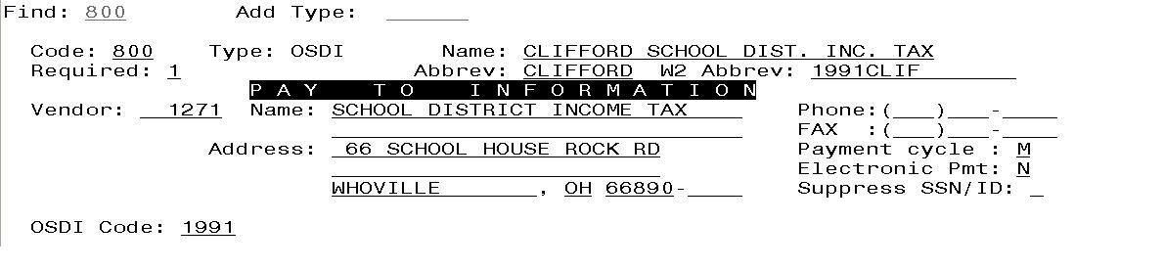
W2- Prep OSDI W2 Abbreviation (Step 23)
OSDI abbreviations
Include OSDI code number in first part of description in USPSDAT/DEDNAM

Slide 45

W2- Prep Outstanding Checks (Step 24)
Run CHKSTS for any outstanding checks (“P” status).
Review to determine if any checks should be voided.
If you wait to void them in the next calendar year; it affects their reported income for this calendar year

Slide 46
W2- Prep Fringe Benefits (Step 25)
Fringe benefit amounts not paid through payroll
Enter taxable amount in fringe benefit field on the federal tax record
Note: This amount is added to taxable gross during W2PROC
Can be added to box 14 on W2 (this is the same box that the optional deduction added are printed)

Slide 47
W2- Prep Dependent Care – Step 26
If using DPCARE type
Add any amounts over legal limit to 001 federal tax deduction
If not using DPCARE type
Add total amount of deducted for dependent care
Amounts over limit ($5,000.00)added to total and taxable gross amounts on Federal, Ohio and City total and taxable gross fields on the W2REPT

Slide 48
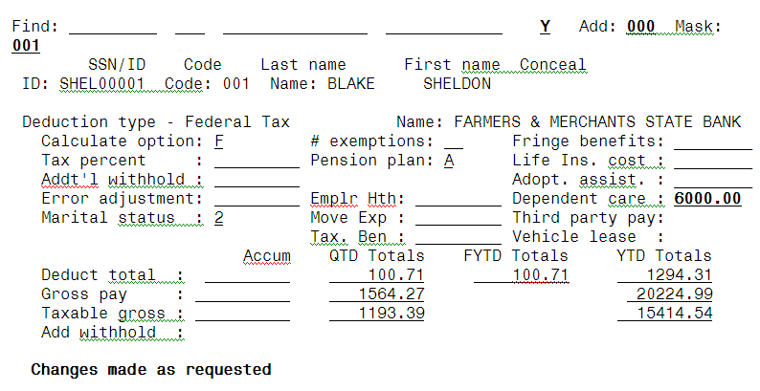
W2- Prep Dependent Care

Slide 49
W2- Prep Vehicle Lease (Step 27)
Use of Company Vehicle
Manually enter leased vehicle value amount into the federal tax field.
Adds the Vehicle Lease amount from the 001 federal record to the total and taxable gross fields on the Federal, and Ohio total and taxable gross fields on the W2 report.

Slide 50
W2- Prep Excludable Moving Expense (Step 27 cont’d)
Excludable moving expenses
- Contact legal advisor with questions
- Manually enter excludable amounts into the federal tax field.

Slide 51

W2-Prep Life Insurance (Step 28)
If notified by an annuity company that life insurance was purchased from an amount withheld as an annuity: a) increase the taxable gross on the 001, 002, and OSDI for the amount identified as insurance and decrease the YTD annuity amount by the amount identified as insurance. If the city honored the annuity when the amount was withheld, the city records should, also, be updated.

Slide 52
W2- Prep Third Party Pay (Step 29)
Did another entity report taxes withheld for third party sick payments?
If disability deduction is taken after tax, third party disability payments are non-taxable
Add the amount paid to the employee in the Third Party Pay field on the 001 federal deduction
Amounts from this field will appear in box 12 with a code of J on W2
If 3rd party pay is taxable
Manual changes to total and taxable gross are required on Federal, Ohio and OSDI deduction records
See Publication 15a, Pages 15-21 and W2 Instructions page 11

Slide 53
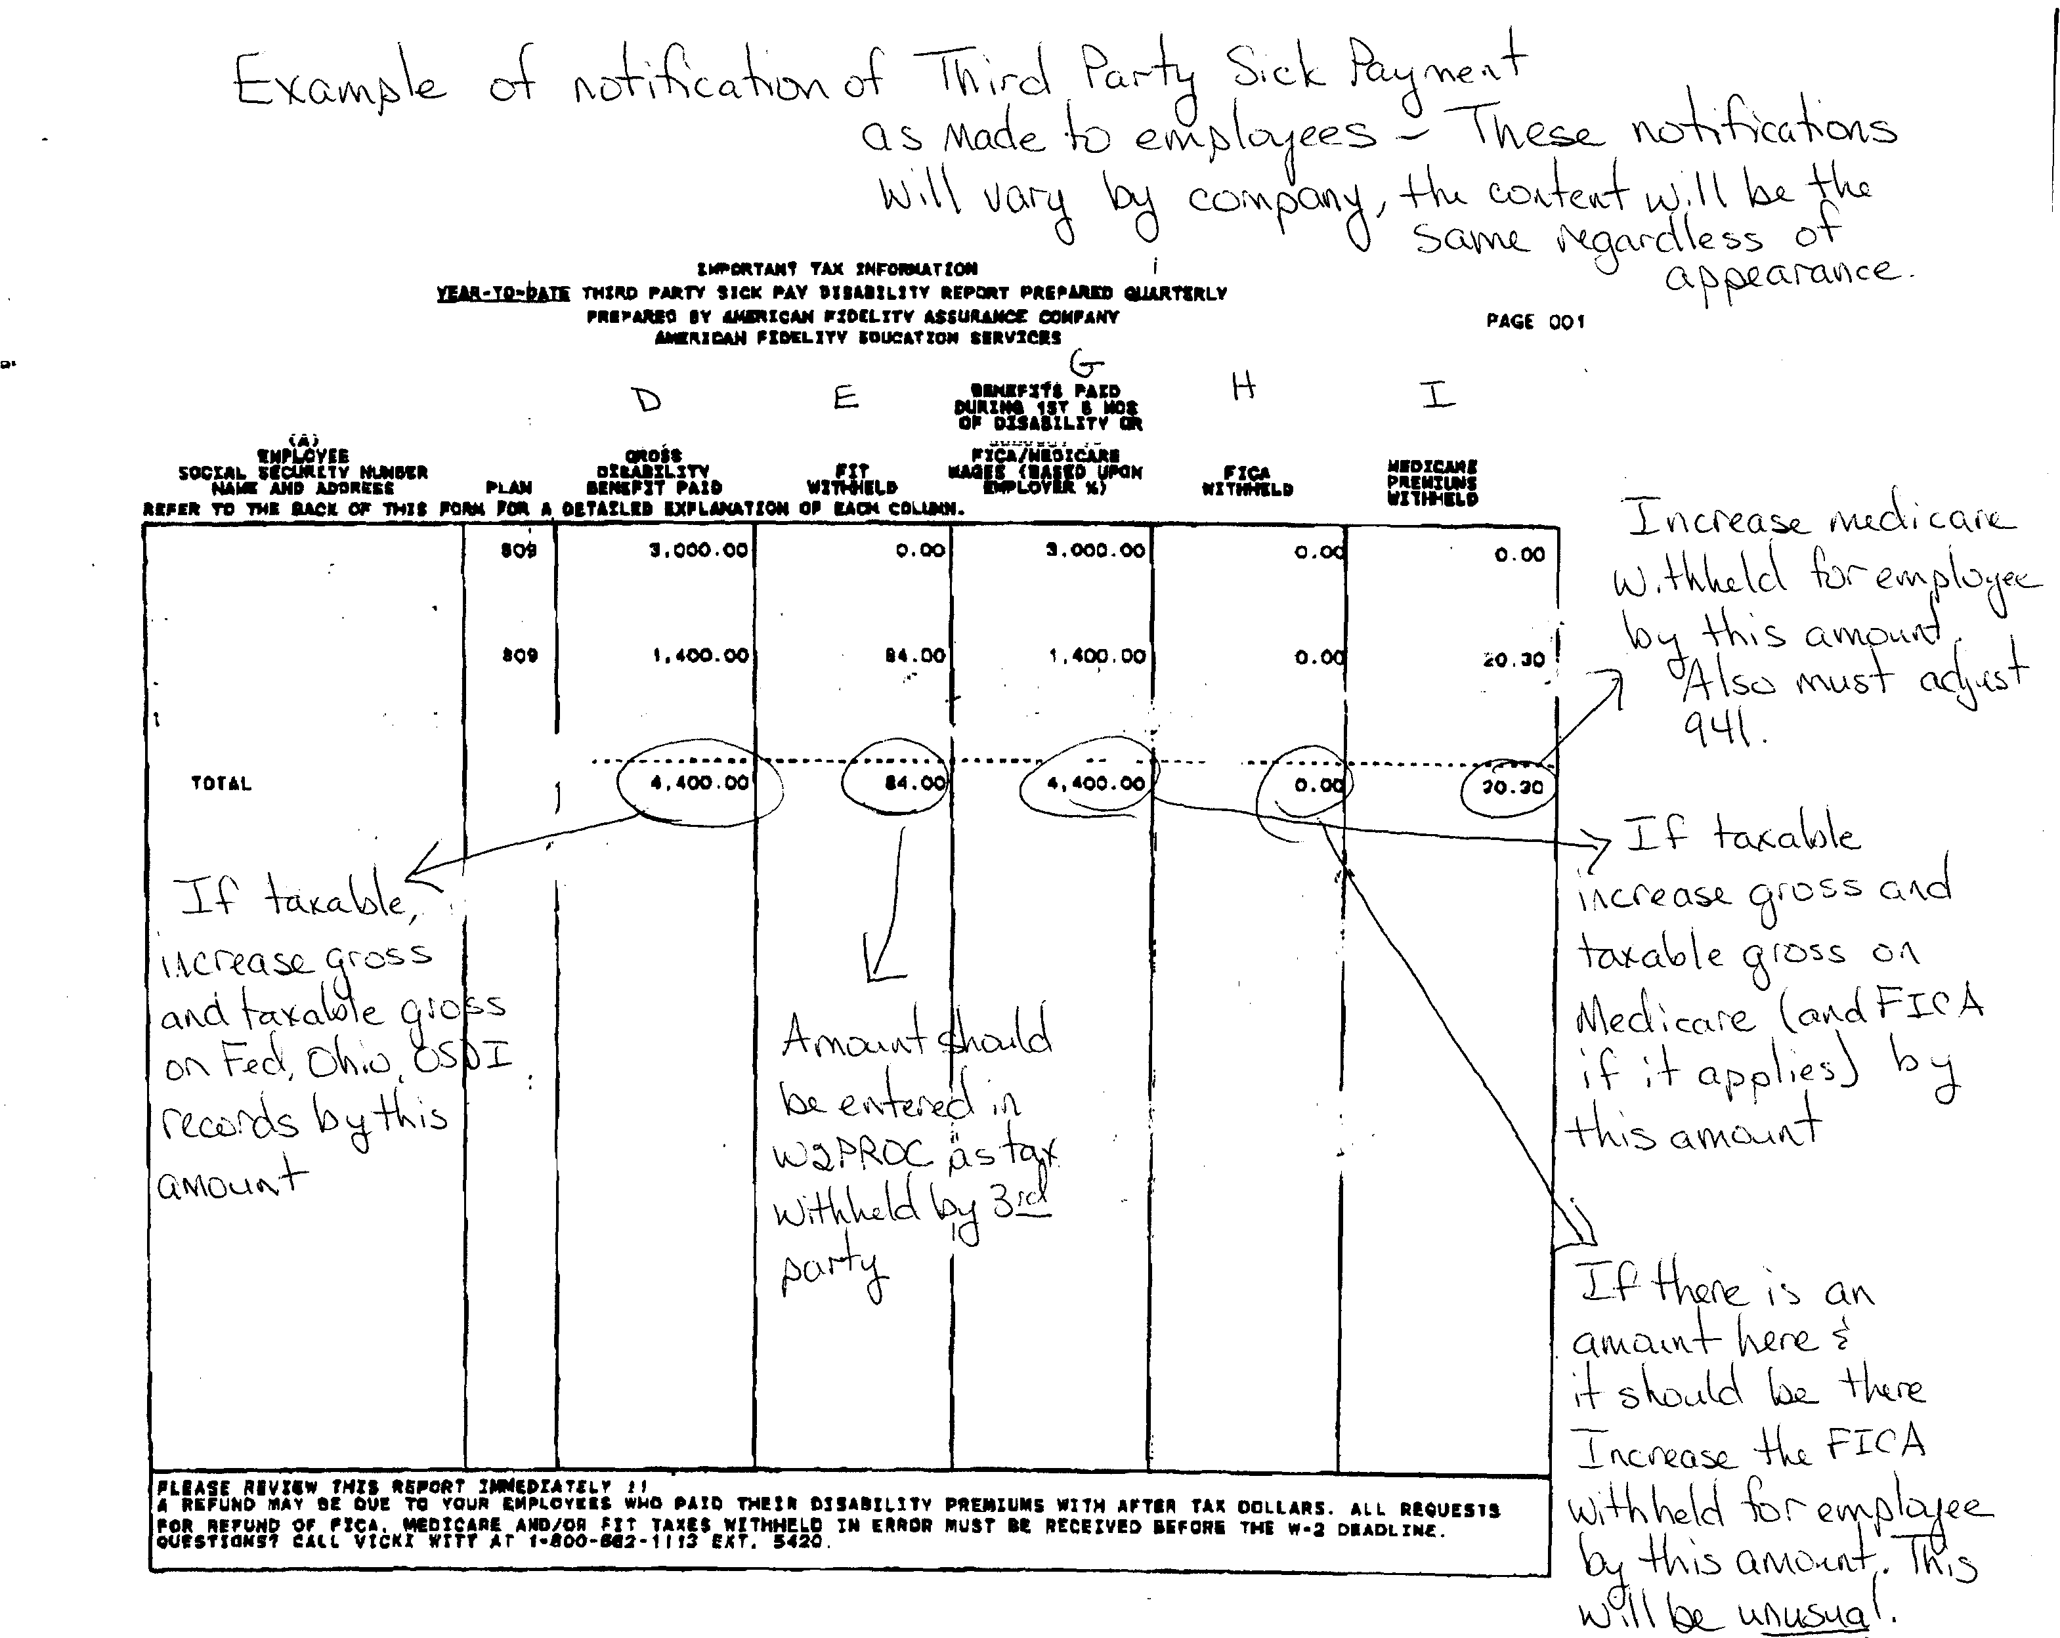

Slide 54
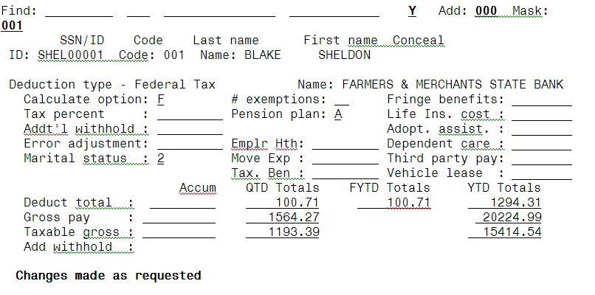
Non-Taxable Third Party Sick Pay

Slide 55
W2PROC (Step 30-33)
Program used to generate
Balancing reports
W2 print forms
W2 .DAT files for laser printing
W2CITY.DAT file used for special city submissions
W2 tape submission file
W2TAPE.SEQ
Federal
State
Cities (RITA/CCA)
Xenia, WCH

Slide 56
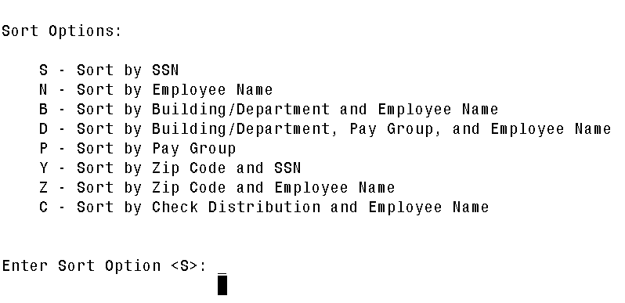
W2PROC
Notes:
When running for the final time, you need to select the sort option that you want the file printed. I’m assuming we will be able to select Entry Order as in previous years

Slide 57
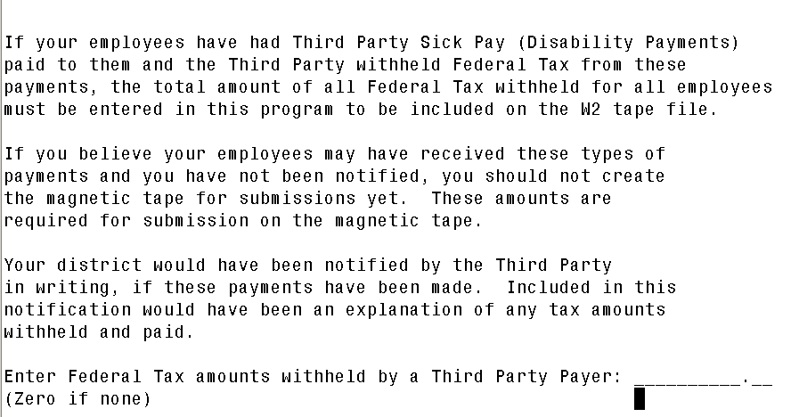
W2PROC
Notes:
This question is asking if a 3rd party payer withheld tax. If you have multiple employees that had federal tax withheld, add the total for all employees.

Slide 58
W2PROC
Do you want to create a W2 tape file?
Answer N until you are sure you have completed all balancing and W2s are complete
Do you need to print employer’s name and address on the W2 forms and Federal and State identification numbers
Answer Y

Slide 59
W2PROC
District data will come from USPCON
Confirm Name
Confirm Address
Confirm Identification numbers
Federal
Ohio
Verify values on W2REPT.TXT

Slide 60
Kind of Employer
Your districts will need to specify what type of employer they are:
The Kind of Employer can be one of the following:
F = Federal Government
S = State and Local Governmental Employer (non 501c)
T = Tax Exempt Employer
Y = State and Local Tax Exempt Employer (501c)
N = None Apply
If the school district is part of a local government and has NOT applied for 501C status, they will check the box for State/local non 501c (S) .
If the school has applied for 501C status and was granted that non profit status they would check State/local 501c. (Y)

Slide 61
W2PROC
Do you want Box 14 to print Fringe Benefits if there are any (Y/N <N>)?
The value in the fringe benefit field on the 001 deduction record is added to the total and taxable gross on the federal and state tax record and placed in box 1, 3 and 5, if applicable, on W2
It’s optional for you to report the fringe benefit amount in Box 14
This will take one of the 3 available lines in this box

Slide 62
W2PROC
Additional deduction codes
Allows districts to print additional information in box 14, “Other”
Six can be entered
Leased vehicle value is always included
Fringe Benefit question in W2PROC if answered “Y”
Other user values are secondary
Prints the first 3 for each employee in the order entered
Alignment forms-Would you like to print a dummy W2 for form alignment?
Answer N

Slide 63
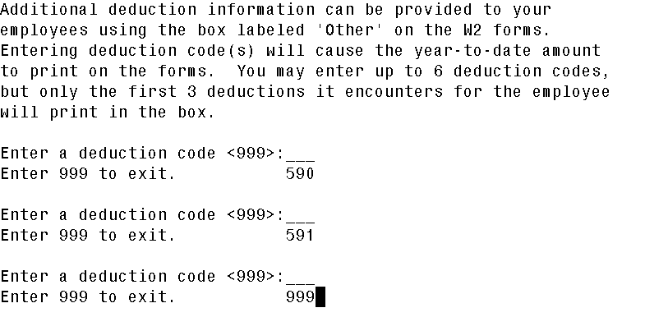
W2PROC

Slide 64
W2PROC
“Y” is selected in the Create Tape File field:
Contact name
Contact phone number
Contact phone extension
Contact fax Number
Contact e-mail address
These fields are not required to be filled out , but it is highly recommended that they be populated so the data is included on the W2TAPE file.

Slide 65
W2 Balancing
Information on W2REPT.TXT should balance to:
941 totals as reported for 4 quarters
ERNREG/ERNSUM figures
Represents amounts as withheld from employees
QRTRPT figures
Represents amounts as current in the YTD figures
Balance Federal, Ohio, and City taxes and gross amounts
Notes:
You will compare multiple reports and your own balancing spreadsheets

Slide 66
W2- Balancing Checking Employer Sponsored Health Care Cost Totals
Verifying the value on W2REPT for each employee
Safari query the Deduction – Annuity domain
EMPLOYEE_ID, DED_CODE, YTD_DEDUCTED, BDYTD_DEDUCTED
If board amount is on a REG deduction type, do a separate query for the board share and use Vlookup function to combine the 2 spreadsheets.
Total Board amounts should be reconciled with checks written from USAS.
Total on W2REPT should be total of all checks for employee share and board checks.
If the totals don’t reconcile modify the Emlr Hth field on 001 record
Annual totals by coverage type should be checked on W2REPT by employee
Notes:
All Employees who had the same coverage all year should have the same totals. You may have to check the exceptions for those who changed coverage because of a new baby or during open enrollment to verify the reported total on W2REPT is correct.

Slide 67
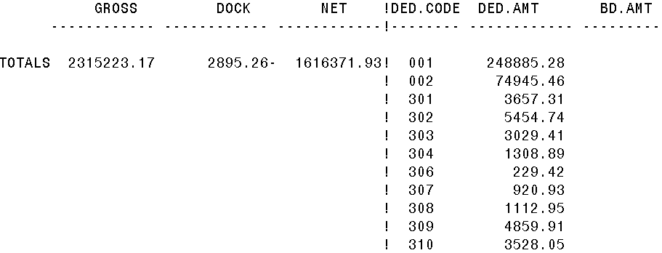
W2REPT Balancing
Amounts in this column on ERNREG should be used for balancing

Slide 68
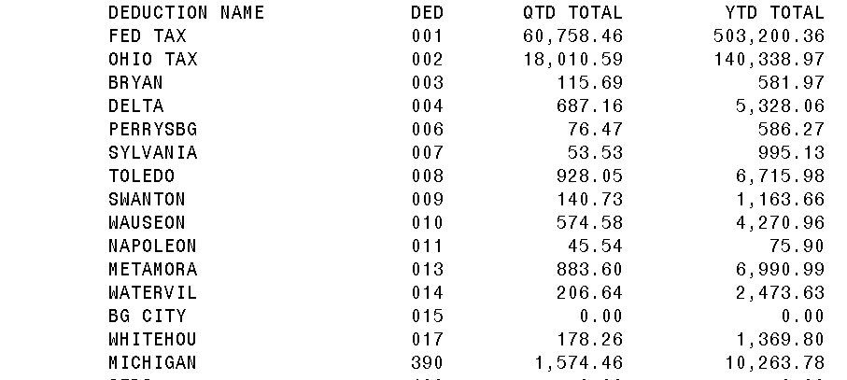
W2REPT Balancing
Check amounts in this column on QRTRPT should be used for balancing

Slide 69
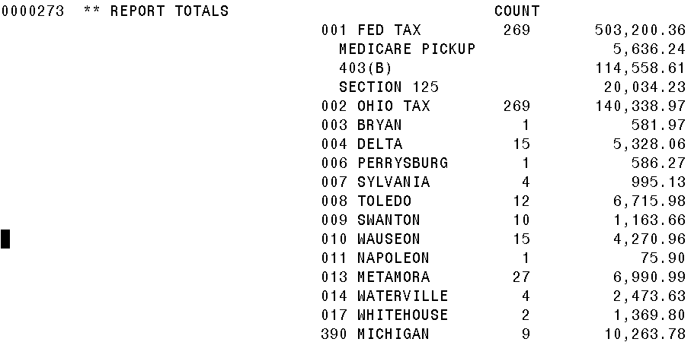
W2REPT Balancing
Amounts in this column on W2REPT.TXT should be used for balancing

Slide 70
W2 Balancing
Items that affect balancing between W2PROC and QRTRPT (because they were not processed in a payroll)
Dependent care benefits over limit
Fringe Benefits
Medicare pickup amounts
Taxable third party sick pay
Use of company vehicle
Any manual changes to total and taxable gross on federal, Ohio, OSDI and medicare

Slide 71
Balancing Problems
Voided checks from prior calendar year
CHKSTS report
Refund of annuity withheld in prior calendar year
AUDRPT
Manual Updates
AUDRPT
Search for YTD changes using VIEW from MENU

Slide 72
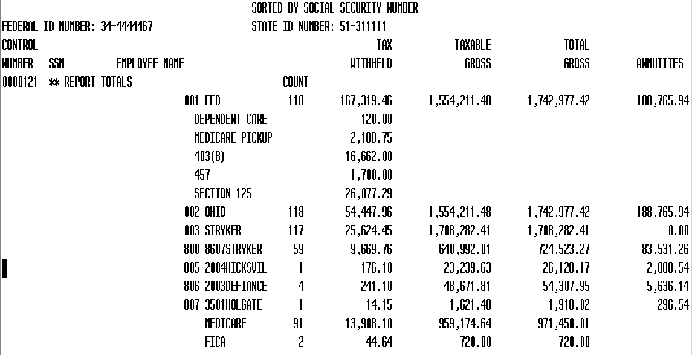
W2REPT
Calculated gross minus taxable gross
Special amounts for W2s
Descriptions for W2 boxes from DEDNAM
From DEDSCN

Slide 73
W2ERR
The following list describes errors and warnings that may appear when the W2PROC program is run. Each message is followed by an explanation of its meaning, a possible solution, along with the severity of each message.
The error messages are classified into three categories:
Inform
Warning
Fatal - Fatals flagged with an ’***’ will cause the tape file to not be created. Fatals flagged without an ’***’ may cause an inquiry from the SSA/IRS. Messages must be researched thoroughly before adjustments are made.

Slide 74
Common W2PROC Messages
Calculated annuity amount exceeds the total annuities
Indicates the total gross minus taxable gross is greater than total annuities from the YTD deduction amounts
Indicates possible problem with annuity amounts, gross or taxable gross
Verify manual updates
Verify error adjustments

Slide 75
Common W2PROC Messages
Negative annuity on file for this employee; assuming zero.
Usually from refund of a prior year’s annuity amount
If desire to report it as if withheld and refunded in current calendar year
Use DEDSCN and zero annuity amount
Use DEDSCN and increase total gross amounts on federal, Ohio, OSDI and city, if the city honored the annuity initially

Slide 76
Common W2PROC Messages
Possible error in OSDI gross or tax
Indicates taxable OSDI wages but no tax was withheld
Common informational for employees who have smaller wage amounts per payroll
Verify amounts
Usually no action is needed

Slide 77
Common W2PROC Messages
Total annuities $$$, do not equal total gross less taxable gross
Calculated annuity amount (total gross less taxable) does not match the YTD annuity amounts from DEDSCN
Program compares total annuities from deductions to total gross less taxable gross calculation, uses federal tax record
Possible problem with annuity total
Possible problem with total gross
Possible problem with taxable gross

Slide 78
Common W2PROC Messages
Total annuities $$$, do not equal total gross less taxable gross (continued)
Verify manual updates
Verify refund of deductions
If refund from prior calendar year and district wants it to appear as if amounts were withheld and refunded in current calendar year
Increase total gross on federal, Ohio, OSDI and city if they initially honored the annuity

Slide 79
Common W2PROC Messages
Fatal Errors
Deduction code not found on the DEDNAM file
Employee first and last name should not be spaces
Gross for this deduction exceeds the maximum for this reporting year
Incorrect retire plan box flag on the USPSCN/DEDSCN federal record
There is no Federal record on file for this employee
This employee has Medicare/FICA tax without any Medicare/FICA wages

Slide 80

W2 Instructions Confirm Name/SSN
SSN/Name confirmation is available by sending a file to SSA
Register with SSA/Business Services Online
http://www.ssa.gov/bso/bsowelcome.htm
This takes a few weeks if not already registered
Run W2MAINT to create a file to upload to the BSO site
Refer to the USPS Reference Manual, W2MAINT section for instructions
Notes:
Weigh the hassle of registering, creating the file, submitting, fixing the errors with the fines that are assessed if the name is wrong.

Slide 81
IRS W2 Instructions Reviewed
Specific details on W2 form reporting requirements see General Instructions for Forms W-2 and W-3
http://www.irs.gov/pub/irs-pdf/iw2w3.pdf

Slide 82
IRS W2 Instructions Reviewed
Corrections (Page 22- 2014 Instructions for Forms W-2 and W-3)
Use W2-C form
A W3-C form must accompany a W2-C form
W3-C form corrects totals submitted on tape file by ITC
Incorrect address
W2-C form not required
Register with SSA/BSO to do online.

Slide 83
IRS W2 Instructions Reviewed
Deceased employee’s wages (Page 7 -2014 Instructions for Forms W-2 and W-3)
If payment is made in year employee died
W2 reporting required
1099 reporting required
If payment is made in year after the death of employee
1099 reporting required

Slide 84
IRS W2 Instructions Reviewed
Health Savings Account (HSA) (Page 10- 2015 Instructions for Forms W-2 and W-3)
Lost W2 form (Page 10)
You will have access to retrieve your W2s that can be printed on 8-1/2 by 11 copy paper through OnBase
Point employee to the kiosk
Hand type new form
Enter “REISSUED STATEMENT” on new copy

Slide 85
IRS W2 Instructions Reviewed
Box a- Employee’s social security number (Page 13 -2014 Instructions for Forms W-2 and W-3)
Employee SSN as entered in BIOSCN
Box b- Employer Identification Number (EIN) (Page 14 )
Federal EIN from USPSDAT/USPCON
Box c- Employer’s name, address and ZIP code (Page 14 )
Employer information as entered in W2PROC
Default values are from USPSDAT/USPCON

Slide 86
IRS W2 Instructions Reviewed
Box d- Control number
W2PROC assigns consecutive number; listed on W2REPT
Boxes e and f- Employee’s name and address (Page 14)
Employee’s name and address
Data from BIOSCN
Uses legal name if non-blank
Uses name field if legal name is blank
Box 1(Page 13 & 14)
Wages from federal taxable gross amount

Slide 87

W2 Instructions Wages for Box 1,5, and16
NC1 and NC3 pay types processed during payroll
Federal, State, Medicare Total and Taxable gross is increased by the amount of the payment on each deduction record
Medical Savings Account deduction type
Federal and Medicare Total and Taxable gross is increased by the board amount
Medicare/FICA Pickup
Added to the Medicare deduction taxable gross during payroll
Added to the federal and state taxable gross during W2PROC
Vehicle Lease, Fringe Benefits, Dependent Care over 5,000
Added to the federal and state taxable gross during W2PROC
*Local wages are affected as defined by the deduction master

Slide 88
W2 Instructions Wages for Box 1, 5 and 16
 |  | TAX | TAXABLE | TOTAL
 |  | WITHHELD | GROSS | GROSS | ANNUITIES
 | 001 FED | 32056.19 | 103479.80 | 104496.50 | 1016.70
 | MEDICARE PICKUP | 1501.30
 | SECTION 125 | 956.70
 | 002 OHIO | 5588.04 | 103479.80 | 104496.50 | 1016.70
 | 801 1205SE | 999.66 | 103479.80 | 104496.50 | 1016.70
 | 003 SPFLD | 84.75 | 4237.50 | 4268.75 | 31.25
 | MEDICARE | 1501.30 | 103539.80 | 102995.20
 | U.W. | 130.00
ERNREG 1/104-12/31/04
GROSS WAGES PD | 102995.20
Medicare Pickup | 1501.30
Total Gross for Fed and State | 104496.50
-Annuities | 1016.70
TAXABLE GROSS FOR FED AND STATE | 103479.80 |  | Placed in Boxes 1, 16 & 18 of W2
GROSS WAGES PD | 102995.20
Medicare Pickup | 1501.30
Total Gross | 104496.50
-Section 125 | 956.70
TAXABLE GROSS FOR MEDICARE | 103539.80 |  | Placed in Box 5 of W2

Slide 89
IRS W2 Instructions Reviewed
Box 2- Federal income tax withheld (Page 15)
Tax withheld from YTD deduct field on federal tax record, 001
Box 3- Social security wages (Page 15)
Social security wages from 692/693 records flagged with a deduction category of “F”

Slide 90
IRS W2 Instructions Reviewed
Box 4- (Page 15)
Social security taxes withheld from the 692/693 and 694/695 records flagged with a deduction category of “F”
Box 5 (Page 15)
Medicare wages from 692/693 records flagged with a deduction category of “M”

Slide 91
IRS W2 Instructions Reviewed
Box 6 (Page 16 - 2014 Instructions for Forms W-2 and W-3)
Medicare taxes withheld found on the 692/693 and 694/695 records flagged with a deduction category of “M”
Box 10 (Page 16)
Dependent care benefits as found on the federal tax record or on the dependent care annuity records

Slide 92
IRS W2 Instructions Reviewed
Box 12-Codes (Pages 16-19 -2014 Instructions for Forms W-2 and W-3)
Code C
Group-term life over $50,000 cost
Code D
401(k) amounts
Code E
403(b)

Slide 93
IRS W2 Instructions Reviewed
Box 12 (continued)
Code F
408(k)(6)
Code G
457(b) 457(f)
Code H
501 c(18)(D)
Code J
Non taxable sick pay

Slide 94
IRS W2 Instructions Reviewed
Box 12 (continued)
Code P
Excludable moving expenses
Code T
Adoption benefits
Code W
Employer contributions to Health Savings accounts
Employer contributions include section 125 annuity amounts the employee contributes
Code AA
- Designated Roth contributions under a section 401(k)

Slide 95
IRS W2 Instructions Reviewed
Box 12 (continued)
Code BB
- Designated Roth contributions under a 403(b)
Code DD
Cost of employer-sponsored health coverage
Code EE
Designated Roth contributions under a governmental section 457 (b) plan

Slide 96
IRS W2 Instructions Reviewed
Box 13 – (Page 19-2014 Instructions for Forms W-2 and W-3)
Retirement plan
401(a)
401(k)
403(b)
408(k)
501c(18)
Notice 87-16 defines “active participant”

Slide 97
IRS W2 Instructions Reviewed
Box 14 - Other (Page 19-20 2014 Instructions for Forms W-2 and W-3)
Value of vehicle lease from federal tax record
Other deductions entered in W2PROC
Optional possibilities include
Union dues
Retirement

Slide 98
W3 Instructions Reviewed
W3 form
Not required unless filing on paper
Totals on W2 submission file created by W2PROC is the substitute for the W3 form

Slide 99

Calendar Yearend Closing
Step 34 – email helpfiscal@mveca.org with the following information:
Sort Order, city instructions, RITA instructions
Step 35 – Create any report for archives
Step 36 – RUN BACKUP, USPSBACKUP
Creates new directory in HISTORY – CY15.
Run reports from this directory if yearend reports are needed
Step 37 – Run CALENDARCD
Step 38 – Run QRTRPT to clear quarter and calendar year to date totals
Step 47 & 48 – Send me the IT-3 for state reporting and Form 17 for RITA, if applicable

Slide 100
W2 Printing
Email helpfiscal@mveca.org for printing
Include instructions for sorting
Include instructions for adding the W2s to the employee kiosk
Include instructions for reporting electronically to cities
Instructions for reporting to RITA
OnBase – You will receive a login to OnBase, www.hccanet.org
Printing employer copies for city reconciliations
Duplicates for lost W2s
Archives

Slide 101
Post W2PROC
Corrections before files have been submitted to SSA
If submission has not occurred MVECA can copy yearend backup files to a demo and allow the district to rerun W2PROC
Corrections after submission of files by ITC
W2C and W3C will have to be submitted
Complete Tax reconciliation for all tax entities
Some have online forms

Slide 102
Preparing for 2016
Enter changes in tax withholding rates effective January 1, 2016
City rates
http://incometax.columbus.gov/search_taxmunicipalities.aspx?id=13116&menu_id=502
OSDI rates
http://tax.ohio.gov/divisions/tax_analysis/tax_data_series/school_district_data/documents/sdit_map_and_list.pdf

Slide 103
Preparing for 2016
Unsure if employee should be taxed
https://thefinder.tax.ohio.gov/StreamlineSalesTaxWeb/default_schooldistrict.aspx
Lookup Tax Rate
Address
Zip Code 5 digit or 9 digit
Latitude/Longititude
Use CHGDED for updates to deduction screens

Slide 104

ACA

Slide 105

WORXTIMEii
Option 1 used to create ee_upload.csv
Option 2 used for hrs_upload.csv
Option 3 used for ee_upload of new or termed employees

Slide 106
1094/1095 Tax Reporting
Information will have to come from your Insurance Provider
3rd party vendors are creating the forms
Edge does not have a solution
Most MVECA districts are using WORXTIME
They had a deadline and not accepting new clients now

Slide 107

EMIS Final Staff 15L reporting
Must submit data
I will be checking data next week to see if anyone has issues

