Slide 1
USAS-R
Fiscal Year End
Closing Procedures
2023

Slide 2
Things to consider prior to FYE District policies & procedures will vary
Closing out all possible purchase orders
FAQ Purchase Orders
Review old outstanding disbursements
FAQ Disbursements
Add/Customize Monthly Report Bundle
Scheduling a Custom Monthly Report Bundle
Maintenance of Effort (MOE)
Budget Summary MOE

Slide 3
Maintenance of Effort
Why important ?
Prior to funding, ODE annually compares the district’s local or state & local expenditures to ensure that the district budgets & expends at least the same amount of funds as the previous year.
SSDT Budget Summary MOE report
You can review the expenditures prior to these being reported to EMIS by running this report
Run the SSDT Budget Summary MOE report in the report manager or,
Run the Budget Summary canned report and apply the filter, ssdt-moe

Slide 4
Things you can do now prior to FYE
Verify Data
District & Building information
Accounts are valid
OPUs for district
Prepare next year budgets & revenue estimates
Prepare requisitions for next Fiscal Year
Optional (SETBAL): Setting Estimate vs. Actual Variances to Zero

Slide 5
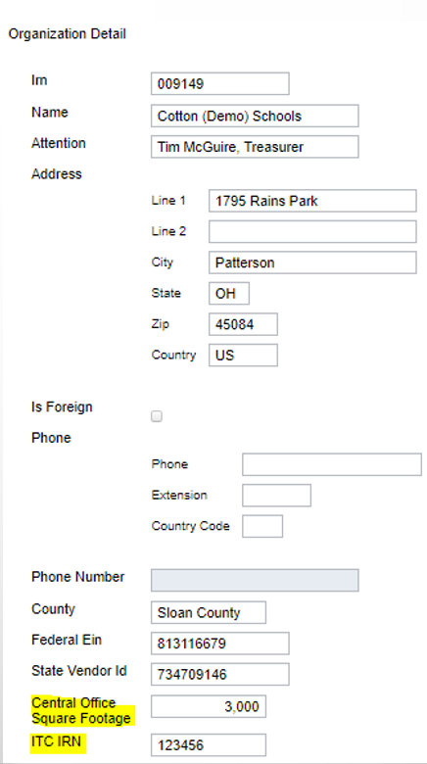
Pre-Closing Procedures
Organization Detail
Used for Financial Reporting EMIS Period H for FY23.
Core > Organization
Central Office Square Footage
ITC’s IRN – No longer required for
EMIS extract

Slide 6
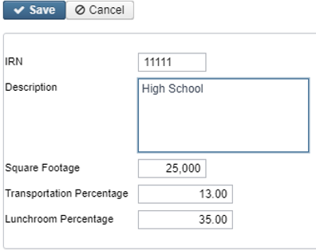
District’s Building Profiles
Periodic Menu > Building Profiles
Review & Update
IRN number
Square footage
Transportation Percentage
Lunchroom Percentage

Slide 7
Verifying with Report
SSDT District Building Information Report

Slide 8
Account Validation
Account Validation
Run the SSDT Account Validation Report to ensure no invalid accounts exist prior to submitting your financial data through the data collector
Optional: Use the query option for active accounts only
NOTE: This report will only check for invalid dimensions. Some of the other warnings messages from classic VALACT (listed below) are validated during the Level 1/Level 2 Validation Reports in the data collector.
ODE warning regarding OPU to be entered for specified func/obj per EMIS guide
Function, Object and Receipt must be defined at a higher level of detail
ODE warning regarding SUBJ or IL to be entered for this func/obj in most cases
Valid EMIS category entered for this fund (see next slide)
If the Level 1 or Level 2 reports contain fatal errors, (and the district has closed the fiscal year), the district can re-open June of the prior fiscal year and make any necessary changes.

Slide 9
Examples of EMIS Errors
XXX is not a valid fund code
XXXX is not a valid function code
XXX is not a valid object code
XXXXXX is not a valid subject code
Receipt code XXXX is not at a valid level of detail
Receipt code XXXX is invalid as of (date)

Slide 10
Level1/Level 2 Validation Reports
Other warning messages that are validated in the data collector.
Function, Object and/or Receipt must be defined at higher level of detail
ODE requires SUBJ or IL to be entered for this func/obj in most cases
ODE requires OPU to be entered for this func/obj per EMIS Guide
If district receives Level 1 or Level 2 fatal error(s) and has closed the fiscal year, June can be reopened to make any necessary changes.

Slide 11
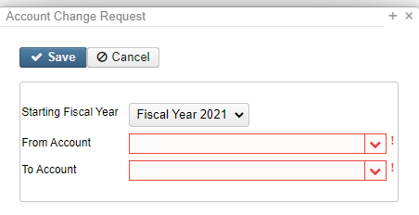
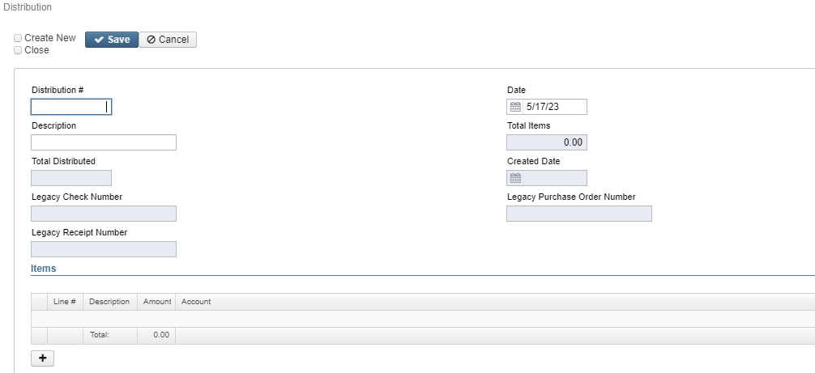
Account Validation Errors
Any accounts with Invalid Validation Errors that have amounts in the reporting fiscal year must be cleaned
Use Account Change under Utilities
Distributions/Error correction under Transactions

Slide 12
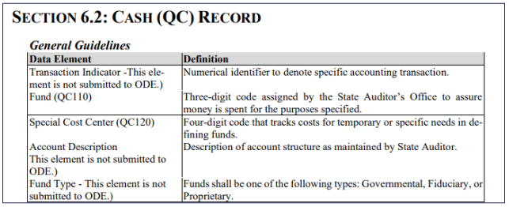
Cash Records
The Cash Record is reported via EMIS with the Financial (H) Collection and the category defines the Fund/SCC describing what type of fund it is for EMIS.
Per ODE website, the ODE Brief Description is set to be removed for FY23 Financial reporting. These were previously referred to as the EMIS Fund Categories.

Slide 13
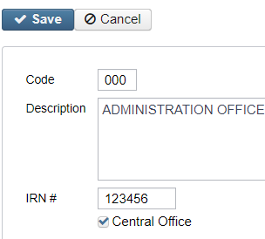
Review Operational Units
Review under Core menu or by running the SSDT OPU Listing report under Reports
Verify IRN numbers and Entity types are accurate.
OPU of 000 must be the reporting district IRN.
All OPU’s must have an IRN defined within your district.
The OPU for Central Office should be checked

Slide 14
Appropriations
Use the BUDGETING > SCENARIOS option to enter next year proposed Budgets and Revenue estimates.
Refer to Appendix > Useful Procedures for steps
Budgeting Scenario Steps for creating proposed amounts for the next Fiscal Year
https://wiki.ssdt-ohio.org/display/usasrdoc/Budgeting+Scenario+Steps+for+creating+proposed+amounts+for+the+next+fiscal+year

Slide 15
Prepare Requisitions
Requisitions can be entered for July 2023
Posting Period must be open for July
July 2023 does NOT need to be current posting period
No budget yet? Requisitions do not require account numbers
Option to Assign Account numbers later
Run SSDT Requisition Detail Report
Sort by Converted=F
Transaction Start date = 07/01/23

Slide 16
Month End Closing
Proceed with closing out for the month of June
Enter all transactions for the current month
Attempt to reconcile USAS records with your bank(s)
Perform Bank Reconciliation Procedure
https://wiki.ssdt-ohio.org/display/usasrdoc/Cash+Reconciliation
Under Periodic menu, select ‘Cash Reconciliation’ to enter your cash reconciliation information for the month
Generate the SSDT Cash Summary report and the SSDT Financial Detail report
The detail report may be run for the month in order to compare MTD totals to the Cash Summary report for June. Totals should match.
If totals agree . . . You are balanced and may proceed

Slide 17
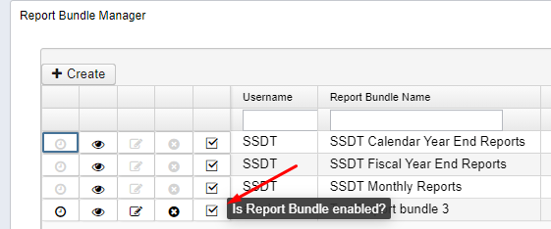
Monthly Reports
Manually run & review any desired reports not
included in the Monthly Reports Archive.
Monthly Reports Archive will automatically run
when Period is closed.
Wait until the bundle is complete before closing another month
Reports can be viewed under Utilities>File Archive
If you do NOT want report bundle to run for Posting Period
Navigate to Report > Reports Bundle
Disable bundle by clicking the checkbox
New USAS File Archive Manager Role, please email helpfiscal@mveca.org if you want this role added and list all users to apply the role to (this has permissions to allow users to delete reports from file archive)

Slide 18
Monthly Reports Archive
27 Month End Reports included in Bundle:
Cash Reconciliation Report for the month
Monthly Balance Report
Cash-related Reports: Cash Summary Report / Financial Detail Report for the month / Financial Summary by Fund
Budget-related Reports:
Budget Summary / Budget Account Activity Report (for the month)
Budget Transactions Summarized by Appropriation / Appropriation Summary Report
Negative Budget Report / Negative Appropriation Account Report / Error Corrections & Supplies Distributions
Revenue-related Reports: Revenue Summary / Revenue Account Activity report for the month
PO-related Reports: Purchase Order Detail Report for the month / Outstanding Purchase Order Detail Report / Transaction Ledger-Vendor Activity / Vendor Listing
Disbursement-related Reports: Detailed Check Register / Outstanding Disbursement Summary Report
Receipt-related Reports:
Receipt Ledger Report for the month / Reduction of Expenditure Ledger Report for the month
Refund Ledger Report for the month / Void Refund Ledger Report
Transfer Advance Summary / Fund to Fund Transfer Ledger Report
User Listing AOS Extract

Slide 19
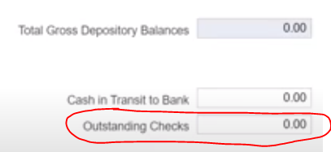
Fiscal Year End Closing
Under PERIODIC menu:
Confirm the CASH RECONCILIATION for the current period has been completed.
Select the FEDERAL ASSISTANCE SUMMARY program and enter the necessary information for the current fiscal year. NOTE: The 'SUMMARY' option must be completed before the 'DETAIL' option to link the records together.
Select the FEDERAL ASSISTANCE DETAIL program
Create/Clone CFDA record & enter the necessary information
Once Cash Account is selected, FYTD revenues and expenditures will populate.
NOTE: the district may need to also enter any non-5%% fund that received federal assistance (i.e. 006) and the amounts do not auto populate for any non-5%% account
Select the CIVIL PROCEEDINGS program to create/update civil proceedings.
Enter as a negat-ive

Slide 20
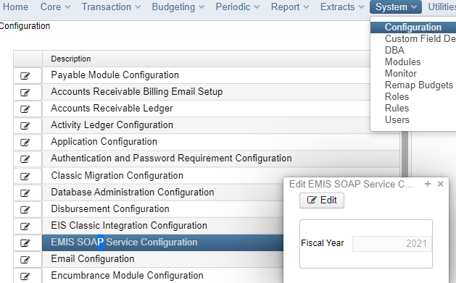
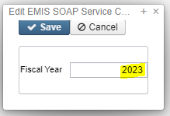
EMIS Extract
NOTE: Before generating the Extract file:
Make sure the EMIS SOAP Service Configuration under SYSTEM/CONFIGURATION is updated to reflect the Fiscal Year the district is reporting for Period H.

Slide 21
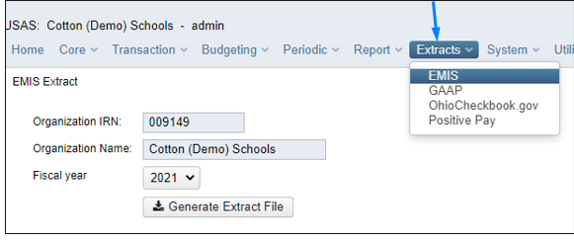
EMIS Extract
Under the Extracts menu, select EMIS and click on Generate Extract File to create a USAEMS_2023.SEQ file to be uploaded into the data collector for Period H reporting.
Once the .SEQ file is uploaded into the Data Collector, it will be used along with the USAS SIF Agent for EMIS-R collections.

Slide 22
EMIS Extract
EMIS Extract contains the same data as Classic’s partial file (USAEMS_EMISR.SEQ)
CASH RECONCILIATION
FEDERAL ASSISTANCE SUMMARY AND DETAIL
CIVIL PROCEEDINGS
DISTRICT AND BUILDING PROFILE INFORMATION
WILL EXCLUDE THE ACCOUNT AND OPERATIONAL UNIT RECORDS.
EMIS Extract does not contain the full file (USAEMS.SEQ).
SIF Agent will pull other Period H files:
CASH, EXPENDITURE, REVENUE ACCOUNTS
ACCOUNT DATA
OPERATIONAL UNITS

Slide 23
Fiscal Year End Reports
Manually run & review any desired reports not included in the Fiscal Year Reports Archive Bundle.
Fiscal Year Reports Bundle will automatically run when Period is closed.
Wait until the bundle is complete before changing the current posting period to a new period if there are custom report bundles scheduled to run on the PostingPeriodCloseCompleted or the FiscalPeriodCloseCompleted event.
Reports can be viewed under Utilities > File Archive by clicking on row.

Slide 24
Fiscal Year Report Bundle
Budget Account Activity Report (BUDLED)
Disbursement Summary Report (CHEKPY)
Financial Detail Report (FINDET)
Purchase Order Detail Report (PODETL)
Receipt Ledger Report (RECLED)
Void Refund Ledger Report (RECVOD)
Fund to Fund Transfer Ledger Report (RECTRN)
Reduction of Expenditure Report (RECEXP)
Refund Ledger Report (RECREF)
Error Corrections & Supplies Distributions
Budgeting Transactions Summarized by Appropriation (RECAPP)
Transaction Ledger – Vendor Activity (TRNLED)
Revenue Account Activity (RECLED)
Civil Proceedings (USAEMSEDT)
Federal Assistance Summary (USASEMSEDT)
Federal Assistance Detail
USAS Auditor Extract – Account (USASAUD)
USAS Auditor Extract – Transaction (USASAUD)
USAS Auditor Extract – Vendor (USASAUD)

Slide 25
Close the Fiscal Year
Create July 2023 Posting Period
Click on CREATE, select JULY, enter 2023 and do not make current.
To close June and the Fiscal Year, go to Core > Posting Periods
Click to close June.
Both the Monthly Report Archive and Fiscal Report Archive bundles will automatically run when the last posting period of the fiscal year is closed.
NOTE: If there are custom report bundles scheduled to run on the PostingPeriodCloseCompleted or the FiscalPeriodCloseCompleted event, users should allow the custom bundles to complete before changing the current posting period to a new period.
Once Report Bundles are complete, make July 2023 current.
You are now closed for the month and fiscal year

Slide 26
POST CLOSING PROCEDURES

Slide 27
Scheduled Extracts for AOS
District Audit Job – ALREADY SCHEDULED BY MVECA
SSDT USAS AUDITOR EXTRACT – ACCOUNT
SSDT USAS AUDITOR EXTRACT – TRANSACTIONS
SSDT USAS AUDITOR EXTRACT – VENDOR
SSDT CASH SUMMARY
GAAP Extract
Utilities > Job Scheduler > Create+
When this job runs, it will generate reports for the PREVIOUS Fiscal Year based on the current period.
Once the current period has been changed to July 2023, then it can be scheduled to run when needed. This may be set for the district’s typical time of audit.
When the Audit Job runs, it will send reports to the File Archive Audit Reports
section AND it will securely file transfer a copy of the reports directly to AOS.

Slide 28
FINANCIAL DATA REPORTING
Financial data Submission to ODE
Process is done through EMIS-R.
Responsibility of the District.
Authorized person in district (i.e. EMIS Coordinator, Treasurer) will UPLOAD flat file (Using EMIS-Extract from Redesign), run the data collection process & submit the data to ODE
Must be sent to ODE before Period H closes for fiscal year 2023
Reminder: As of FY20, capital assets are no longer needed and are NOT to be included in the data collection.

Slide 29
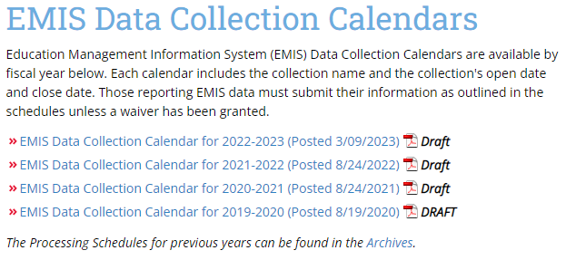
PERIOD H - Financial Reporting
ODE has DRAFT schedule posted online:
Check for updates on ODE’s website, email announcements or newsletters for information on Period H Processing.

Slide 30
Financial Reporting Special Notes:
Districts only needs to upload the sequential file (from the EMIS EXTRACT in USAS-R) in the “financial” data source in EMIS-R. When they are ready to run a collection in the data collector, they will select the USAS SIF agent and the “financial” data source.
The EMIS Soap Service Configuration tells the SIF if it should pull account information from the history records or the current account file

Slide 31
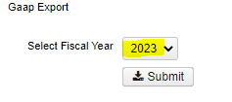
GAAP EXTRACT
Run GAAP from Extracts menu to create necessary file for GAAP reporting
Select the Fiscal Year and click on ‘submit’ to generate the GAAPEXPORT.TXT file
Attach file in an email to person(s) responsible for uploading the file into WEBGAAP.

Slide 32
WEBGAAP
GAAP URL
HTTPS://GASB34SYS.AUDITOR.STATE.OH.US/GAAP
GAAP WIKI
HTTP://GAAPWIKI.OECN.K12.OH.US/INDEX.PHP?TITLE=MAIN_PAGE

Slide 33
MVECA WEBPAGE Enhancements
https://www.mveca.org/
FISCAL Drop Downs
New drop downs and pages specific to Redesign USAS, USPS, and Inventory
To come: USAS MVECA report Library
USAS: All documentation was moved to the new page including trainings, helpful links, cross-walks, WIKI link, and SSDT YouTube link
USPS: All documentation was moved to the new page including trainings, helpful links, cross-walks, WIKI link, and SSDT YouTube link
Added: USPS Mass Load Templates
JSON Reports
USPS Custom Fields for Salary and Direct Deposit Notice
New drop down and page with links to all district Redesign URL’s
FYE Documentation Link: https://www.mveca.org/FISCALYearendDocumentation.aspx

Slide 34
FYE Checklist
https://www.mveca.org/Downloads/2023%20USAS%20FYE%20CHECKLIST.pdf

