Slide 1

EIS-R
Inventory
Fiscal Year-End
Closing Procedures
2023

Slide 2
Pre-Closing Procedures
Finish all current year processing.
Items received on or prior to June 30^{th,} 2023 should be added to Inventory for FY2023
Items received after June 30th can be added to the Inventory pending file for FY2024
If depreciation has been changed on several items so much that it’s necessary to completely recalculate the life-to-date (LTD) depreciation, you may select the desired items from the Items grid and select 'Depreciate'.
NOTE: Recalculating depreciation will affect items that have had improvements (additional acquisitions added throughout the life of the item) causing items to lose their true depreciation history. Please refer to the Depreciation chapter in the Appendix or Depreciate section of Items for further information on the depreciate option

Slide 3
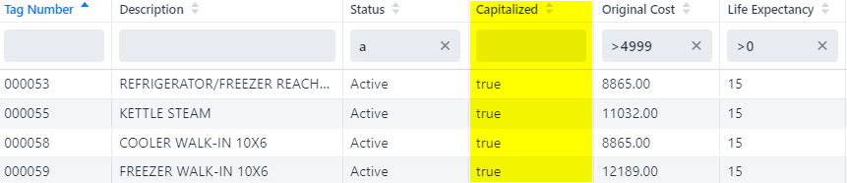
Pre-Closing Procedures
Ensure items that meet or exceed the entity's capitalization threshold are marked as 'capitalized'. On the Items grid, add the 'capitalized' column and filter using their capitalization threshold. If there are items that meet the threshold criteria but are marked false under capitalized, these items need to be looked into further as to why they are not capitalized.
  For example: the entity has a dollar threshold of $5000 and a life expectancy of 1 year.

Slide 4
Fiscal Year-End Closing Procedures
When all assets have been entered for the FY, district can run the recommended list of reports (this includes all necessary GAAP schedules).
All recommended FYE reports are explained in the upcoming slides.

Slide 5
GAAP Reports
Fixed Assets by Source…..summary of the original cost of capitalized items by their source (or fund) the items were charged to on the purchase order
  Classic Counterpart: EIS101
  Source means “the fund the items were originally charged to when purchased”
  Uses the PO information from the acquisition record to identify the source fund used in purchasing the items.
  Report Filename: FixedAssetBySourceReport.pdf
  Fixed Assets by Source recording

Slide 6
GAAP Reports
GAAP Reports
Fixed Asset by Function and Class….schedule of fixed assets by function and class.
  Classic Counterpart: EIS102
  May generate up to three different report formats:
    Schedule by Function & Class - displays original cost & book value
    Schedule by Class - displays original cost & book value
    Summary by Function and Class - choose to summarize by 2-digit function and may report on original cost or book value
      For FYE, it is recommended to generate the report for all three formats
  Book Value is the Original Cost minus Total Depreciation
  Report Filename: FixedAssetByFuncClassReport.pdf
  Fixed Asset by Function and Class recording

Slide 7
GAAP Reports
Schedule of Change in Fixed Assets
Classic Counterpart: EIS103
Contains “changes” in capital assets during the current fiscal year
Ability to generate a summary or detail report
Ability to generate the report by asset class, fund or function.
  For FYE, it is recommended to generate the report for all three types
Report Name: ScheduleOfChangeReport.pdf
Summary report lists the beginning balance, acquisitions, dispositions, transfers in/out, adjustments and the ending balance in column format.
Detailed report lists individual tags that make up the acquisitions, dispositions, transfers, or adjustments amounts.
Schedule of Change in Fixed Assets recording

Slide 8
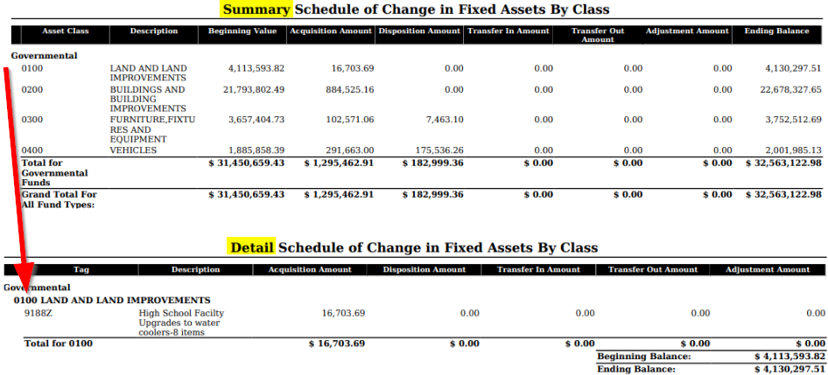

Slide 9
GAAP Reports
Totals on the
  Fixed Assets by Source
  Fixed Asset by Function and Class
  Schedule of Change in Fixed Assets
Original Cost amounts should match when balancing out for the fiscal year-end.
Balancing Reports recording

Slide 10
GAAP Reports
Schedule of Changes in Depreciation
Classic Counterpart: EIS104
Contains “changes” in depreciation of capital assets during the current fiscal year
Ability to generate a summary or detail report
Ability to generate the report by asset class, fund or function
  For FYE, it is recommended to generate the report for all three types
Report Name: ScheduleOfChangeInDepreciationReport.pdf
Summary report lists the beginning depreciation, continuing items, acquisitions, dispositions, transfers, adjustments and ending depreciation balance in column format.
  Detailed report lists individual tags that make up the acquisitions, dispositions, transfers or adjustment amounts.
  Schedule of Change in Depreciation recording and Balancing Depreciation Reports

Slide 11
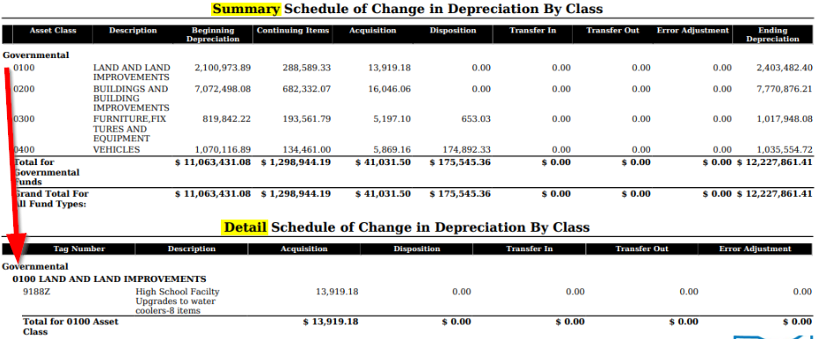

Slide 12
Suggested Non-GAAP Reports
Asset Listing by Grant/Source….listing of acquisition transaction data by source account code and/or grant identifier
  Classic Counterpart: EIS203
Brief Asset Listing….. brief listing (one line per item) of all assets or a subset of them.
  Classic Counterpart: EIS304
  Recommended 5 versions of the Brief Asset generated at FYE
    Include capitalized items only and Status codes of “Active, New, Excess Asset Held for Sale, and Excess Asset Not in Use (with the exception of the disposition report below).
      Brief Asset Listing by fund
      Brief Asset Listing by function
      Brief Asset Listing by asset class
      Acquisitions for current fiscal year
      Dispositions for current fiscal year

Slide 13
Suggested Non-GAAP Reports
Book Value Report…..displays depreciation information listing original cost, salvage value, book value, % of depreciation, and last year of useful life.
  Classic Counterpart: EIS305
  The current FY is used for the reporting date.
    Recommended 4 versions generated at FYE
    Include capitalized items only and Status codes of Active, New, Excess Asset Held for Sale, and Excess Asset Not in Use (with the exception of the disposition reports below).
      Book Value Report by function
      Book Value Report by class
      Depreciation for current FY dispositions by function
      Depreciation for current FY dispositions by class

Slide 14
Suggested Non-GAAP Reports
  Audit Report…..tracks changes made in the application
    Classic Counterpart: EIS801
    For FYE, generate the Official Option
Depreciation Posting Report
  Classic Counterpart: EISDEP projection report generated from classic EISCLS
Fiscal Year Ending Balances Report
  Classic Counterpart: EISCLS report generated from classic EISCLS

Slide 15
Fiscal Year-End Closing Procedure
Close the current fiscal year by clicking the Close Icon in Core>Fiscal Years
  Advances EIS last FY closed date in Core>Configuration by one year
  Adds one year’s worth of depreciation to LTD depreciation field
  Updates beginning balance fields for new FY
In Core>Fiscal Years, you can create FY2023, open the year and make it current to start processing inventory for the new year.

Slide 16
Fiscal Year-End Closing Procedure
In Core>Fiscal Years, create FY2024, open the year and make it current to start processing inventory for the new year.
If GAAP flag is not enabled and the entity would like to start on GAAP for the next fiscal year, please email helpfiscal@mveca.org
  Once the GAAP flag is enabled, entity may start entering inventory for the new fiscal year.

Slide 17

Questions?
EIS FYE Checklist
https://wiki.ssdt-ohio.org/display/ID/Inventory+Fiscal+Year+End+Checklist

