Slide 1
EMIS COMMON ERRORS 2024

Slide 2
EMIS COMMON ERRORS 2024
EMIS BASICS
EMIS Description State Software Description
CI Staff Demographic Employee
CK Staff Employment Position and Compensation
CJ Contractor Staff Employment EMIS Entry Contractor CJ
CC Contract Only Staff EMIS Entry Contracted Services
EMIS Manual Chapter 3 Element List

Slide 3
EMIS Reports-Checking Errors
GETTING STARTED
Reports/EMIS REPORTS/Generate Employee Report.
Reports/EMIS REPORTS/Generate Position Report.
Run as many times as needed until EMIS is error free.
If errors are on the Employee Report and/or Position Report
email helpfiscal@mveca.org and we will run the Debugging EMIS Report Errors.

Slide 4
EMIS Reports-Checking Errors
GETTING STARTED
Correct the errors based on the App Log report from MVECA.
Re-run the EMIS Reports>Employee and/or Position Reports until they are error free.

Slide 5
EMIS Reports-Checking Errors
GETTING STARTED
Use Level 1 Reports from Data Collector to correct errors.
Example of how to read Level 1 Errors and find them in EMIS Manual Chapter 3.
EMIS Manual Chapter 3 Great Resource for correcting errors

Slide 6
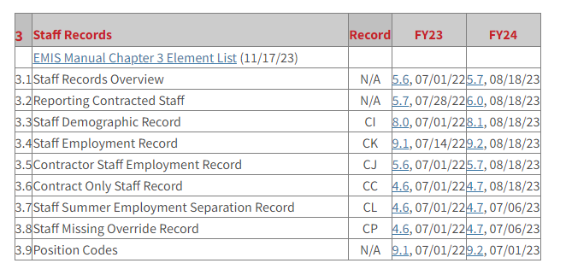
EMIS Reports-Checking Errors
Resources to Assist in Correcting Errors
ODE EMIS Manual – Chapter 3 - Staff Records

Slide 7
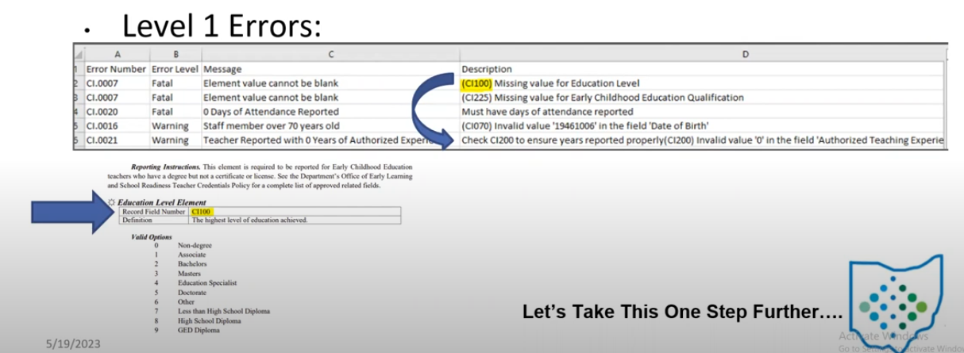
EMIS Reports-Checking Errors

Slide 8
EMIS Reports-Checking Errors
EMIS Level 1 Error Explanation spreadsheet on MVECA’S web page
Still no PERDET equivalent report in USPS - USPSRFB-1361 enhancement request
EMIS Manual Chapter 3 Great Resource for correcting errors
Good idea to use the EMIS “Staff and Course (L) Collection Checklist”

Slide 9
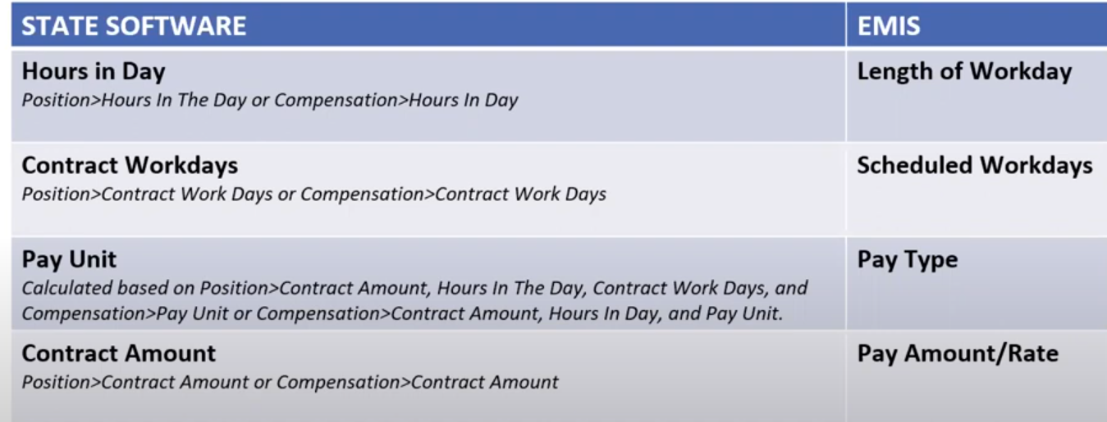
EMIS Reports-Checking Errors
AREAS OF DIFFICULTY - Most questions asked
Terminology - Redesign vs EMIS

Slide 10
EMIS Reports-Checking Errors
Hours In Day vs Length of Work Day
*If a value is entered in Position>EMIS Related Information,
Hours in The Day field, that is the value that is reported
To EMIS as the Length of the Work Day
*If a value is NOT entered in Position>EMIS Related Information
Hours in The Day Field,
Then the value in Compensation Hours in Day is reported
To EMIS as the Length of the Work Day
.

Slide 11
EMIS Reports-Checking Errors
*Suggestion - In the POSITION EMIS Related Information - Make the following changes to Headers:
Full Time Equivalent EMIS Override Full Time Equivalent
Contract Amount to EMIS Override Contract Amount
Contract Work Days to EMIS Override Contract Work Days
Hours in The Day to EMIS Override Hours in The Day

Slide 12
EMIS Reports-Checking Errors
*Suggestion - In the POSITION EMIS Related Information - Make the following changes to Headers:
These new field names will help remind you that this is EMIS Override data.
Use these fields with caution. These fields report data that is different from what is in the Compensation record.
To Make these changes:
Go to: System/Custom Field Definition/Applies to Position

Slide 13
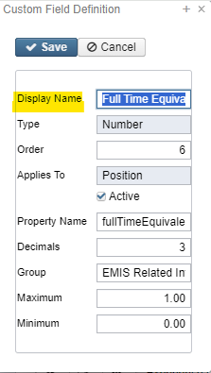
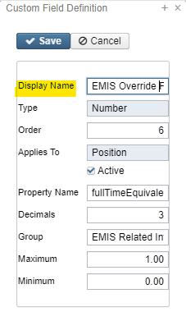
EMIS Reports-Checking Errors
*Suggestion - In the POSITION EMIS Related Information - Make the following changes to Headers:
To Make these changes:
Go to: System/Custom Field Definition/Applies to Position
Before After

Slide 14
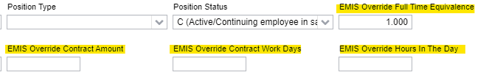
EMIS Reports-Checking Errors
This is how the Custom Field Definition change affects the EMIS Related Information fields on the Position Screen.

Slide 15
EMIS Reports-Checking Errors
Contract Work Days vs Scheduled Work Days
*If a value is entered in Position>EMIS Related Information>
Contract Work Days field,
That is the value reported to EMIS as Scheduled Work Days.

Slide 16
EMIS Reports-Checking Errors
Contract Work Days vs Scheduled Work Days
*If a value is NOT entered in Position>EMIS Related Information>
Contract Work Days Field,
Then the days on the Compensation > Job Calendar
are reported To EMIS as Scheduled Work Days.

Slide 17
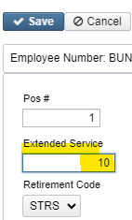
EMIS Reports-Checking Errors
Contract Work Days vs Scheduled Work Days
The Compensation Start and Stop Dates are used as the date range to lookup days on the Job Calendar.
If the Position>Extended Service field has a value, that amount is subtracted from the above amounts and that is the FINAL scheduled worked days reported.

Slide 18
EMIS Reports-Checking Errors
Contract Work Days vs Scheduled Work Days
*For Scheduled work days to be reported for Non Contract Compensations, they can be reported in two ways:

Slide 19
EMIS Reports-Checking Errors
Contract Work Days vs Scheduled Work Days
* Option 1. Using a Job Calendar. (not typical)
Date range is determined using a start date from the EMIS Reporting Fiscal Year.
OR The Compensation Start Date, if it is after the EMIS Fiscal Year and a stop date from the EMIS Reporting Fiscal Year OR

Slide 20
EMIS Reports-Checking Errors
Contract Work Days vs Scheduled Work Days
* The Compensation>Compensation Stop Date
If it is before the EMIS Reporting Fiscal Year.
Work Days, Holidays, and Calamity Days are then added to the count from the assigned Job Calendar using the date range above.

Slide 21
EMIS Reports-Checking Errors
Contract Work Days vs Scheduled Work Days
* Option 2. Using the Position>EMIS Related Information>
Contract Work Days Field,
Enter the number of Days Worked for the Fiscal Year.

Slide 22
EMIS Reports-Checking Errors
Pay Unit vs Pay Type
* Two Options
Annual Salary (A)
Hourly Rate (H)
By default, the type is set to Annual (A).
However – Calculated field based on Contract Amount, Hours in Day, Work Days, and Pay Unit In the following order:

Slide 23
EMIS Reports-Checking Errors
Pay Unit vs Pay Type
Condition | Salary Type
Contract Amount > 0 Position>EMIS Related Information>Contract Amount or Compensation>Contract Amount | Annual
Pay Unit = Hourly | Hourly
Pay Unit = Daily and Hours in Day > 0 | Hourly
Pay Unit = Daily and Work Days > 0 | Annual
Note: Any other combination will generate an error in USPS and zero will be reported.

Slide 24
EMIS Reports-Checking Errors
Contract Amount vs Pay Amount/Rate
If a value is entered in Position>EMIS Related Information>Contract Amount field, that value is used as the Pay Amount/Rate
If a value is NOT entered in the EMIS Contract Amount field then the value in Compensation/Contract Amount is used as the Pay Amount/Rate.
Note: For an amount to be reported on Non Contract Compensations, a value MUST be entered in the Position/EMIS Contract Amount field.

Slide 25
EMIS Reports-Checking Errors
Contract Amount vs Pay Amount/Rate
If NO pay amount is found, then:
If Compensation/Pay Unit = Hourly, the UNIT AMOUNT(hourly rate) is reported
If Compensation/Pay Unit = Daily and Hours in Day > 0 then the following calculation occurs and that is the reported Pay Amount.
Unit Amount(Daily Rate)/Position Hours in a Day OR
Compensation Hours in a Day.

Slide 26
EMIS Reports-Checking Errors
Contract Amount vs Pay Amount/Rate
If Compensation> Pay Unit = Daily and Contract Work Days > 0 then the following calculation occurs and that is the reported Pay Amount.
Unit Amount (Daily Rate) on Position Screen reported as Hours in the Day OR
Compensation reported as Hours in a Day

Slide 27
EMIS Reports-Checking Errors
Contract Amount vs Pay Amount/Rate
Hours in Day | Work Days | Pay Unit | Contract Amount | Contract Amount Calculation | Calculated EMIS Salary Type
 |  |  | >0 | Contract Amount | Annual
 |  | Hourly | =0 | Unit Amount | Hourly
>0 |  | Daily | =0 | Unit Amount/Hours in Day | Hourly
 | >0 | Daily | =0 | Workdays x Unit Amount | Annual

Slide 28
EMIS Reports-Checking Errors
Absences/Attendance
This is reported at the Employee level and returned with the Employee collection.
If the Employee “Report to EMIS” flag is True, then a count of attendance and absences occurs, and WILL be included in the collection
The system DOES NOT exclude Compensations when the EMIS flag is False.
Attendance and Absence records are counted if the record is assigned to a Compensation and the Activity Date falls within the “fiscal year” date range.

Slide 29
EMIS Reports-Checking Errors
Absences vs Attendance
WORK AROUND: If you are receiving an EMIS error on attendance days that should not be reporting, Add a Compensation Calendar Stop Date using the date prior to the first attendance record posted.
Then these attendance days will not report and will prevent errors.

Slide 30
EMIS Reports-Checking Errors
Absences vs Attendance
Items to Consider:
Position/Termination Date is used in Attendance Days Calculation when counting days from the Job Calendar for the employee’s Position/Compensations.
If the Position Job Status is set to Terminated, then the STOP DATE used to find days on the calendars will be set to the Position Termination Date.
If no Position Termination Date is entered, then the Employee Termination date is used.
If no Employee Termination Date is entered, then the Compensation Calendar Stop Date is used.

Slide 31
EMIS Reports-Checking Errors
Absences vs Attendance
Items to Consider:
If no Compensation Calendar Stop Date is entered, the Compensation Stop Date is used.
If none of these dates are entered, then the System Configuration EMIS Reporting Fiscal Year is used which would be June 30th.

Slide 32
EMIS Reports-Checking Errors
Absences vs Attendance
Hourly Employees:
If the employee has Hourly Absences and Attendances, they are converted to days. In the process of doing this, the system needs to know how many hours are in a day.
This happens by using the Compensation Hours in Day that is assigned to the Absence and Attendance and the value provided.
If there is no Compensation assigned, then the system looks to find an Active Compensation. Then the Compensation date range is used to convert hours to days.
The system looks for a Compensation where the Absence and/or Attendance Activity Date falls within the date range of the Compensation Start and Stop Dates.

Slide 33
EMIS Reports-Checking Errors
Absences vs Attendance
Hourly Employees:
If there is no Compensation Hours in Day value, then the system looks at the Position EMIS Related Information for Hours in the Day and then that value is used in the conversion to hours.
If no hours in the day is found in either place, an error is returned. (no hours in a day found)
Once the system determines the hourly values the system uses the following conversion. The Conversion = Length of Attendance divided by Hours in Day

Slide 34
EMIS Reports-Checking Errors
Absences vs Attendance
EMIS AJUSTMENTS:
Core/Adjustments/Type/EMIS Attendance and EMIS Absence is available to adjust EMIS Attendance and Absences.
The Transaction Date needs to fall within the EMIS fiscal year.

Slide 35
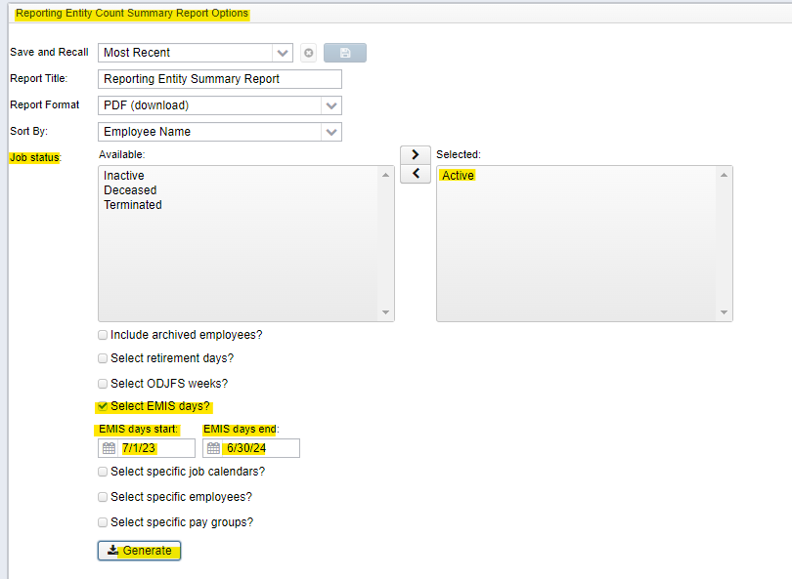
EMIS Reports-Checking Errors
Absences vs Attendance
Reporting Entity Count Summary Report: RPTSUM

Slide 36

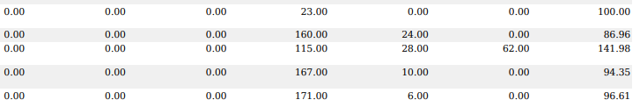
EMIS Reports-Checking Errors
Absences vs Attendance
Reporting Entity Count Summary Report: formerly RPTSUM
This can be found in Reports Menu
Helpful verifying Attendance and Absence Days for EMIS Reporting

Slide 37
EMIS Reports-Checking Errors
Long Term Illness
Long Term Illness Days are 15 Consecutive Absences Days. (Entered on Employee Record)
At least 15 consecutive days absent due to an illness of the staff member or the staff member’s spouse, child or parent.
Note that a day is defined as the period of time the staff member normally spends at work during a 24-hour period. This may vary from staff member to staff member.
Please remember, that if you enter long term illness on the Employee Record, you must have Absences entered in Attendance or EMIS errors will occur.

Slide 38
EMIS Reports-Checking Errors
Quick Check Tips and Tricks
Go to System/Configuration/EMIS Configuration. Make sure the Fiscal Year is correct.
Is the Credential ID the valid number of characters (must be 9 digits) Type over Credential ID to make sure there are no white spaces.
Are all dates valid especially Hire Date and Birth Date

Slide 39
EMIS Reports-Checking Errors
Resources to Assist in Correcting Errors
USPS-R Documentation https://mcoecn.atlassian.net/wiki/spaces/uspsrdoc/overview
Core/Employee, Position, Compensation and EMIS Entry Chapters
You can also run a report MVECA has available called:
“EMIS Reportable Employee Position Compensation” This can be found on the MVECA website under Fiscal/Redesign USPS/USPS MVECA json Report Library

Slide 40
EMIS Reports-Checking Errors
Resources to Assist in Correcting Errors
USPS-R Documentation continued: https://mcoecn.atlassian.net/wiki/spaces/uspsrdoc/overview
USPS and EMIS Connection
Checklist
Quick Reference Sheet
Field Names and Locations
Send email to helpfiscal@mveca.org

Slide 41
EMIS Reports-Checking Errors
Staff and Course Collection Reminder
Final L Collection closes August 7, 2024

Slide 42
EMIS Reports-Checking Errors
Questions?

